Slide 1
Request for Certification
Process for Completion

Slide 2
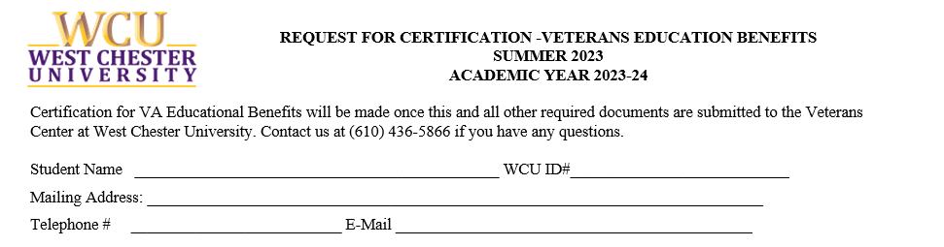
RFC Part One -Personal Information
Fill in your name as it appears on your VA benefit application.
WCU ID Add your ID here.
Your mailing address, home or off campus address, where do you want your mail to go to?
Phone number – Where can we reach you? E-Mail – Where can we reach you?

Slide 3
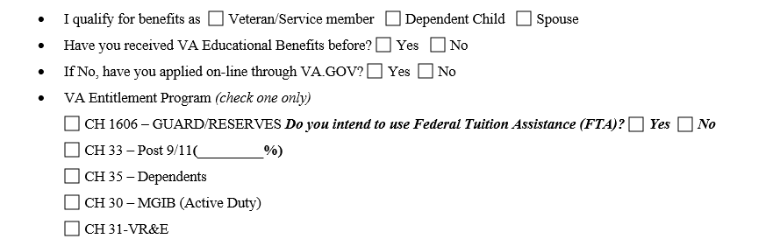
RFC Part Two- Veteran Benefit Information
Qualify: Are you (check one) Veteran/Service Member? Dependent of a Veteran? Or Spouse of a Veteran?
Have you received VA Ed Benefits before? Y/N
  If No, have you applied at www.va.gov? Note- you may have to wait up to 30 days for your COE. – Certificate of Eligibility.
VA Entitlement Program
  CH30 – Rare, for Active-duty Reservist/Guard
  CH33 Post 911 Common for Veterans and Reservist/Guard who qualify, and Dependents whose Veteran parents gave them their benefits.
  CH35 for Dependents only. CH1606 Reservist/Guard All Branches,
  CH31 Rare – VR& E (Veterans Readiness & Employment) -special program for Veterans.

Slide 4
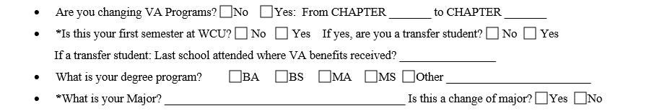
RFC Part Three- Degree Program Information
Changing Programs: Some Vets, Reservist/Guard, and Dependents change from program to program.
  Example:
  Guard goes from 1606 to CH33 due to qualifying time while called up on active duty.
  Dependent switches from CH33 parent benefits to CH35 when 33 Benefits are exhausted.
Additional questions: First semester at WCU?
  You need to complete an RFC each year, or each semester if you apply on-line.
  If you are a transfer, what school did you attended where you used VA Benefits, we may need to coordinate.
Ed program: We need this to report to VA. If you change your Major, we need that info as well.

Slide 5
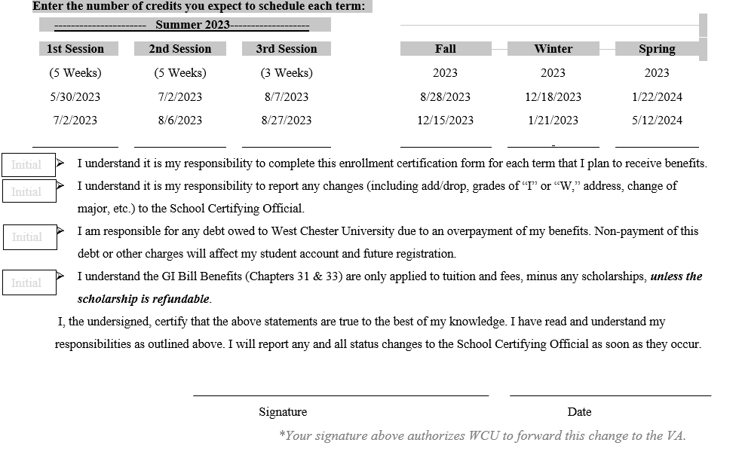
RFC Part 4 -Completion and Signature
We need current semester information. While you can fill this out for a whole year, please keep in constant contact should Degree Program, quantity of credits or benefits change. (This form is also available Electronically on our Website.)
We ask that you initial your responsibilities to make sure that you are aware of the process and to help limit debt you can incur.
Sign and date. Your signature will allow the Veterans Center to process your benefits with the VA.
Do not hesitate to reach out if you have any questions.
Thank you, your VA Ed Center Team!

