Slide 1






TEST
PREPERATION
Success Coaching
Academic Success Workshop

Slide 2





GETTING STARTED
1. Figure out the information you know already
Make a list of key concepts and define as many as you can from memory
Answer questions in your notes, or make up your own questions from your notes/readings
Lecture to yourself, to someone else, or to an imaginary audience on the core concepts
Make a study plan/study guide
Make flashcards (Quizlet)
Time manage and figure out what days/times you will study

Slide 3
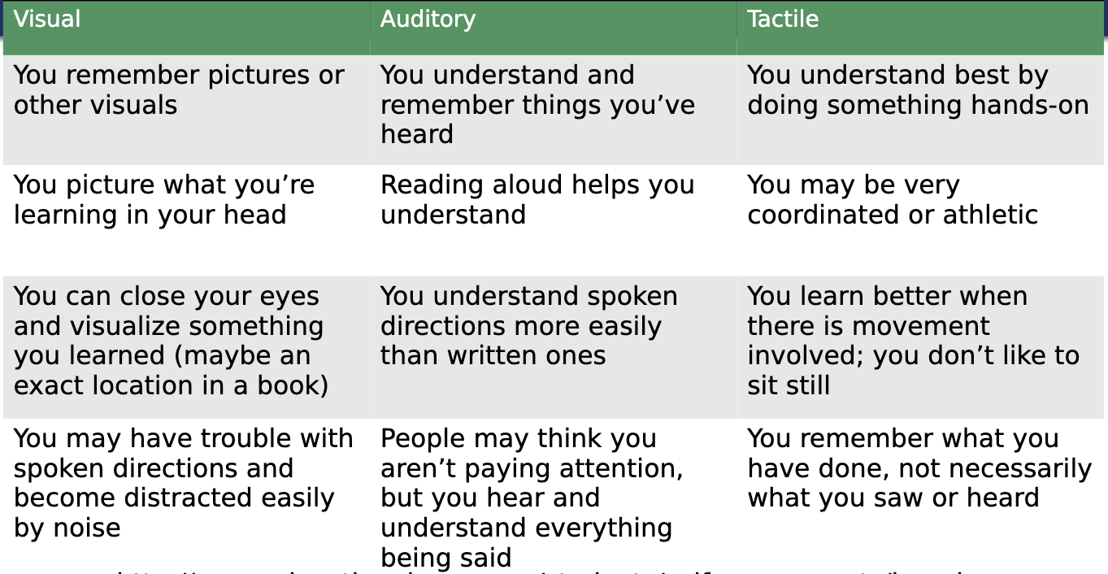
Learning Styles

Slide 4


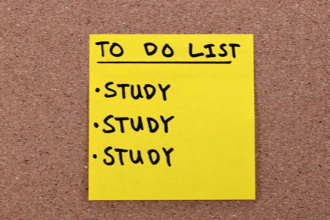
How Do You Study Best?
Learning Styles
Recopy notes later if you’re
visual, or use a highlighter or annotate.
Record a lecture and listen later if
you’re auditory.
Move around and use activities when
you review if you’re tactile.

Slide 5



Where Do You Study Best?
Residence Hall side lounge
Library
Sykes
Your room
Where Else?

Slide 6


How Often? Distributed Study
Daily Review:
15-20 minutes a day
Weekly Reviews:
45 minutes to 1 hour
Major Reviews:
1-2 hours, _ days in a row before exam

Slide 7

While Studying
1
4
Use the study techniques that work best for you to get engaged with the information
Form a study group
2
5
Make practice tests or use quizzes/questions available to you
Make your own study guide/Quizlet
6
3
When studying from the textbook:
Review past exams, quizzes, and assignments
In each chapter pay special attention to introductions, summaries, case examples,
graphs or pictures, and bold texts/
headings to help organize your review and
find important information

Slide 8

Breaking Bad Study Habits
Minimize distractions
Take breaks
Organize your notes
Prioritize your tasks
Set realistic study goals for each session
Practice willpower by thinking about the bigger reward at the end of the semester

Slide 9


Your Exam Day
Arrive early and prepared with any necessary materials or tools allowed you
Do the questions you are confident in first
Know exactly how much time you have and budget it (develop a plan so
you can finish)
Use the test to help you (find clues in other questions)
Use your time and do not rush
Go over the test when you are finished, even if you don't feel like it

Slide 10
Utilize Your Resources!
Professor Office Hours:
Check your syllabus for professor’s office hours
Send an email or talk to them before/after class
Office hours and your professor are there to help you!
Tutoring at the LARC:
Personalized help from students who have taken the course
Appointments in-person at Lawrence Hall 224 or through Zoom
Sign up at: https://wcupa.mywconline.net/
Success Coaching:
Develop study and note-taking skills
Help with test preparation
Time management, and more!
Sign up at: https://www.wcupa.edu/asa/achieve/
success-coaches.aspx
Located at Lawrence 220
Free Online Tutoring Through Tutor.com:
When a time or tutor is not available at the LARC,
use Tutor.com!
Tutor.com provides free virtual 24/7, expert,
individualized academic support to WCU students.
You can access Tutor.com in any course D2L page under
the "Resources" tab.

Slide 11

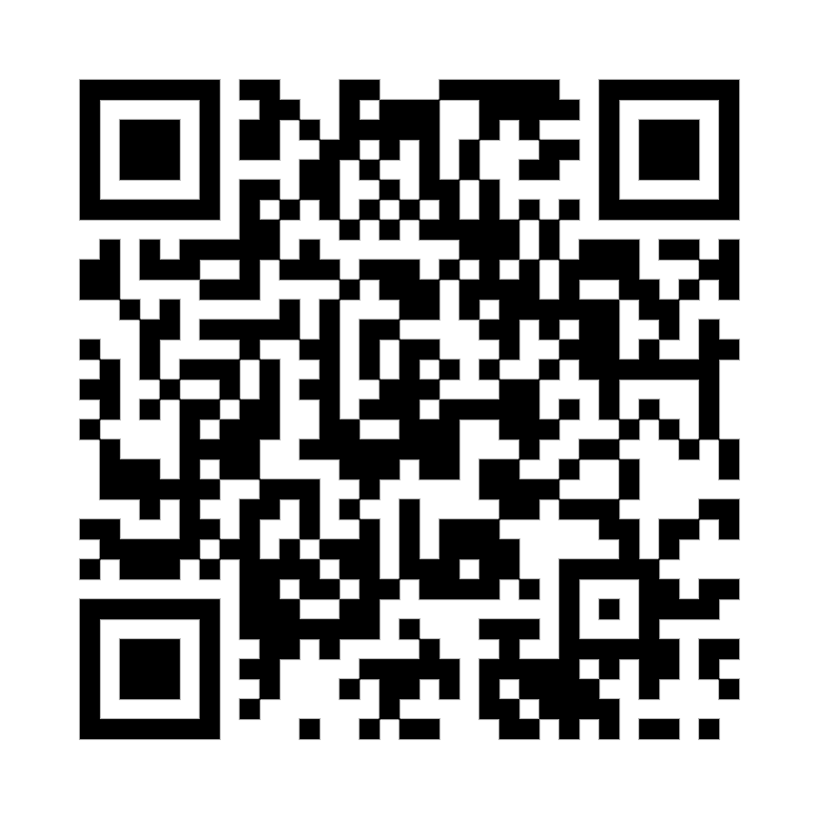

THANK YOU!
To receive more individualized Test Preparation assistance schedule with a Success Coach!
220 Lawrence Center
Phone: (610) 436-1067
Email: successcoaching@wcupa.edu

