Slide 1

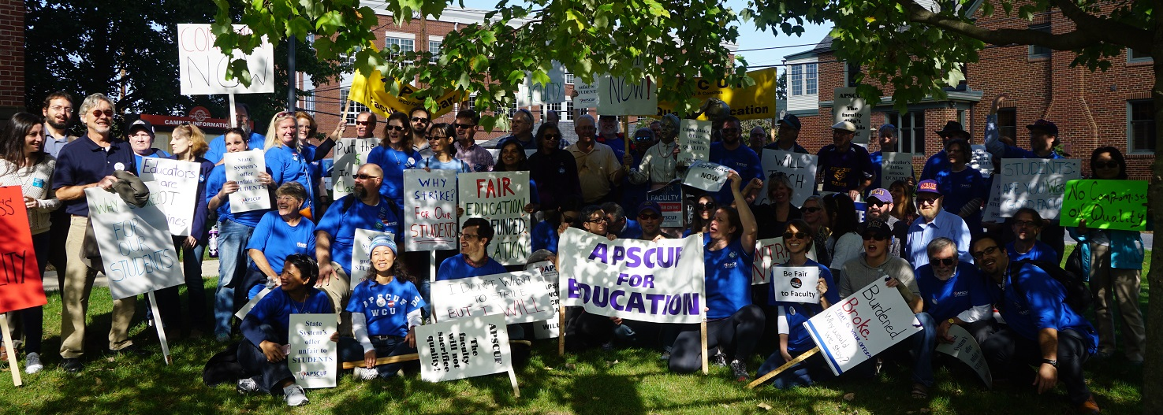
YOUR CBA A guided tour
A little (red) book that protects and defends you

Slide 2
Some examples of how OUR CBA compares to other contracts
APSCUF CBA
Other Contracts
Includes all faculty INCLUDING Adjuncts
Statewide, covering 14 institutions
Has conversion language for temporary workers to tenure track
Single Salary Scale
Adjuncts not a part of the bargaining unit
Many contracts do not cover multiple campuses, or have many differences between how campuses operate.
Often do not allow conversions to tenure track
Often drastically different pay scales based on field of expertise.

Slide 3

Articles 1 - 10
Establishing and defining the bargaining unit

Slide 4
Highlights
Preamble p. 2: Definitions (Regular, Probationary, Temporary, etc.).
Article 2: Academic Freedom (c.f. Local Statement)
Article 3: Fair Practices (Discrimination)
Article 4: last sentence “…FACULTY MEMBERS have the responsibility to … preserve and defend the goals of the UNIVERSITIES, including the right to advocate change”.

Slide 5
Article 5: Grievance & Arbitration
Individual Grievance vs. Policy Grievance (APSCUF)
Timeliness – must file within 40 calendar days*;
Four steps: Informal, Written Complaint, State Level, Arbitration*
If you feel your rights have been violated, quickly contact:
WCU GRIEVANCE CHAIR: Chris Stangl
your APSCUF department representative
OR another union official

Slide 6
Article 6: Department chairs
Are faculty members, not managers
Recommend faculty loads – Management assigns
6A = duties, decision making powers (#2, 3)
6B = Selection, Election, Removal, & Assistant Chair
Stipend and Workload reduction based on dept. size

Slide 7
Article 7 Performance of Bargaining Unit Work
Governs all teaching on campus
Incl. GAs, Teaching Associates, Managers, and Staff
Governs teaching in other departments and approval votes.
Gives Provost and Deans (not Assist./Assoc. Deans) right to apply for Tenure and Rank.
Helps guard against incursions into the bargaining unit, for both classroom and non-classroom faculty.

Slide 8
Articles 9 and 10: rights and responsibilities
Article 9 (APSCUF):
Meet and Discuss, Interaction of Bargaining Agent and Management
Orientation for ALL faculty (9F) incl. 90 minutes with APSCUF
Due notice to APSCUF of Trustee meetings, Board of Governors, etc.
Article 10 (SYSTEM):
Management controls the facilities and property
University controls inherent managerial policies – “right to direct the workforce”. 10C = Blanket clause

Slide 9
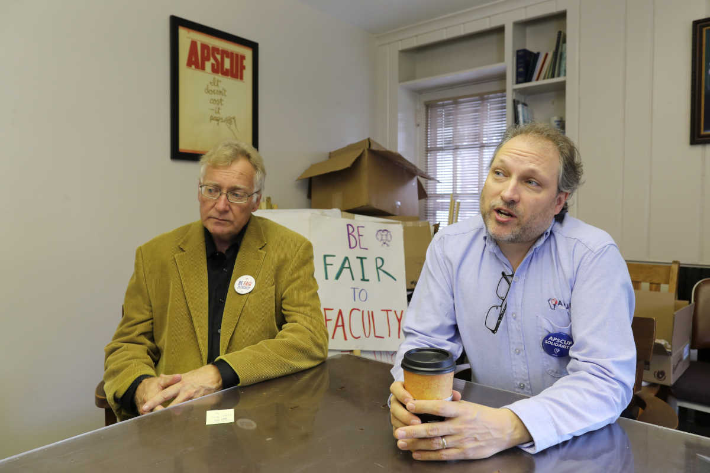
Articles 11 - 16
Hiring, performance review, tenure and promotion

Slide 10
Article 11 – appointment of faculty
11A-E governs searches and appointments “from any source”
11F governs hiring of adjunct (Temporary) faculty and RPT, faculty, establishes 25% cap.
11G allows for conversion of temporary faculty member to tenure track based on dept. vote.*
11H allows dept. to request permanent lines.
11-J guarantees appropriate rank after 11G conversion

Slide 11
New Language: 11-I (Adjunct/Temporary Faculty)
11-I #1 defines 60 credit preferential status for adjuncts
11-I #2 requires May 31 notice re: FT status for adjuncts

Slide 12
Article 12 – performance review
12B Establishes and defines three categories – primary/teaching, continued scholarly growth, and service
Defines process for regular faculty (12.C.1.a – b.2)
3 or more members on each committee (not chair)
Treats conflict of interest, outside members, change in committee members, etc.
Student Evals (SRIS) in all semesters until tenure
Peer Evals: 2+ from committee/semester, 1/year from dept. chair
b.3 – 6: Vita, reviews from work in other depts., etc
12.C.1.c. 1-2 governs the proper delivery and opportunities to respond in writing to Committee and Chair Reports.

Slide 13
Article 12 - Continued
12.C.1.c.3 governs Dean’s Annual Report.
12.D. = Non Classroom Evals., 12.E. = Mixed load Faculty Evals.
12F = Schedule of probationary non-tenured faculty reviews
12F also has some language on non-renewals
12G = Eval of Tenured Faculty (5 year reviews)
12H = Temporary Faculty Reviews
12I = DE Faculty Teaching Reviews

Slide 14
Evaluation Due Dates* for Fall TT Hires
Year | Completed by
One | Committee: Jan 30 Chair: Feb 8 Dean: Feb 28
Two to Four | Committee: November 1 Chair: Nov 8 Dean: Dec 18
Year 5 | Submit T&P Materials by Nov 1 Committee Rec: Nov 1 Chair Rec: Nov 8
Tenure/Promotion | See Local Tenure and Promotion Policies, c.f. session by Lisa Millhous
Notes:
Due Dates are the END of the process.

Slide 15
Evaluation Due Dates for Temporary Faculty
 | Temporary w/ Fall Contract Only | Temporary w/ Annual Contract | RPT Fall Hire Yr 1 | RPT Yr. 2 - 5 | RPT 6+
Committee | Nov 1 | April 1 | Jan 30 | Nov 1 | Apr 8
Chair | Nov 8 | April 8 | Feb 7 | Nov 8 | Apr 8
Dean | Nov 30 | May 15 | Feb 28 | Dec 15 | May 15

Slide 16
Article 14: Renewal and Non-Renewal
Regular Faculty: annual contracts for first 5 years, renewals in years 1 - 4
Notification in year 1 (April 1)
Notification for 2 – 4th years by January 30;
For fifth year renewal follow Article 15, Tenure
Non-renewal can only be grieved in limited ways; see 145 – 9
14B covers Resignation.

Slide 17
Article 15: Tenure
Will be covered by Lisa Millhous in a separate session
Local Policy governs the process on our campus (updated Fall 2017). Posted on Provost’s Website.
Establishes the process & Tenure and Promotion Committee (TeP).
Gives all deadlines as reflected in local policy.
Tenure is recommended by the faculty and awarded by the President; Deans and Provosts do not write a recommendation.
15F.1 allows termination, suspension or discipline of tenured faculty member only for just cause; I5.F.2. allows for non-tenured probationary faculty lesser protection.

Slide 18
Article 16: Promotion
Will be covered by Lisa Millhous in a separate session
Local Policy (approved by both parties at State Meet and Discuss) governs the process on our campus (updated Fall 2017). Posted on Provost’s Website.
Establishes the process and the Tenure and Promotion Committee (TeP).
Gives all deadlines as reflected in local policy.
Guarantees 10% Salary increase upon Promotion (16C)

Slide 19
Articles 17 - 27
Working Conditions, leaves, benefits, salaries, etc.

Slide 20
Article 17: Sick Leave
Regular full-time = 15 days/year (cumulative)
Full time Temporary = 7.5/semester or 15/year (cumulative)
RPT = pro-rated (cumulative)
Conditions carefully discussed in 17A and B
17C = Sick Leave Bank
17D = Use Employee Self Service Portal to report sickness
17E = payout of unused sick days upon retirement

Slide 21
Article 18: Leaves of Absence
18A = Sabbatical Leave
One per 7 years of service for FT Tenured Faculty ONLY. Local Agreement Posted on Provost’s Website.
18B = Military Leave, 18C = Civil Leave (Jury Duty, Subpoenas)
18D Professional and Educational Leaves
18E Leaves for APSCUF Service (State President, etc.)
18F Miscellaneous Leaves without Pay (incl. Pregnancy, Childrearing, Family Care Leave)

Slide 22
Articles 19: Work-Related Injury
19A = disability pay will be equal to net pay before the accident.
19F Right to return to same dept. and rank within 3 years after becoming disabled
19G Disability retirement = 70% of final average salary with some deductions.

Slide 23
Article 20 – Retirement
Article 20 allows for choice of Pension (SERS PSERS) or alternate plan (TIAA-CREF, etc.).
APSCUF and Management have signaled an interest in phased retirement in future negotiations.

Slide 24
Article 21 – Fringe benefits
21.A.1-9 = Health Benefits for Active Employees (See handouts in APSCUF Packets)
A1 – Eligibility: All FT Employees and their Spouses and Dependents covered; PT Faculty with 50% of a standard workload for a full year are eligible.
A2 – All new Faculty in PPO plan.
A3 – info on Premiums. Includes Healthy U, which saves $$$ on Premiums
A4 – 5 – info for PT faculty
A6 gives our plan to non-represented employees
A7 = Hearing benefits
A8 = Benefits during leaves
A.9: Prescription Drug Card with Prescription Drug Managed Rx Coverage Program
Specialty Pharmacy Program

Slide 25
Article 21 – Fringe benefits (continued)
21D = Life Insurance Policy
21E = Holidays for non-classroom faculty
21F Personal Leave Days: 9 month FT faculty = 2* 10 month FT = 3* 12 month FT = 5*
21H = Tuition Waiver = 100% for WCU, 50% for system universities. See article and local policy for conditions.

Slide 26
Article 22 – Salaries
Defines and gives pay increases by year: Step (AI) and GPI
Allows for Cash Payments for those at top of scale
Designations and Steps (Schedule C, p. 76):
Q01 = Instructor
Q02 = Assistant Professor
Q03 = Associate Professor
Q04 = Full Professor

Slide 27
Article 23 = workload and equivalents
23A = Standard Classroom Workload (credits, office hours, hours, preps, etc.) 1. Teaching Faculty 2. Library Faculty 3. Laboratory School Faculty 4. Non-classroom Faculty hours (WCU = 37.5/wk)
23B&C – Administrative Faculty and Mixed Loads
23D – load given for Coaching and Athletics
23E – load given for Music Activities
23F – load given for Forensics, Dramatics and Journalism
23G&H – manner of assignment by President
23I & J – President may increase loads via Meet and Discuss, or create new ones
23 L – APSCUF Presidential workload (State and Local)

Slide 28
Articles 24 - 27
Compensation outside of standard workload

Slide 29
Articles 24 - 27
Article 24 = Summer Employment (55% of 1/24th of Salary per credit).
Article 25 = Workload Overload and Prep Overload – includes exceptions to preparation (lab courses, some music courses, etc.); Student Teacher Supervisor overload; Library and other Faculty overloads.
Article 26 = Independent Study and Individualized Instruction ($200 per Independent Study or Workload Hour)
Article 27 = Continuing Education*
Notes:
Effective at the start of the fall, 2013 semester, except as described in Section C. below, overload for FACULTY MEMBERS shall be paid at the rate of 68% of one- twenty-fourth (1/24) of the current academic year’s regular full-time salary for each workload hour in excess of fifteen (15) assigned during any academic term or in excess of twenty-four (24) assigned during any academic year (see Appendices I, J, and K).
Effective at the start of the fall, 2013 semester, 31% of one-twenty-fourth (1/24) of the current academic year’s regular full-time salary, excluding any chairperson stipend, per course workload hour, shall be paid for each preparation beyond three (3) per academic term to each FACULTY MEMBER who is eligible under the provisions of Article 23, WORKLOAD AND WORKLOAD EQUIVALENTS.

Slide 30
Articles 28 - 30
Added more piecemeal over time – various topics

Slide 31
Articles 28 - 30
Article 28 = Membership Maintenance and Checkoff – establishes dues for membership and Fair Share, ability of APSCUF to maintain membership data as reported by PASSHE
Article 29 = Retrenchment*
Article 30 = Health and Welfare Benefits – article deals mainly with System’s responsibility to contribute to the fund. Eye, Dental benefits.

Slide 32
Article 31 – Miscellaneous Conditions
A = “suitable” office space and facilities
B = Guarantees right to Unemployment Benefits under the law
C = Faculty are Indemnified from Liability by the system in the course of doing their jobs
D = Television Tapes (maintenance thereof)
E = Establishes CAPC (Curriculum Committee) and its purview. See Local Bylaws on Associate Provost Website.
F = Past Practice*
G = Academic Advising* and Scheduling
H = Deadlines falling on a Sat/Sun are extended to next business day.

Slide 33
Articles 32 – 38
Article 32: Travel Expenses for AUTHORIZED travel
Article 33 prohibits unlawful job actions by APSCUF and lockouts by the System.
Article 34 = Interuniversity transfers (theoretically helps avoid Retrenchment)
Article 35 = Legislative Action needed by contract language will be granted only when legislation exists. Article 35 = change in the law will supersede contract language but will result in good faith efforts at M&D.
Article 37 = Totality – ONLY CONTRACT items must be bargained collectively
Article 38 = Successors*

Slide 34
Article 39 – Intellectual property
Defines the sorts of products that the university does and does not have interest in.
Defines significant financial support as $40,000 over 3-year period*
Defines ownership of rights and faculty share of income for IP with Univ. interest
Allows faculty to sign agreements for externally supported/owned IP
Allows faculty to choose public domain

Slide 35
Article 40 – Branch CampusES and other Locations
Must occur in appointment letter, otherwise voluntary.
If part-time on other campus, primary campus must be designated in hiring letter.
Faculty will be paid travel expenses to secondary campus, eg., CC faculty travel to WCU, vice versa.
40B – covers teaching at other locations, with cash incentives* & development $*

Slide 36
Article 42 – Distance Education (DE)
Must be in hiring letter if expected, otherwise DE is voluntary.
80%+ of course must be online
C = may require training
D = technical support given by university
E = covers DE course approvals
F = course ownership follows article 39, Intellectual Property
G = DE courses are in-load, like face-to-face credits; $25/head per remote student. Other additional compensation not available in this contract
H = Travel paid for costs incurred for DE course orientations, etc.

Slide 37
Article 43 – Faculty Professional Development Program
Not to be confused with campus grants (URF, School Grants, etc.)
Statewide money not included in this contract; Governor promised in budget
Revenue side of Budget still not approved

Slide 38
Article 44 – Regular Part-Time Faculty
Different status than Temporary, Part-Time Faculty
Cannot take advantage of 11-G conversion
Is not a tenured position
May normally only work up to 50%; local grievance resolved in 2015*
Different evaluation schedule, eligibility for steps, etc.

Slide 39
Final Bits and bobs
Last article, appendices, side letters

Slide 40
Article 45 and appendices
Article 45 = Term of Agreement of CBA 7/1/2015 – 6/30/18. All prior agreements (local) expire in 10 years*
Seniority Policy – used only for Sabbatical Leave and Retrenchment (no “senior” or “junior” faculty designations, etc.), see Appendices A – D
Appendix E – Disability Retirement Determination Procedure
Appendix H – Summer School pay schedule for 2018
Appendix K – Overload Schedule for 2017-2018
Appendix M – Wellness Program (look for HealthyU Emails)
Appendix 1 – PPO Blue Benefit Schedule

Slide 41
Side Letters
Establish committees and bargaining over items of interest to at least one party in between negotiations. Includes:
Peer Eval of Distance Education (not in contract!)
Hours for Non-Classroom Faculty
Dept. Chair and Asst. Chair Workload
Terminal Degrees
Virtual Office Hours (see local policy)
Workload Equivalents Review
Definition of Secret Ballot procedures from State APSCUF
Notes:
WCU faculty on two committees; already meeting or working.

Slide 42






Slide 43
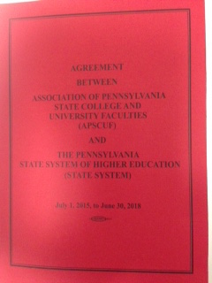
Still Confused? Crack a (red) book!
And feel free to contact local APSCUF!
*I get confused, too!

Slide 44
Please feel free to contact me!
Mark Rimple President WCU-APSCUF Professor Dept. of Music Theory, Composition, and History mrimple@wcupa.edu

