Slide 1
WCU Campus Store
Timely Book orders and Student Success
Presented by Erica Considine & David Urbany

Slide 2
Our Mission
The mission of the WCU Campus Store
To provide the WCU community with products, services, and technologies that ensure academic success, promote campus pride and enhance the lifestyle of our campus.
This is achieved through excellent customer service, competitive pricing and campus wide collaboration.

Slide 3
HEOA Higher Education Opportunity Act
Disclosure to bookstores: Colleges must provide their affiliated bookstores with the most current course schedule, course enrollment and textbook assignments, upon request
Why it is necessary: Textbook costs are unpredictable - one semester could total $100, the next could be $600, and students often do not know their book assignments until the semester starts. Students lose out on the opportunity to shop around for the lowest prices, and the final amount can catch students and their families off guard.
How it lowers costs: This provision can save students hundreds by giving them time to search for the best deals, and to evaluate options like rentals and e-books. It also makes textbook costs more manageable by giving students the information they need to plan ahead for the full cost of attendance.

Slide 4
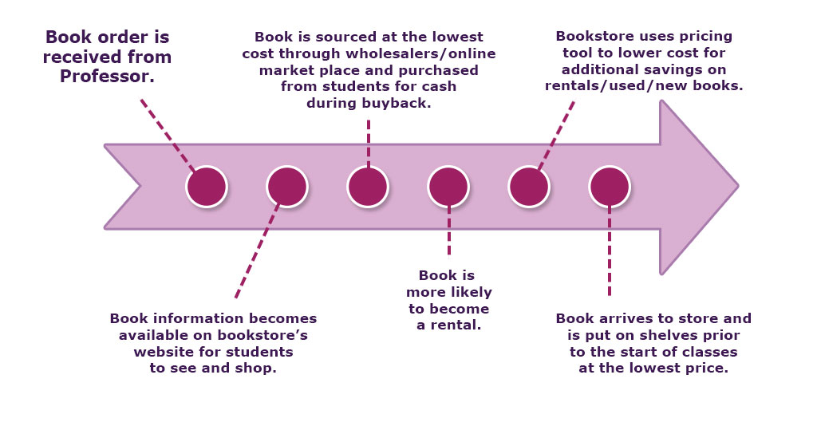
How it works

Slide 5
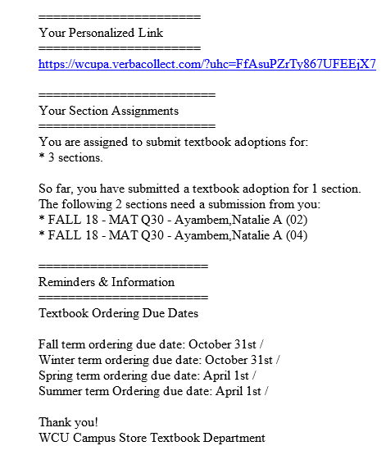
How to submit book orders
You will receive a weekly email about a month into the semester. In this email there will be a personalized link. Use this link to place your book orders. This is the preferred methods for placing book orders.

Slide 6
How do students find the books I requested?
Everything is always listed on our website
WWW.WCUCAMPUSSTORE.COM

Slide 7
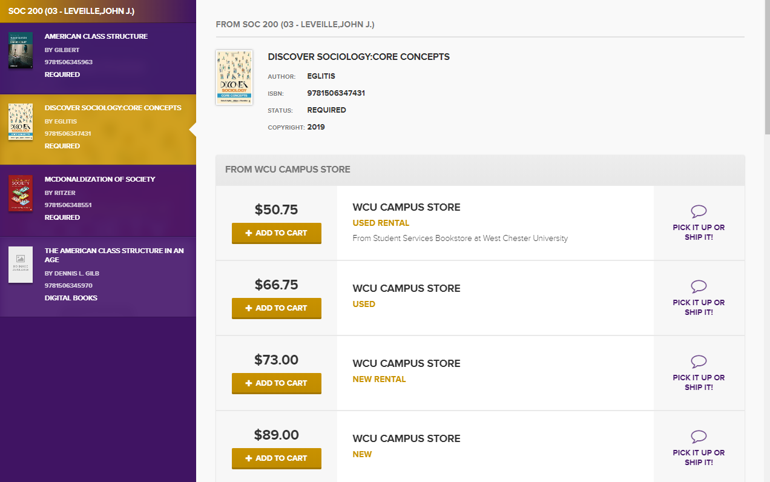

Slide 8
When book orders are delayed: How does this affect student success?
Less opportunity for students to sell back books to the bookstore which creates less used books for the students in the upcoming semester as well as little or no cash back for books sold.
The bookstore is unable to capture the full potential of the used books through online markets and wholesalers.
In turn it affects bookstore’s capability to lower costs, decreases the amount of used books, and delays rental information and/or possibility
Unable to use pricing software to maximize savings.

Slide 9
Let’s improve student success together!
The Positive Impact
How can we get there together?
Transparency to the customer
Lowest possible cost for the students
Larger amount of rental titles available
Students more likely to have materials first day/week of classes
Book information available earlier on bookstore’s website which allows for students to comparatively shop
More money at Buyback
Compliance of HEOA law
Our average is 65 % at the start of classes and we have been able to save students $1 million dollars in the past year.
Imagine the overall potential of savings with 100% of book orders?!

