Slide 1
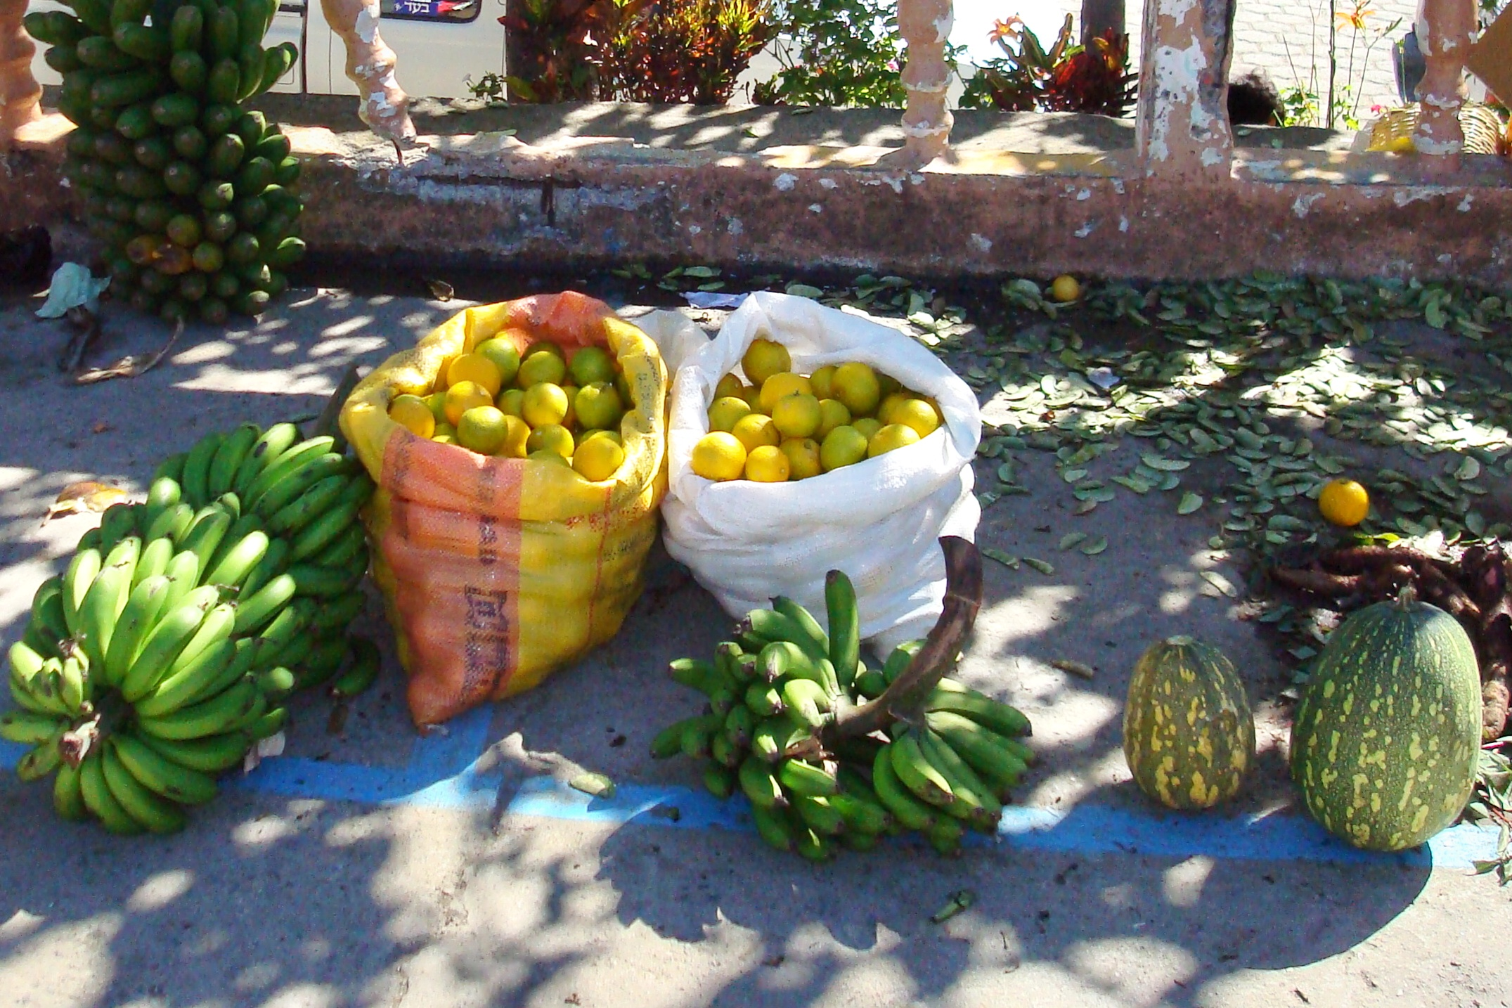
Latinx Immigrants and barriers to illness management: Coping with
Type 2 Diabetes
Jasmin Tahmaseb McConatha
West Chester University, West Chester, PA, 19383, USA

Slide 2

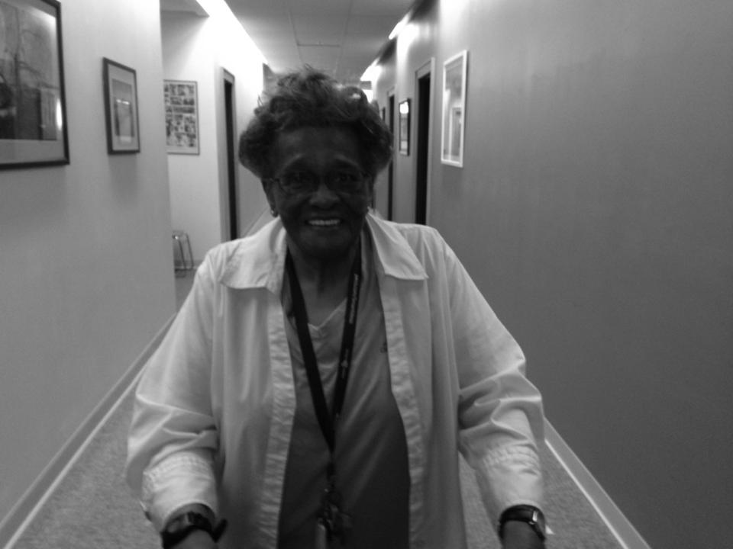
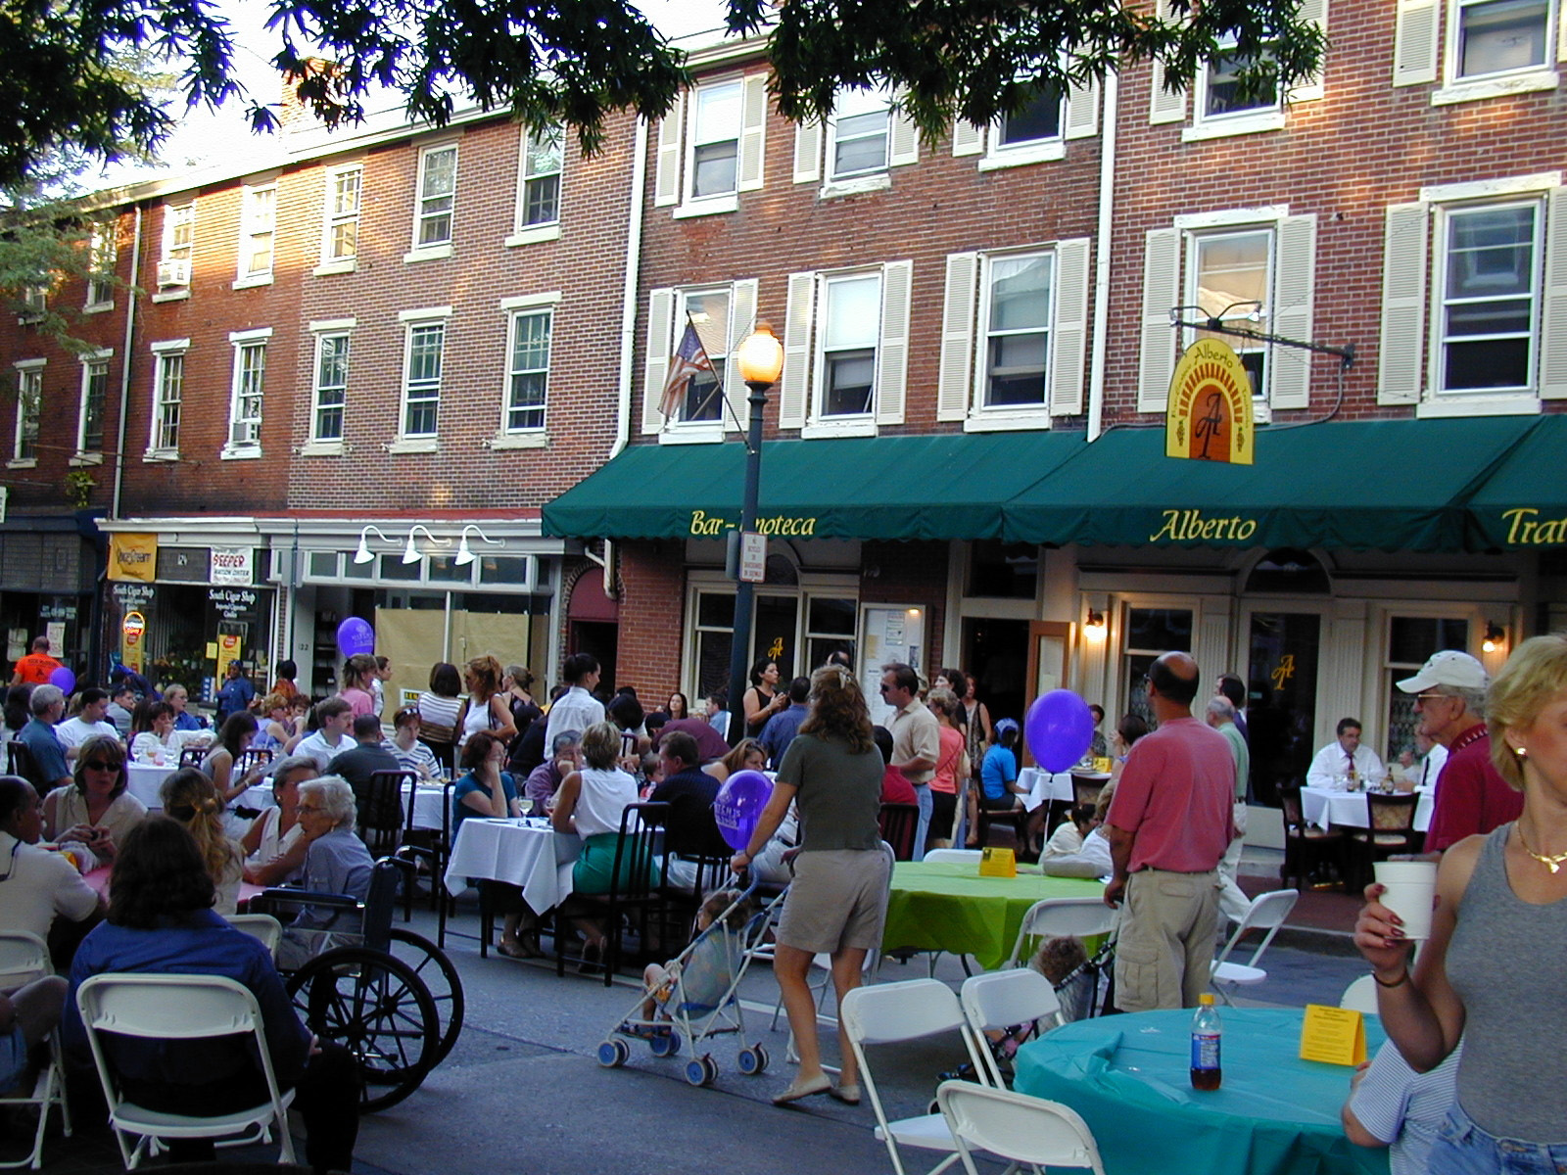
Health promotion is one of West Chester, Pennsylvania’s Age Friendly Goals
Focus of community work:
Promote equal access to healthcare
Address social and cultural barriers to health promotion
Promote resilience
Combat Ageism and other forms of discrimination
Promote Social participation, respect and community inclusion
Increase civic participation and employment
Provide Community support

Slide 3

A glimpse of the community

Slide 4
This Project
This project focuses on an analysis of the ways that older Latinx immigrants cope with type 2 diabetes
Latinx immigrants face unique health challenges in the United States.
They are at increased risk for developing many preventable health conditions – they tend to have limited access to healthcare and benefits, legal status challenges, and inadequate income.
As they age they develop chronic conditions at a younger age and are diagnosed at a more advanced stage than other elders.
Latina’s in particular face increased vulnerability often as a result of their role and position in the family.
Their health and well-being tends to be more vulnerable: for example the majority of Latinx immigrant women (78.5%) overweight or obese.
  49 % get no regular physical activity.

Slide 5


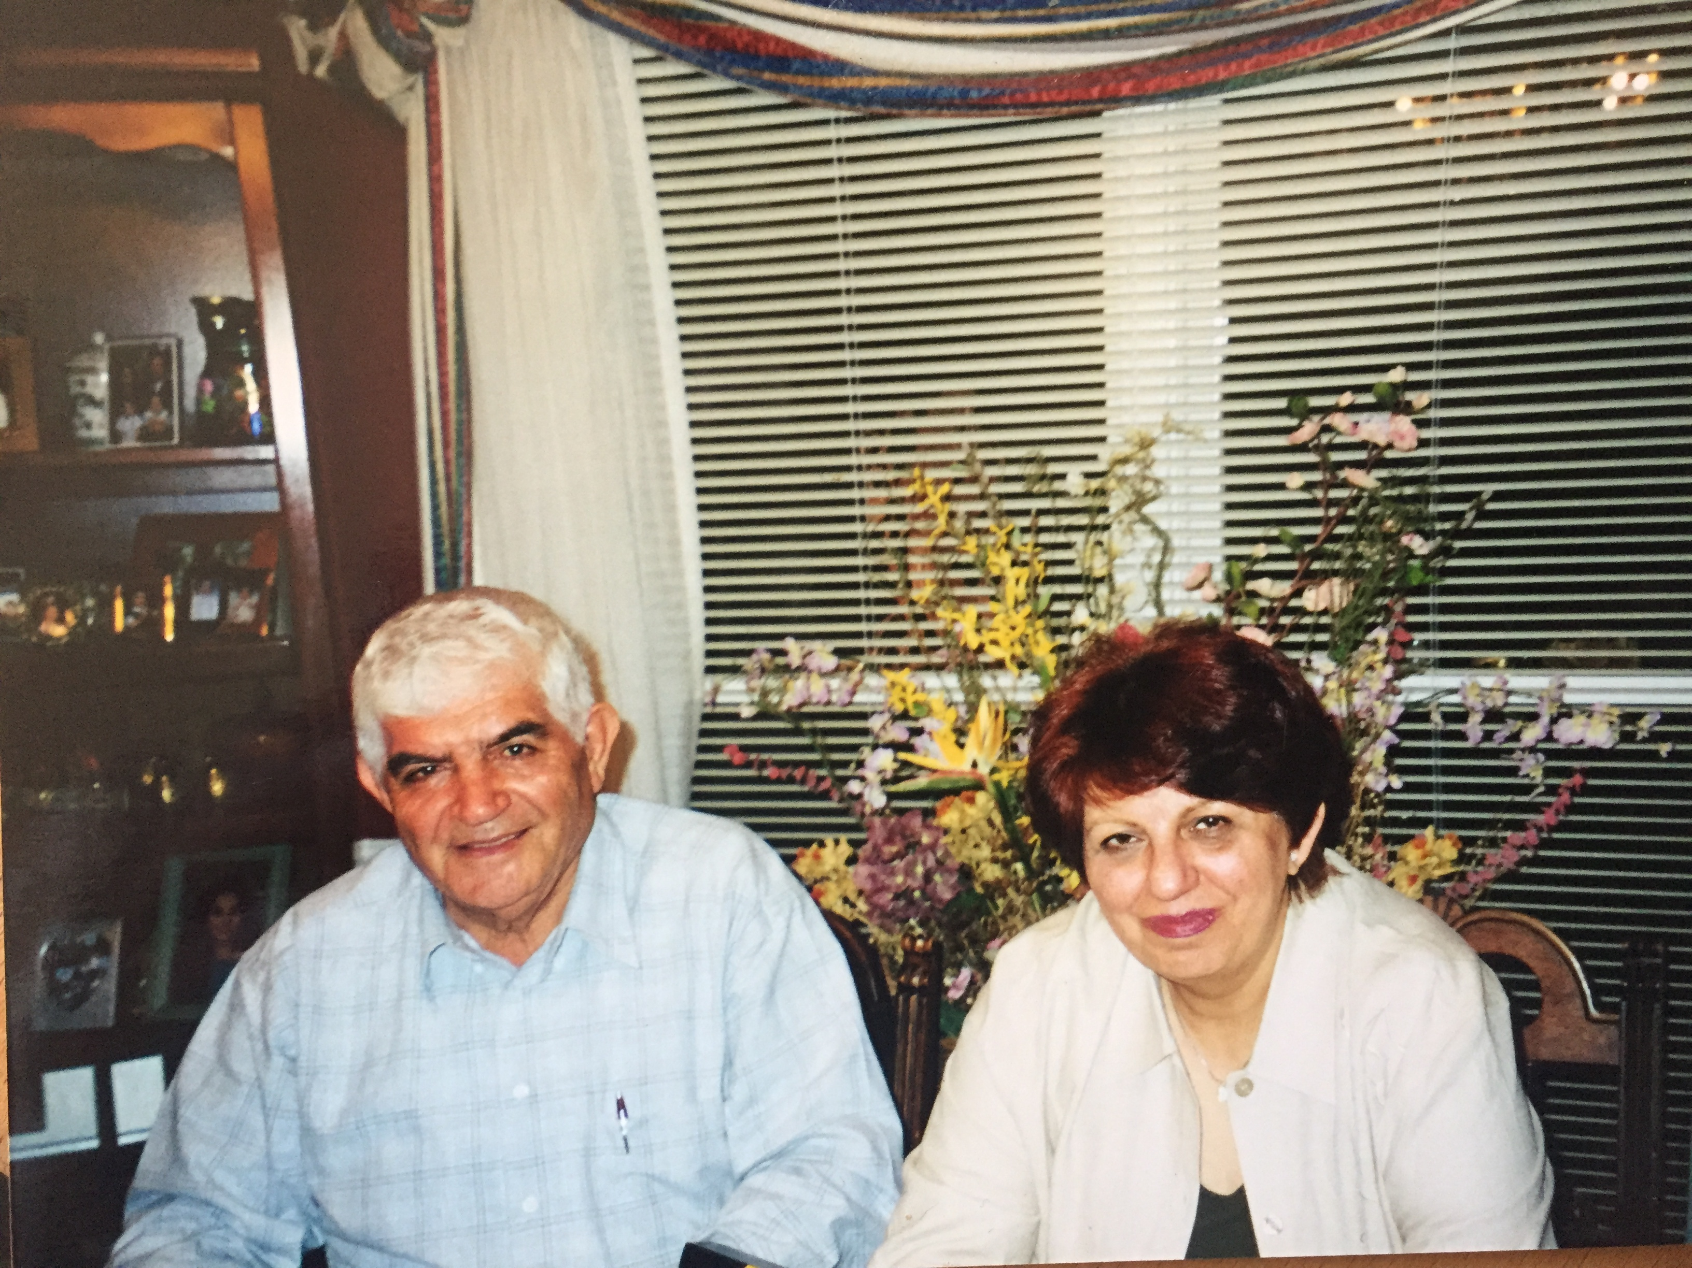

Latinx Immigrants in the United States
There are 44.4 million immigrants living in the U.S. in 2017, making up 13.6% of the overall population.
https://www.pewresearch.org/hispanic/2019/06/03/facts-on-u-s-immigrants/

Slide 6
Aging Latinx Immigrants in the U.S.
In the last 20 years, the population of older immigrants in the U.S. has increased by 70% (from 2.7 million to 4.6 million; Population Reference Bureau (PRB), 2018).
  Older Latinos account for one of the largest increases in the older immigrant population (PRB, 2018).
  In 2030, they will constitute 22% of the older population, compared to 8% of today’s older adults (PRB, 2018).

Slide 7
Increasing Population and increasing illness concerns
In 2018
Diabetes was 5th leading cause of death in Latinx population.
Latino’s are experiencing the fastest increase in the rates of type 2 diabetes.
Most with prediabetes are unaware that they have it. Almost half of Latinx immigrants between 45 and 64 have pre-diabetes (46.9% of men and 44.7% of women). The rates are higher for those over 64.
Latino’s face a 50 % higher death rates from type 2 diabetes than non-Latino’s.
If prediabetes goes undetected or if lifestyle changes are not made, prediabetes progresses to type 2 diabetes and other chronic conditions.
Notes:
They are at a greater risk than non-Hispanics for having prediabetes, developing type 2 diabetes, stroke and heart-disease.

Slide 8



Chronic Conditions in Later Life
As people live longer there is an increase in the percentage of women and men who struggle to manage one or more chronic conditions. The six most common chronic illnesses in the United States are (CDC, 2016) Heart Disease, Stroke, Cancer, Type 2 Diabetes, Obesity, and Arthritis.
Approximately 92% of adults, over the age of 65, suffer from at least one chronic condition (NCOA, 2015).
171 million people globally are known to have type 2 diabetes. Millions more have undiagnosed pre-diabetes or type 2 diabetes.

Slide 9

Latinx Immigrants and Chronic Illness Development
Latinx immigrants tend to develop chronic conditions earlier than the majority population.
They are also more likely to:
  develop diabetes
  receive a diagnosis at a later stage and once diagnosed may have in-adequate health care and support.
In 2016, they were 2.6x more likely to be hospitalized for treatment of end-stage renal disease related to diabetes, as compared to non-Latino whites. It is estimated that 2.5 million, or 10.4% of Latinx Americans aged 20 and older have diabetes. In 2017 - the CDC also estimated that Latinos were 50 percent more likely to die from Type 2 Diabetes.

Slide 10
Immigration and overall well-being
Being an immigrant to the U.S. is stressful - being a Latinx immigrant is even more difficult.
Stereotypes and negative perceptions, leave Latinx to live in constant anxiety and fear of victimization. Regardless of status, Latinx immigrants are generally perceived as illegal or undocumented.
  In 2019, 55% Latinx immigrants in the U.S., regardless of legal status, say they worry “a lot” or “some” that they, a family member or a close friend could be deported. As a result their day to day lives are filled with added stress and anxiety.
Notes:
Regardless of status, Latinx immigrants are often perceived as illegal. As a result their day-to-day lives are filled with stress and anxiety. They live in constant anxiety and fear of victimization.

Slide 11

The Erosion of the Healthy Immigrant Effect?
Historically, immigrants to the U.S. have lived longer healthier lives than native born Americans
The “healthy immigrant effect” is eroding:
  Years of difficult labor conditions,
  Intersecting prejudices of gender, age, and ethnicity.
  A life time of discrimination based on immigration status,
  Lack of access to health care
  an aging population struggling with numerous acute and chronic health conditions.
(Markides & Rote, 2019; Riosmena, Kuhn, & Jochem, 2018).

Slide 12
Illness and Gender
For an inclusive understanding of health and health-care disparities one must address gender differences - illnesses are experienced differently by men and women.
As part of the fastest growing and largest ethnic minority group in the U.S., projections indicate that 128 million Latinos will reside in the United States (U.S.) by 2050.
Research on racial and ethnic disparities in health-care access and utilization identifies Latinx immigrants as one of the most disadvantaged ethnic groups.
Using measures such as health care, health insurance coverage, and quality of care, multiple barriers for Latinas can be identified.

Slide 13
The Gendered face of type 2 diabetes
Women are often vulnerable and disadvantaged in their ability to care for themselves – they may face:
structural barriers (language, health care coverage, time constraints)
gendered family roles hinder their ability for self care
Insecure immigration status or fear of discrimination by care providers
Economic dependence

Slide 14

Gendered Barriers to Treatment of Chronic Illness
Cultural and household norms often prevent effective illness management.
  Family and social responsibilities tend to supersede personal health concerns.
  They are often diagnosed in an emergency care situation
  There is a lack of preventative care – particularly for low income women
  Older women are particularly vulnerable – Latina’s are often diagnosed with type 2 diabetes 7 years earlier
  They also tend to suffer from complications and mortality from chronic diseases like type 2 diabetes.
  They often live their later years in poorer health than other elders.

Slide 15
Community Discussions and Research
Over the past 5 years we have held dozens of conversations with Latinx immigrants regarding their health promotion behaviors and their health concerns.

Slide 16

A large percentage of Latinx immigrants in the WC community stated that they struggled with type 2 diabetes.
  Community Women faced higher levels of stress and more complex challenges in managing Type 2 Diabetes (time for walking or other exercise, support in food purchasing and preparation).
    Found it difficult to make lifestyle changes, particularly those related to diet and exercise.
    For women, a diabetes diagnosis was also more likely to also lead to an increase in feelings of isolation and loneliness (an avoidance of gatherings, anxiety and feeling depressed).
    Male participants tended to rely heavily on their female partners for illness management support (i.e. food preparation).

Slide 17

Mealtime, food, and Cultural identity
Social and cultural factors influence food preferences:
Cultural Identity influences what people like to eat, how they eat it, and the meanings of certain foods.
Foods of a particular culture tends to be preferred over the other foods.
Food provides comfort and connection to home.
Notes:
Food consumption is often the central ingredient of social gatherings. For immigrants, social gatherings serve to reinforce connections with people of their own culture of origin. Social gatherings that feature an array of traditional foods contribute positively to a sense of cultural connection and continuity. Holidays and traditions are shaped by specific foods. A diabetes diagnosis can pose a challenge to maintaining cultural connections because diet restrictions can result in disengagement from social gatherings leading to isolation and feelings of loneliness.

Slide 18
Food, gender, and culture
Food consumption is often the central ingredient of social gatherings. For immigrants, particularly women, social gatherings serve to reinforce connections with people of their own cultural background.
Social gatherings that feature an array of traditional foods contribute positively to a sense of cultural connection and continuity.
Holidays and traditions are shaped by specific foods.
A type 2 diabetes diagnosis can pose a challenge to maintaining cultural connections - diet restrictions can result in disengagement from social gatherings leading to isolation and feelings of loneliness.

Slide 19

Men have more support in managing type 2 diabetes
Gendered roles in the home and health management – These comments are typical of men struggling with type 2 diabetes:
“My wife measures out the quantities of food for me and I stopped eating too much”.
I eat less rice and more meat, we now have more vegetables, my wife is a good cook and a good organizer.
Notes:
None of the men interviewed had the major responsibility for cooking in the home, their wives were seen as supportive and helping them cut down on what they ate.
These participants had the support of their spouses and were better able to make changes with such support.

Slide 20
Men and Women Experience
Diabetes Differently
This community project explores the challenges and supports older adults face when diagnosed with a life threatening illness.
  Women diagnosed with type 2 diabetes appear to be also at a higher risk for other illnesses such as depression, coronary artery disease, obesity, hypertension, and mortality.

Slide 21

Moving forward: What do we need to know
Cultural background shapes how people manage their chronic illness.
Cultural background may help or hinder illness management efforts.
Family interdependence and support can serve as a motivation for self care, it can also serve as one barrier.
Stress resulting from illness management efforts can be taxing to both patients and their families and may strain relationships.
Campos and Kim (2017) who stated “A better understanding of culture that is more comprehensive, nuanced, and inclusive of the great diversity of human relationship experience is likely to yield important new insights about the role of relationships in health” (p. 552).

Slide 22
Conclusions and moving forward and helping our community
Projects addressing health disparities can help us better address health promotion and illness management.
Latinx immigrants are a fast-growing demographic, yet they face considerable challenges as they struggle to work, live, and stay healthy in their adopted country.
As a community resource – this project can help increase understanding of the barriers Latinx immigrants face.

Slide 23
Contact us for more information
Website and Video: Website and video highlight the health promoting and age friendly aspects of West Chester, PA, USA: https://www.wcupa.edu/_academics/sch_cas.psy/agefriendlywestchester/

Slide 24

For more information please contact
Dr. Jasmin Tahmaseb McConatha
West Chester University of Pennsylvania, West Chester, PA, USA Phone: 610-436-3209 ~
Email: JTahmasebMcConatha@wcupa.edu

