Slide 1

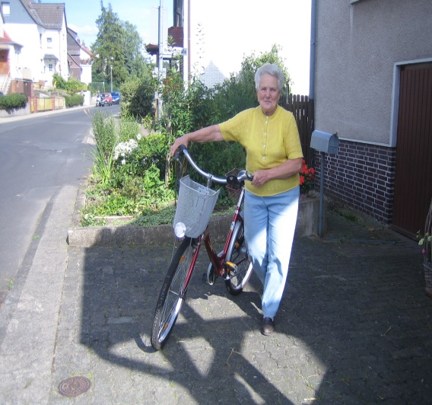

ILEARN: Connecting Generations and Communities
“In learning you will teach, and in teaching you will learn.”- Phil Collins
Jasmin Tahmaseb McConatha, Ph.D.
Professor of Psychology
West Chester University
West Chester, Pennsylvania, 10383, USA

Slide 2
Goals of ILEARN
Broaden the range of learning opportunities and resources available to younger and older adults.
Share diverse perspectives on real world concerns.
Promote lifelong learning.
Gain an appreciation of “wisdom” gained from life experiences.
Promote intergenerational understanding.
Help facilitate students' and older adults understanding of the contributions and experiences of older and younger adults of diverse backgrounds.
Help reduce ageism, and gender, and ethnic stereotyping.

Slide 3
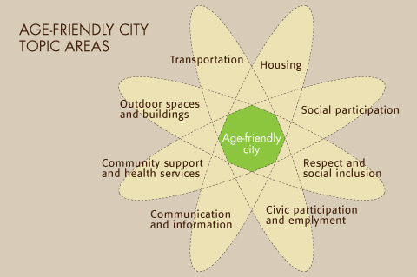
The World Health Organization’s (WHO) Global Network of Age-Friendly Cities and Communities: Areas of Assessment
Age Friendly Domains:

Slide 4
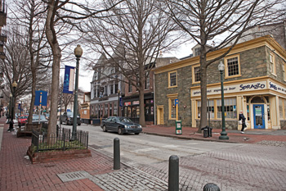
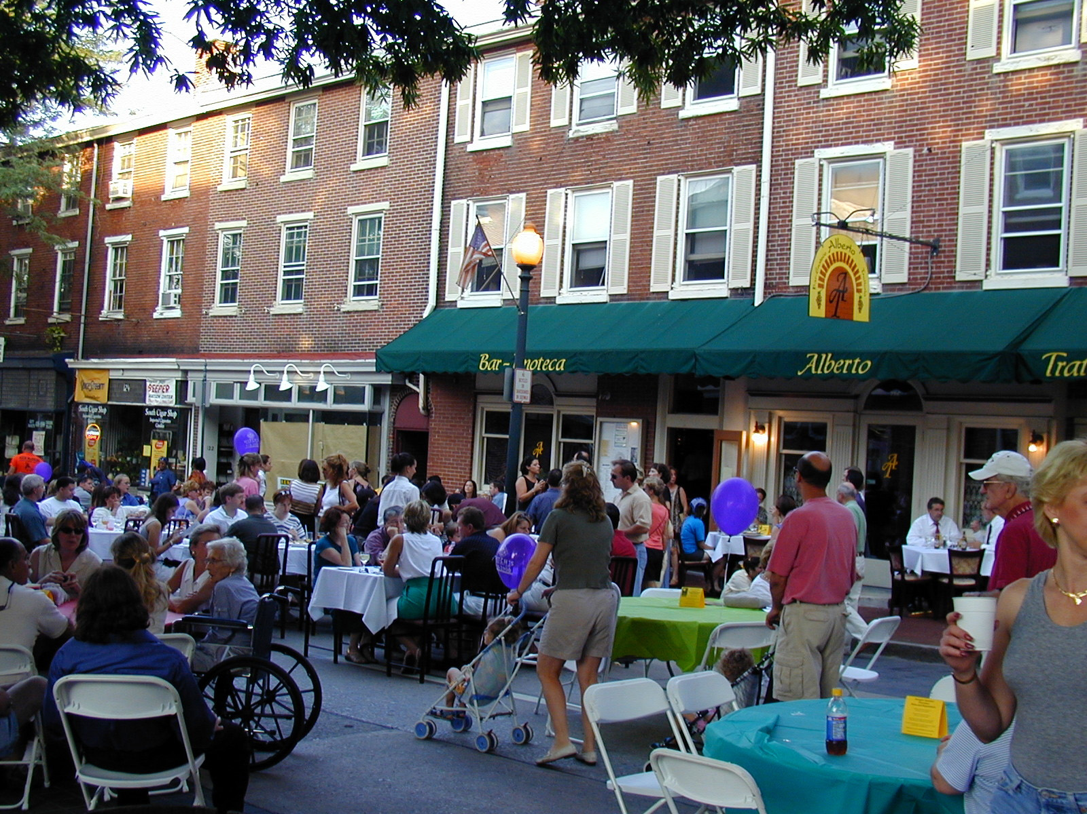
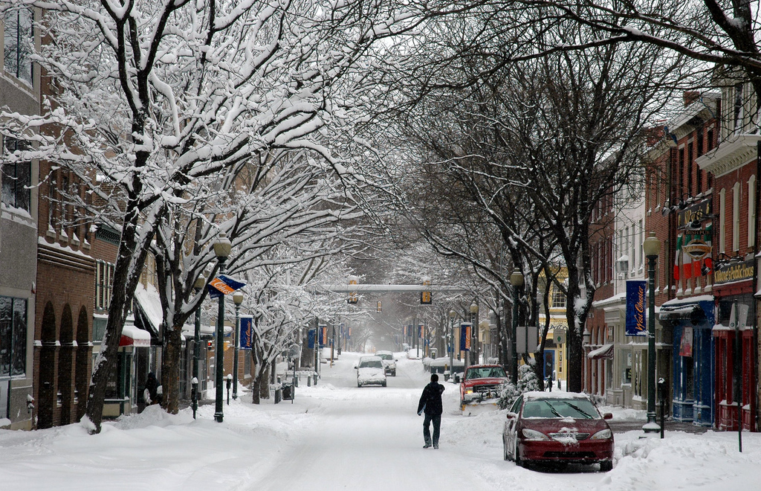
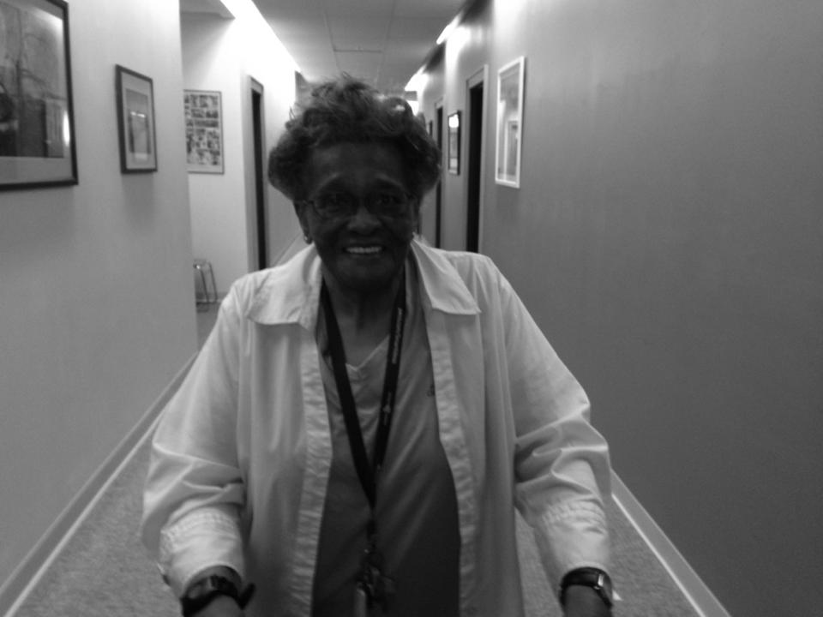
Age Friendly Goals: West Chester, PA
Promote Social participation
Promote Respect and social inclusion
Increase civic participation and employment
Provide Community support
Combat Ageism

Slide 5
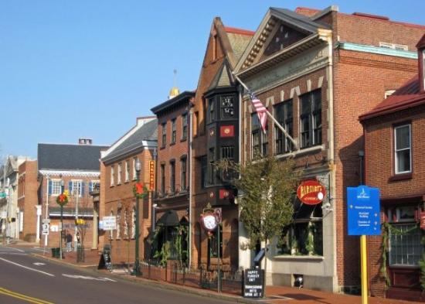
A glimpse of the community

Slide 6
Documentary Video
Website and Video: Website and video highlight the health promoting and age friendly aspects of West Chester, PA, USA: https://www.wcupa.edu/_academics/sch_cas.psy/agefriendlywestchester/

Slide 7
Intergenerational Learning
  In industrialized and post industrialized societies, there has been a decline in intergenerational contact. There are fewer opportunities for exchange, especially equal exchange, communication, and/or learning opportunities across generations, especially with elders from diverse backgrounds.
  Population mobility, changes in the traditional multigenerational family structure, and cultural changes have widened the “generation gap”.
  Lack of meaningful exchange and ongoing contact across the generations has been shown to increase ageism (Zucchero, 2011).

Slide 8
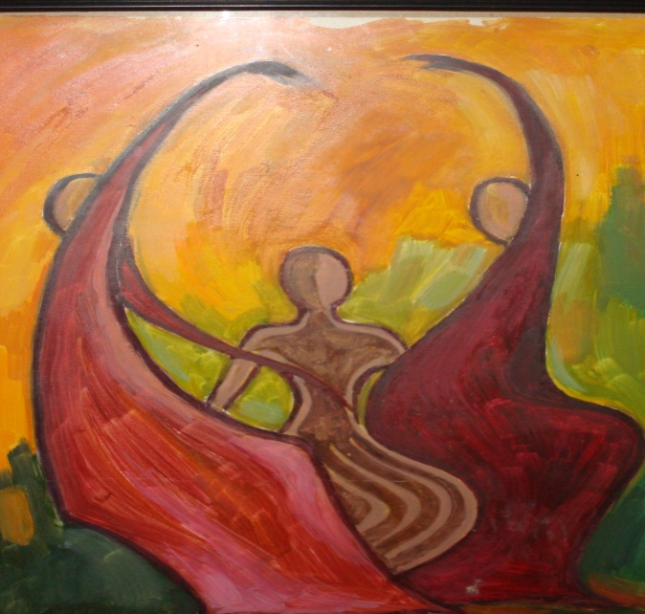
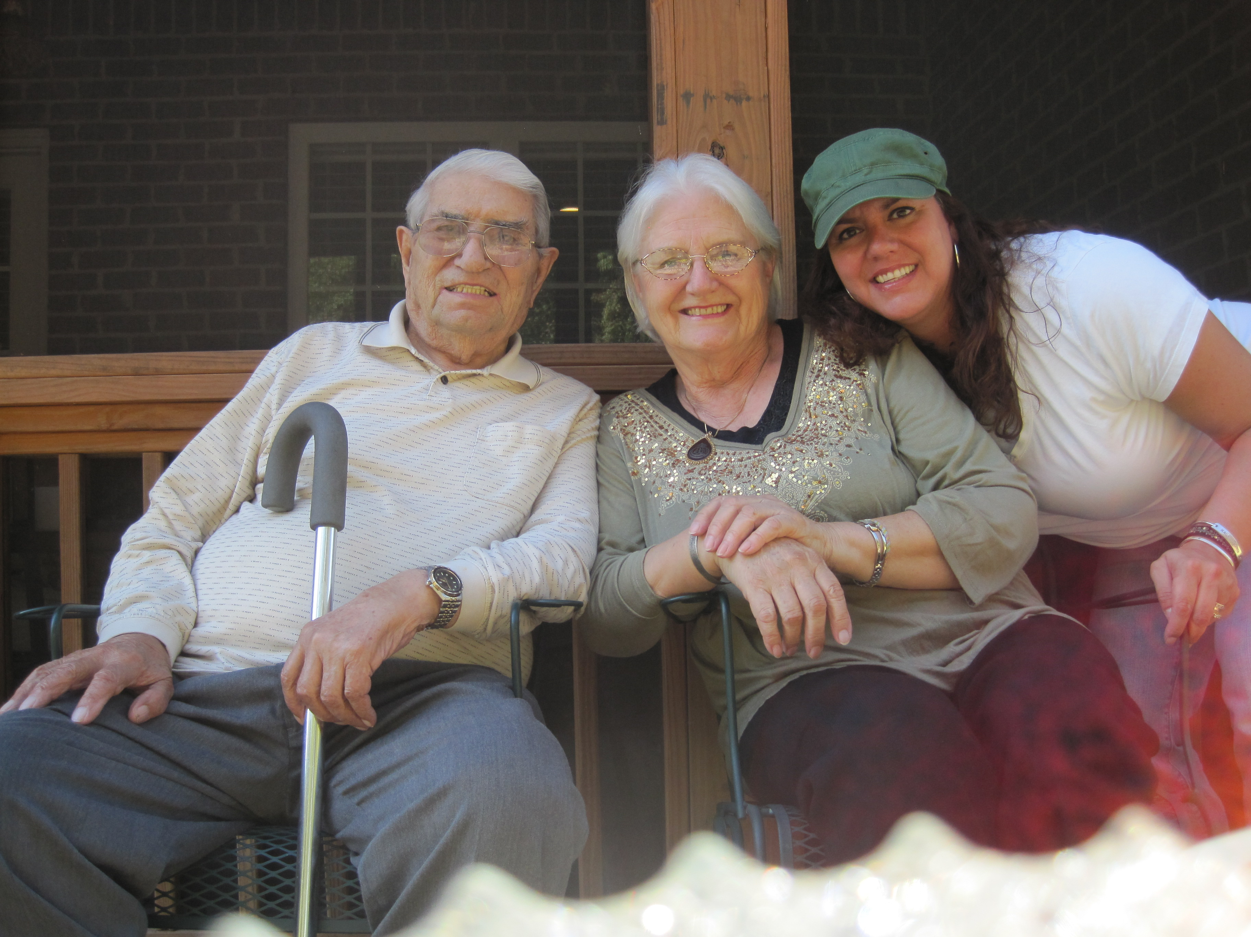
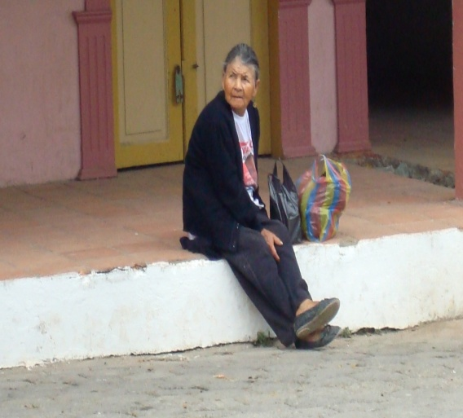
Ageism and Intergenerational Learning
Studies have found that intergenerational learning programs can help reduce negative stereotypes of older adults and increase knowledge of the past, present, and combat ageism (Weinreich, 2004).

Slide 9
Well-being and intergenerational learning
Contact across the generations increases feelings of social integration.
Studies have indicated that feeling that one is vital member of an intergenerational community can promote well being and happiness.
People of all ages benefit from multi-generational relationships, especially if that relationship is based on status equality.

Slide 10
The Contact hypothesis
Gordon Allport (1954) first presented the contact hypothesis stating that acquaintance lessens prejudice.
Knowledge alone will not cause people to negate their prejudices and stereotypes about others.
It is through contact, getting to know the other, that people may be able to break down their stereotypes.
Studies that have addressed ageism have found that contact reduces ageism and avoidance of older adults and reduces fears of one’s own aging.

Slide 11
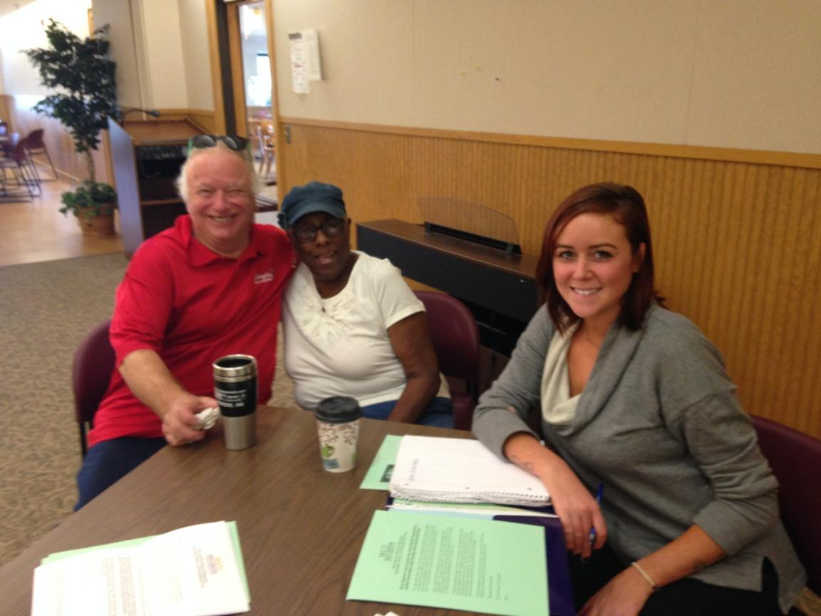

ILEARN
ILEARN an “Age Friendly Community” initiative is one inter-generational learning and mentoring program designed to promote an equal exchange and communication across the generations.
The goal of this program is to promote:
Mutual mentoring and learning;
Intergenerational contact;
Life long learning;
Civic engagement;
Social participation;
Reduce ageism;

Slide 12
Goals of ILEARN for younger generations
Broaden the range of learning opportunities and resources available to students.
Help facilitate students' understanding of the contributions and experiences of older adults of diverse backgrounds.
Help reduce age, gender, and ethnic stereotyping and biases.

Slide 13
ILEARN - An ongoing learning and mentoring project: A 5 year project review
This program promotes respectful intergenerational relationships which focus on mutual mentoring and learning.
Expected outcomes include a reduction in ageism and an increase in cross-generational understanding including the development of realistic view of young and later adulthood.

Slide 14
ILEARN
For 15 years ILEARN has provided an intergenerational education exchange opportunity for older and younger adults.
Facilitating mentoring and learning across generations occurs in four ways:
  Group meetings
  Life history interviews
  Informal meetings
  Email exchanges

Slide 15
ILEARN: A review of 5 years
Time Frame: 11 Semesters
Participants: 64 Undergraduate Students and 24 Older Adults
Biweekly meetings
Mutual mentoring

Slide 16
Instructions for Meetings
Students were paired up with an older adult and asked to at least one bi-weekly meetings for one semester (they could continue if they wished to).
  Meetings could take place via email (less than 50 %).
  They were asked to discuss various topics of interest including but not limited to health, well being, stress-management, problem solving, career concerns, and travel.

Slide 17
Younger adult participants: Pre and post Assessments: Assessing Ageism
Modified items from Kogan’s Attitudes Towards Old People Scale
1 = Strongly Agree to 5 = Strongly Disagree (Iwasaki & Jones, 2008)
1. It would be better for older people to hang out with other older adults.
2. Older people are no different from anyone else.
3. Older people should stop working in order to allow younger people to have more access to jobs.
4. When you get old you get set your ways.
5. Wisdom and knowledge is not related to age.
6. Older people like to give advice.
7. Older people have too much power and influence.
8. Old people are generally all the same.
9. Older people like to complain about younger generations.
10. It is hard for old people to learn new skills.
11. You loose many of your abilities as you age.
12. If old people want to be liked they need to get rid of their irritating habits.

Slide 18
Pre and post Qualitative Assessment
Narratives were created based on life history interviews.
Interviews with participants.
Participants were asked to write an essay reflecting on the assignment.
They were asked to include areas of particular interest discussed with partners as well as information, and knowledge gained from participation in ILEARN.

Slide 19
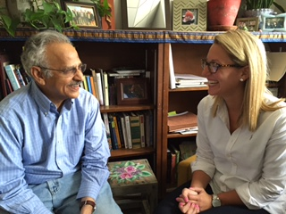
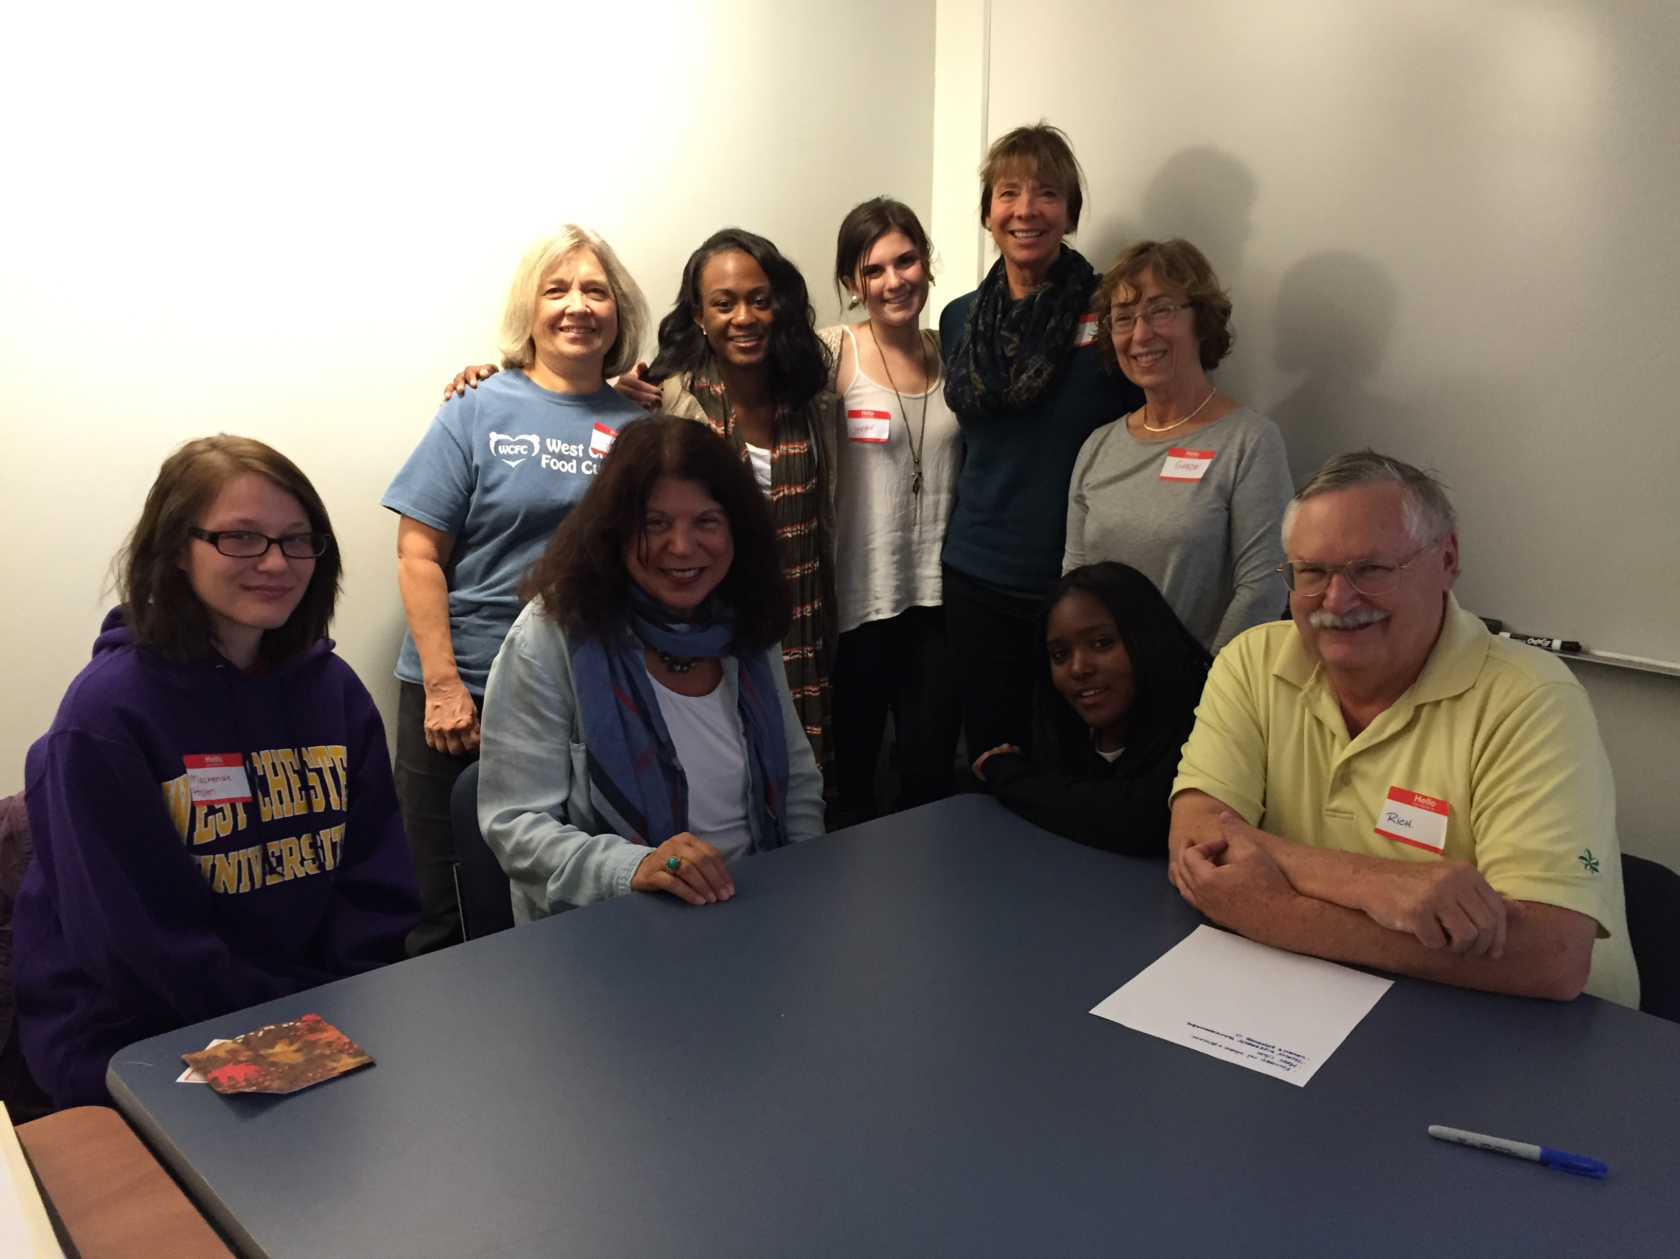
Results of Evaluations

Slide 20
Subjective assessment by Elders
Participation provided a valuable outlet for older adults to share their experiences with younger generations:
The experience promoted a sense of satisfaction and increased feelings of ego integrity.
Older adults also reported gaining more respect for younger generations.
Appreciated an opportunity to update technological skills.
Engaged in Reminiscence

Slide 21
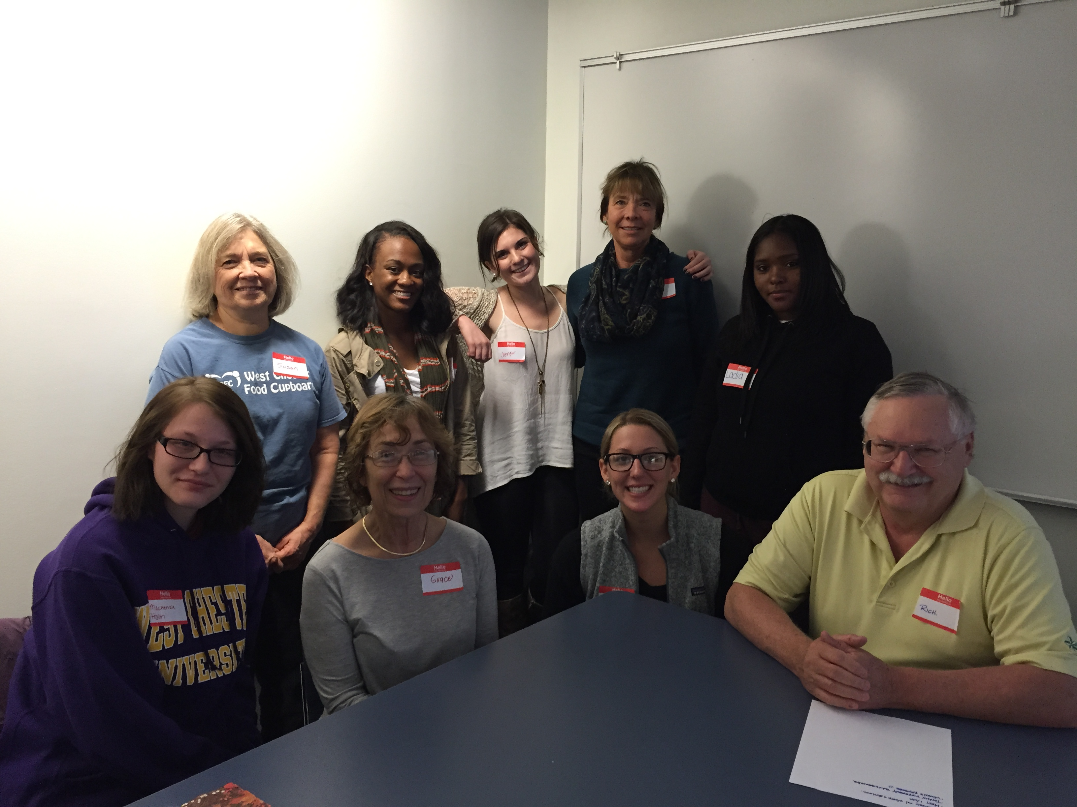
Results of older adults assessments of program
Older participants experienced an increased feeling of fulfillment and enrichment. A greater sense of purpose and contribution (generativity).
An increased feeling of connection with younger generations.
A increased feeling of social integration and connection with community (Muir, 2006).
Self affirmation was gained from
recounting accomplishments and
adventures.
Older adults were able to discuss
the discrepancies between “plans for
the future” and how the future actually
worked out, in many cases better than
planned.

Slide 22
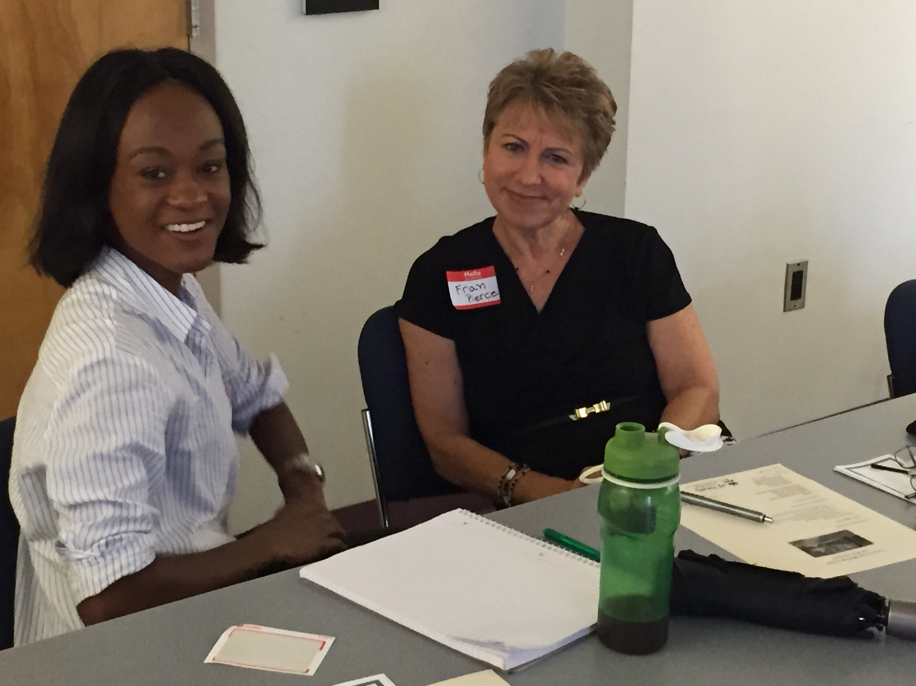
Subjective Assessment: Younger Participants
Reduced ageism
Gained time management skills
Increased coping skills, gained perspective and respect, appreciated the wisdom of experience.

Slide 23
Analysis of Results of ILEARN participation: Summary
Pre and post analysis indicated improved attitudes and a reduction in negative stereotyping.
Consistent with other studies contact led to improved attitudes toward the aging and older adults.
Content analysis of essays indicated that the experiences were considered worthwhile and meaningful by more than 90 % of the participants.
Students adjusted their perceptions of older adults as relying on the system and gained more realistic views of elders as important participating and contributing members of society.

Slide 24
ILEARN: A five year analysis
The program resulted in positive, improved attitudes towards older and younger adults.
Personal satisfaction and growth for both students and elders.
Students and elders reported a greater generational understanding.
The exchange led to an awareness of similarities in goals, concerns, sources of stress, and the struggle for happiness.
Reduced biases and miss-perceptions across the generations and groups.

Slide 25
ILEARN
Overall finding of the project indicated that intergenerational learning provides an outlet for the valuable contributions made by older adults of diverse backgrounds to society.
  The interaction of college students and older adults assisted in the breakdown of misconceptions and stereotypes often held by younger people.
  University students were introduced to real world issues, solutions and problem solving derived from the ILEARN experience.

Slide 26
Theoretical and Practical Implications
ILEARN is one effective program which has attempted to take advantage of the knowledge and experience of people of different generations.
General conclusions:
There is no one good way to learn.
There is not one good thing to learn.
Learning takes place in the experience between the learner and the knowledge presented.
The contact hypothesis can be useful in understanding and reducing ageism.

Slide 27

For more information please contact
Dr. Jasmin Tahmaseb McConatha
West Chester University of Pennsylvania, West Chester, PA, USA Phone: 610-436-3209 ~
Email: JTahmasebMcConatha@wcupa.edu

