Slide 1
Modeling respiration with Grodins
Pro Kumar

Slide 2
Content
Brief Bio I & History
Compartments
Assumptions (making life easier)
Homogenous SGM-II
Non-homogenous SGM-II
Semi-Linear SGM-I
Conclusion

Slide 3
Bio background & History (pt. 1)
Differing breathing rates with differing activities. Why?
Physical activity requires energy; body gets energy through cellular respiration; CO₂ is a byproduct.
1905 Haldane – experimentally identifies CO₂ as primary agent of increasing ventilation.¹
  As CO₂ builds in blood, reaction with H₂O results in acidic product.
  Receptors in brain detect acidity.
  Signals sent to diaphragm to increase contraction rate.

Slide 4
Bio background & History (pt. 2)
1946 Gray – attempts to quantify this respiratory action by considering “multiple factors”, (only one forcing term – CO₂ intake).²
1967 Grodins – Considers a compartment model of flow of partial pressures of CO₂, through the body.³ (This is what we’re going to discuss!)

Slide 5
Layout of Compartments
C_{L,i}
Lungs,
C_{L}
C_{L,o}
Subscript notation:
  L = lungs
  B = brain
  T = soft tissue
  i – into
  o – out of
  C = CO₂ concentration
  f – blood flow
f
Brain,
C_{B}
f_{B}
C_{B,o}
C_{B,i}
f-f_{B}
Soft tissue,
C_{T}
C_{T,o}
C_{T,i}

Slide 6
Assumptions
C_{L,i}
Lungs,
C_{L}
C_{L,o}
Concentration out = Concentration
of compartment. (e.g. C_{L,o} = C_{L} )
Concentration entering brain and soft tissue is
delayed version of what left the lungs.
  However, time delays = 0.
  (e.g. C_{B,i} = C_{L,o} )
Concentration leaving lungs is the same as
the concentration that enters.
f
Brain,
C_{B}
f_{B}
C_{B,o}
C_{B,i}
f-f_{B}
Soft tissue,
C_{T}
C_{T,o}
C_{T,i}

Slide 7
Homogeneous (pt. 1 – example)
C_{L,i}
Lungs,
C_{L}
C_{L,o}
Using “rate-in – rate-out” method…
E.g. Brain
Since C_{B,o} = C_{B} and C_{B,i} = C_{L,o}, we have (after converting
concentrations to partial pressure):
f
Brain,
C_{B}
f_{B}
C_{B,o}
C_{B,i}
f-f_{B}
Soft tissue,
C_{T}
C_{T,o}
C_{T,i}

Slide 8
Homogeneous (pt. 2 - system)
C_{L,i}
Lungs,
C_{L}
C_{L,o}
Applying this method to all compartments, we have
f
Brain,
C_{B}
f_{B}
C_{B,o}
C_{B,i}
f-f_{B}
Soft tissue,
C_{T}
C_{T,o}
C_{T,i}

Slide 9
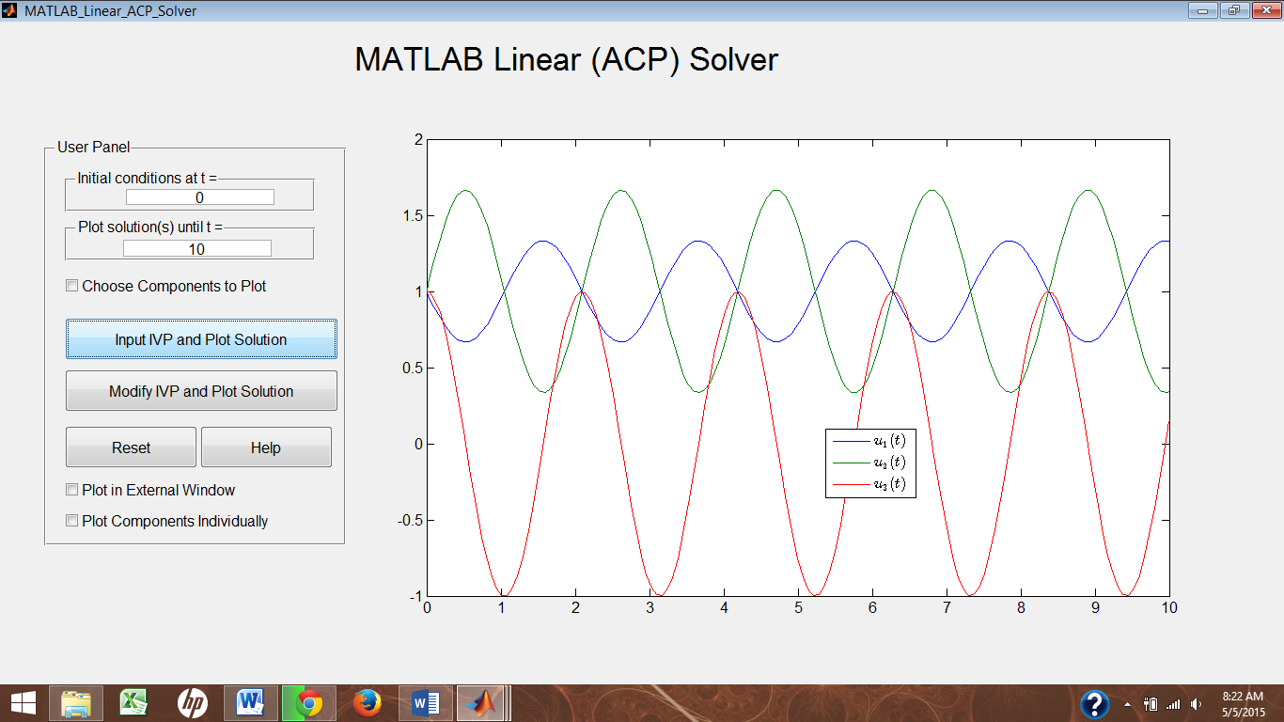
Homgeneous (pt. 3 - solution)
Unique solution exists by Theorem 4.6.1, from McKibben⁴

Slide 10
Non-homogeneous (pt. 1 - system)
Forcing terms
  Partial pressures of brain, and soft tissue.
  Brain and soft tissue metabolic rates. (could be indicative of “fitness” level)
  Constant ventilation rate, based on partial pressure leaving lungs. (not an isolated system)

Slide 11
Non-homogeneous (pt. 2 - solution)
Unique solution exists by Theorem 5.3.1, from McKibben⁴

Slide 12
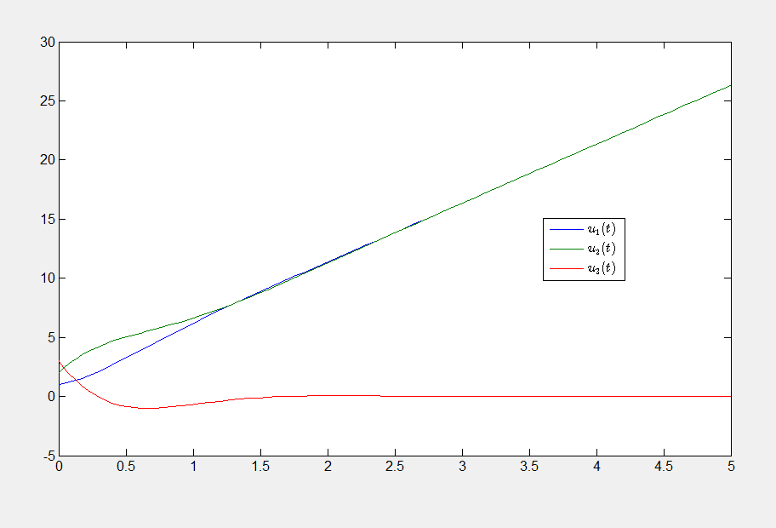
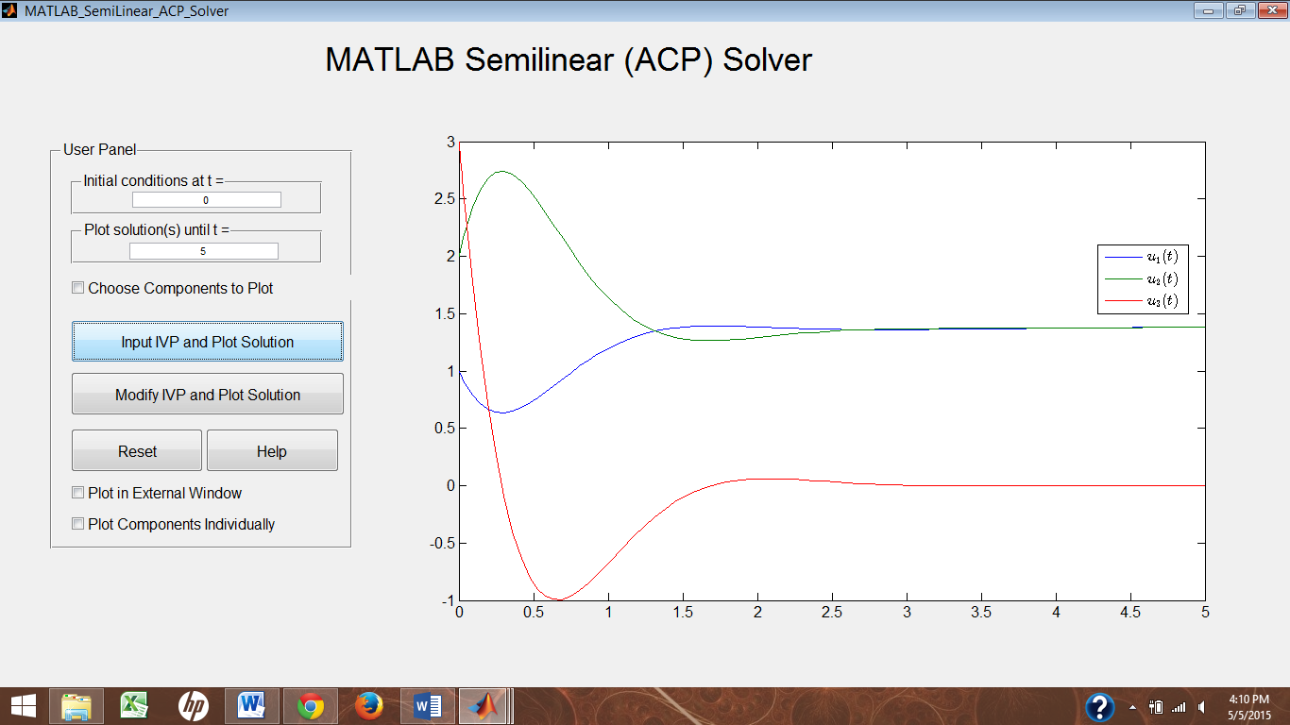
Non-homogeneous (pt. 3 – graph)
Forcing vector = (5,5,0)
Forcing vector (0.01,0.01,0)

Slide 13
Semi-Linear (pt. 1 – system)
Changes: non-constant ventilation rate; dependent on
  Base ventilation rate.
  Constant of rate increase.
  CO₂ partial pressure in brain.
  Threshold to CO₂ partial pressure.

Slide 14
Semi-Linear (pt. 2 – solution)
Unique “mild” solution exists by Theorem 7.6.1, from McKibben⁴

Slide 15
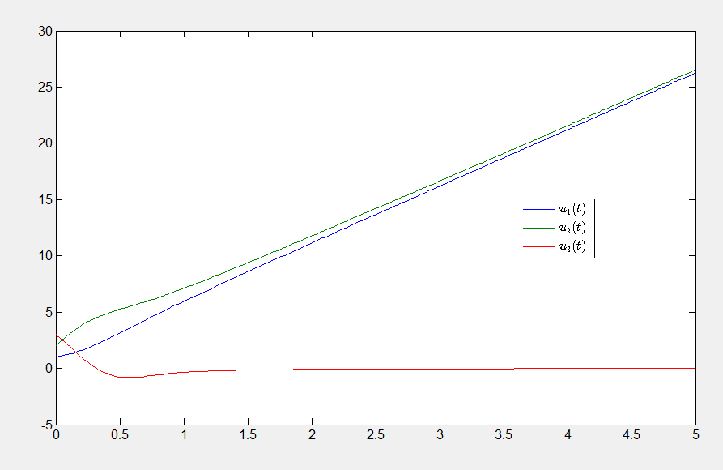
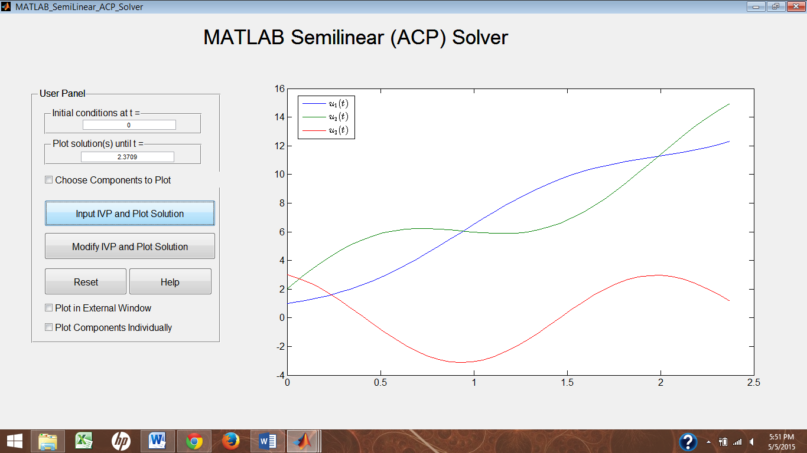
Semi-Linear (pt. 3 – graphs)
Example solution plot
Example solution plot with ventilation reduced by factor of 200.

Slide 16
Conclusion
Quantitatively, homogeneous case seems to model better.
Qualitatively, semi-linear case would be better since it takes more of physical reality into account.
Further analysis of the terms of the system should provide evidence for the latter.

Slide 17
References
[1] J. S. Haldane, and J. G. Priestley. The Regulation of Lung-Ventilation. The Journal of Physiology, 32, 225–266. (1905).
[2] J. S. Gray. The Multiple Factory Theory of the Control of Respiratory Ventilation. American Association for the Advancement of Science, 103, 739–744, (1946).
[3] F. S. Grodins, J. Buell, A. Bart. Mathematical analysis and digital simulation of the respiratory control system. J. Appl. Physiol., 22(2), 260–276, (1967).
[4] M. A. McKibben and M. D. Webster. Differential Equations with MATLAB: Exploration, Application, and Theory. CRC Press. (2015).
[5] J. Keener and J. Sneyd. Mathematical Physiology II: Systems Physiology. Springer. (2009).

Slide 18
The End
(I can finally breathe!)

