Slide 1
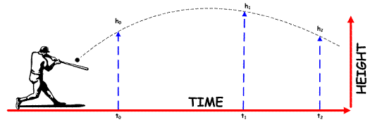
Projectile Motion
Ryan Knab
MAT 493

Slide 2
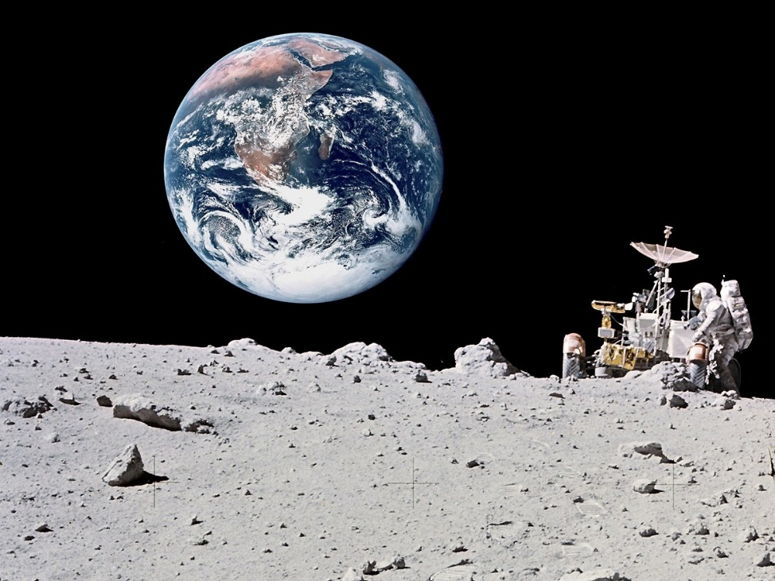
Definition
Projectile Motion is defined as the motion of an object near the earth’s surface.
‘Near’ → Gravity extremely influential to the trajectory of an object

Slide 3
history
Aristotle – projectiles pushed along by some external force that was transmitted through the air called “impetus”
Moved in a straight line until object lost momentum, then fell straight to the ground
Galileo – performed experiments on uniformly accelerated motion
Ball rolled with uniform motion until falling off the table
Noted time was the same no matter how fast the marble was moving horizontally
Vertical and horizontal directions do not depend on each other
Newton – Three laws of motion: 1686
Law 1: uniform motion until external force will change state
Law 2: sum of forces in each direction must be equal to mass*acceleration in specific direction

Slide 4


Creating a model
m $\frac{d^{2}x(t)}{{dt}^{2}}$ = -r_{x}$\frac{dx(t)}{dt}$ + F_{x}(t)
m $\frac{d^{2}y(t)}{{dt}^{2}}$ = -r_{y}$\frac{dy(t)}{dt}$ +) F_{y}(t)
m $\frac{d^{2}z(t)}{{dt}^{2}}$ = -r_{z}$\frac{dz(t)}{dt}$ -mg + F_{z}(t)
Reduce to first order differential equation with change of variables:
V_{x} =$\frac{dx(t)}{dt}$, V’_{x} = $\frac{d^{2}x(t)}{{dt}^{2}}$
V_{y} = $\frac{dy(t)}{dt}$, V’_{y} = $\frac{d^{2}y(t)}{{dt}^{2}}$
V_{z} = $\frac{dz(t)}{dt}$, V’_{z} = $\frac{d^{2}z(t)}{{dt}^{2}}$
∑ Forces in x-direction = m $\frac{d^{2}x\left(t\right)}{{dt}^{2}}$
∑ Forces in y-direction = m $\frac{d^{2}y\left(t\right)}{{dt}^{2}}$
∑ Forces in z-direction = m $\frac{d^{2}z(t)}{{dt}^{2}}$
What are some possible forces?
Gravity? Air resistance? Wind?
Assume air resistance proportional to velocity

Slide 5


Projectile motion models 1 and 2
Model 1: No air resistance
m V’_{x} = F_{x}(t)
m V’_{y} = F_{y}(t)
m V’_{z} = F_{z}(t)
$V_{x}^{′}\left(0\right)=V_{x0}$
$V_{y}^{′}\left(0\right)=V_{y0}$
$V_{z}^{′}\left(0\right)=V_{z0}$
Model 2: Air resistance proportional to velocity
m V’_{x} = -r_{x}V_{x} + F_{x}(t)
m V’_{y} = -r_{y}V_{y} + F_{y}(t)
m V’_{z} = -r_{z}V_{z} + F_{z}(t)
$V_{x}^{′}\left(0\right)=V_{x0}$
$V_{y}^{′}\left(0\right)=V_{y0}$
$V_{z}^{′}\left(0\right)=V_{z0}$

Slide 6


H-cp
Model 1
${\left[\begin{matrix}V_{x} \\ V_{y} \\ V_{z}\end{matrix}\right]}^{′}$= $\left[\begin{matrix}0 & 0 & 0 \\ 0 & 0 & 0 \\ 0 & 0 & 0\end{matrix}\right]\left[\begin{matrix}V_{x} \\ V_{y} \\ V_{z}\end{matrix}\right]$
$\left[\begin{matrix}V_{x} \\ V_{y} \\ V_{z}\end{matrix}\right]\left(o\right)= \left[\begin{matrix}V_{x0} \\ V_{y0} \\ V_{z0}\end{matrix}\right]$
Model 2
${\left[\begin{matrix}V_{x} \\ V_{y} \\ V_{z}\end{matrix}\right]}^{′}$= $\left[\begin{matrix}−\frac{r_{x}}{m} & 0 & 0 \\ 0 & −\frac{r_{y}}{m} & 0 \\ 0 & 0 & −\frac{r_{z}}{m} \end{matrix}\right]\left[\begin{matrix}V_{x} \\ V_{y} \\ V_{z}\end{matrix}\right]$
$\left[\begin{matrix}V_{x} \\ V_{y} \\ V_{z}\end{matrix}\right]\left(o\right)= \left[\begin{matrix}V_{x0} \\ V_{y0} \\ V_{z0}\end{matrix}\right]$

Slide 7



H-CP Solutions: U(t) = $e^{At}U_{0}$
Model 1
$\left[\begin{matrix}V_{x} \\ V_{y} \\ V_{z}\end{matrix}\right]=$ $\left[\begin{matrix}V_{x0} \\ V_{y0} \\ V_{z0}\end{matrix}\right]$
Model 2
$\left[\begin{matrix}V_{x} \\ V_{y} \\ V_{z}\end{matrix}\right]= \left[\begin{matrix}{e^{−\frac{r_{x}}{m}t}V}_{xo} \\ {e^{−\frac{r_{y}}{m}t}V}_{yo} \\ {e^{−\frac{r_{z}}{m}t}V}_{zo}\end{matrix}\right]$

Slide 8
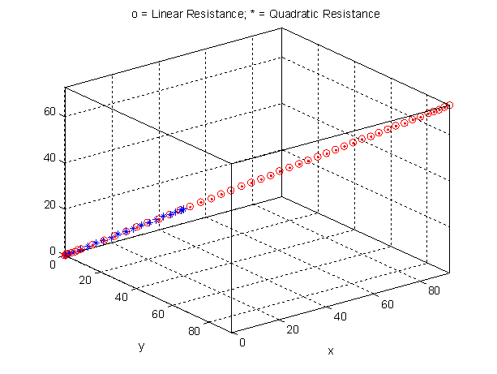
H-cp graph
H-CP Solutions do not physically make sense, we are not taking account for gravity
Can we find a better way to model the motion?

Slide 9


Non-cp
Model 1
${\left[\begin{matrix}V_{x} \\ V_{y} \\ V_{z}\end{matrix}\right]}^{′}$= $\left[\begin{matrix}0 & 0 & 0 \\ 0 & 0 & 0 \\ 0 & 0 & 0\end{matrix}\right]\left[\begin{matrix}V_{x} \\ V_{y} \\ V_{z}\end{matrix}\right]+\left[\begin{matrix}0 \\ 0 \\ −mg\end{matrix}\right]$,
m = mass, g = gravity(9.8m/s)
$\left[\begin{matrix}V_{x} \\ V_{y} \\ V_{z}\end{matrix}\right]\left(o\right)= \left[\begin{matrix}V_{x0} \\ V_{y0} \\ V_{z0}\end{matrix}\right]$
Model 2
${\left[\begin{matrix}V_{x} \\ V_{y} \\ V_{z}\end{matrix}\right]}^{′}$= $\left[\begin{matrix}−\frac{r_{x}}{m} & 0 & 0 \\ 0 & −\frac{r_{y}}{m} & 0 \\ 0 & 0 & −\frac{r_{z}}{m} \end{matrix}\right]\left[\begin{matrix}V_{x} \\ V_{y} \\ V_{z}\end{matrix}\right]+\left[\begin{matrix}0 \\ 0 \\ −mg\end{matrix}\right]$, m = mass, g = gravity(9.8m/s)
$\left[\begin{matrix}V_{x} \\ V_{y} \\ V_{z}\end{matrix}\right]\left(o\right)= \left[\begin{matrix}V_{x0} \\ V_{y0} \\ V_{z0}\end{matrix}\right]$

Slide 10



Non-cp solutions: U(t) = $e^{At}U_{0}+ \int_{0}^{t}{e^{A(t−s)}F\left(s\right)ds}$
Model 1
$\left[\begin{matrix}V_{x} \\ V_{y} \\ V_{z}\end{matrix}\right]=$ $\left[\begin{matrix}V_{x0} \\ V_{y0} \\ V_{z0}−mgt\end{matrix}\right]$
Model 2
$\left[\begin{matrix}V_{x} \\ V_{y} \\ V_{z}\end{matrix}\right]= \left[\begin{matrix}{e^{−\frac{r_{x}}{m}t}V}_{xo} \\ {e^{−\frac{r_{y}}{m}t}V}_{yo} \\ {e^{−\frac{r_{z}}{m}t}V}_{zo}−e^{2\frac{r_{z}}{m}t}\frac{m^{2}g}{r_{z}} \end{matrix}\right]$
According to theorem 5.3.1, if the forcing function is continuous in each direction for the entire time interval, we can say the Non-CP IVP has a unique solution given by the variation of parameters formula

Slide 11


Projectile motion model 3
Even more realistic of a model would be air resistance proportional to velocity squared
This causes some problems:
Cant just square velocity → always positive
No longer linear
$−r_{x}\left|V_{x}\right|V_{x}$
$−r_{y}\left|V_{y}\right|V_{y}$
$−r_{z}\left|V_{z}\right|V_{z}$
Use some constant that can relate:
c1 + c2$\left|V_{0}\right|$
Model 3: Air resistance proportional to velocity squared
m V’_{x} = - (c1 + c2$\left|V_{x0}\right|$)V_{x} + F_{x}(t)
m V’_{y} = - (c1 + c2$\left|V_{y0}\right|$)V_{y} + F_{y}(t)
m V’_{z} = - (c1 + c2$\left|V_{z0}\right|$)V_{z} + F_{z}(t)
$V_{x}^{′}\left(0\right)=V_{x0} , V_{y}^{′}\left(0\right)=V_{y0} , V_{z}^{′}\left(0\right)=V_{z0}$

Slide 12
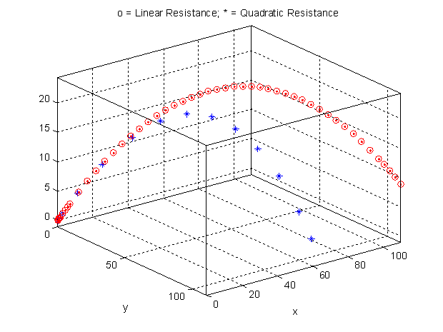
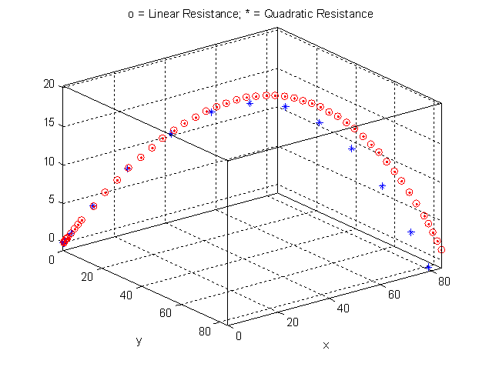

Non-cp graphs
Non-CP Model 2
R=0.01
Non-CP Model 3
R=0.01 + .005$\left|V_{0}\right|$

Slide 13

Projectile motion model 4
Model 4: Air resistance proportional to square of speed
m V’_{x} = -$r_{x}\sqrt{{V_{x}}^{2}+{V_{y}}^{2}+{V_{x}}^{2}}V_{x}$ + F_{x}(t,$V_{x},{ V}_{y},{ V}_{z}$)
m V’_{y} = -$r_{y}\sqrt{{V_{x}}^{2}+{V_{y}}^{2}+{V_{x}}^{2}}V_{y}$ + F_{y}(t,$V_{x},{ V}_{y},{ V}_{z}$)
m V’_{z} = -$r_{z}\sqrt{{V_{x}}^{2}+{V_{y}}^{2}+{V_{x}}^{2}}V_{z}$+ F_{z}(t,$V_{x},{ V}_{y},{ V}_{z}$)
$V_{x}^{′}\left(0\right)=V_{x0} , V_{y}^{′}\left(0\right)=V_{y0} , V_{z}^{′}\left(0\right)=V_{z0}$

Slide 14

Semi-cp: Model 4
${\left[\begin{matrix}V_{x} \\ V_{y} \\ V_{z}\end{matrix}\right]}^{′}$=$\left[\begin{matrix}0 & 0 & 0 \\ 0 & 0 & 0 \\ 0 & 0 & 0\end{matrix}\right]\left[\begin{matrix}V_{x} \\ V_{y} \\ V_{z}\end{matrix}\right]$ + $\left[\begin{matrix}−r_{x}\sqrt{{V_{x}}^{2}+{V_{y}}^{2}+{V_{x}}^{2}}V_{x} \\ −r_{y}\sqrt{{V_{x}}^{2}+{V_{y}}^{2}+{V_{x}}^{2}}V_{y} \\ −r_{z}\sqrt{{V_{x}}^{2}+{V_{y}}^{2}+{V_{x}}^{2}}V_{z}−mg\end{matrix}\right]$
m = mass, g = gravity (9.8m/s)
$\left[\begin{matrix}V_{x} \\ V_{y} \\ V_{z}\end{matrix}\right]\left(o\right)= \left[\begin{matrix}V_{x0} \\ V_{y0} \\ V_{z0}\end{matrix}\right]$

Slide 15

Semi-cp solution
Model 4
$\left[\begin{matrix}V_{x} \\ V_{y} \\ V_{z}\end{matrix}\right]= \left[\begin{matrix}V_{x0} \\ V_{y0} \\ V_{z0}\end{matrix}\right]$ + $\int_{0}^{t}{\left[\begin{matrix}−r_{x}\sqrt{{V_{x}}^{2}+{V_{y}}^{2}+{V_{x}}^{2}}V_{x} \\ −r_{y}\sqrt{{V_{x}}^{2}+{V_{y}}^{2}+{V_{x}}^{2}}V_{y} \\ −r_{z}\sqrt{{V_{x}}^{2}+{V_{y}}^{2}+{V_{x}}^{2}}V_{z}−mg\end{matrix}\right]}ds$

Slide 16

The green monster
Left field, Fenway Park
95.4 meters away from home plate
11 meters tall
X-coordinate → third base line
Y-coordinate → first base line
Launch angle? 29 degrees
Batted ball speed? 45.15 m/s
Initial height? 0.82 meters
Official baseball mass? 0.145kg
$V_{HORIZONTAL}=45.15 cos(29)$ = 39.49 m/s
$V_{VERTICAL}=45.15 sin(29)$ = 21.89 m/s
$V_{x}=39.49 sin(75)$ = 38.14 m/s
$V_{y}=39.49 cos(75)$ = 10.22 m/s
$V_{z}=V_{VERTICAL}$ = 21.89 m/s

Slide 17
Homeruns?
Using our realistic velocities to ensure the appropriate launch angle and direction along with a coefficient value of 0.005 will result in the ball flight we are looking for
If the resistance were to be any greater or the initial velocities any slower, may not have a homerun
In order to ensure homeruns, either raise initial velocities or lower the quadratic coefficient below 0.005

Slide 18
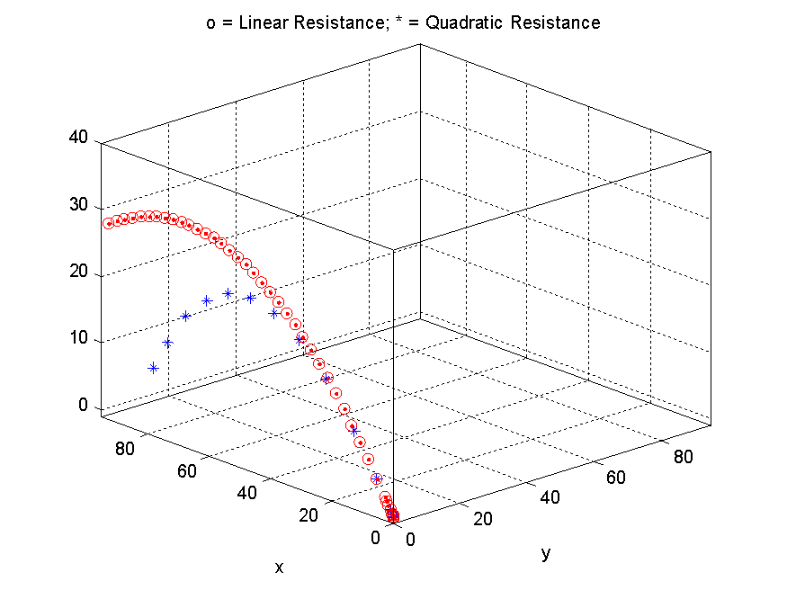
Three dimensional

Slide 19
The end

