Slide 1
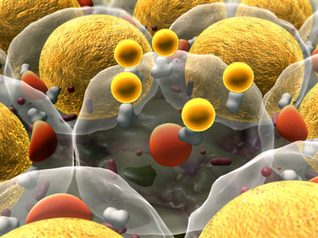

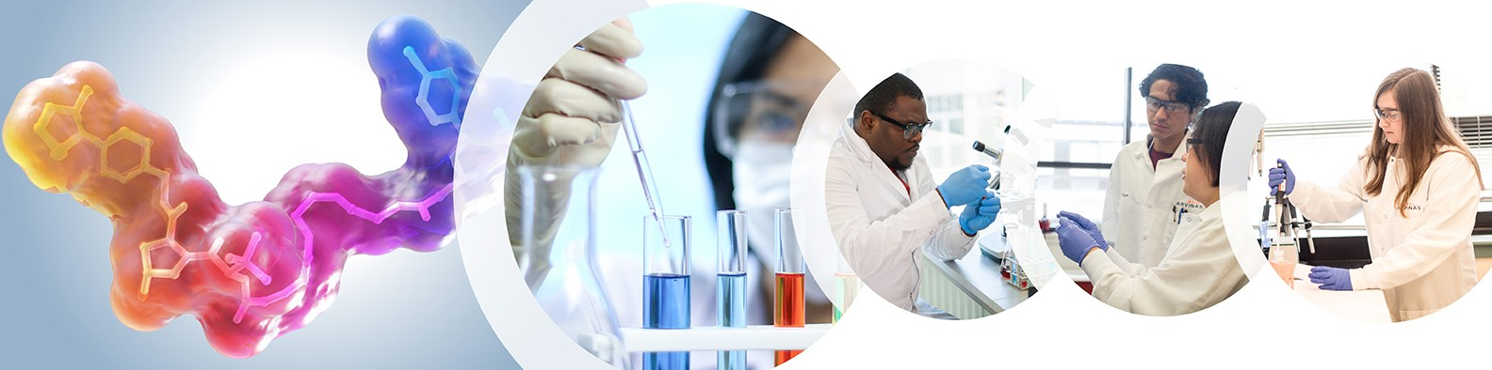
PPD Guest Seminar: Keith Hornberger (Arvinas) “PROTAC Protein Degraders: Past, Present, and Future” Monday 11/22/2021; SSN 190; 6:00-7:00 PM
About Arvinas: Arvinas is a clinical-stage biopharmaceutical company dedicated to improving the lives of patients suffering from debilitating and life-threatening diseases through the discovery, development, and commercialization of therapies that degrade disease-causing proteins. Arvinas uses its proprietary PROTAC® Discovery Engine platform to engineer proteolysis targeting chimeras, or PROTAC® targeted protein degraders, that are designed to harness the body’s own natural protein disposal system to selectively and efficiently degrade and remove disease-causing proteins.
Dr. Keith Hornberger, Senior Director of Chemistry at Arvinas, will provide a presentation on exciting research advances in the relatively new area of PROTAC research and development.
Career opportunities for science majors (especially PPD, Chemistry and Biology based majors) will also be discussed.

