Slide 1

Exercise Science: Internship Application Process
Dr. Melissa A. Whidden (Exercise Science Coordinator)
Heather Showers (CHS, Administrative Assistant of Clinical Experiences)

Slide 2
Steps Involved in Securing Your Placement in EXS 490 Internship
Find an internship site that is willing to work with you the semester before you intend to graduate
Submit the online internship application (BEFORE the due date)
Be patient and work on collecting your documentation
Submit correct documentation to your CastleBranch portal (BEFORE the due date)
Receive an official enrollment email from Dr. Whidden

Slide 3
Step 1: Find an Internship Site
EXS 490 Internship MUST be completed in your last semester
EXS 490 is your capstone class, a Speaking Emphasis class, and a Writing Emphasis class
3-credit internship: 125 hours at your site
4-credit internship: 165 hours at your site
5-credit internship: 205 hours at your site
6-credit internship: 250 hours at your site
You must apply for your placement in EXS 490 the semester before you intend to take it
Find an internship site that is willing to work with you
Approach potential sites dressed professionally and explain your situation correctly. You are an Exercise Science undergraduate student looking for an internship experience.
Never send an email as your initial outreach, go into the facility or call!

Slide 4
Step 1: Find an Internship Site (continued)
You are required to find your site; we do NOT place you at a facility.
We have a list of sites where students have interned before, but this list is not a guarantee that the site will work with you.
The list is an excellent starting point for you because if the site is listed, that means we have a contract already in place with the facility.
If you want to intern at a site that is NOT ON THE LIST, that is okay too. However, your application process will be longer, so be patient!

Slide 5
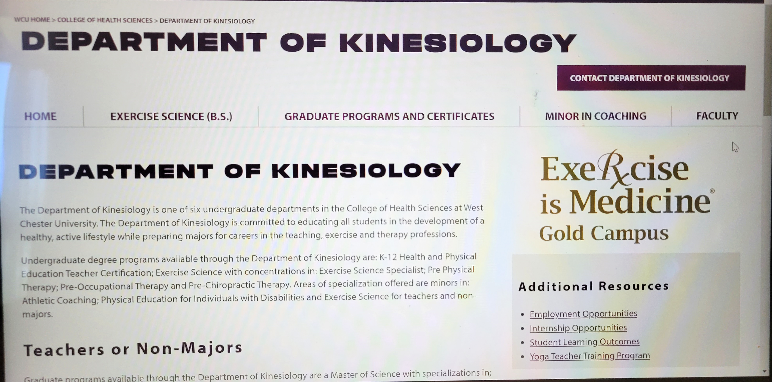
Step 2: Submit Online Internship Application
Go the Kinesiology home page and you will see a gray box on the left. Click on Internship Opportunities

Slide 6
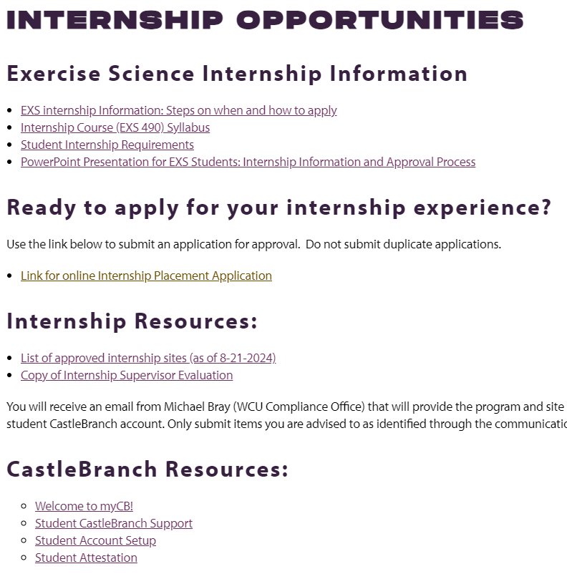
Step 2: Submit Online Internship Application (continued)
Application asks for your basic information
Year and semester that you want to take EXS 490
Credit number
Type of internship; Pre-PT, Pre-OT, Pre-Chiro, EXS, or other
Site information: name of facility, address, phone number, name of supervisor, and email address of supervisor
For a Spring semester placement, applications are due Oct 1st
For a Summer/Fall semester placement, applications are due Mar 1st

Slide 7
Step 3: Be Patient and Collect Documentation
After you submit the application, you will receive a generic email from no-reply@wcupa.edu confirming that we received your application (no action is required on your part)
If we have a contract in place with your site, you will receive an email from Mike Bray (WCU Compliance Office) within 1-2 weeks of your application submission that will provide the program and site compliance requirements you must complete.
If we DON’T have a contract in place with your site, BE PATIENT. The contract process takes time, and Heather is working hard to establish it (can take 1 week-3 months)

Slide 8
Step 3: Be Patient and Collect Documentation (continued)
WCU works with a third-party provider, CastleBranch, to approve all student compliance requirements.
Every exercise science intern must purchase a basic compliance package through CastleBranch which is $25. All internship compliance costs are the responsibility of the student.
The $25 basic package requirements ALL students must complete are listed below:
PA Criminal Background Check
PA Child Abuse Clearance ($13)
CPR certificate (can’t expire during internship semester)
Professional liability insurance with limits of $1million/$3million (you must purchase a policy) (estimated $40)
Signed WCU student attestation document
Add-on packages – Depending on the agreement terms with your placement site, students may also need to complete:
FBI Fingerprint clearances (add-on $9 + cost of the clearance $23)
Medical/Immunizations (add-on $38)
Drug Test(add-on $45)
*Prices in red are in addition to the package cost.
Once the affiliation agreement is in place, you will receive an email from Mike Bray (University Compliance team member) that will list the required package(s)/documents you must upload for approval and provide next steps to activate your CastleBranch account. (DON’T DELETE THIS EMAIL)

Slide 9
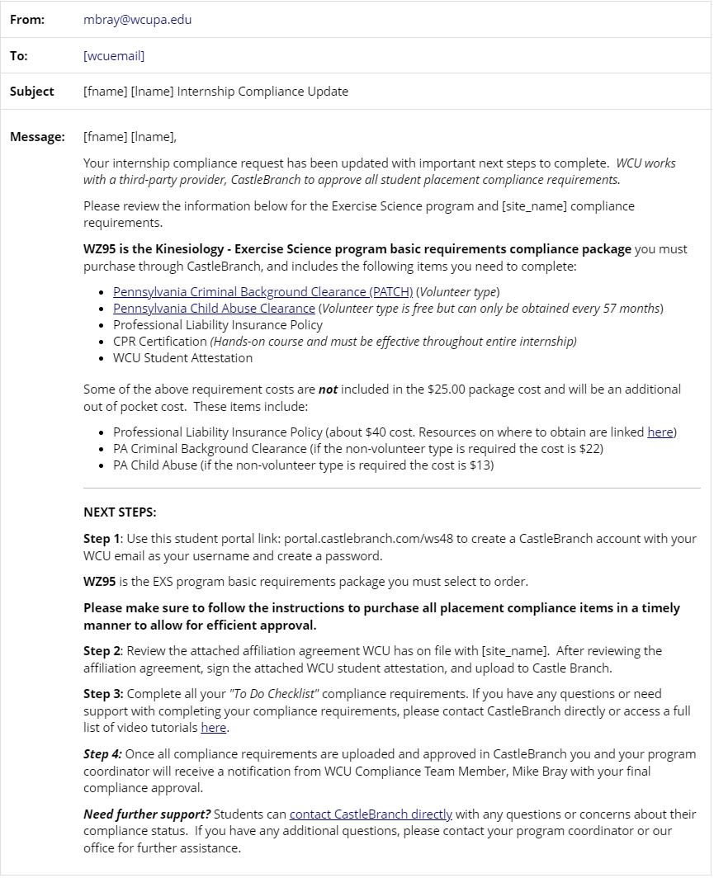
←
Email example of what students will receive from Mbray@wcupa.edu after the agreement is on file.
This email will list the basic package and any additional “add-on” packages that need to be completed to comply with program and site compliance requirements.

Slide 10


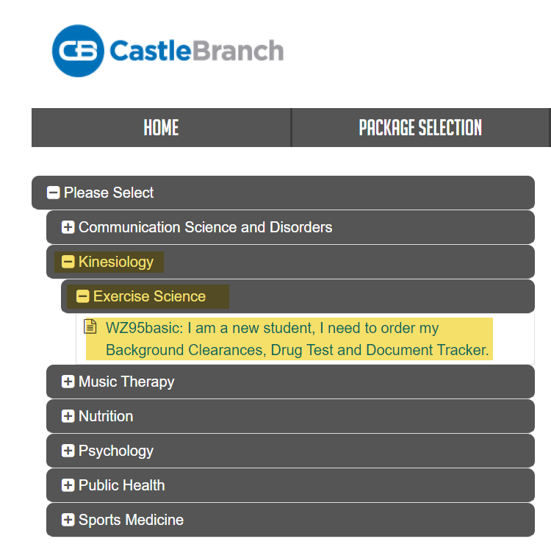
STEP 1: Click link to access CastleBranch and activate account - https://portal.castlebranch.com/WS48
Step 2: Place Order
Step 3: Select package
Step 4: Complete package order
*If an add-on package is required, students will receive separate email(s) to complete the add-on package order. Students will need to re-enter account information for each package purchased.

Slide 11
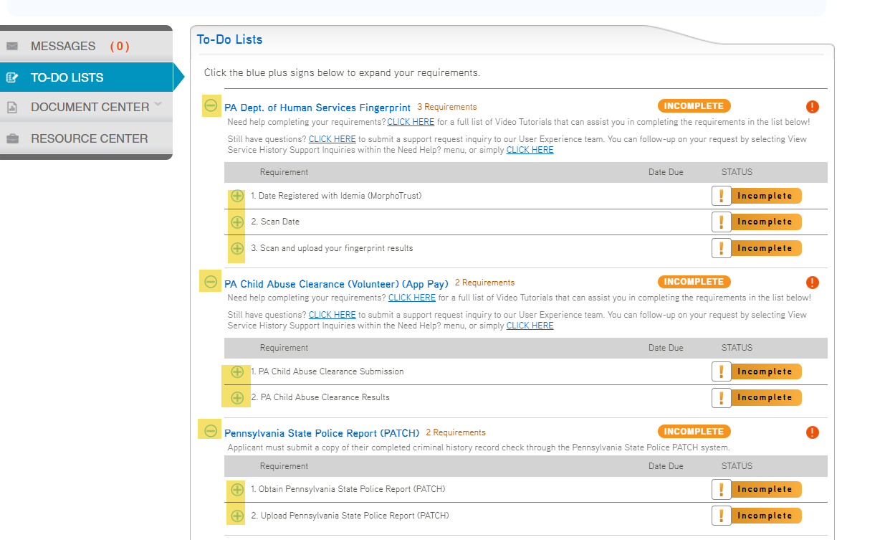
Step 4 (cont.): Submit Documentation to CastleBranch portal
Log into your CastleBranch account https://portal.castlebranch.com/WS48
Access your “To-Do Checklist”
Each requirement has a + icon that you click on to display all steps to complete the requirement.
Add-on packages will display on your To-Do list (if applicable)
Spring placements:
Documents are due the third week of November
Summer/Fall placement:
Documents are due the third week of April

Slide 12
Additional Documentation May Be Required (based on the agreement terms with your placement site)
In addition to the basic package, your site may require extra items to be completed.
These add-on packages are an additional cost on top of the basic requirement package.
If your internship site requires additional compliance items, you will receive an email from customerservice@castlebranch.com with the “add-on” packages to order and complete.
Add-on packages may include:
FBI Fingerprints (add-on $9 + cost of obtaining fingerprints)
Medical Requirements (add-on $38)
(MMR, Hep B, Varicella, Tdap, physical exam, TB test, COVID-19, Flu)
Drug Test (add-on $45)
It is the student’s responsibility to confirm with their site supervisor any other requirements the site may need prior to beginning on-site hours.

Slide 13
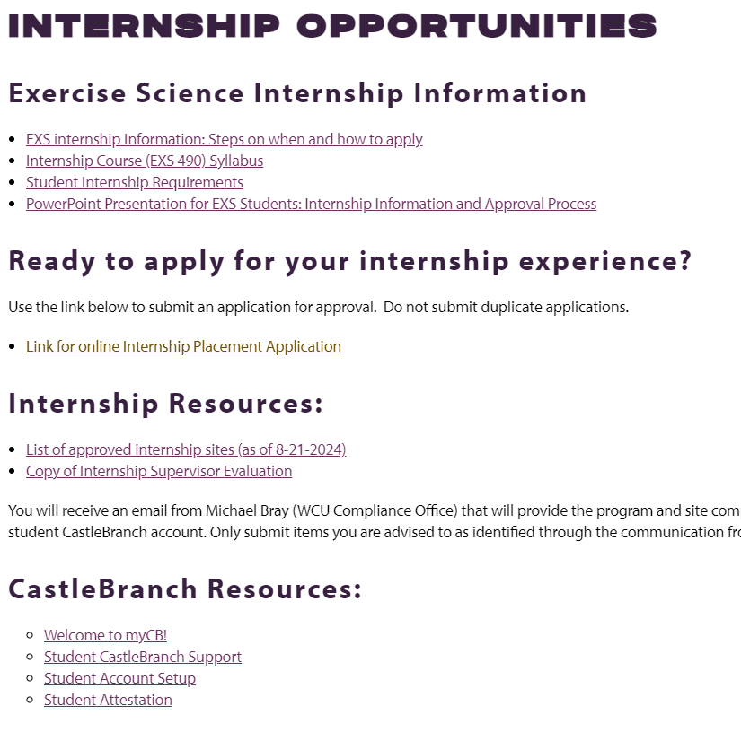
Students attest they understand their responsibilities of the internship experience and agree to comply with all ongoing requirements for placement by WCU and the internship site.

Slide 14
Any Questions?

Slide 15
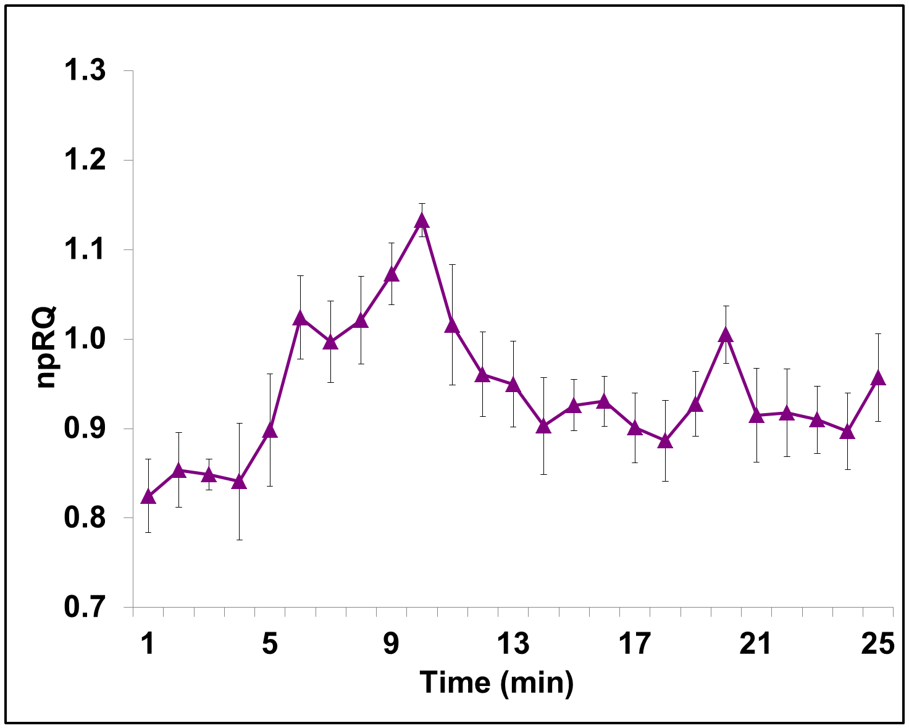
Step 5: Receive Official Approval from Dr. Whidden
When all your documents have been successfully uploaded and verified, you will receive an email from Dr. Whidden
The email will confirm that we will add EXS 490 to your schedule
Email heading: Approved EXS 490 Internship for ___________ semester
The email will also inform you that you can’t begin to intern at your site UNTIL you have met with your assigned EXS 490 professor to discuss the syllabus
Reminder: You CAN’T add EXS 490 to your schedule!

