Slide 1

WEST CHESTER UNIVERSITY POLICE DEPARTMENT COMMUNITY NEWSLETTER
Symptoms of Alcohol Overdose:
  Confusion, difficulty remaining conscious/awake, vomiting, seizures, slow breathing and heart rate, clammy skin, unresponsive to voice or touch and no gag reflex (prevents choking)
PA Good Samaritan Law:
  (a) A person may not be charged and shall be immune from prosecution... if the person can establish the following:
  (1) law enforcement officers only became aware of the person's commission of an offense... because the person transported a person experiencing a drug overdose event to a law enforcement agency, a campus security office or a health care facility; or
  (2) all of the following apply:
  (i) the person reported, in good faith, a drug overdose event to a law enforcement officer, the 911 system, a campus security officer or emergency services personnel and the report was made on the reasonable belief that another person was in need of immediate medical attention and was necessary to prevent death or serious bodily injury due to a drug overdose;
  (ii) the person provided his own name and location and cooperated with the law enforcement officer, 911 system, campus security officer or emergency services personnel; and
  (iii) the person remained with the person needing immediate medical attention until a law enforcement officer, a campus security officer or emergency services personnel arrived.
If you feel unsafe or have an emergency call 610-436-3311 or 911
Answer the call takers questions as best you can to help the officers get to you
Our police officers will work with our neighboring police departments for Homecoming weekend including PA State Police and Liquor Control Board Enforcement Officers

Slide 2

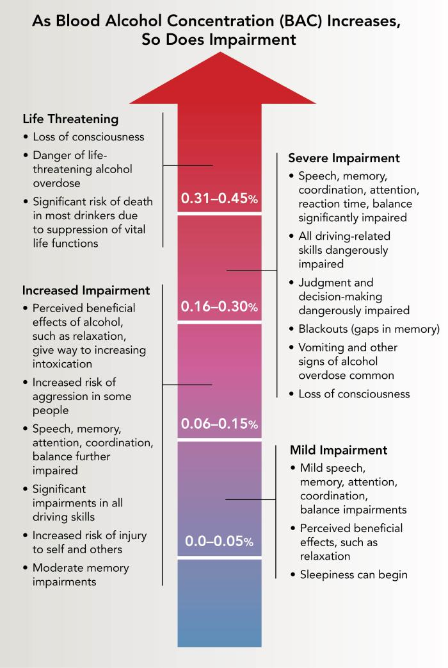
General Safety Tips for Homecoming
Know your surroundings
Stay hydrated with water
Know your limits
  Take breaks
Walk in groups
Keep phone charged
Ask to pet Pennsylvania state trooper horses before touching

