Slide 1
Gen Ed Portfolio q & a
Karen J Mitchell
Gen Ed Committee Chair
Gen Ed Council Director
Department of Special Education Retreat Aug 23, 2024

Slide 2
What is it and why should we do it?
Primarily academic portfolio
Created in Google Sites, not D2L or any other professional portfolio

Slide 3
What is it and why should we do it?
COLLECT
Gather Artifacts From Courses & Activities
CONNECT
Draw Links Across Courses, Seeing Academic Career Holistically
REFLECT
Think About What Is Being Learned and Why It Matters
CREATE
Forge a Digital Identity

Slide 4
What is it and why should we do it?
Required as part of 2019 Gen Ed Program
Considered High Impact Practice by AAC&U
Focus on Metacognition: Reflecting on one’s learning leads to more integrated and deeper learning, students make holistic connections across their classes

Slide 5
Faculty Responsibilities
Select an artifact(s) that meets the Gen Ed Goal(s) of your course
  Choose artifacts that are good representation of the competencies related to that goal

Slide 6
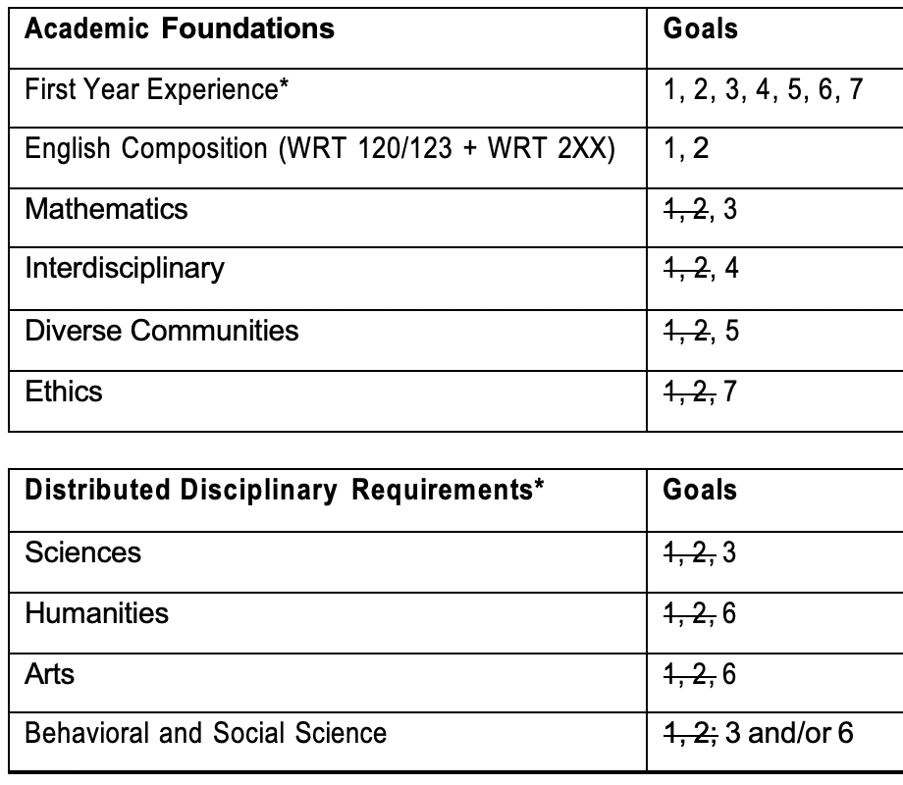
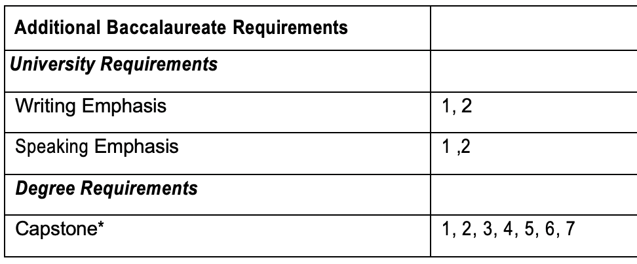
Standardized by FYE
Students should upload their Capstone Reflection Assignment

Slide 7
Faculty Responsibilities
Add syllabus statement: “You must upload [assignment name, or options] to your General Education Google Sites E-Portfolio so you will have it to reflect upon during your Capstone course. If you took FYE at WCU your first year, you should have created your portfolio then. If you have not previously created your portfolio in Google Sites for any reason, please follow these instructions for creating your Portfolio using Google Sites.” [https://d2l.wcupa.edu/d2l/le/content/2513024/viewContent/25587891/View]

Slide 8

Where can I find this information?

Slide 9
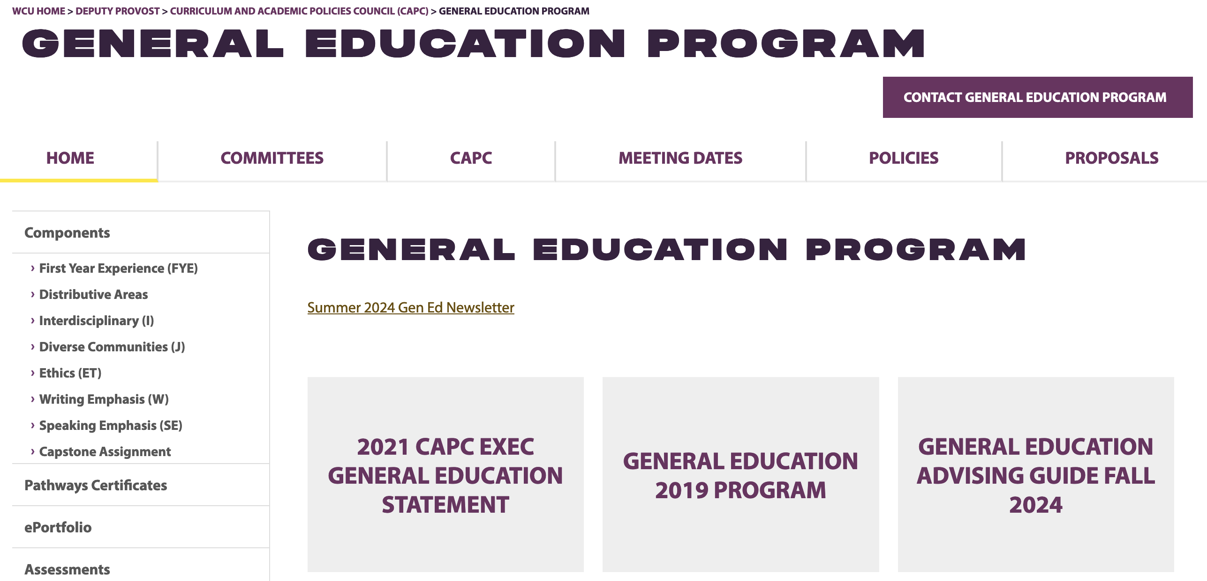
Where can I find this information?

Slide 10
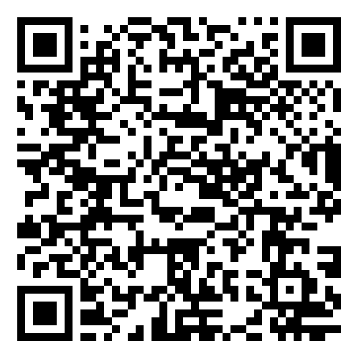
Help for students
For technical assistance in creating portfolios in Google Sites you can send students to Navigating Digital Learning (https://d2l.wcupa.edu/d2l/le/content/2513024/viewContent/25587891/View)
If students have trouble accessing or using Google Sites with their wcupa.edu accounts, refer them to the Help Desk

Slide 11
Help For Faculty
GEP Hub built in Google Sites will be one stop shop for faculty resources, launching this fall
For faculty questions, contact Janneken Smucker, ePortfolio Director (jsmucker@wcupa.edu)

