Slide 1
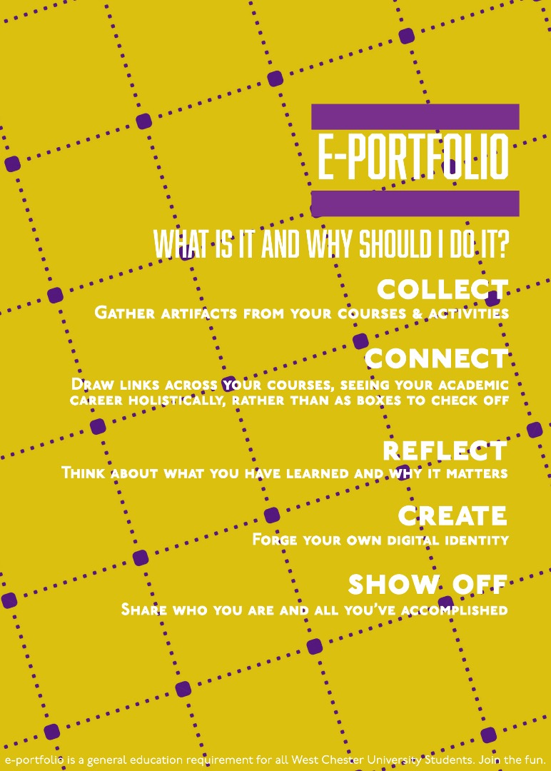
GENERAL EDUCATION PORTFOLIO
INFO SESSION/ Q&A
Janneken Smucker
Director of e-portfolio, West Chester University
Summer 2024
With advice and assistance from WCU’s e-portfolio team Maria Cabrera, Shannon Mrkich, Tom Pantazes + Ilknur Sancak-Marusa

Slide 2
Our Agenda
What is it?
Why are we doing it?
What’s my responsibility?
How do I get help?
Your Questions

Slide 3
What is it and why should I do it?
COLLECT
Gather Artifacts From Your Courses & Activities
CONNECT
Draw Links Across Your Courses, Seeing Your Academic Career Holistically, Rather Than As Boxes to Check Off
REFLECT
Think About What You Have Learned and Why It Matters
CREATE
Forge Your Own Digital Identity
SHOW OFF
Share Who You Are And All You’ve Accomplished

Slide 4
What is GEP?
Collection of assignments, at least one from each Gen Ed course, that demonstrate how students met Gen Ed goals
Built in Google Sites during FYE
Students review their portfolios during Capstone and complete reflection, varies by major

Slide 5
How we are implementing e-portfolio?
Introduced during First Year Experience, using Navigating Digital Learning tutorial. Students required to upload artifacts:
Four Year Plan
Statement of Purpose Video
General Education Courses throughout college career:
At least one artifact from each course designed to meet that course’s Gen Ed Goal; instructors may select which assignment or students choose; ideally, students should also reflect on the assignment, loading that reflection along with the artifact
Capstone Reflection requirement
Built in Google Sites, log-in with wcupa.edu email

Slide 6
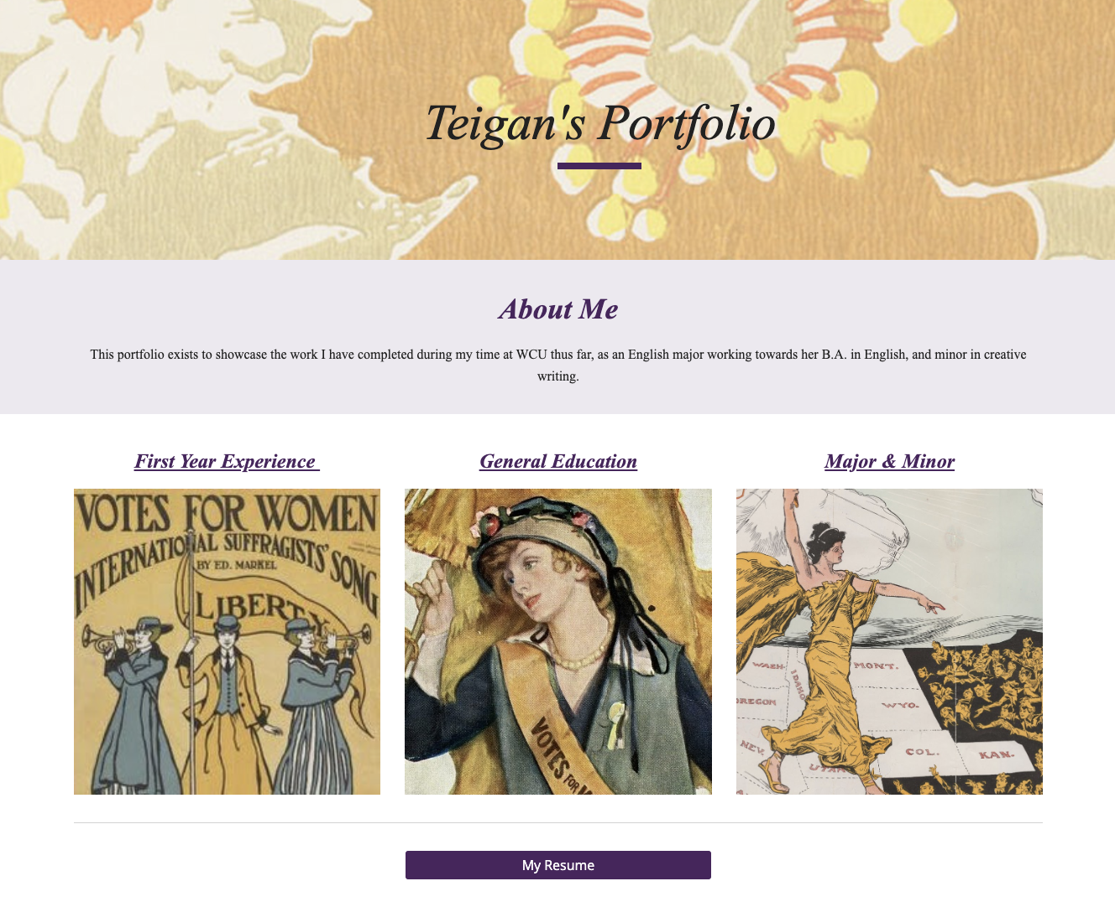
Example of GEP

Slide 7
Why are we doing it?
Required component approved as part of 2019 General Education package
Considered High Impact Practice by AAC&U
Focus on Metacognition: Reflecting on one’s learning leads to more integrated and deeper learning, students make holistic connections across their classes

Slide 8
Why Metacognition?
Miller, Ross, and Wende Morgaine. “The Benefits of E-Portfolios for Students and Faculty in Their Own Words.” Peer Review 11, no. 1 (Jan 2009): 8–12.
“Reflection on work saved in e-portfolios can
build learners’ personal and academic identities as they complete complex projects and reflect on their capabilities and progress,
facilitate the integration of learning as students connect learning across courses and time,
be focused on developing self-assessment abilities in which students judge the quality of work using the same criteria experts use,
help students plan their own academic pathways as they come to understand what they know and are able to do and what they still need to learn.”

Slide 9
What’s my responsibility?
Select an artifact that meets the Gen Ed Goal of your course for students to upload to GEP, or give students a choice among several artifacts
Add syllabus statement: “You must upload [assignment name, or options] to your General Education Google Sites E-Portfolio so you will have it to reflect upon during your Capstone course. If you took FYE at WCU your first year, you should have created your portfolio then. If you have not previously created your portfolio in Google Sites for any reason, please follow these instructions for creating your Portfolio using Google Sites.”

Slide 10
What’s my responsibility?
Consider adding a reflection component to accompany the artifact; does not need to be graded
Remind students to upload their artifact to GEP; you may, but are not required to, incentivize GEP uploading by making it a graded assignment or offering extra credit if students share the link to the GEP
Point students without GEPs (including transfer students) to the GEP tutorial site

Slide 11
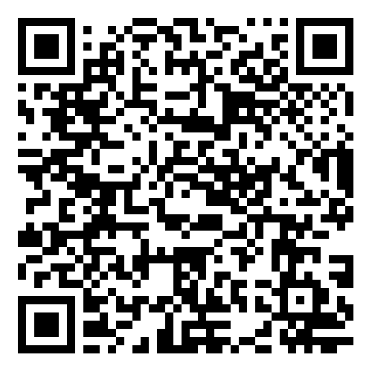
How do I get help?
For technical assistance in creating portfolios in Google Sites see Navigating Digital Learning (link in chat or by following QR code)
If students have trouble accessing or using Google Sites with their wcupa.edu accounts, refer them to the Help Desk
GEP Hub built in Google Sites will be one stop shop for resources, launching this fall
If all else fails, contact me! jsmucker@wcupa.edu

