Slide 1
Capc kick-off meeting
Fall 2022

Slide 2
How CAPC Works

Slide 3
WHAT IS “CAPC”?
CAPC is the Curriculum and Academic Policies Council
CAPC is a faculty legislative body, the only such body with authority to recommend changes to (or creation of) the curriculum and/or academic policies
CAPC is a recommending body; the Provost has sole authority other the curriculum and academic policies

Slide 4
Why are we here?
…because CAPC is the curricular body mandated by the CBA (Article 31 section E):
“There shall be a curriculum committee at each University, which shall be selected as determined by the FACULTY, but which may include at least one (1) administrator if designated by the President.”

Slide 5
Why are we here?
CAPC is governed by a set of bylaws that lay out the committee structure, duties, and processes that comprise the foundation of CAPC’s work
APSCUF runs elections for CAPC, which involve both at-large and department-specific members.
Members are elected to do the following:
participate in CAPC’s decision-making processes around curriculum and academic policies, through the committee structure
report back to their constituencies (department, college, etc.) about CAPC processes and actions
department-specific members also provide support and guidance for colleagues developing curriculum proposals for submission to CAPC, e.g., about learning outcomes, CIM, etc.

Slide 6
How CAPC Works
Participation in decision-making processes happens through:
work on committees and subcommittees
monthly CAPC General Assembly meeting where decisions are made on the proposals sent up by the committees

Slide 7
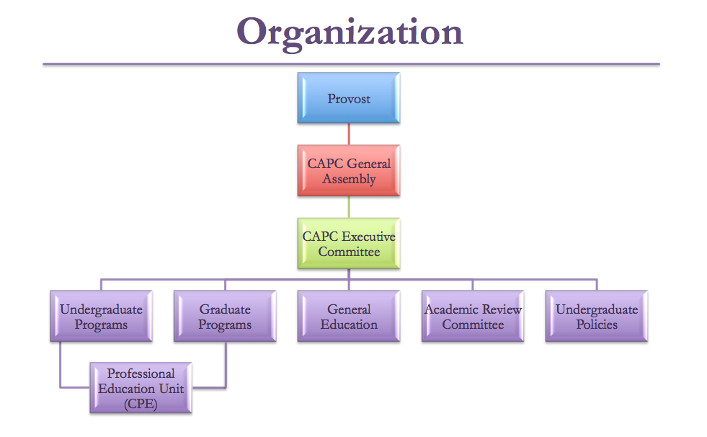
How CAPC Works

Slide 8
How CAPC Works
Several CAPC Committees have subcommittees:
General Education
Distributives
Diverse Communities
Ethics
Interdisciplinary
Speaking Emphasis
Writing Emphasis

Slide 9
How CAPC Works
Several CAPC Committees have subcommittees:
Academic Review
Course Review and Revalidation
Low Enrollment Advisory
New Programs Advisory
Program Review
Undergraduate Programs
Culture Cluster

Slide 10
2022-23 CAPC Executive committee
Chair: Susan Johnston, Anthropology & Sociology
Vice Chair: Rodney Mader, English
Secretary: Francis Atuahene, Undergraduate Studies & Student Support Services
Undergraduate Programs: Josh Auld, Associate Provost for Academic Affairs
Undergraduate Policies: Elizabeth Pfaffle, Applied Music
Graduate Programs & Policies: Lisa Calvano, Dean of the Graduate School
General Education: Karen Mitchell, Psychology
Academic Review: Jade Burris, Early & Middle Grades Education
CAPC Support: Patrick Richard, Academic Affairs

Slide 11
How CAPC Works
You should know your assigned committee(s) by now. If not, they can be found at the CAPC website
Committees should meet on a regular schedule
Your service on CAPC includes attendance at both Assembly meetings and committee meetings
If you cannot attend, your proxy should attend on your behalf – applies to both Assembly and committee meetings
The bylaws require all CAPC members to have a proxy identified in advance of meetings

Slide 12
How CAPC Works
Article 4.A.1.c.
“Each CAPC member will submit to the CAPC Secretary written notification of that member’s proxy. In the case of members elected by constituency, the proxy must be selected from the same constituency. Proxies should be identified no later than the first scheduled Assembly in the fall. Should the proxy require an alternate, the proxy or member should notify the Recording Secretary in writing prior to the Assembly in which the alternate is to serve.”

Slide 13
How CAPC Works
Your service on CAPC also includes the following:
preparing for committee and sub-committee meetings by reading in advance and reflecting on all documents on the agenda
preparing for CAPC Assembly by reviewing in advance those items on the agenda that did not come from your committee
ensuring that you are fully acquainted with the current requirements for course and program proposals, including the relevant policies (syllabi, course evaluations, etc.)

Slide 14
How CAPC Works
Part of your duty as a CAPC member is to represent your constituency, and this means reporting back to them about CAPC Assembly and its procedures, debates, and recommendations.
This includes CAPC decisions about courses, programs, or policies that may have impact on your department (or your other constituencies), whether or not they originated in your department or college
You should also let your constituents know when an item of theirs appears on the Assembly agenda and remind them that they are invited to attend the relevant assembly meeting to respond to questions that might arise

Slide 15
How CAPC Works
NOTE: When a committee has sent an item forward for the Assembly agenda, it is with that committee’s approval (unless explicitly stated otherwise).
Similarly, when a department chair, dean, or CAPC officer ‘signs off’ on a proposal in CIM, it indicates approval (not simply acknowledgment)
That said, deans may assume they are leaving curricular decisions to the departments and to CAPC, and are only approving the availability of resources and other non-curricular issues
In point of fact, a decision at each step in the review process is to recommend (or not), since final approval rests with the Provost

Slide 16
How CAPC Works
Motions passed by CAPC are submitted to the Provost for approval. She makes the ultimate decisions regarding curriculum and academic policy.
There is a procedure for dialogue in the event that the Provost does not approve CAPC recommendations. This is rare, however.
The Provost’s approvals are circulated by Patrick Richard and are available on the CAPC website.

Slide 17
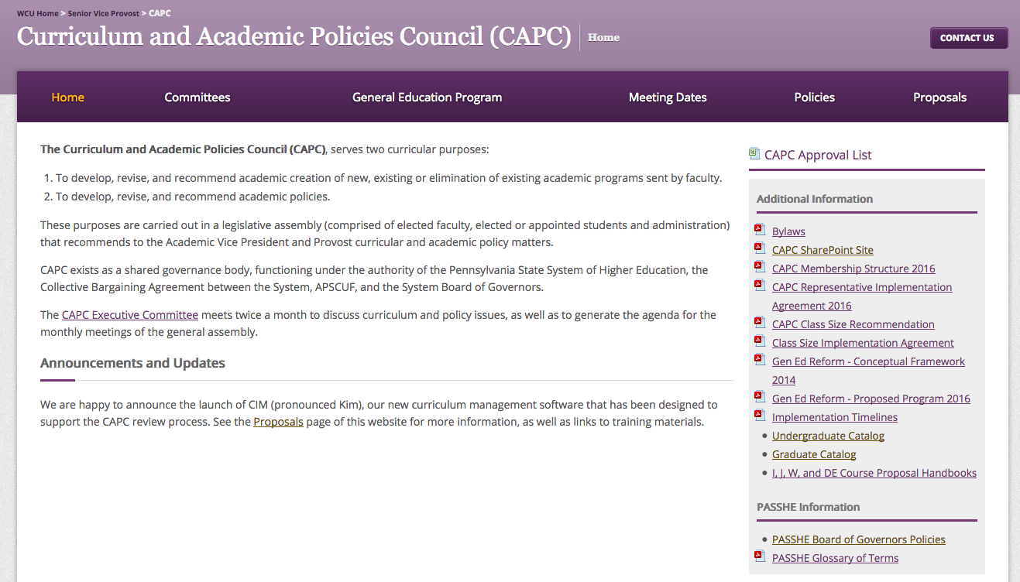
CAPC website
https://www.wcupa.edu/viceProvost/capc/

Slide 18
REMEMBER…
In summary:
CAPC is a contractually mandated representative body that gives faculty significant control over the curriculum.
At WCU, we have it a lot better than many other places, including some in PASSHE
As CAPC representatives, we have an obligation to responsibly carry out our mandate on behalf of the faculty and departments we represent

Slide 19
How cim Works

Slide 20
CIM: Course inventory management
https://www.wcupa.edu/viceProvost/capc/

Slide 21
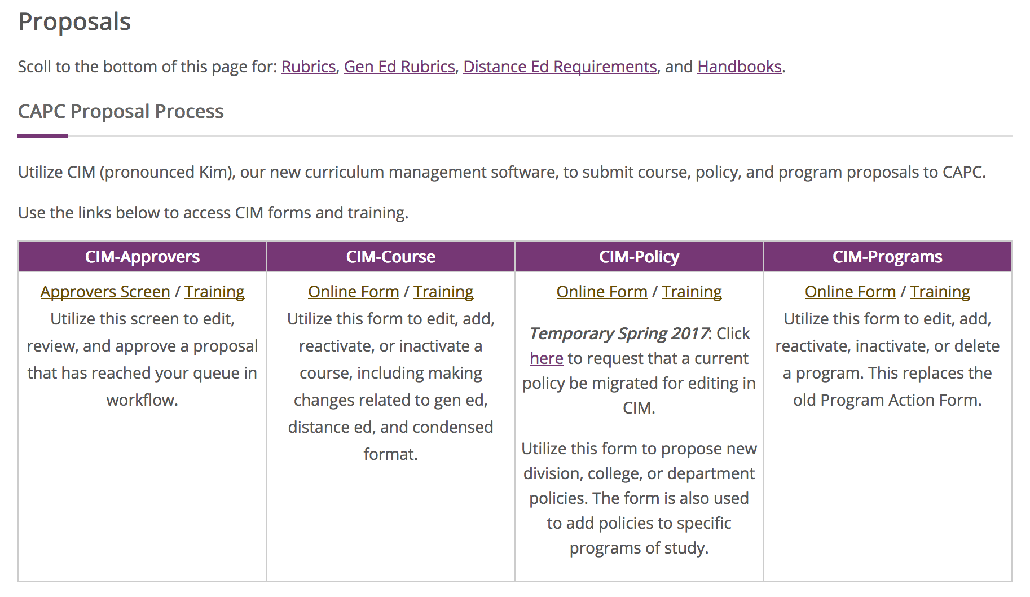
HOW CIM WORKS

Slide 22
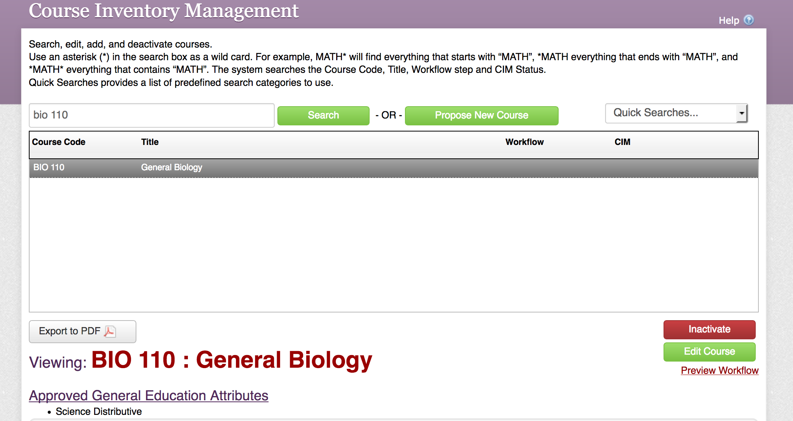
HOW CIM WORKS

Slide 23
HOW CIM WORKS

Slide 24
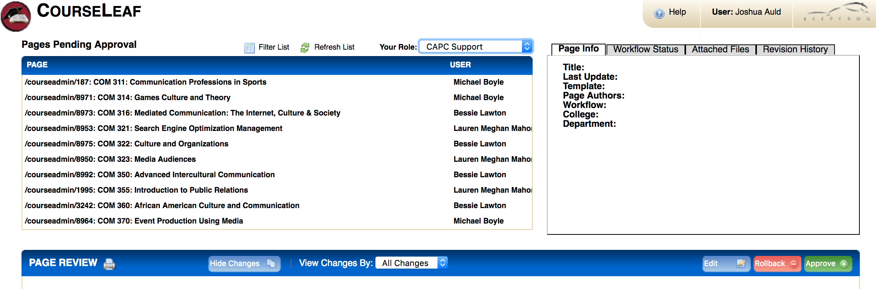
HOW CIM WORKS

Slide 25
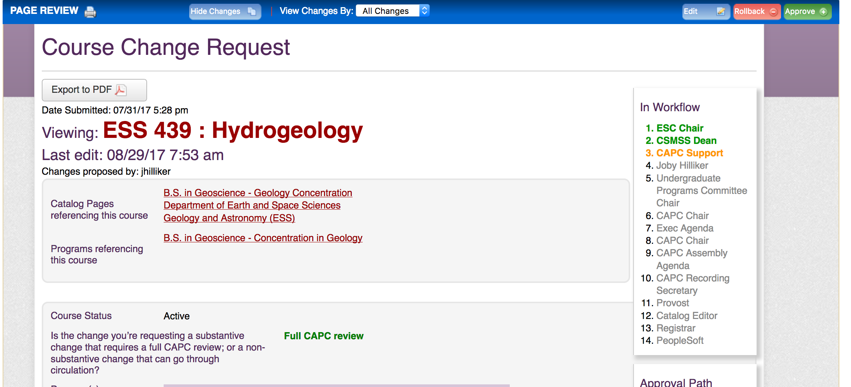
HOW CIM WORKS
Note: Email notifications (approval requests & notifications) come from “Patrick Richard”

Slide 26
HOW CIM WORKS

Slide 27
CIM OPEN LABS
Tuesday, Sept. 6, 2-4, Philips Lower-Level Conference Room
Wednesday, Sept. 14, 11-1, via Zoom (email was sent out by Patrick with link)

Slide 28
Recent updates & Efforts for this year

Slide 29
Progress toward academic program compliance – Spring 2022
PASSHE Minor Policy Requirements
Students must complete a minimum of six credits of advanced standing courses as part of the minor
Academic Minors must not include concentration, tracks, emphasis, specializations (reserved for academic majors under PASSHE policy)
WCU Interim Policy Framework, approved May 2022
Advanced standing = any 300-400 level course, and 200 level courses with at least 2 prerequisites (identified by depts)
Prerequisites for specified required courses must be listed in the minor and counted toward total credits
Removal of terminology like ‘concentrations’, ‘tracks’, etc. from minors; replacement with ‘focus areas’ or ’electives’

Slide 30
general Education program & additional baccalaureate requirements (May 2022)
General Education Program
ACADEMIC FOUNDATIONS:
First Year Experience requirement | 4
English Composition requirement | 6-7
Mathematics requirement | 3-4
Interdisciplinary requirement (I) | 3
Diverse Communities requirement (J) | 3
Ethics requirement (ET) | 3
DISTRIBUTED DISCIPLINARY FOUNDATIONS:
Science requirement | 6-8
Behavioral and Social Science requirement | 6
Humanities requirement | 6
Arts requirement | 3
TOTAL CREDITS | 43-47

Slide 31
general Education program & additional baccalaureate requirements (May 2022)
Additional Baccalaureate Requirements
UNIVERSITY REQUIREMENTS
Writing Emphasis requirement for all Baccalaureate Degrees (W) | 9
Speaking Emphasis requirement for all Baccalaureate Degrees (SE) | 9
DEGREE REQUIREMENTS
Language and Culture requirements for certain Baccalaureate Degrees | 0-15
Capstone Requirement | 1-15

Slide 32
Efforts this year
Academic Programs & Policies
Continue development and review of comprehensive
Undergraduate Academic Programs Policy
Graduate Academic Programs Policy
Revisit/complete work on other academic policies in need of updating
Ensure undergraduate major and minor programs comply with existing PASSHE policy and local definitions
Minor programs: 6 cr. advanced standing; no hidden pre-reqs; no tracks; concentrations etc.; minimum 18 cr.
Major programs: BA no more than 42 cr. required and cognate courses; BS no more than 60 cr.

Slide 33
Efforts this year
General Education (GE) and General Requirements
Re-envisioning the Interdisciplinary requirement
Temporary suspension of new Interdisciplinary (I) course proposals while this is in process
Writing Emphasis course revalidation AY22-23
Call for GE Capstone Assignments AY22-23
Campus-wide roll-out of Google Sites as the Gen Ed e-Portfolio platform; identification of artifacts for the e-Portfolio across Gen Ed courses
Ongoing: Gen Ed courses that come through the proposal review process, regardless of rationale, will be reviewed under the current GE goal and SLO structure

Slide 34
Efforts this year
Diverse Communities Task Force 2021-2022
Report received this month and will be reviewed by Exec for appropriate follow-up via CAPC process
DE Training Task Force, Summer 2022
Report anticipated soon and will be reviewed by Exec for appropriate follow-up via CAPC process
Bylaws
We have entered into conversation with APSCUF about renewing the bylaws; current version is 10 years old and needs updating

