Slide 1
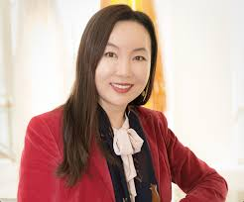
Dr. Oh wins award for research!
The Academic Recognition Committee
has designated
Dr. Jea Sophia Oh
as the 2024 recipient of the
Distinguished Research Award.
This award is an expression by her peers of their respect for her and her contributions to the University.
Official presentation of this award will be made during the December 2024 undergraduate commencement ceremonies.

