Slide 1

WCU Navigate Progress Reports

Slide 2
What is WCU Navigate?
WCU Navigate(EAB Navigate) is a Student Success & Engagement Platform
The platform helps improve collaboration between support offices and cuts down on sending multiple spreadsheets and emails across campus.
It is a space for instructors, advisors, staff, administrators, and students to proactively support and empower students throughout their academic and personal journey.
Notes:
Nanook Navigator (EAB Navigate) is a Student Success Management System. See the handout “INSIDE NAVIGATE: EAB’s Student Success Management System” for more information.
The purpose of Nanook Navigator is to provide a collaborative space for instructors, advisors, staff, administrators, and students to proactively and holistically support and empower students throughout their academic journey.
Nanook Navigator has three areas: strategic care, smart guidance, and intelligence.
Strategic Care (Fall 2017 to current): is designed to support the holistic development of students and meet evolving expectations of care. This student success collaborative technology supports areas beyond advising, it coordinates diverse activities and creates a culture of care that is unified, responsive, and student-centered. Through the strategic care features UAF is able to expand students’ coordinated care network from professional advisors to instructors, faculty advisors, tutoring, residence life, career services, financial aid, athletics, CARE team, and many other student support teams.
Smart Guidance consists of Milestone Guidance (Mobile App) and Academic Planner.
Milestone Guidance (releases Fall 2022): The Navigate mobile app provides a structure for the college journey and proactive guidance at students' pivotal moments. Nanook
Academic Planner (pilot releases Fall 2022): a tool students use to plan, schedule and register classes for their current and upcoming terms.
Intelligence (Fall 2017 to current): Nanook Navigator’s student success analytics, success markers, and predictive modeling help administrators understand which interventions are working and how to best adjust our strategy.

Slide 3
What are Progress Reports?
Progress Reports are an early-alert mechanism
Connects students with resources to support their success
Celebrate the progress and success students are having
Can be done for specific classes
Can be done for cohorts of students

Slide 4
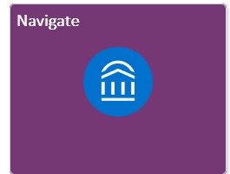
Accessing Navigate
An email is sent directly to instructional faculty, which has a link to the Progress Report. No need to log in to Navigate
If you want to add an Adhoc Alert, Referral, or Kudo after the Progress Report period you can access Navigate from the MyWCU dropdown on the WCU website, look for the Navigate Tile.
Use your WCU username and password to access Navigate

Slide 5
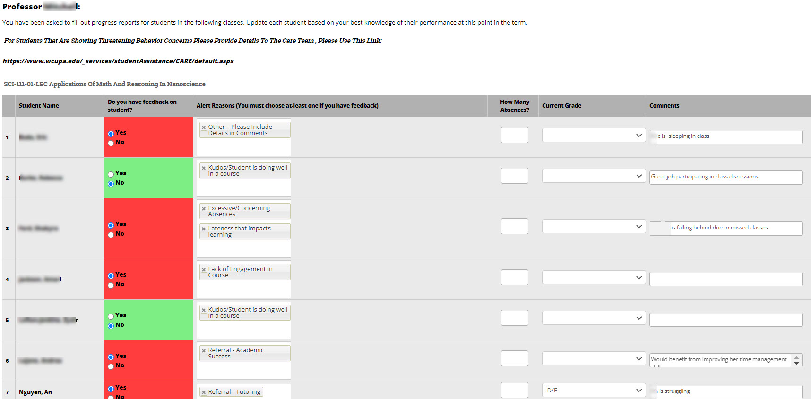
Progress Reports
Always say “No” to feedback questions when giving a Kudo
Notes:
Unites student success teams to deliver proactive, holistic support to students.
Eliminate completion barriers through feedback and proactive engagement
Identify and prioritize students that are at academic risk and require immediate intervention.
Provide proactive care that is accessible to all student success members support students
Simplified student outreach.
Coordinate proactive early alerts campaigns and student outreach.
Create a holistic view of the student’s academic progress.
Easy appointment scheduling and record-keeping, such as flagging students who are no-shows for appointments.
User-friendly search tools and reports.
Support students with technology-enabled advising
Build belonging and academic confidence
Collect additional data and make data-driven decisions
Gather user-friendly data that support each department, school, or college efforts to communicate directly with their students.
Searchable enrollment data, as well as comprehensive parameters in the search functionality, allow for extremely targeted reporting and the ability to gain insight into students enrolled in their programs.

Slide 6

Alerts, Referrals, Cases, and Kudos
Alert: Add an indicator to student record
Alerts are added to student profiles for a support network to see
Alerts can be queried for reporting purposes.
Cases: Similar to alerts but require a staff member to close the case via follow-up.
Referral: a way for faculty to automatically link students with campus resources.
Referrals need to be closed by the appropriate care team
Kudos: way to say job well done, keep it up!

Slide 7
Tips & tricks: progress reports and alerts
Reach out
Reach out by using Alerts in the Progress Report and Adhoc alerts throughout the year
Provide
Provide as much information as possible in the comments section
Use
Use the most appropriate alert/feedback reasons
Notes:
Reach out to the student before submitting feedback (texting is available through Nanook Navigator)
Submit urgent concerns within the first 3 days of progress reports going live and using the “save as you go” submit option. Keep these open for other students who may be of concern by the progress report close date.
Provide as much information as possible in the comments section for the advisor or staff member managing the student case.
details about concern/feedback
outreach method completed (email, text, call, in-person)
student response to outreach
what can be done about the concern (submit a late assignment, attend tutoring, etc)
will the instructor accept work, be flexible
recommendations for the advisor and student
best option for the student to connect with the instructor (in class, office hours, appointment link)
if the student will be dropped or withdrawn from the course
Use the most appropriate alert/feedback reasons (“other” is difficult without additional context)
Reach out to Jessica for support and questions anytime
TAs who are the instructor of the course are able to complete progress reports. TAs not on record can not access progress reports, but can complete alerts with additional permissions.

Slide 8
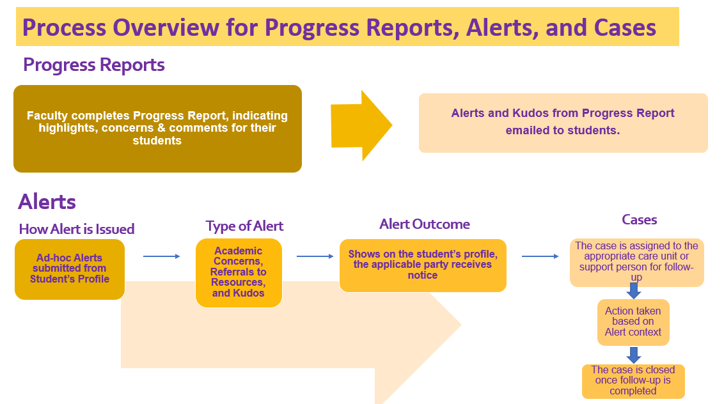
Notes:
Red are urgent signs the student is in need of support.
Yellow are signs the student may need additional support now and in the future
Green are kudos you can provide to the student to provide positive feedback

Slide 9
Navigate Support
Website: www.wcupa.edu/Navigate
Training Site: https://www.wcupa.edu/academicEnterpriseSystems/training/navigateTraining/default.aspx
Technical Support: Navigate@wcupa.edu
Notes:
I am Jessica Skipper and I am UAF’s Student Success Coordinator. I am also the Nanook Navigator application administrator. Feel free to contact me with any questions at this email address or phone number. I am also on google chats as well. I have been with UAF since 2017, where I started in the Provost’s Office but wanted to be close to students and in a position I could more directly advocate for student success and university cultural changes. I have a BA in Psychology from the University of Montana, Missoula and my MPA with a Higher Education concentration for University of Alaska Southeast.
I welcome you all to Nanook Nation and I look forward to getting to hear your stories and assist you with student success technology.

