Slide 1


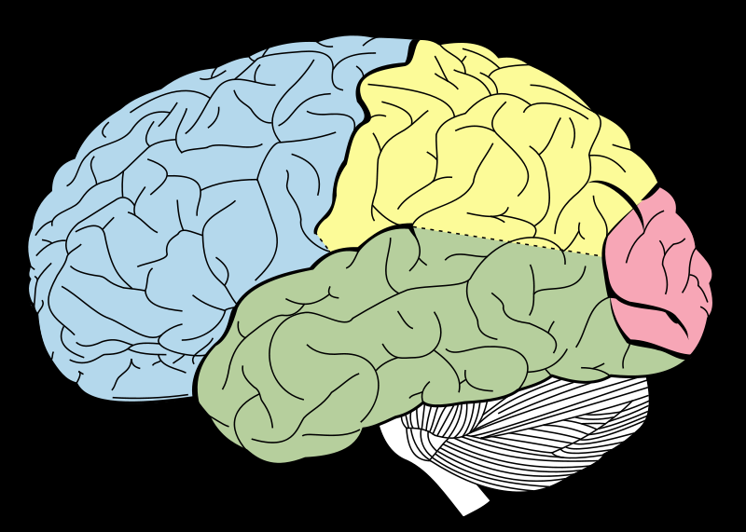






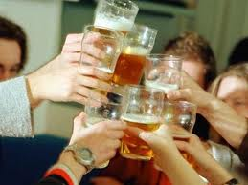
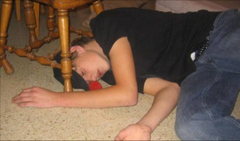
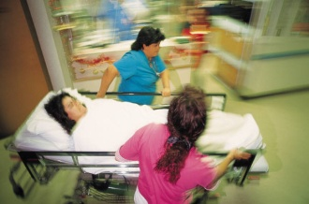
Stage 2: Excitement
Stage 3: Buzzed/Drunk
Stage 4: Very drunk
Social
Intelligence
Motor
coordination
Starts .03-.06
Starts .08-.09
Sensory
Coherence
Inhibitions/Judgment
Starts .14-.17
Starts .01-.03
Stage 1:
Relaxed/
Euphoria
Memory
Creation
Balance,
breathing, heartbeat
Starts .20
Starts .30
Stage 6:
Coma,
Death
Stage 5:
Stupor/
blackout
Notes:
ALL BEHAVIORS DUE TO ALCOHOL EFFECTS ON Central Nervous System. Alcohol=depressant=slowing/depression of CNS
Stage 1: First site of alcohol action: pre-frontal cortex (also still developing in a big way through age 25). May want to discuss briefly: executive function: planning, organizing, synthesizing. This is the “super ego”- keeps an eye on us and prevents doing and saying stupid things.
With a drink or 2:Relaxed
Effects are progressive and cumulative, moving from front to back (high level/complex thinking to lower level and automatic like breathing)
Stage 2: BAL ~.03-.06
Increased Sociability, talkativeness
Increased self-confidence
AND
Decreased inhibitions
Decrease in attention, judgment and control
Beginning of sensory-motor impairment
Loss of efficiency in finer performance tests
Generally do not do anything stupid or regrettable. Frontal lobe still working.
STAGE 3: BAL ~.08-.09 Remember, this is cumulative. Alcohol is loading from the front.
(can vary per individual)
Emotional highs and lows
Loss of critical judgment
Impairment of perception,
memory and comprehension
Decrease sensory response; increase reaction time
Vision may start to blur
Impaired balance and coordination
Drowsiness
IMPORTANT to note that the pre-frontal area (that usually helps us keep an eye on ourselves) starts shutting down.
STAGE 4 .14-.17
Disorientation & Dizziness
Exaggerated emotional states
Loss of critical judgment to figure out what is safe/not safe OR good idea vs. not
Disturbances of vision
Increase pain threshold
Decreased muscular coordination; staggering gait; slurred speech
Apathy, lethargy
STAGE 5 .20 -.25 BLACKOUTS COMMON. All mental, physical, and sensory functions are severely impaired. The person is emotionally numb. There's an increased risk of asphyxiation from choking on vomit and of seriously injuring yourself by falling or other accidents. Vomiting and incontinence can occur.
STAGE 6 ~.30 +
.35 is level of surgical anethesia.
All conscious activity is blocked. Breathing and heart rate are slowed due to depression of these brain areas by alcohol
Danger of cardiac and/or respiratory arrest (death)

Slide 2
Stage 2: Excitement
Stage 3: Buzzed-Drunk
Stage 4: very drunk
Social
Intelligence
Motor
coordination
Starts .03-.06
Starts .08-.09
Sensory
Coherence
Inhibitions/Judgment
Starts .14-.17
Starts .01-.03
Stage 1:
Euphoria/
Buzzed
Memory
Creation
Balance,
breathing, heartbeat
Starts .20
Starts .30
Stage 6:
Coma,
Death
Stage 5:
Stupor/
blackout
Notes:
Use this slide to discuss:
We talked about good things and less good things. Which part of the brain do you think is related to each?
When you drink, which part of your brain do you want to completely protect? Which part are you OK with being affected by alcohol?

