Slide 1


Job Search Basics

Slide 2
FIRST STEP, SELF-EVALUATION
How can you know what to search for,
without first knowing yourself?
  Are their specific industries or roles you are interested in?
  What are your top skills you will be using on the job?
  Are you looking at local opportunities only? Or to relocate?
  What are you passionate about as you begin your career journey?
  Are there certain values that are important for you to see reflected in the job? (Ex: work life balance, giving back to the community, changes for quick upward movement)
  Where do you see yourself in five years?
Notes:
Script: It is challenging to begin an internship or job search without knowing a few things about your career goals. You may not be able to answer all of these questions and that is okay. Start reflecting on those you can answer and exploring those question that you are unsure about. A base level of self-reflection will make your search process easier.

Slide 3
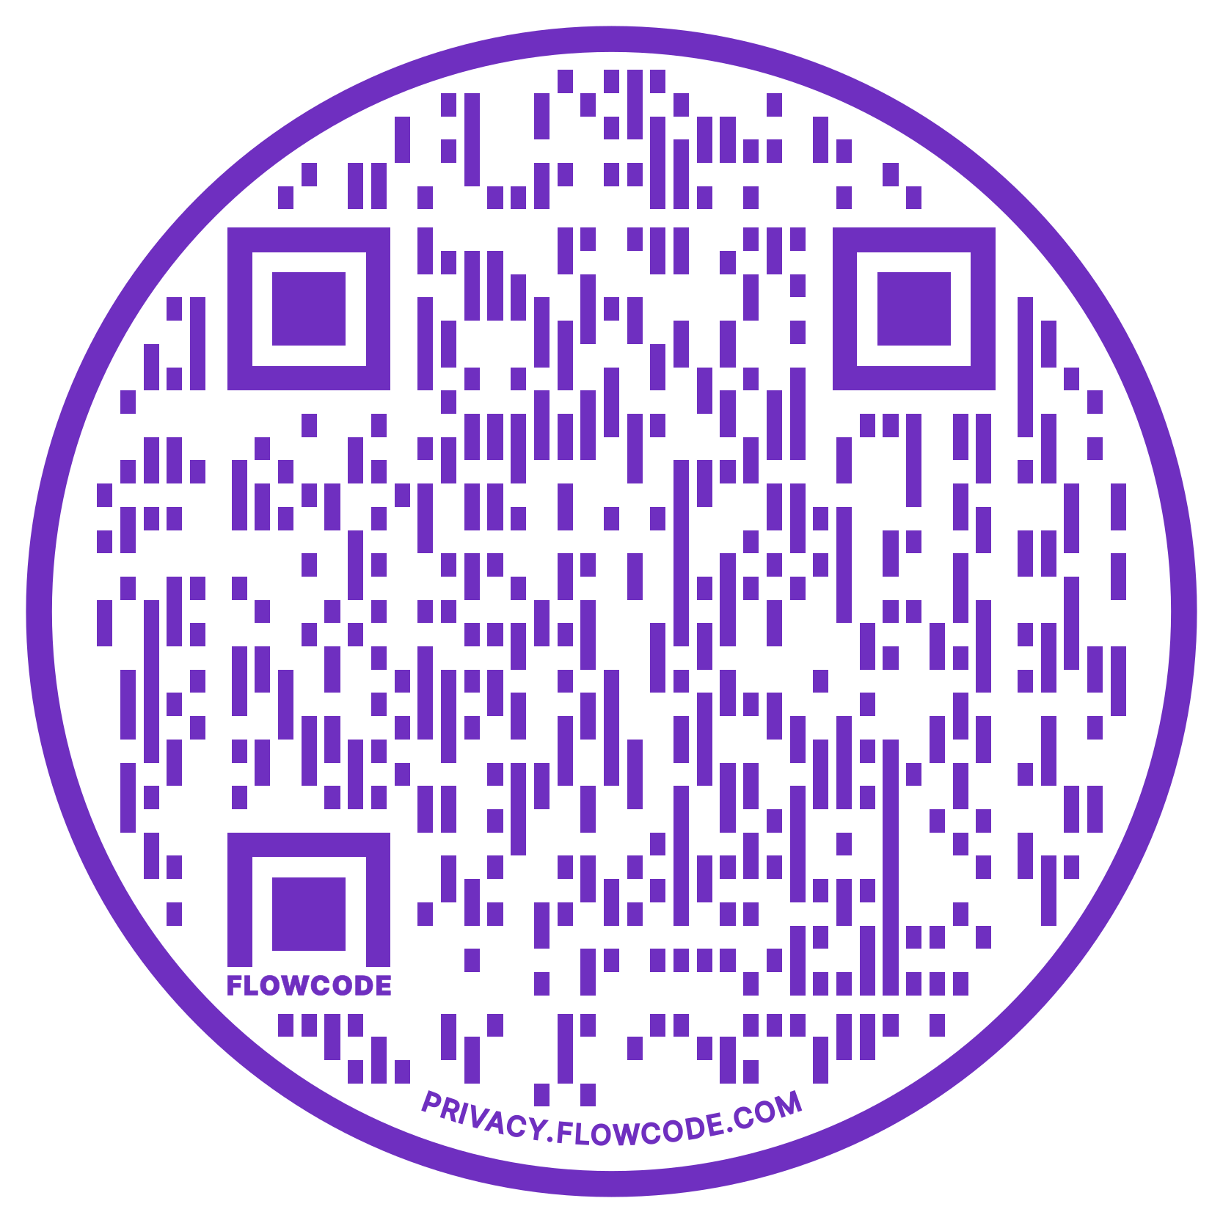
Reactive Search Methods
Large Scale Job Boards
Geographically/Industry Specific Boards
Professional Organizations/Associations
Organization/Company Websites
Check out where new graduates are finding work!
wcupa.edu/outcomes
Notes:
Script: Let’s talk about the two categories where job search methods fall into. First, are reactive search methods. This is where you are reactive to an opportunity that is available and publicly posted. For this method it is good to use a mix of sources from large scale job board to direct company human resources pages. You can also explore where past WCU graduates have found work and research those employers for any current opportunities.
Most people spend the majority of their search using reactive methods. While they are necessary, they should not be the only method you use and should be balanced with Proactive Methods.

Slide 4
LinkedIn
Professional Associations
& Conferences Events/Engagement
Informational Interviews
Career Fairs
Networking
PROACTIVE
Job & Internship Search
METHODS
Notes:
Script: Proactive methods are grounded in the idea that making connections with people can create a stronger lead to openings (some that may not even be publicly posted) and allow your personal story or brand to make more of an impact (being more than just a resume in a large stack). As you can see these methods are creating opportunity to make career connections and network. The great thing about proactive methods are they are helpful not just for your current search but for you continued career development and future searches.

Slide 5
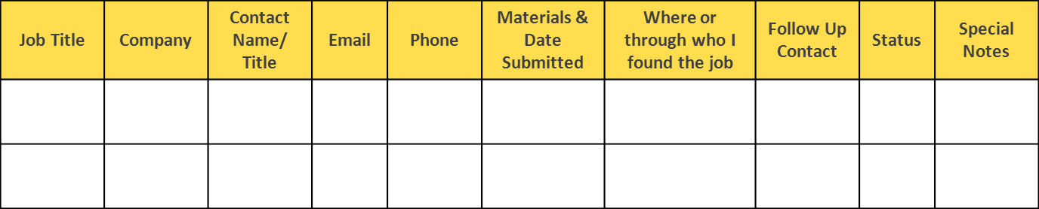
General Tips
Stay organized
Be timely
Know that rejection is part of this process
KEEP A POSITIVE OUTLOOK
  With every ‘no’ you are a step closer to a ‘YES’!
Notes:
Script: A few things to keep in mind as you search:
Good organization will help. You will be managing your access to a lot of different websites, connecting with many new people, and handling various communications happening all at once. Find your personal way to maintain your contacts, deadlines, and other items.
Make sure you are keeping track of emails and phone calls/voicemails in order to quickly response to things related to the search and interviews
You will hear no before you hear yes. Try to keep a positive outlook and lean on your support system when you need to.

Slide 6

Don’t Forget…
Resumes
Cover letters
Interviews
Job offers
Negotiations
…are all part of the
search process too.
Notes:
Script:
In order to successfully search, you will need to prepare a resume/cover letter, practice interviews, and understand the job offer process. It is more than just applying to things online. Remember the career center can help with all of these items AND their services are available to you as a WCU alum.

Slide 7


Visit the CDC!
The Career Development Center is here to support you through the search process!
Our office can help prior with all elements of the search, application, and interview processes.
The CDC website has great resources for resume development, interview prep, and more. Visit: wcupa.edu/cdc
SCHEDULE 1-1 APPOINTMENT
CHECK OUT EVENTS
Get help with any career need by meeting with a career counselor.
Career fairs, industry meet ups, employer tables and more!
Visit wcupa.joinhandshake.com
Notes:
Script: Do not be overwhelmed! - YOU ARE NOT ALONE and visit the Career Development center for individualized help with any of your career needs.

