Slide 1

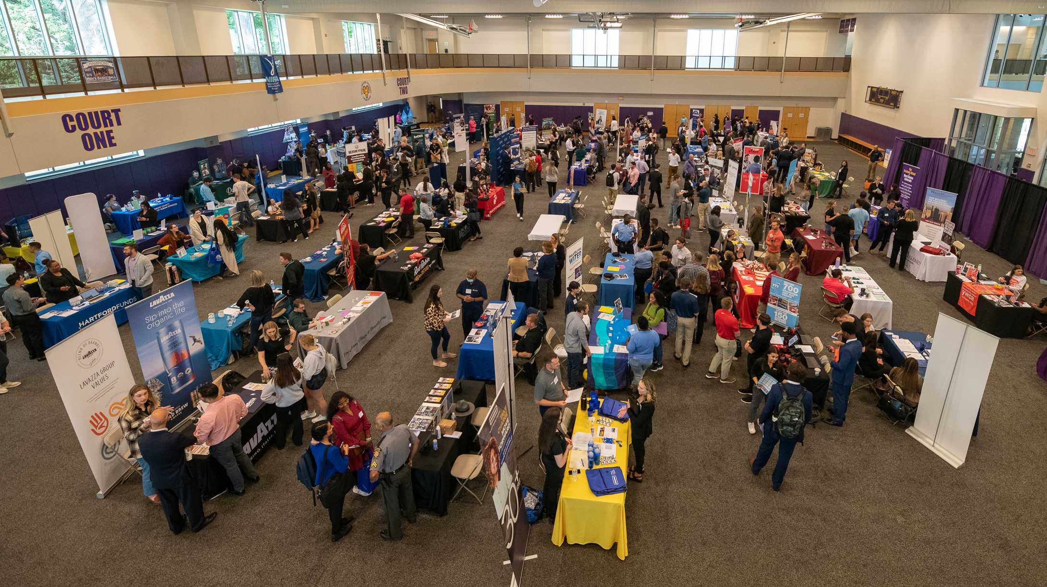
Preparing for Career Events

Slide 2
FIND OUT WHICH COMPANIES WILL BE ATTENDING
Visit Handshake for a list of participating companies and organizations: wcupa.joinhandshake.com
Before
The
Event
RESEARCH THE COMPANIES
Do research on the company before attending the fair. The more you know about what the company does, the more comfortable you will be when meeting their representatives.
DRESS APPROPRIATELY
The level of formal dress varies by industry, but a general plan should be to stay away from sweatshirts and sweatpants. Visit the Career Closest in the CDC for access to free career attire.
Do your prep work to feel confident!

Slide 3
Hi, my name is Sarah Smith and I am a current Interdisciplinary Studies major with an interest in consumer research and product development. I serve as President of the
Entrepreneurship Association on campus as well as working at the Student Union. My educational and work experience has allowed me to develop skills in multi-tasking, leadership, and critical thinking. I’m very interested in gaining experience in product development with a firm such as P&G,
which continues to set the industry standard for analyzing consumer behavior and developing cutting-edge products. I’d like to learn more about internship opportunities within your organization.
Employer
Interactions
The 30-Second Pitch
Extend your hand, say "hello" and state your name. Be ready to talk about your career interests as well as academic and extracurricular experiences to show your skills and
strengths. Practice makes confident!

Slide 4
BRING COPIES OF YOUR RESUME
It's important that you bring plenty of error-free resumes to the fair. Some employers will take physical copies while others will direct you on how to send it/apply to openings.
Employer
Interactions
ASK ABOUT THE NEXT STEPS
Do they have current openings? What is the best way to apply? Ask for a contact information from the recruiter to stay connected.
Be sure to think about your non-verbal cues as well.
Keep eye contact, remain engaged, have open posture, and smile.
SAY AND SEND A THANK YOU
Thank the recruiter for their time before you depart from their table. Also, follow up after the fair as directed and/or to simply connect, reiterate your interest and thank them again.

Slide 5


Visit the CDC!
The Career Development Center is here to support you through the entire process!
Our office can help prior to the fair in your preparation efforts, and we are available the day of the event for any assistance you need.
The CDC website has great resources for resume development, interview prep, and more. Visit: wcupa.edu/cdc
SCHEDULE 1-1 APPOINTMENT
CHECK OUT PREPARE FOR FAIR
Get help with resumes, creating your pitch, and any other questions by meeting with a career counselor.
A week before the fair, the Career Center holds a prep event. Check out wcupa.joinhandshake.com for details.
Notes:
Appts – virtual and in person
Drop-Ins – in person
Events – virtual and in person (hybrid to account for varying levels of comfort and ability to provide a safe experience)
Do not be overwhelmed! - YOU ARE NOT ALONE and we are going to break things down together today so you can leave here with one tangible action step you are comfortable moving forward with .

