Slide 1
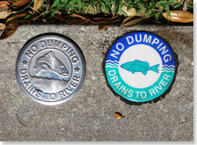
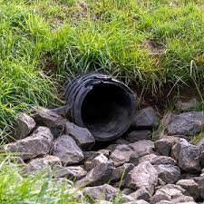
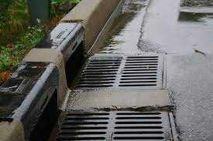


Storm Drain Awareness
Here are 5 easy steps you can take to help protect our watersheds:
Rainbows in the sky, not on our roads! Maintain your car free from oil and fluid leaks. Avoid washing your car in the street.
When it rains, it drains! Properly disposing of your trash, debris, and rubbish so it does not drain into the storm system.
Stop POO-llution! Keep the street clean by picking up your pet’s waste and discarding of it properly in the trash can.
Think twice about pesticides! Do not apply pesticides or other chemicals near storm drains or when it is about to rain.
Save water, save our storm drain! Watering grass less helps reduce water runoff. Avoid spraying sidewalks, driveways, and streets to prevent pollutants from being carried into storm drains.
For more information, contact EHS at ehs@wcupa.edu

