Slide 1
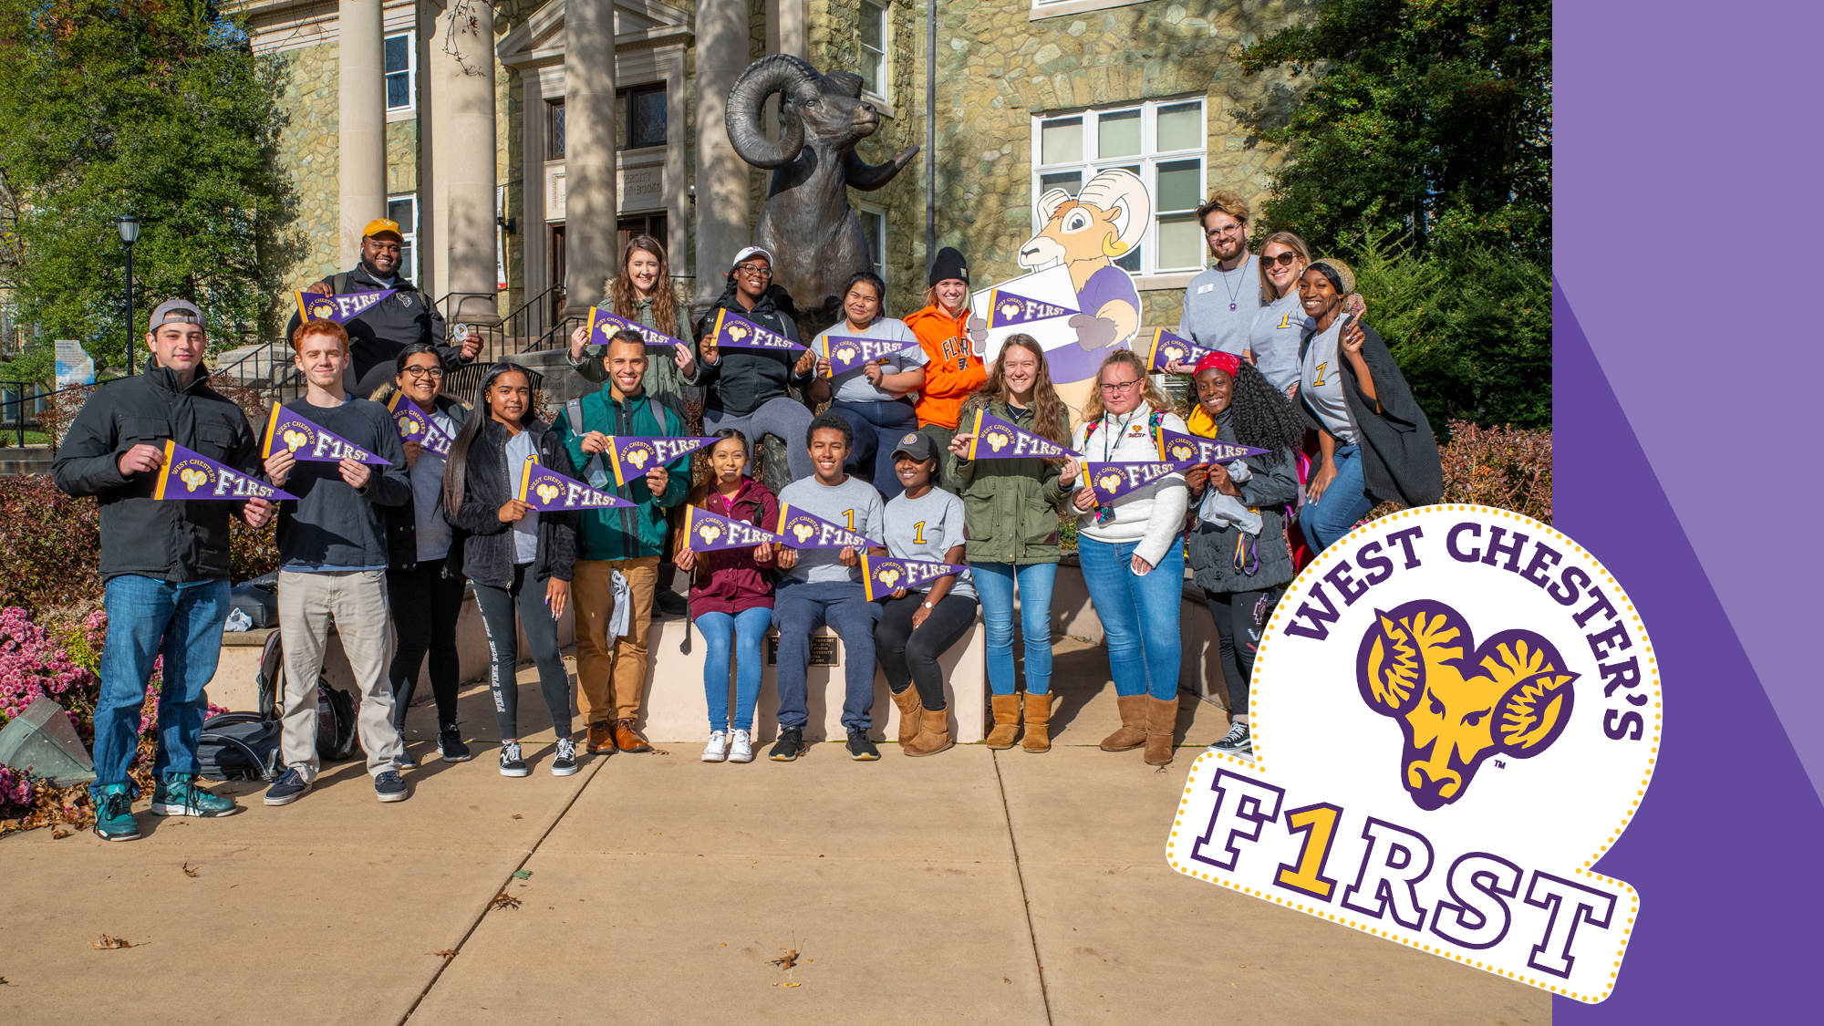



Slide 2
If none of your parents or guardians completed a bachelor’s degree, then you are one of
WEST CHESTER’S FIRST
WHO IS A
FIRST GENERATION
COLLEGE STUDENT?

Slide 3
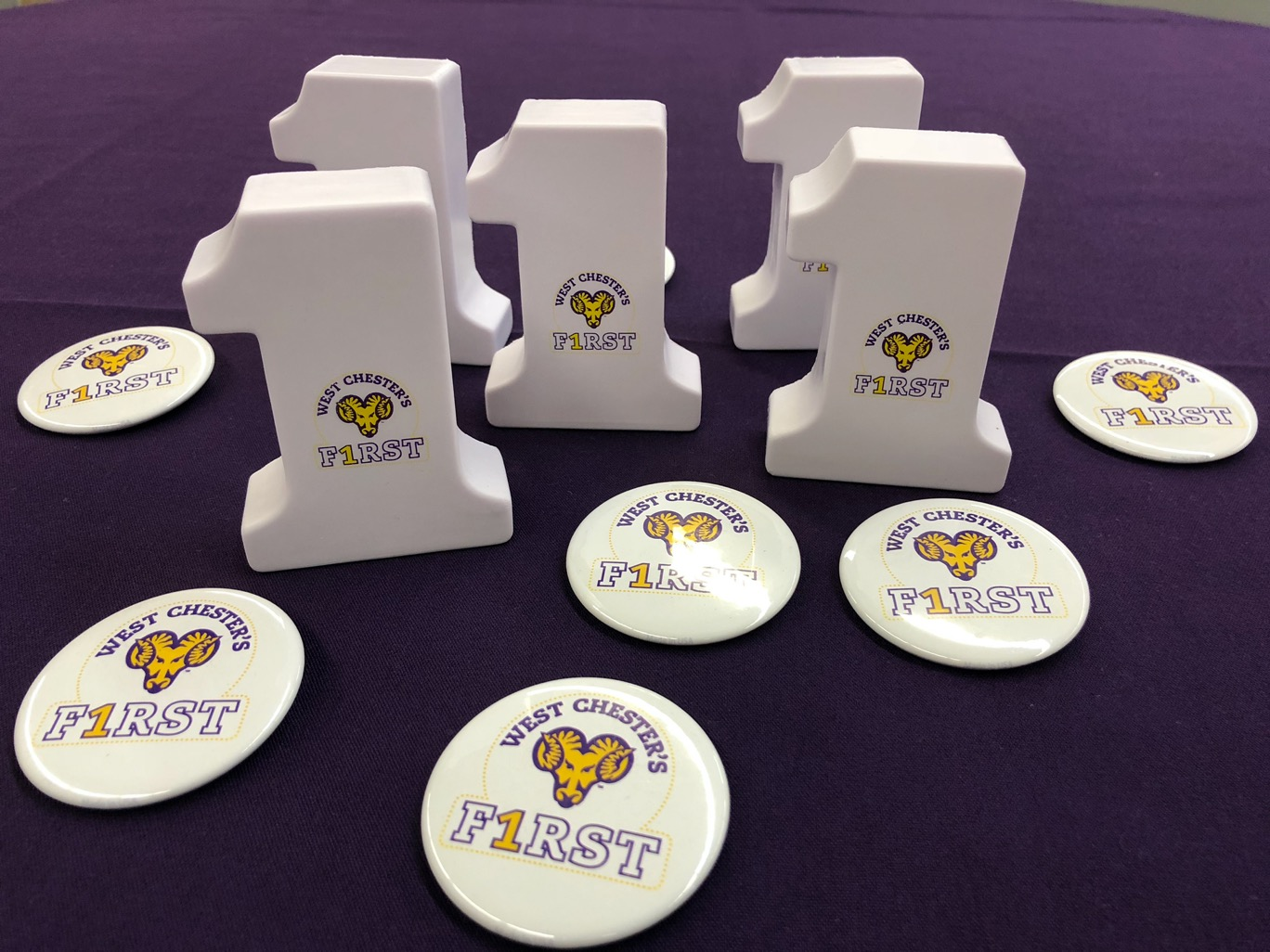

HOW MANY
FIRST GENERATION
STUDENTS ATTEND WEST CHESTER UNIVERSITY?
a. 25% b. 5%
c. 53% d. 30%

Slide 4
APPROXIMATELY
30%
That means
MORE THAN 4,200 STUDENTS
at West Chester University are first generation

Slide 5
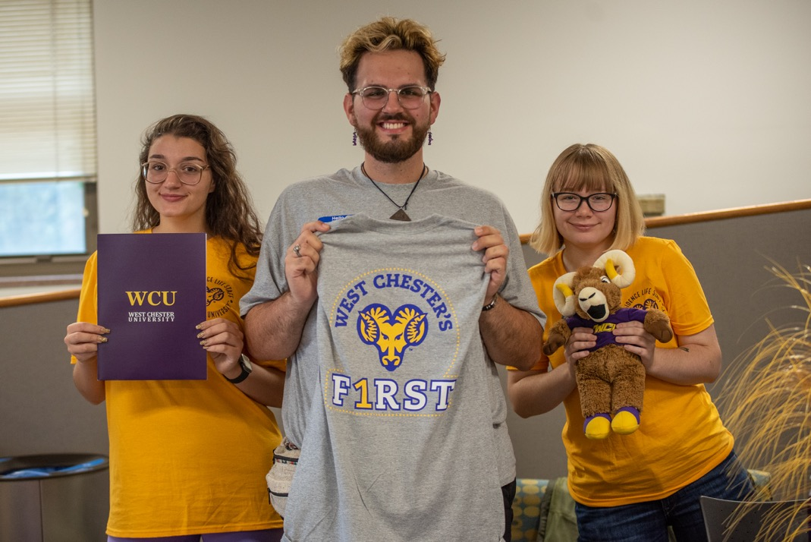
WE
CELEBRATE STUDENTS LIKE YOU!
We’re proud that so many
first-gens choose West Chester

Slide 6

RECOGNITION
FOR OUR WORK
WCU is one of only 80 universities in the country to receive this distinction in 2019
West Chester University has been recognized by NASPA: Student Affairs Administrators in Higher Education, a leading national organization, for our work with first- gen students

Slide 7
Nearly one-third of WCU’s undergraduates are first generation (“first-gen”)—that’s a lot of our students!
We know that sometimes, the college experience can be overwhelming for any first year student. Things like:
  Making new friends
  Getting comfortable with the campus
  Applying for financial aid, selecting classes, and meeting your advisor (who’s similar to your high school guidance counselor)
We’re here for you! We want to make sure our first-gen students and their families have all the information they need, right from the start!
WHY IS
WEST CHESTER’S
FIRST
IMPORTANT?

Slide 8
INVOLVED
CONNECTED
INFORMED
and most of all…
PROUD!
WE WANT
ALL OUR
FIRST-GENS
TO BE

Slide 9
BE
Participate in campus events, especially first-gen events! Stay updated on our website: www.wcupa.edu/wcfirst
Make friends by joining the West Chester’s First student organization, or one of our 300+ student organizations at the Fall Involvement Fair in August. Learn about student organizations here: Student Leadership and Involvement
Participate in National First-Generation College Celebration Day on November 8
By getting involved, we hope you love it here as much as we do!
INVOLVED

Slide 10
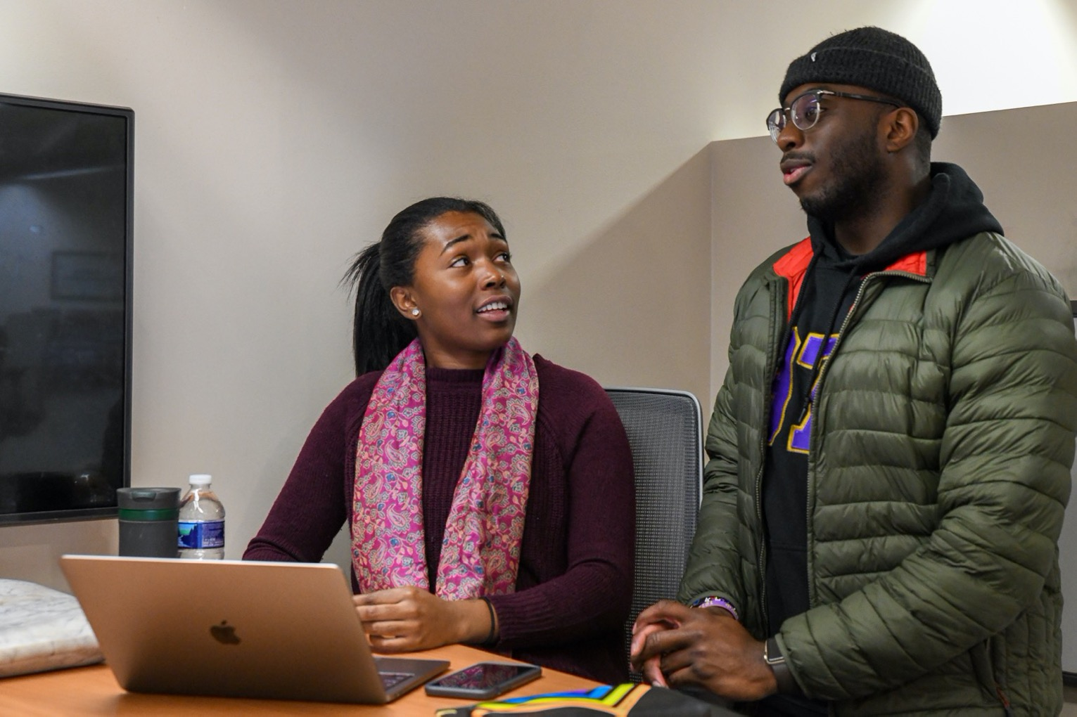

JOIN OUR
STUDENT
ORGANIZATION:
WEST CHESTER’S
FIRST

Slide 11
Reach out to your Student Success Coordinator and faculty advisor—they’re like your high school guidance counselor. They can answer questions about your classes.
Student Success Coordinators
Academic Advising
Get to know your professors by visiting their office hours. They’ll tell you when they’re available to meet on your first day of class
Take a virtual tour so you’re familiar with the campus
BE
CONNECTED

Slide 12
Receive your West Chester’s First t-shirt at the start of the semester. When you see someone wearing that t-shirt, you’ll know they’re first-gen like you!
Participate in Weeks of Welcome events to kick off the fall semester, and meet other students who are getting started at WCU
Attend Meet & Greet events with other first-gen students, faculty and staff
Watch the Parent and Family Relations website for details about a special event for first-gens and their families this fall
Don’t miss Homecoming on October 23 – 24
Join the fun on Banana Day, a unique WCU tradition held each spring
WCU’s big spring celebration, Ramboree, is a great time for all students!
WAYS TO
BE
CONNECTED
IN YOUR FIRST YEAR
AT WCU

Slide 13
Save the date!
NATIONAL FIRST GENERATION COLLEGE
CELEBRATION
SUNDAY, NOVEMBER 8
Visit our website: www.wcupa.edu/wcfirst for more information

Slide 14
BE
Learn about West Chester University resources on our website: www.wcupa.edu/wcfirst
Questions about Financial Aid? Visit their website Financial Aid and ask a question in the chat box
  It’s important for your family, and everyone who supports you, to be informed too! Check out our Parent and Family Relations website
INFORMED

Slide 15
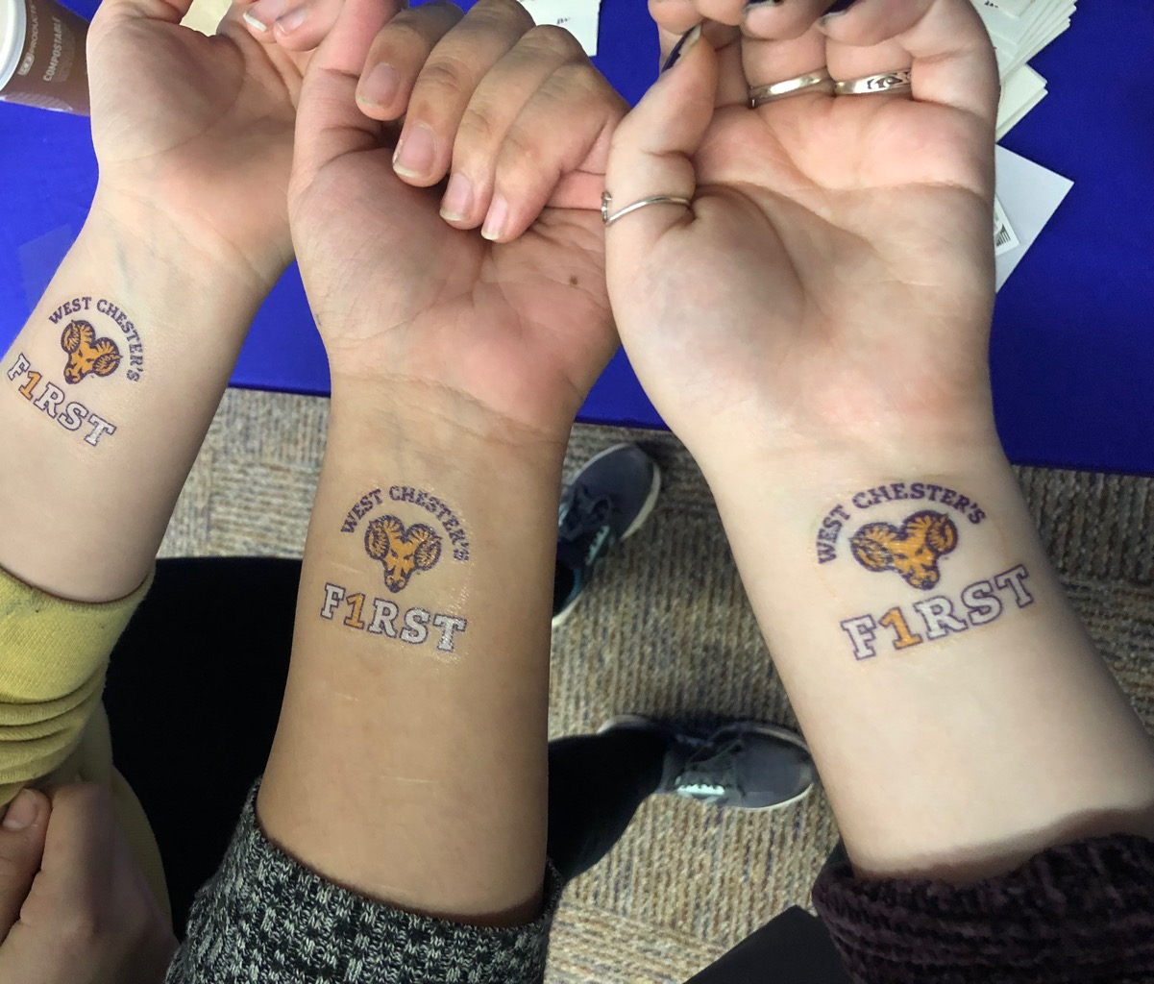
CHECK OUT ALL THE RESOURCES ON THE
WEST CHESTER’S
FIRST
WEBSITE
www.wcupa.edu/wcfirst

Slide 16
BE
You’re joining a proud community! West Chester University has hundreds of first-gen faculty and staff, and thousands of first-gen alumni
First-gen students are known for their creativity, resiliency, entrepreneurship and grit. West Chester is the place that will help you grow those strengths
First-gens want to make the most out of their college experience by doing their very best to achieve, both inside and outside the classroom
PROUD

Slide 17

Want to join a proud group of first-gen scholars? Apply to become a member of Alpha Alpha Alpha national first-gen honor society
Who’s eligible: First-gens who have completed about three semesters at West Chester University (students usually apply for membership in their second year)
Minimum 3.2 grade point average
Watch www.wcupa.edu/wcfirst for application information
NATIONAL
FIRST-GEN HONOR SOCIETY

Slide 18

BE PART OF A
PROUD TRADITION
Questions? Call 610-436-3301 | Email wcfirst@wcupa.edu

