Slide 1

Welcome!
WCU Veterans Center Orientation
Notes:
On behalf of the Greg and Sandra Weisenstein Veteran’s Center, I would like to welcome Student Veterans and their families to West Chester University!

Slide 2
Agenda/Topics To Be Covered
About the Veterans Center
Student Veterans Group @WCU
GI Bill Benefits Information
  Required Documents
Additional Resources Available
Notes:
This presentation includes information about the Weisenstein Veteran’s Center, the Student Veterans Group, GI Bill Benefits Information and requirement documents, and additional resources to get you connected at West Chester.

Slide 3

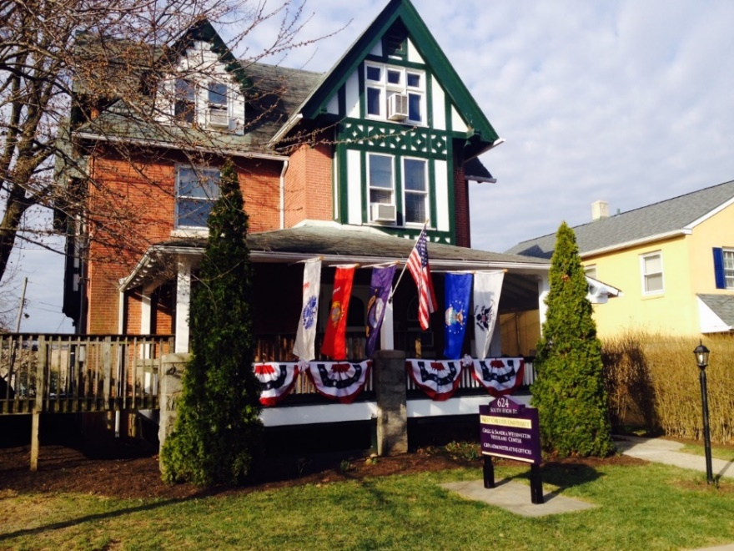
WCU Weisenstein Veterans Center
Established in December 2010, the Greg and Sandra Weisenstein Veterans Center at West Chester University strives to create an intentional culture of understanding, acceptance, and success for Veterans, active military, and those whose support them.
The Veterans Center is committed to facilitating communication among our campus offices in order to serve student Veterans, military service members, reservists, and their families with a coordinated system of service to provide a meaningful transition from the military to West Chester University.
.
Notes:
Established in December 2010, the Greg and Sandra Weisenstein Veterans Center at West Chester University strives to create an intentional culture of understanding, acceptance, and success for Veterans, active military, and those whose support them. Staff in the center work in partnership with others across the University to effectively serve student Veterans, military service members, reservists, and their families with a coordinated system of service to provide a meaningful transition from the military to West Chester University.

Slide 4

WCU Weisenstein Veterans Center
The Veterans Center is located at
624 S. High St.
Lillian Morrison serves as the Coordinator
Notes:
Throughout the year, the center provides a calendar of programs and events that connect students with personal, professional, social and service opportunities. The Center actively connects with external partners to continuously support the needs of student veterans, while building partnerships. The Veterans Center is centrally located at 624 S. High St on the main campus and actively connects with the Philadelphia campus, as well as WCU students taking classes at Delaware Community College. Lillian Morrison, an Air Force Veteran, has served as the Coordinator of the Veterans Center since 2014. The center includes a student lounge, kitchen area, computer lab and conference room.

Slide 5




WCU’s commitment to Student Veterans
Acknowledged by GI Jobs as a Military Friendly School from 2014 -2020
*Silver designation
Acknowledged as a Top University by Military Advanced Education
WCU is a Yellow Ribbon School
Annual military scholarship banquet
Notes:
West Chester University works diligently to demonstrate its commitment to support the success of our student veterans and their families. West Chester is a Yellow Ribbon School and recently participated in a voluntary review program with the Department of Defense (DoD) to ensure compliance with DoD requirement. The University has maintained military friendly designations since 2014 and recently advanced from bronze to silver designation, an honor achieved by a select group of colleges/universities. The University annually awards a host of military specific scholarships through the Annual Military Scholarship banquet held during the fall semester.

Slide 6

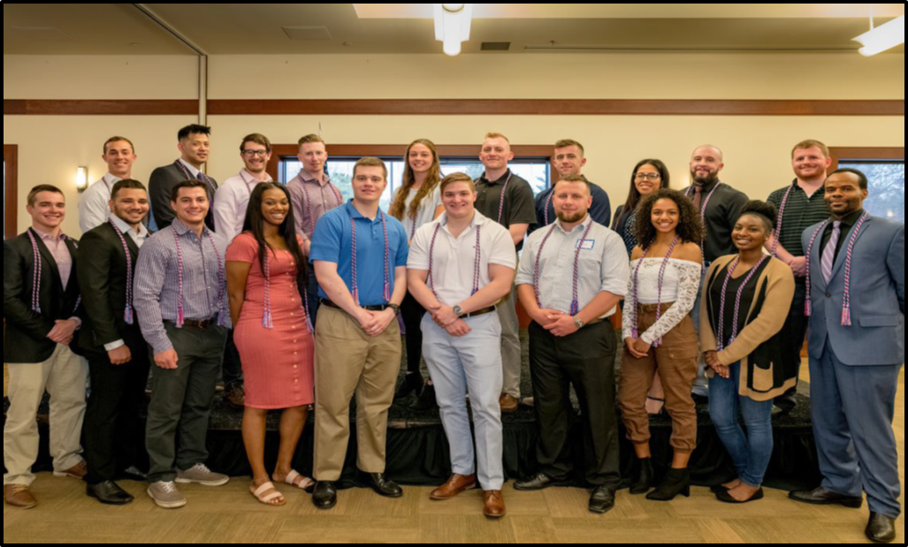
Student Veterans Group (SVG)
Notes:
Many students chose to connect through the Student Veterans Group or SVG. The SVG welcomes and is open to all active members of the military, Reservists, members of the National Guard, Veterans and those whose support them.

Slide 7
Student Veterans Group (SVG)
Executive Board
President
Vice President
Treasurer
Secretary
Parliamentarian
Bi weekly meetings are held at the Veterans Center
Notes:
The SVG has five key leadership positions which are elected annually and consist of a president, vice president, treasurer, secretary and parliamentarian. SVG meets bi-weekly in the Veterans Center Conference Room.

Slide 8


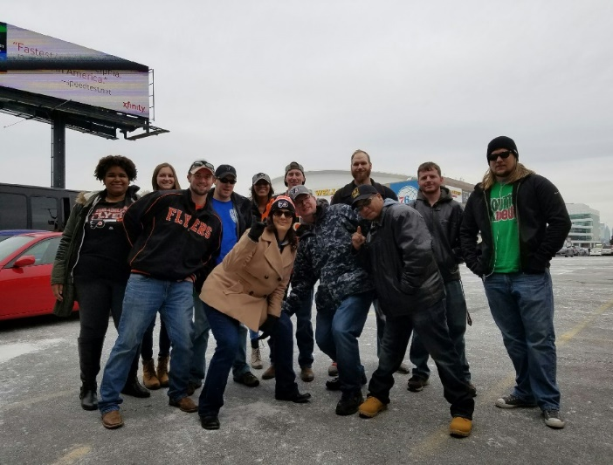
Student Veterans Group
Activities
Notes:
The Student Veterans Groups hosts several social and service events throughout the academic year to help student veterans create a sense of community and network personally and professionally.

Slide 9
GI Bill Education Benefits
Chapter 30
Montgomery GI Bill
Chapter 33
Post 9/11
Chapter 35
Dependents
Chapter 1606
Reserves
Chapter 31
Vocational Rehabilitation
Other benefits
Notes:
There are four chapters of education benefits currently in use by Student Veterans. Post 9-11 also referred to as Chapter 33, Montgomery GI Bill/Selected Reserves also called Chapter 1606, Vocational Rehabilitation or Chapter 31, and Survivors and Dependents Educational Assistance also called Chapter 35. Chapter 30 benefits are used by Active Duty Service Members.
The majority of our Student Veteran population use the Post 9-11 GI Bill. The University has two VA School Certifying Officials, Lillian Morrison (Veterans Center) and Kristy Slusser (Financial Aid Office). To get started, go to the Veterans Center website, click on “Your benefits” and follow the instructions provided.
Please note that credits may be given for Military Service and you can begin that process by submitting your Military Transcript to the Admissions Office when applying to WCU.
Finally, to aid your success and ability to enroll in required courses, WCU provides priority registration for all student veterans utilizing their veteran educational benefits.

Slide 10
Required Paperwork
Certificate of Eligibility or Statement of Benefits
DD214 Member 4 Copy (excluding Transfer of Education Benefit)
Request for Certification (every semester or yearly)
Housing Form and PA Lease (Choice Act Participants)
Notes:
To begin the process of using your Veterans Education benefits, please note the following required paperwork:
A certificate of eligibility or statement of benefits
A DD214 Member 4 Copy
A request for certification must be completely every semester or yearly.
For out of state residents temporarily residing in Pennsylvania while attending WCU, you may be eligible for in-state tuition under the Choice Act. Please contact Lillian Morrison for more details.

Slide 11

Resources Available on Campus
Financial Aid
Bursar
Career Center
University
Housing
Food Pantry
Counseling Center
Office of Services for Students with Disabilities
Recreation Center
Center for Women & Gender Equity
LARC
The Learning & Assistance Resource Center
Notes:
While the University has a Veterans Center, please keep in mind that staff across the University can assist you with a host of needs or furthering your connections.

Slide 12




Questions and Connecting
https://www.facebook.com/wcuvetcenter/
Phone: 610-436-2862
Email: veteranscenter@wcupa.edu
https://www.wcupa.edu/veteranscenter/
VA School Certifying Officials: Lillian Morrison & Kristy Slusser
Notes:
If you should have any question about the center, using your veterans education benefits or even how to connect with off-campus resources , visit the Veteran’s Center website for a host of resources, or contact a staff member by emailing veteranscenter@wcupa.edu or calling 610.436.2862. You can also connect with the Weisenstein Veterans Center or the Student Veterans Groups online through our Facebook page or RamConnect.

