Slide 1
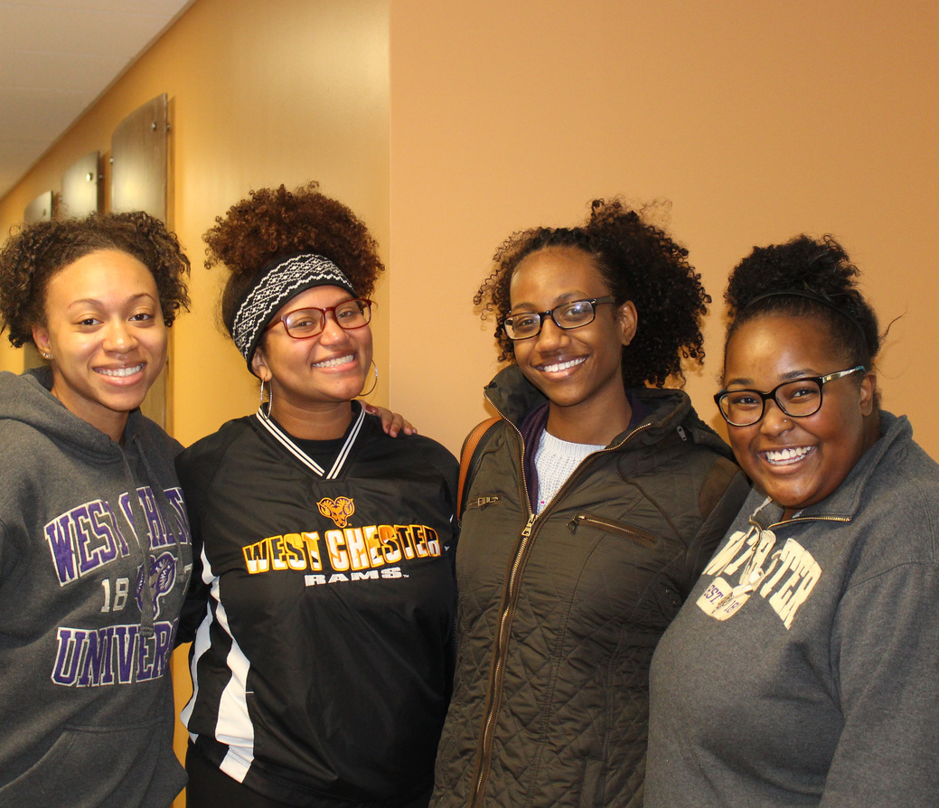



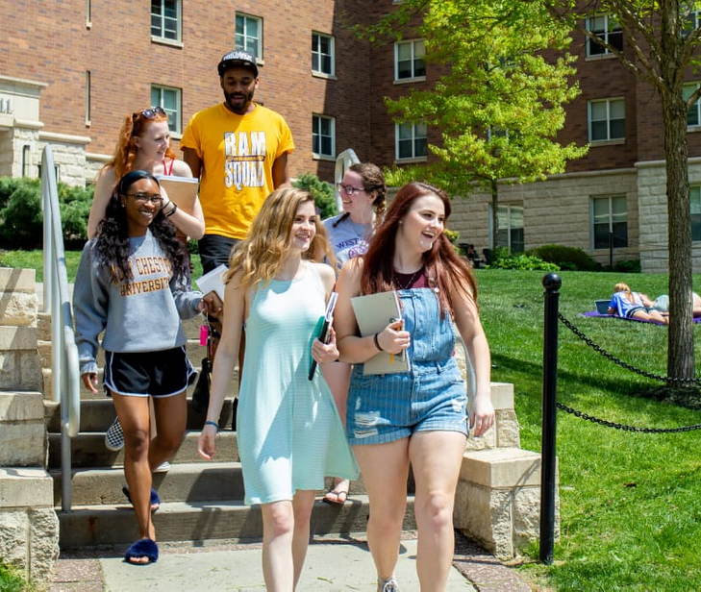




University
Student
Housing
Also Known As
USH Affiliated Housing
Located
On-Campus

Slide 2

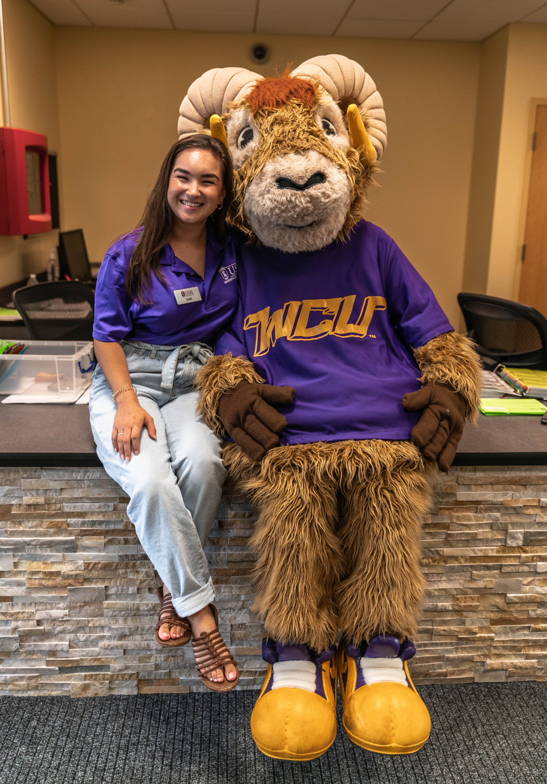
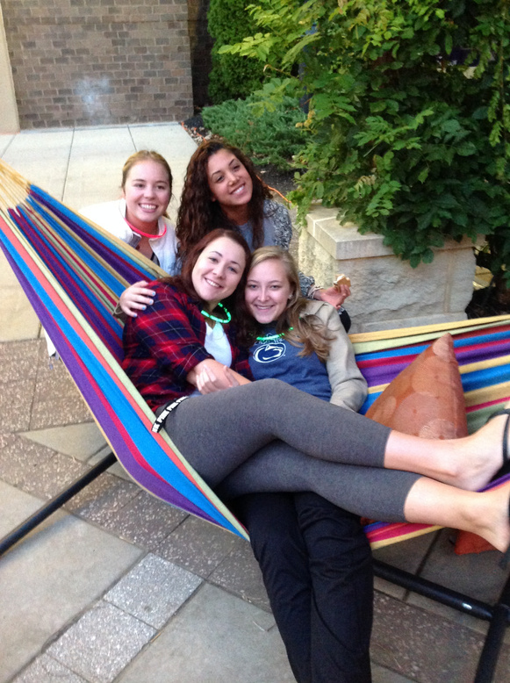
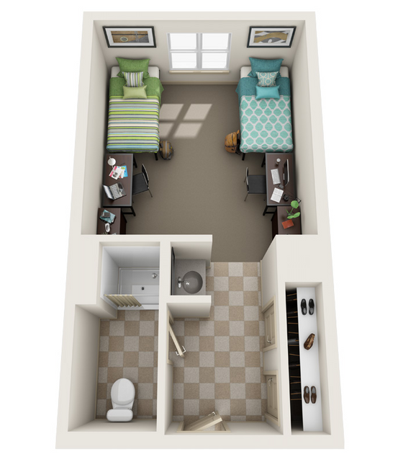
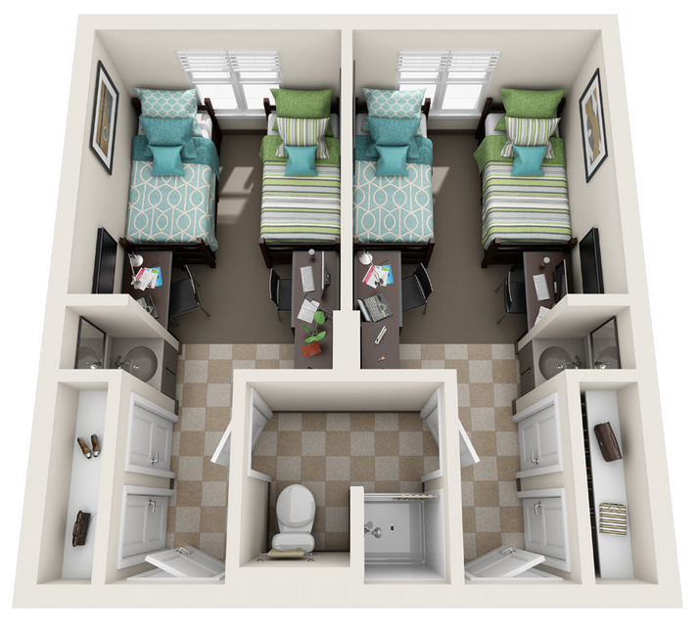
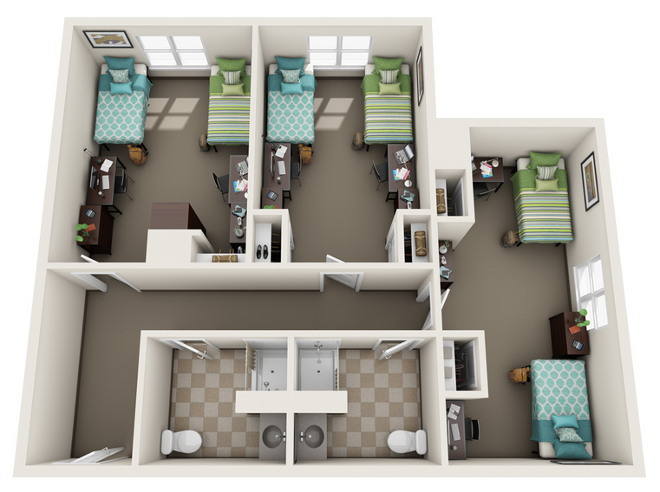
First-Year Students
(North Campus)
Three Bedroom Double
Brandywine Hall, Commonwealth Hall, Allegheny Hall
One Bedroom Double
Brandywine Hall, Commonwealth Hall, Allegheny Hall
North Campus
Two Bedroom Double with Shared Bath
Commonwealth Hall
Renderings are an artist's conception and are intended only as a general reference. Features, materials, finishes, and layout of subject unit may be different than shown.

Slide 3

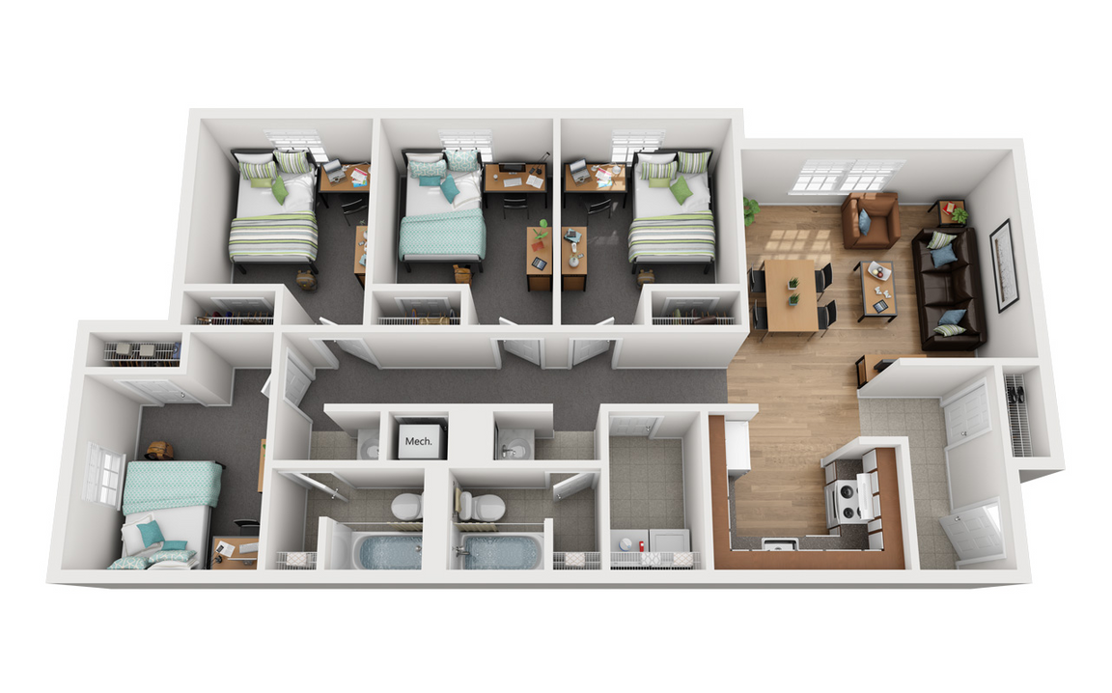

Transfer Students
(South Campus)
Village Apartments
4 Bedroom, 2 Bathroom
Includes:
  Full Kitchen
  Desk & Desk Chair
  Bed Frame & Mattress
  Living Room Furniture
  Dining Table & Chairs
  Washer & Dryer
Renderings are an artist's conception and are intended only as a general reference. Features, materials, finishes, and layout of subject unit may be different than shown.

Slide 4
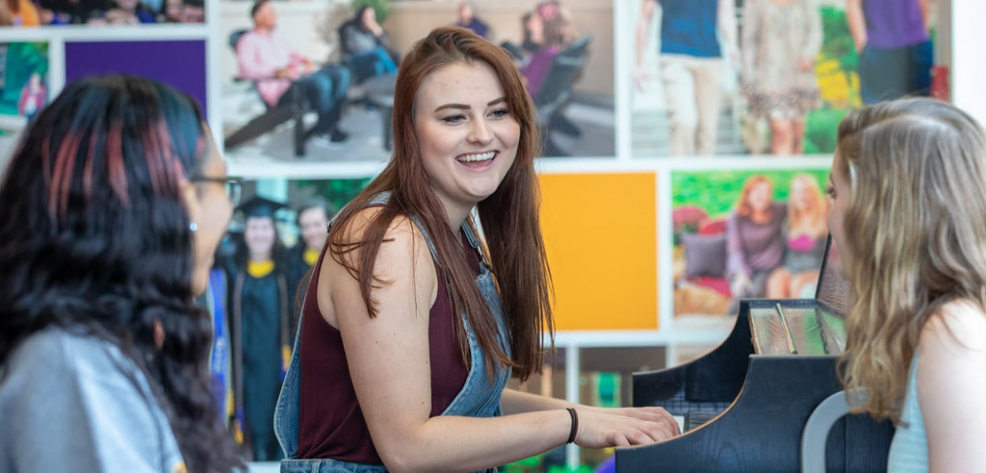
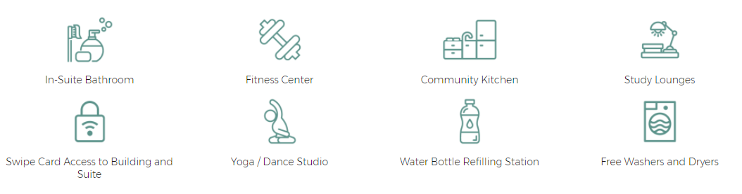
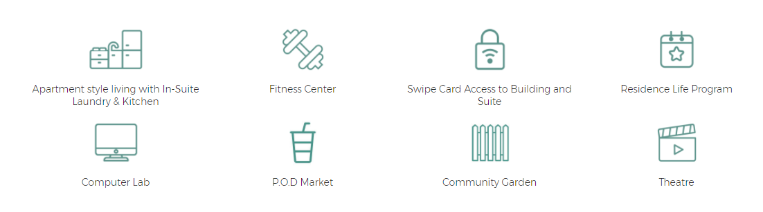
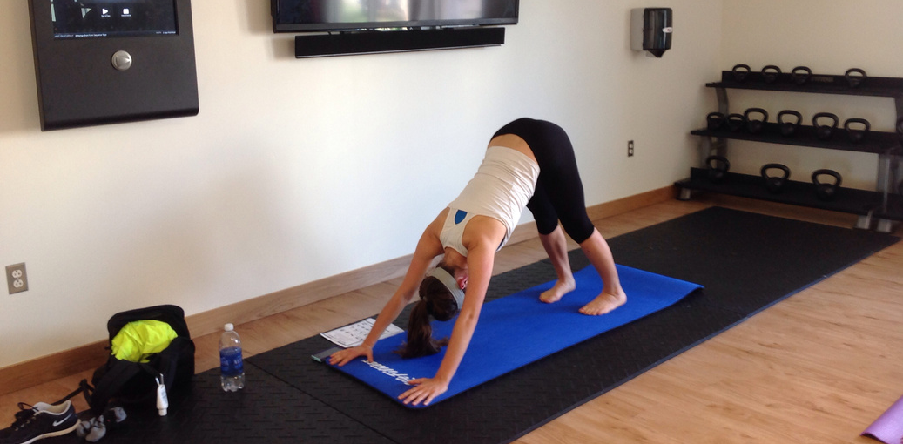
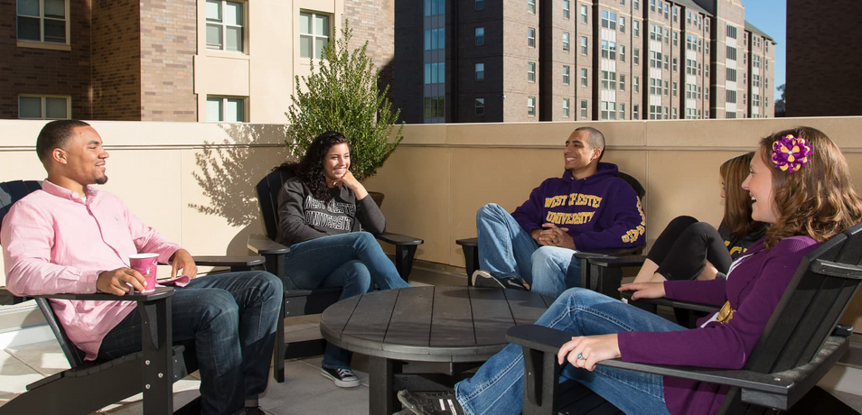
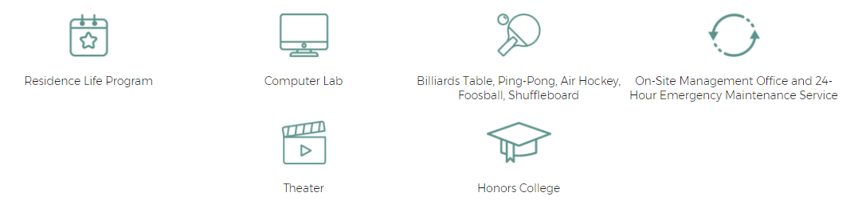

Amenities
North Campus
South Campus

Slide 5


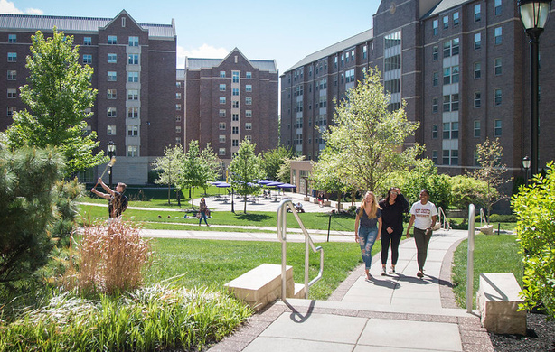
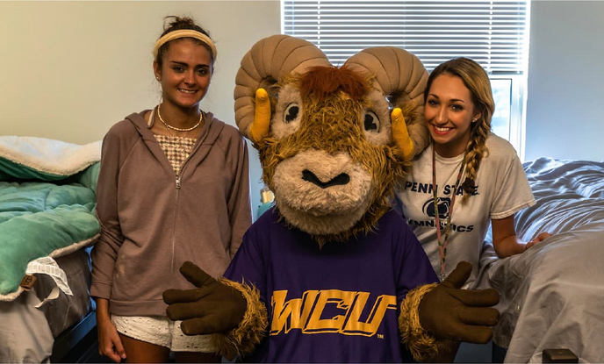
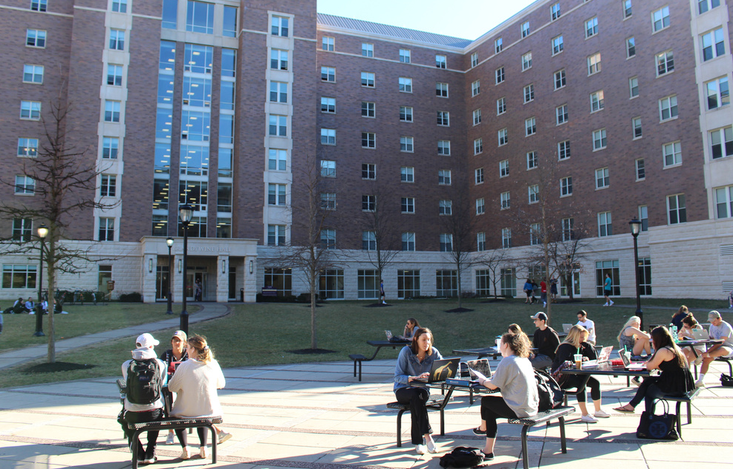
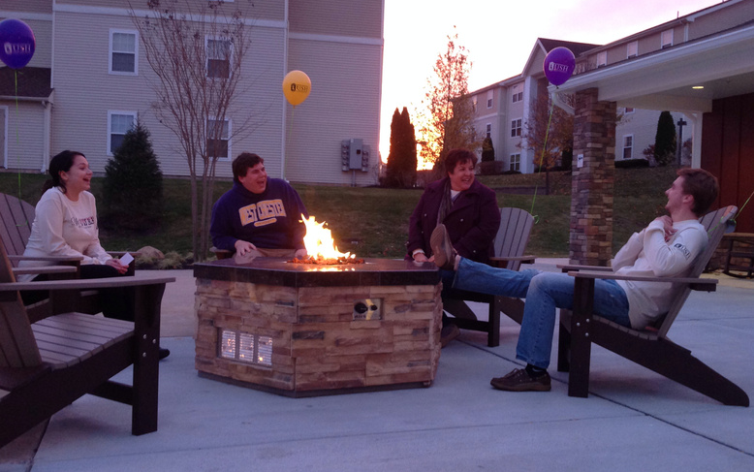
Application Steps
Housing Email
Create an Account
Application Fee
Sign Lease
You will receive application instructions to your WCU email. Follow these steps to begin your application for your preferred housing. This email is typically sent within 2 weeks of paying your Admissions deposit.
Use the link in the housing email to go to the USH Resident Portal. This is where you will create your account by clicking "Register (New Users Only)".
Click "Apply for Housing" and complete the first part of your application. This includes the $200 non-refundable application fee.
Once your application is reviewed, you can log back in to the resident portal to review and sign your lease agreement and leasing documents. Once you sign your part, the documents will be emailed to your guarantor to sign.
Finished!

Slide 6
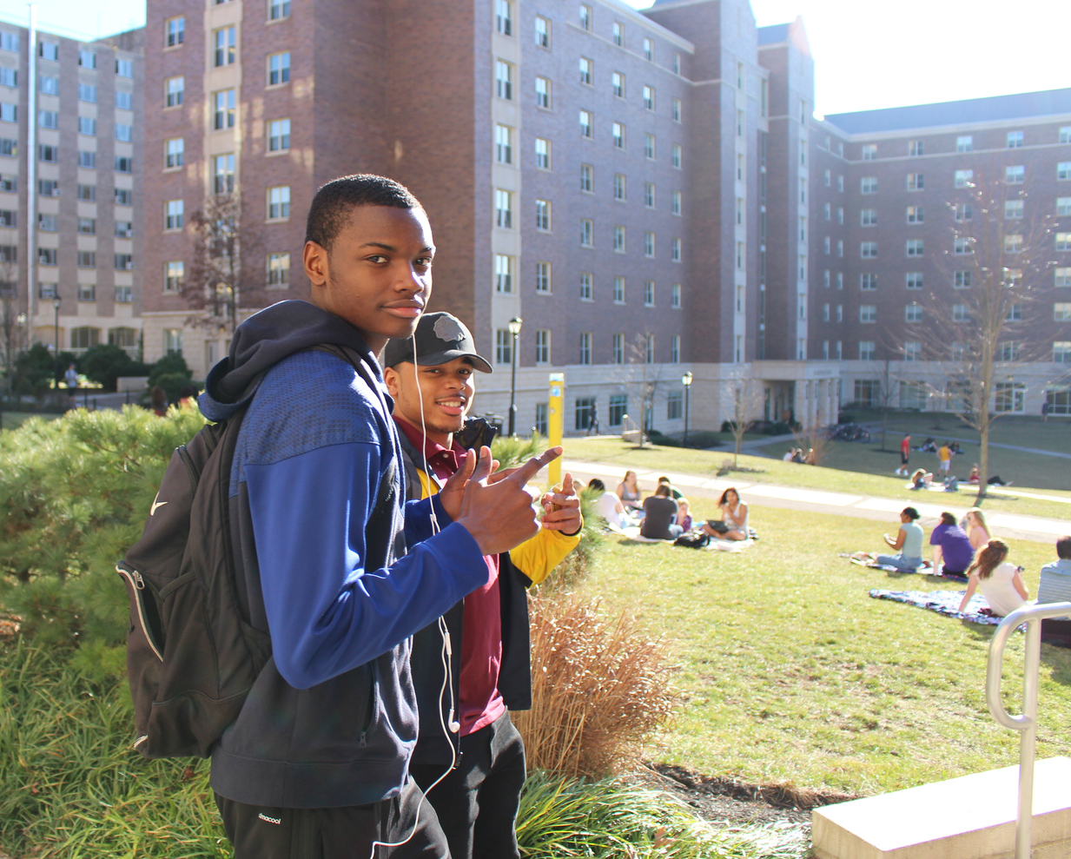
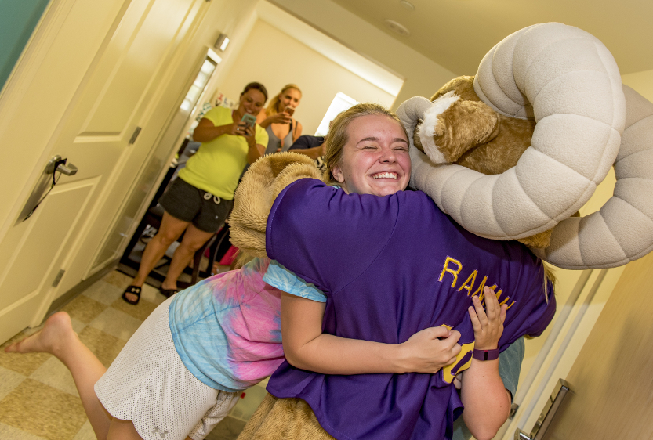

Roommate Requests
If you already know who you would like to request as a roommate, you and your roommate(s) will need to apply for the same suite style. Once you complete the application, you can create a roommate group together.
Gender Inclusive Housing
Roommate Matching
A student can identify gender as neutral in the Affiliated Housing Application and connect directly with other students who have selected neutral, or USH will work to assign you to a room with another gender-neutral student. By selecting neutral, you will be shown other students who have selected neutral as well when utilizing the roommate matching functions of the resident portal.
Affiliated housing offers a roommate matching service where applicants can fill out a roommate questionnaire and then see how well they match with other students who selected the same suite style. For USH communities, all applicants are able to utilize the roommate matching portion of the online leasing portal.

Slide 7
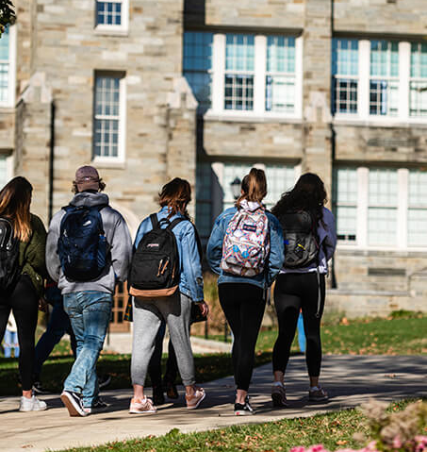

Virtual Tours
Pre-Recorded
Model Unit Tours
Visit our website to see pre-recorded tours of our model units and the amenities that are offered in our communities!
You can also check out our Facebook page for our previously recorded Live Tours of the communities!
CLICK HERE TO SEE OUR TOURS

Slide 8

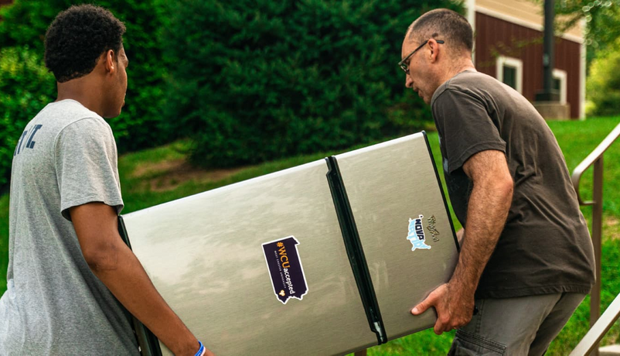

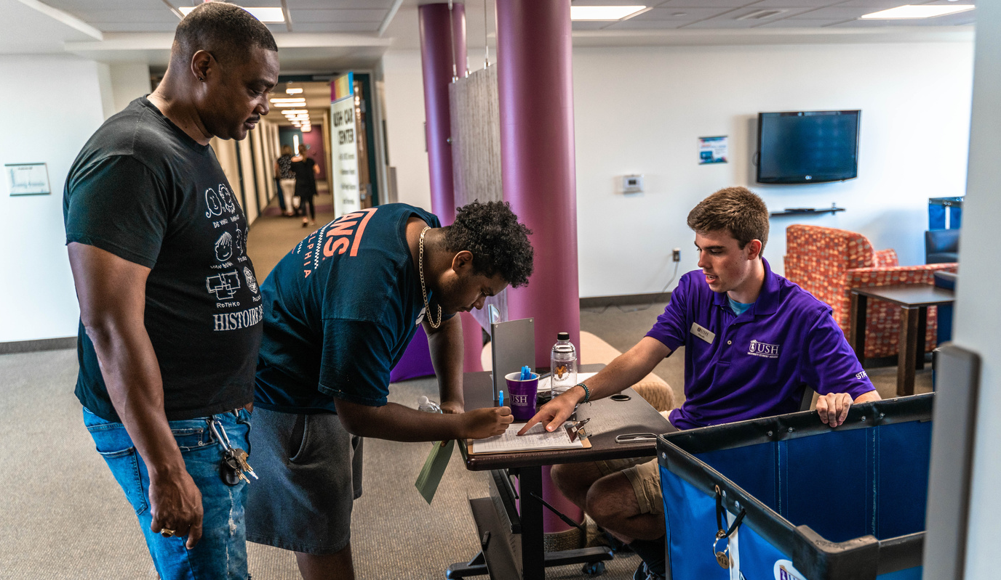
Drop & Go
Move-In
Drop & Go takes the stress out of Move-In Day! You are able to arrive with your belongings on your assigned date to set-up your room, see what additional items you need, and meet other students on your floor!
Move-In Day you will check-in to your building during your assigned timeslot, get your keys, and our volunteers will help you move items into your room!

Slide 9
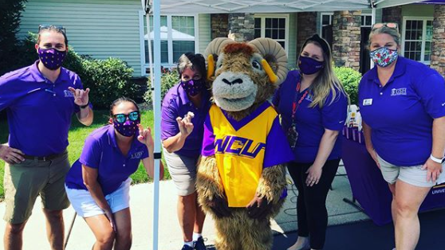
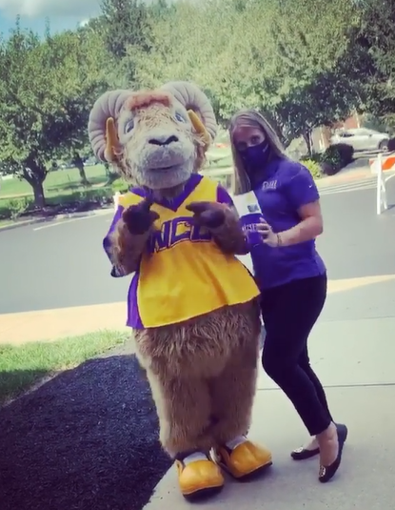
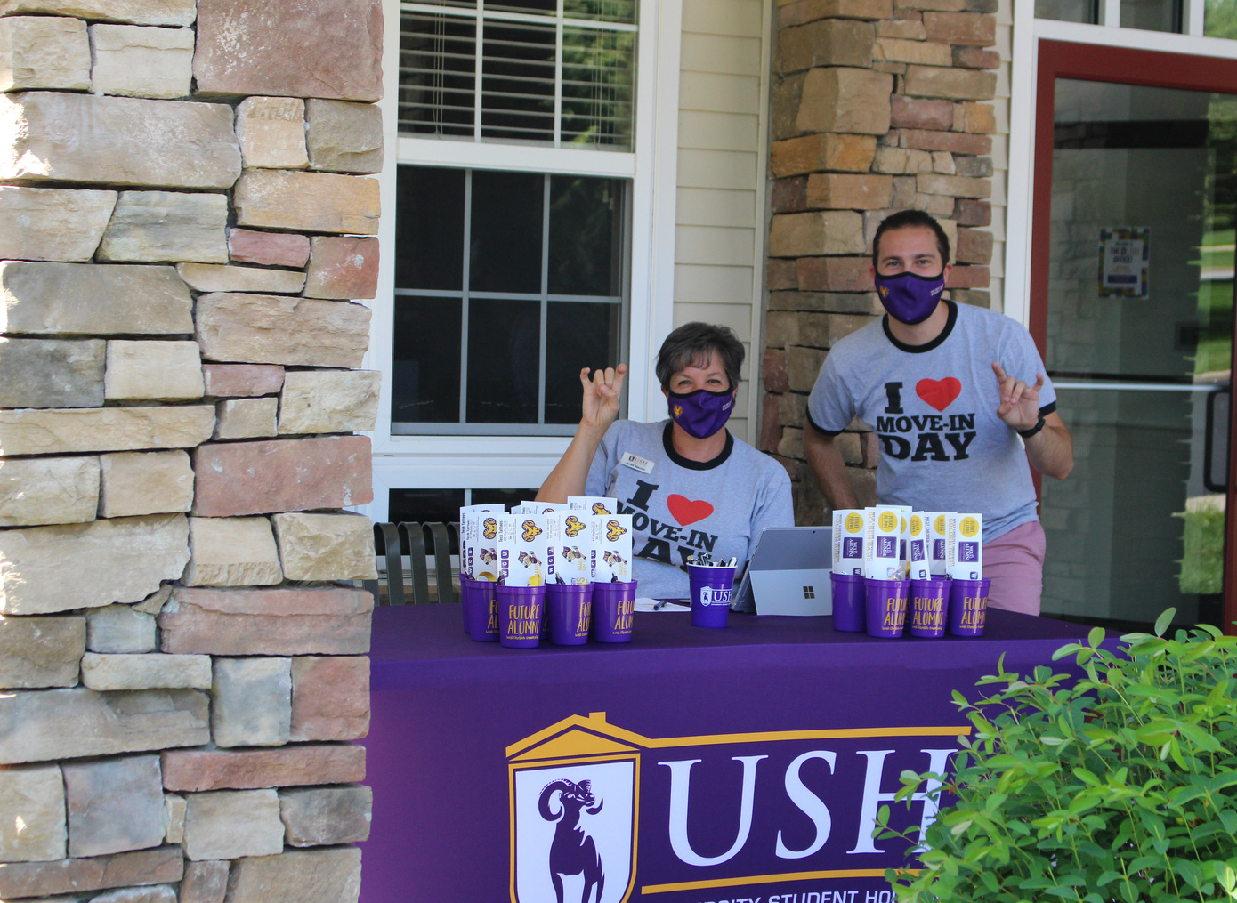


Questions?
Contact our Team!
www.wcuhousing.com
(610) 430-4988
leasing@ushcommunities.org
Follow us:

