Slide 1

The Office of Services for Students with Disabilities at WCU

Slide 2
Office of Services for Students with Disabilities – OSSD –
Location:
223 Lawrence Center
West Chester, PA 19383
Contact Info:
(610) 436-2564
Fax: (610) 436-2600
Email: ossd@wcupa.edu
Hours of Operation: Monday-Friday 8:30 a.m. - 4:30 p.m.

Slide 3
The Registration Process
Receive contact information
Register with Request specialty accommodations
Students must initiate Accommodations services
Registration with the OSSD is the student’s responsibility.
Accommodations are not retroactive

Slide 4
REGISTRATION Process
https://www.wcupa.edu/universityCollege/OSSD/
Step 1: COMPLETE THE OSSD ONLINE FORM if you are a current WCU student or have committed to attending WCU and have a diagnosed disability; if you have not been previously diagnosed with a disability, please refer to the OSSD Documentation Guidelines
Step 2: SUBMIT APPROPRIATE DOCUMENTATION VIA EMAIL TO OSSD@WCUPA.EDU (once you do so, an email will be sent to your WCU email address that includes information about the type of documentation required and how it should be submitted)
Step 3: ATTEND AN INTAKE MEETING (upon receipt of appropriate documentation, the OSSD will contact you to schedule a one-on-one intake meeting)

Slide 5
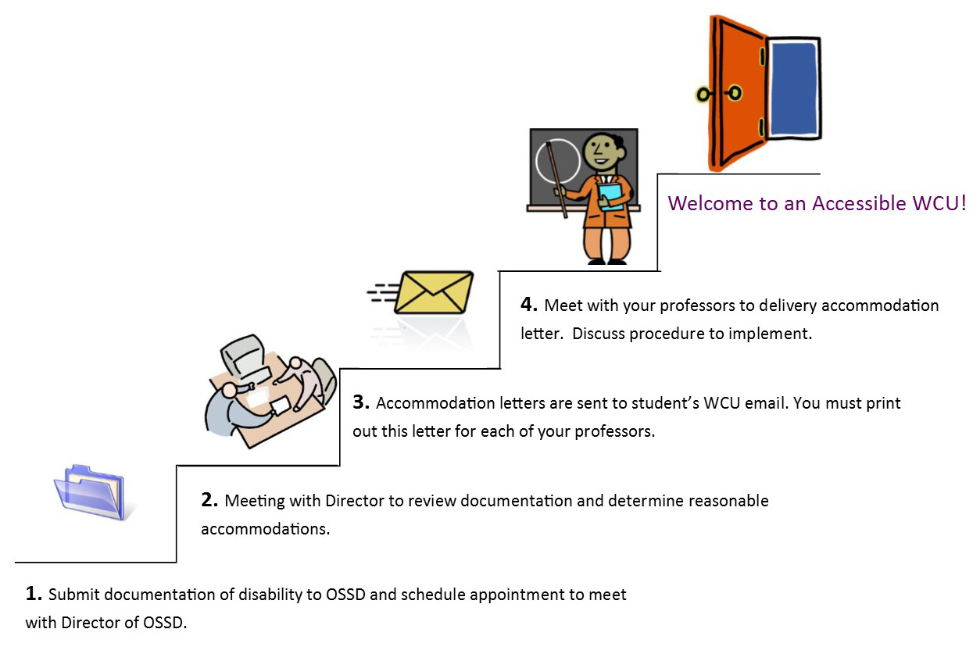
The Accommodation Process
Notes:
We do not contact your ins tutors we don't coordinate services , we don't force you to attend services

Slide 6

“Academic accommodations, as required by law, are not meant to compromise academic
standards. It is intended to create an opportunity for students with disabilities to learn and for professors to evaluate fairly.”
Your academic requirements and course objectives remain unchanged

Slide 7

There's No IEP in College !

Slide 8
ACCOMODATIONS
-Extended Time for Test Taking
-Alternative Textbook Format
-Note-taking Assistance
*Special Summer Orientation
-Alternative Testing Locations
-Adaptive Classroom Technology
-Advocacy with Faculty
Notes:
Summer Orientation ½ day in July

Slide 9

OSSD Services
Coaching
Tutoring
Mindfulness
Drop -In -Hours
Career Skills
Ambassadors

Slide 10

Technology
PDF or Audiobook Text Formats
Kurzweil
Smart Pen Training program
Jaws
Notes:
Smart pen demonstration

Slide 11

OFFICE OF SERVIVICES FOR STUDENTS WITH DISABILITIES
http://www.wcupa.edu/ussss/ossd/

