Slide 1

Explore | Prepare | Experience |Become Twardowski Career Development Center • wcupa.edu/cdc • 610-436-2501 225 Lawrence • Monday-Friday, 8am-4pm

Slide 2
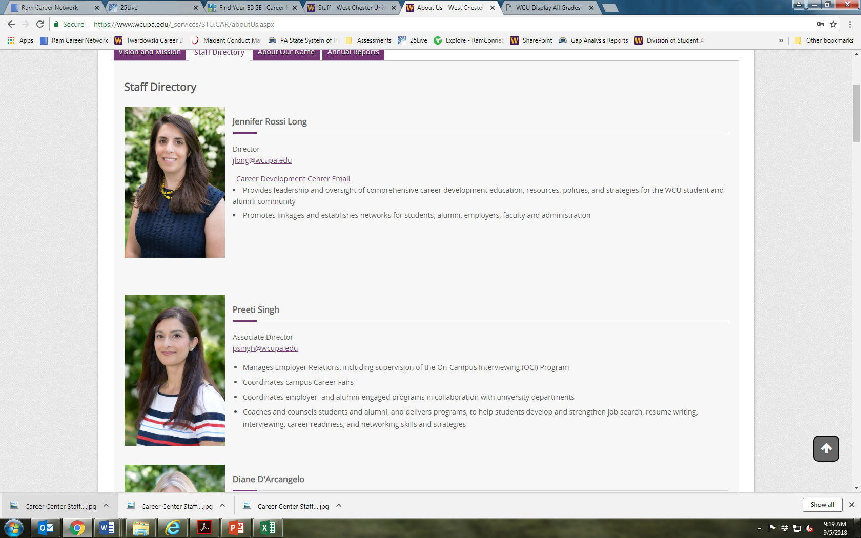
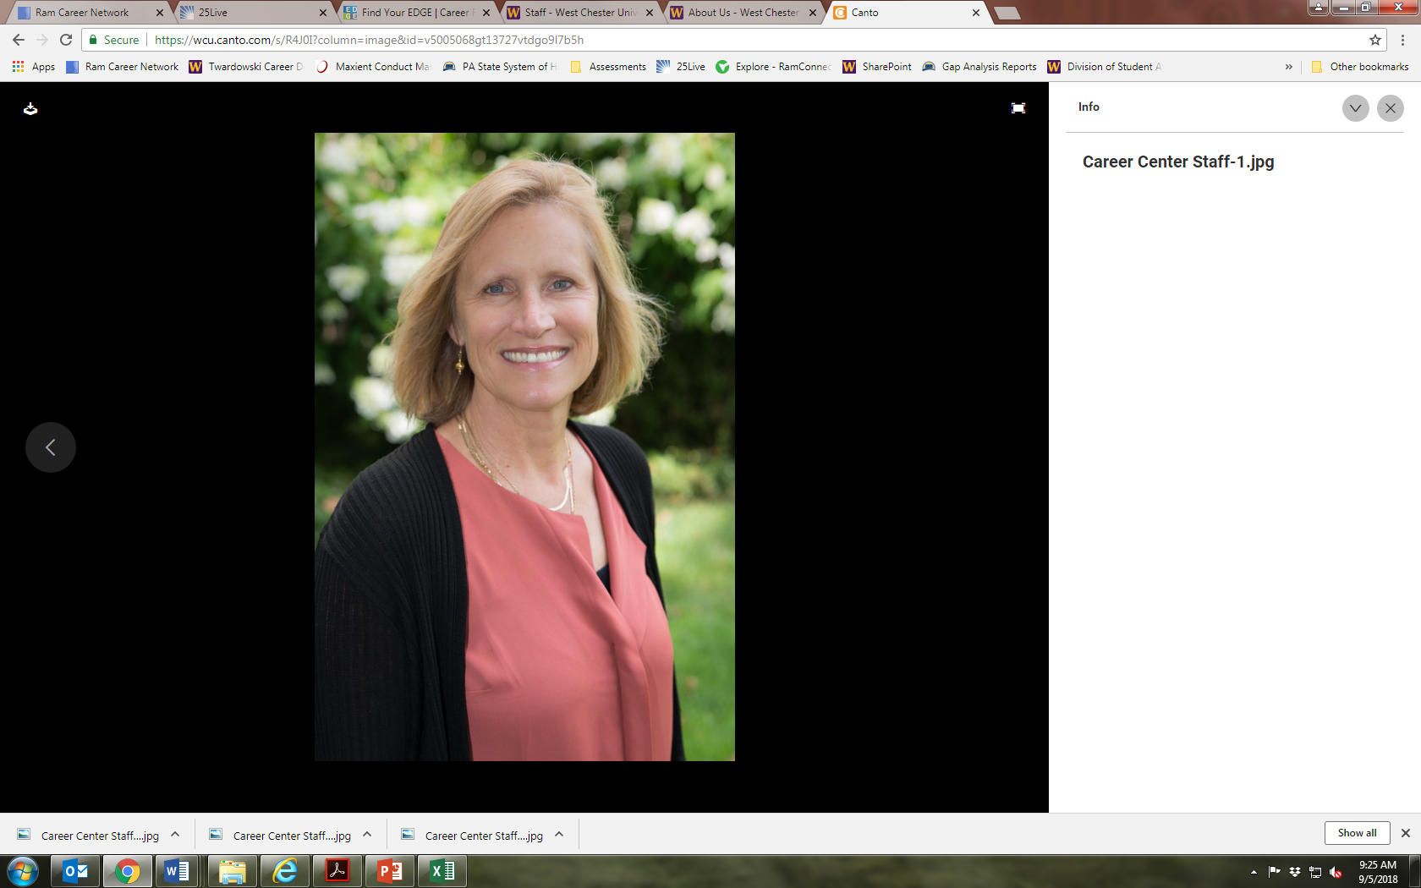
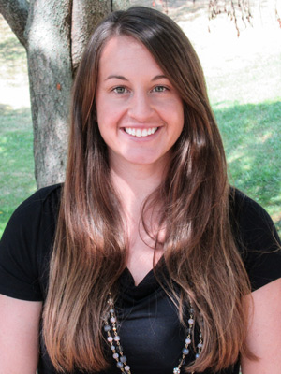
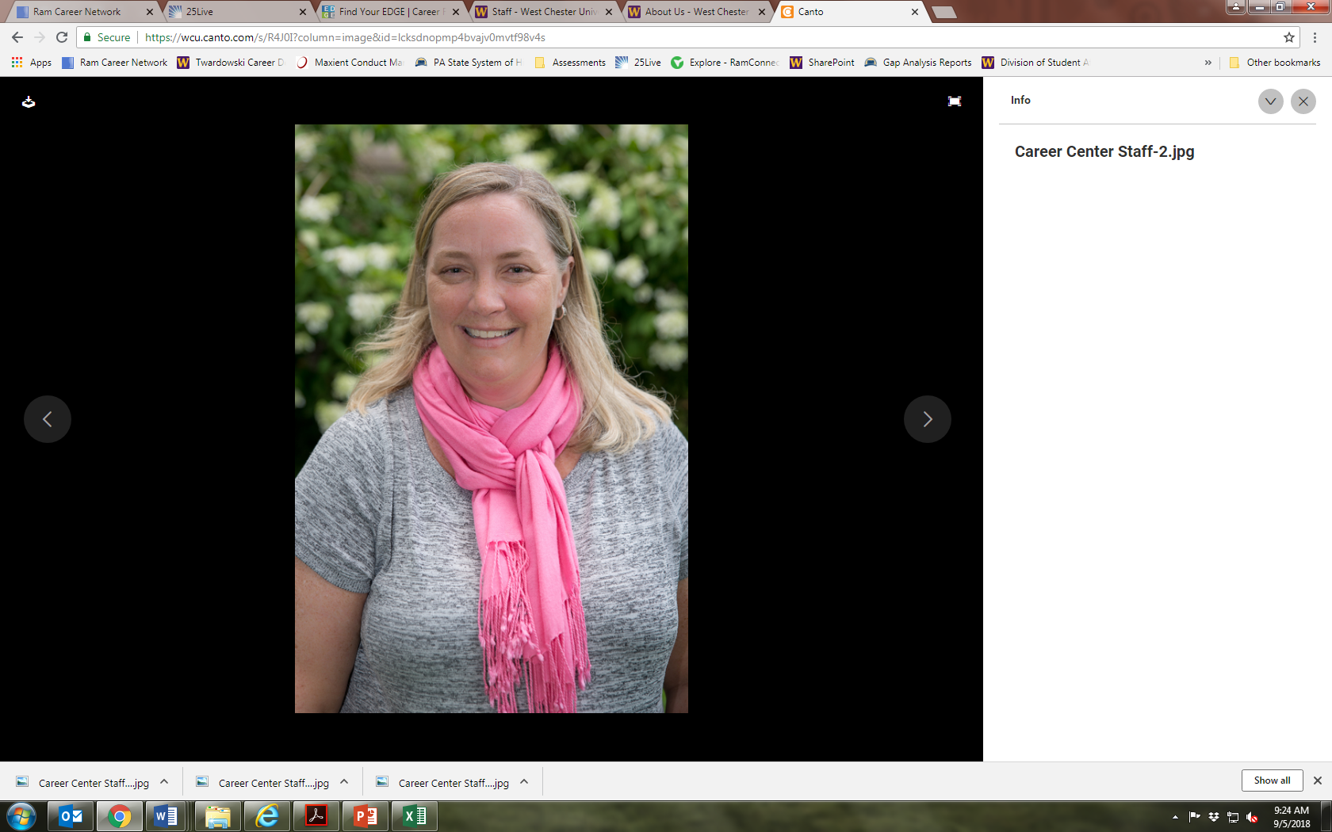
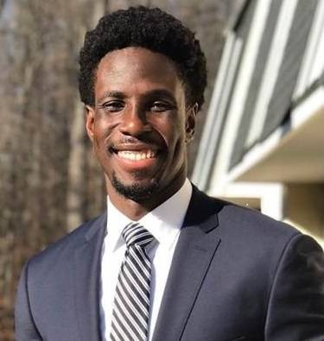

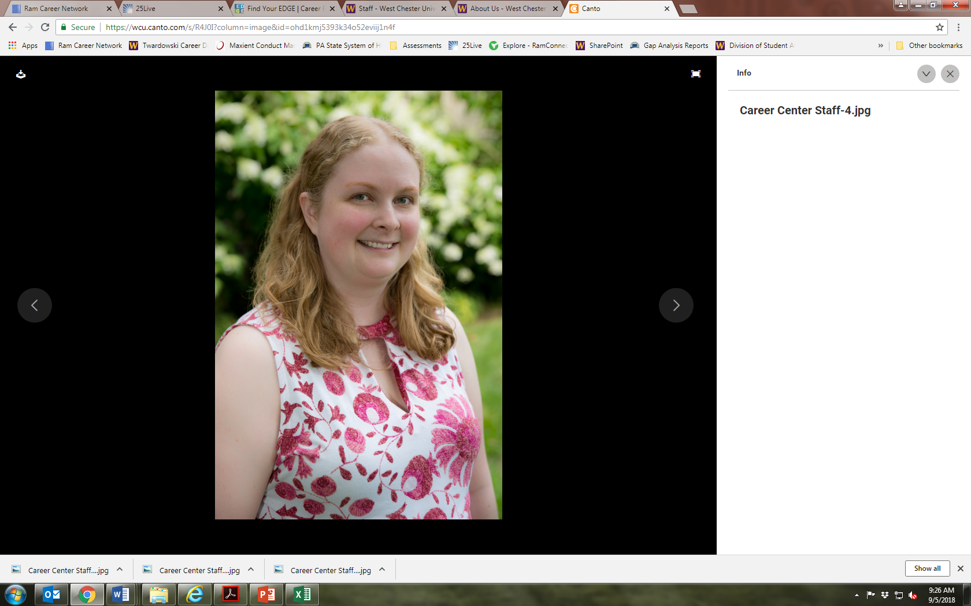
Who We Are
Jen Rossi Long
Senior Director
Phyllis Schoen
Associate Director
Kate Shellaway
Associate Director
Lynn Hewitt
Recruiting & Events Coordinator
Eric Frans
Assistant Director
Amber Pleasants
Assistant Director
Amanda Machonis
Assistant Director
Notes:
Twardowski Career Development Center
cdc@wcupa.edu - 610.436.2501

Slide 3
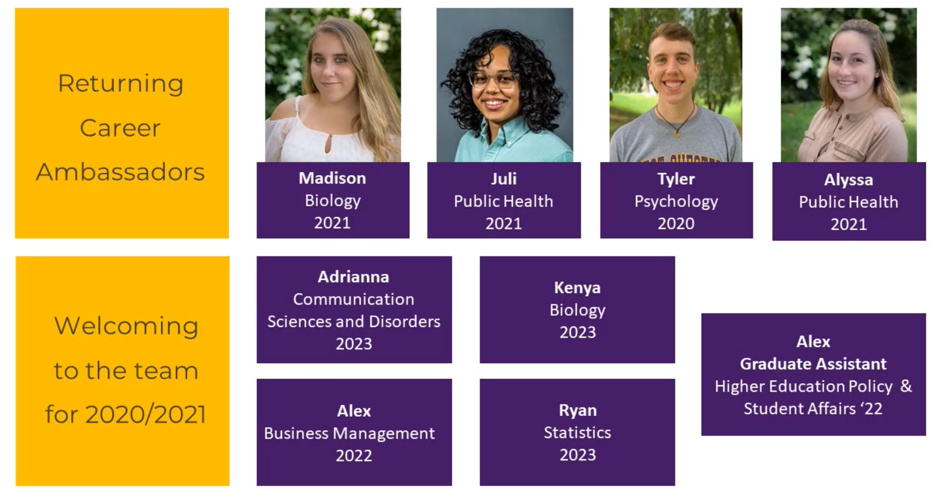

Slide 4
How We Help
We Assist 1-1 Through Appointments And Drop-in Hours
Majors and Careers
Resume and Cover Letter
Job Search
Interview Preparation
Networking & LinkedIn
Graduate School
Career Assessments
The Career Center has gone virtual!
Fall Drop-Ins:
Every Mon –Friday: 1-3pm
Tuesday & Thursday 10-12pm
Wednesday 6:30-7:30pm
Online Tools: Handshake, Career Assessments, Ram Nation and more!

Slide 5
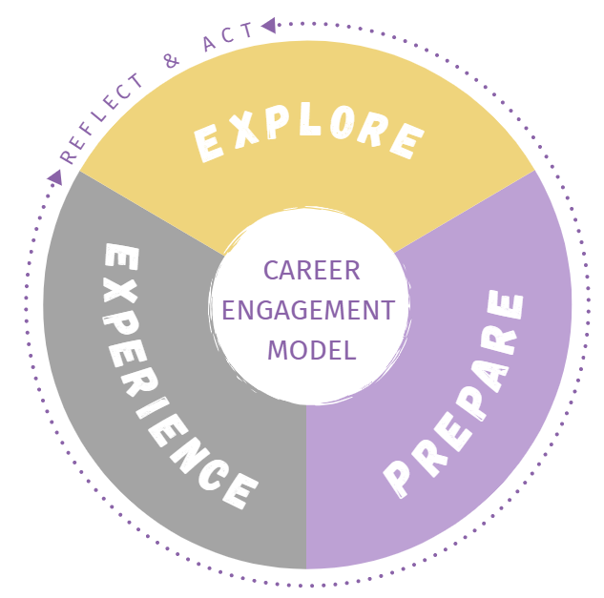
EXPLORE
Explore your options by developing an understanding of who you are and the goals you are working toward. Research WCU majors and career options by discovering your personal values, interests, and skills.
PREPARE
Prepare for opportunity by building your resume, cover letter, network, and interviewing strategies. These preparation pieces act as the foundation of a successful career journey.
EXPERIENCE
Experience all there is to offer on and off campus. Build your skills by getting involved in volunteering, student organizations, part-time jobs, or research. Students who graduate with at least one internship are better equipped to find a full-time job.

Slide 6

Things to Know!
It is never too soon to work with the CDC; the earlier you start engaging in your career development, the better!
First year
Senior
Alumni
Sophomore
Junior

Slide 7



Things to Know!
Our services are available to you – regardless of where you are!

Slide 8



Things to Know!
Career Development isn’t something you have to put on a suit to do.

Slide 9

How We Help
Web Content On Demand
Handshake, Ram Nation, Big Interview
Connection to Employers & Alumni:
Job & Internship Fairs
Employer Resume Reviews
Employer Mock Interviews
Industry Meet Ups
Majors and Careers
Resume and Cover Letter
Job Search
Interview Preparation
Networking & LinkedIn
Graduate School
Career Assessments

Slide 10

Handshake
Schedule appointments
Upload documents
Apply for jobs/internships
Research employers
Check out upcoming events
And more!
wcupa.joinhandshake.com

Slide 11

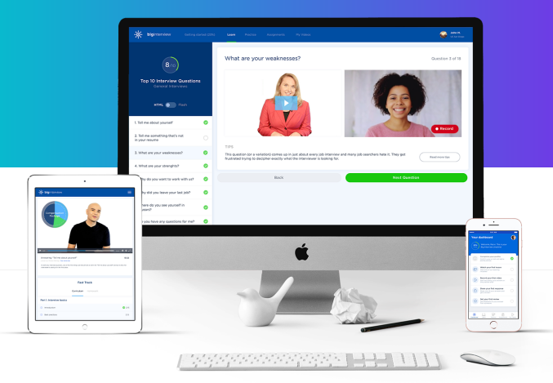

https://wcupa.biginterview.com/

Slide 12
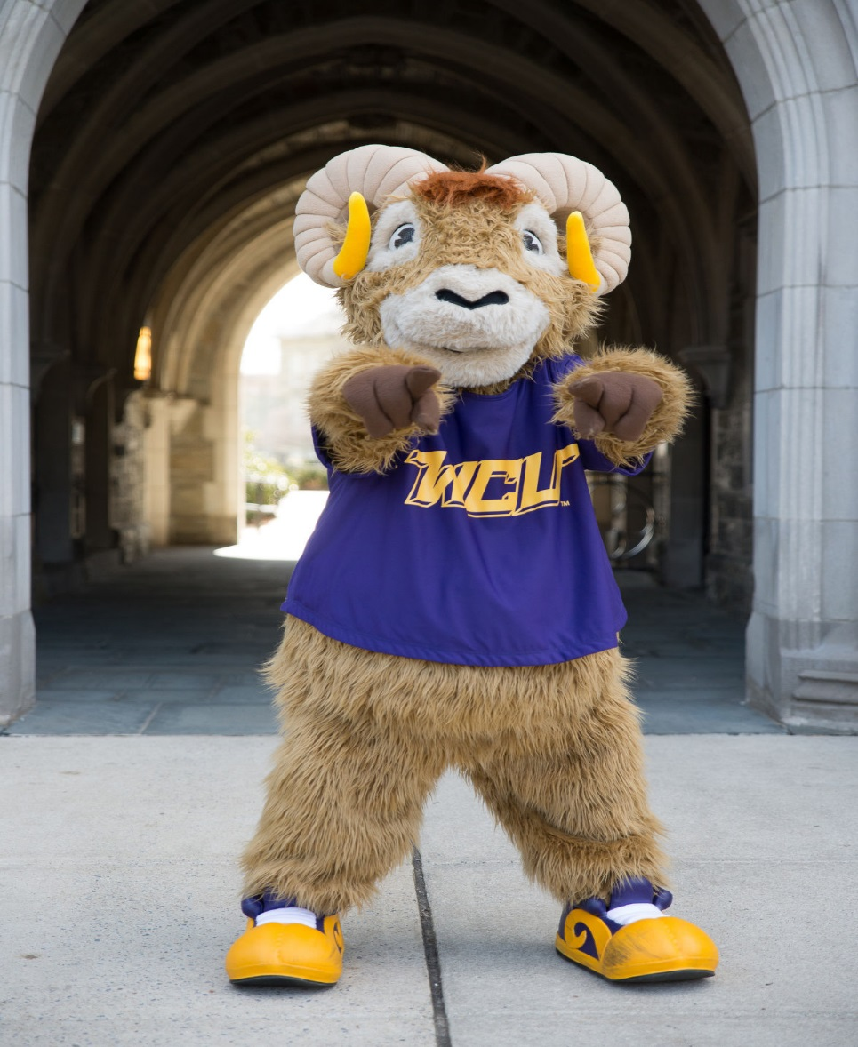



Questions?
www.wcupa.edu/cdc
cdc@wcupa.edu
@WCUCareerCenter
wcu_tcdc
West Chester University Career Center

