Slide 1
Play, Sleep, and Poverty-Related Stress
Fola Shokunbi, Molly Murphy, Mallory Garnet
Faculty Mentor: Dr. Ellie Brown
West Chester University, Department of Psychology

Slide 2
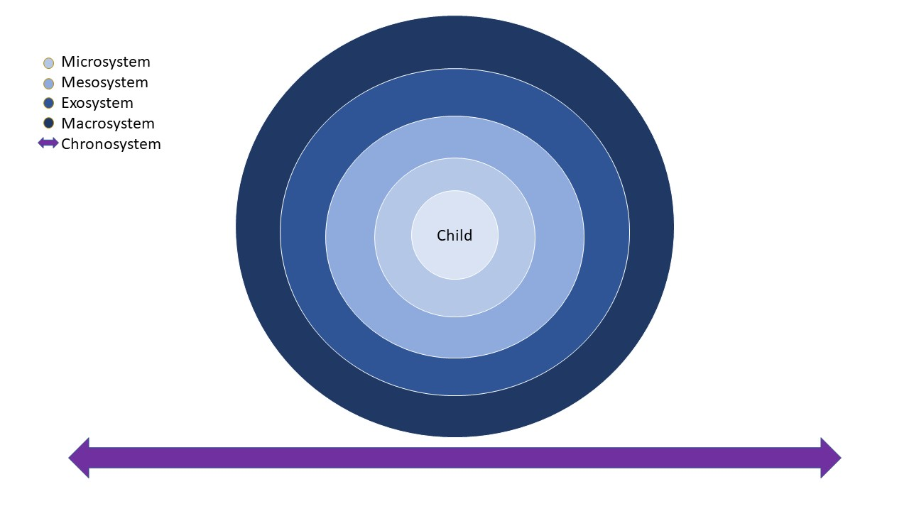
Bronfenbrenner’s Model
Understanding an individual’s context of living
Five Nested Categories
Microsystem
Mesosystem
Exosystem
Macrosystem
Chronosystem
Notes:
Context shapes a person and the systems around them is crucial to understanding development.
This will allow us to visualize the true impact poverty has on child development, along with the isolation from the negative effects of poverty a child may face due to methods such as positive parenting practices, play, and sleep implements both in the home and at institutions like preschools.
Nested Categories
Microsystem: Child's immediate environment. School, home, peer group
Mesosystem: Environments that connect the Micro and Exosystems. the home life and environment can have positive or negative effects with the child’s relationships with their school or teachers or vice-versa
Exosystem: Systems with indirect effects on the child. A parent's workplace, the school board.
Macrosystem: Larger societal forces that act on people. Cultural beliefs and values, Gov't policies
Chronosystem: Changes over time.

Slide 3

Overview
Poverty circumstances tax physiological systems that respond to stress (Lupien, King, Meany, McEwen 2001; Blair et al 2011) as well as the brain areas influenced by stress hormones, such as the prefrontal cortex (Hanson et al 2013, Hair et al 2015; Noble et al 2015; Blair & Raver 2016)
Positive parenting may provide some protection (Blair and Raver 2016)
Present study uses daily interview methodology to probe how parent might structure children's days to promote lower stress levels in the context of poverty

Slide 4
Parenting, defined as, responsive caregiving, including creation of stimulating and rewarding environments has effects including:
Improved effortful control and emotion regulation (Neppl et al 2020)
Reduction of cortisol levels in children being raised in poverty
Facilitation of play experience can make a difference
Play provides opportunities for children to acquire and develop executive functioning and emotion regulation skills
Structuring of sleep matters as well
Sleep quality can have both immediate and lasting effects on development
•Children with more fragmented sleep patterns show higher levels of cortisol at waking (Scher et al 2010)
•Sleep quality can moderate SES effects on cognitive performance (Buckhalt 2007)

Slide 5
Methods
Participants were 139 children who attended a Head Start preschool in a large Mid-Atlantic US city and their primary caregivers.
The mean age of the children was 4 years, 2.08 months (SD = 6.81 months).
48.9% were identified as female, and 51.1% as male.
52.6% identified as Black/African American, 16.6% as Latino/Hispanic American, 8.6% as Asian American and 22.3% as White/European American.
Almost 100% of participants faced economic hardship, with their income-to-needs ratios falling below 2X the federal threshold for poverty status.
Primary caregivers completed initial demographic interviews as well as follow-up parent interviews
They were conducted over the telephone by trained research assistants in order to collect information about daily routines, on 10 different days across two weeks.

Slide 6
Questions were asked about the prior day’s activities.
Parents were asked what their children did during the hours they were home together and were asked what time they went to sleep.
Child activities were coded by trained research assistants as falling into one of five categories:
play (e.g., blocks, dolls, sports, drawing)
leisure (e.g., TV, music listening, eating)
socializing (e.g., talking with someone in person, on the phone, or virtually)
chores (e.g., setting the table, taking a bath)
learning (e.g., reading a book, practicing writing).
Scores were coded as a proportion of the total time the parent and child were home together and were averaged across the 10 days of the interview.
Child cortisol was measured via samples of saliva collected at 9am, just following preschool drop-off and prior to breakfast.
Collection, storage, and analysis was conducted according to standard procedures (Blair et al., 2005).

Slide 7
Results
Table 1
Table 2
shows a zero-order correlational analysis
Out of all the activity categories in the study, more playtime is related to lower levels of the stress hormone, cortisol.
A later bedtime related to higher levels of cortisol.
shows a regression analysis that included key demographic controls
Playtime and bedtime explained unique variance in cortisol.

Slide 8
Table 1
Variables | 1 | 2 | 3 | 4 | 5 | 6 | 7 | 8 | 9 | 10 | 11
1. Age | −
2. Sex | -.029 | −
3. Race/ethnicity | .002 | .149 | −
4. Family income | -.007 | -.137 | .175* | −
5. Chores | -.154 | -.193 | -.202 | -.098 | −
6. Leisure | -.016 | .092 | .126 | .04 | -.539** | −
7. Socializing | .004 | .027 | -.06 | -.034 | -.123 | .108 | −
8. Learning | .074 | .049 | .039 | .036 | .009 | -.028 | -.233* | −
9. Playtime | -.168 | .299** | -.078 | -.226* | -.193 | .038 | .115 | .042 | −
10. Bedtime | .043 | -.082 | -.049 | .047 | -.329** | .027 | .039 | .053 | -.04 | −
11. Cortisol | -.049 | .068 | .08 | .004 | -.09 | .011 | .150 | -.132 | -.271* | .331** | −
Descriptive Statistics for Child Demographics, Daily Activities, and Cortisol (N=139)
Note. Child age is coded in months. Child sex and race/ethnicity are coded dichotomously (1 = male and minority group member, respectively). Family income represents the income-to-needs ratio based on federal guidelines. Cortisol is measured in micrograms per deciliter (μg/dL).
*p < .05, **p < .01.

Slide 9
Results: Table 2
 |  | Model 1 |  |  | Model 2
Variable | B | SE B | β | B | SE B | β
Age | -.001 | .004 | -.045 | -.003 | .003 | -.096
Sex | .001 | .054 | .002 | .039 | .049 | .098
Race/ethnicity | .001 | .061 | .002 | .009 | .055 | .02
Family income | -.014 | .035 | -.053 | -.034 | .032 | -.133
Playtime |  |  |  | -.001 | .000 | -.36*
Bedtime |  |  |  | -.077 | .027 | .33**
R² |  | .003 |  |  | .094
F for change in R² |  | .082 |  |  | 2.905***
Results of Hierarchical Regression for Child Cortisol (N = 139)
*p = .005, **p = .006, *** p = .001.

Slide 10
Discussion
Results suggest both playtime and sleep time matter for the stress levels of children facing economic hardship
Interventions can be implemented at different levels of the Ecological Model
Microsystem
Parents •might facilitate play experiences with children during time together and make sure they have adequate amounts of sleep
•Play-based interventions in school might supplement and help develop ones learned at home

Slide 11
Mesosystem
Schools might help facilitate implementation of play and sleep interventions at home or help reduce parental stress that limits opportunities for play at home (Hamden-Thoompson & Galindo 2017)
Macrosystem
Policy implications concern the importance of play and sleep for children facing economic hardship
Chronosystem
Supportive interventions over time may benefit children raised in poverty, providing boosts to academic achievement, reductions in instances of substance abuse, and overall better outcomes (Verner 2018, Negrão et al 2014, Roetman et al 2019)

Slide 12
Limitations
•This is an initial study using novel methodology to examine an understudied area
•Potential unmeasured confounding variables that explain these relations, and future studies are needed

Slide 13
Questions?

Slide 14
Thank you!

