Slide 1
Knowledge of Food waste and food preparation
Lucas Ramirez-Bryan & Amir Golmohamadi

Slide 2
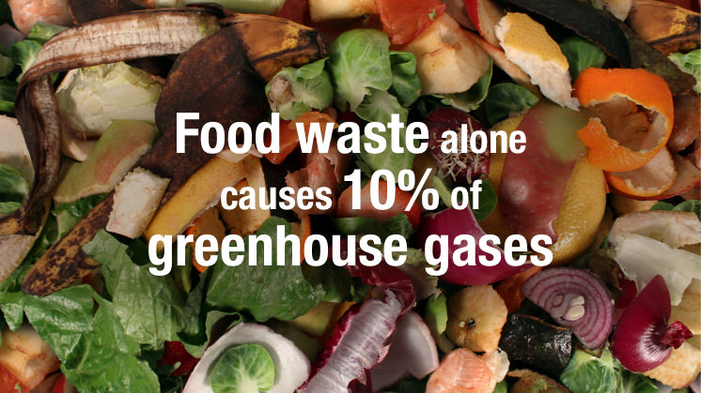
Why is food waste important?
40 million tons of food waste in U.S alone
Contributes to land and resource waste, and CO2 emissions
Can be treated at individual level
Wasted money and resources

Slide 3
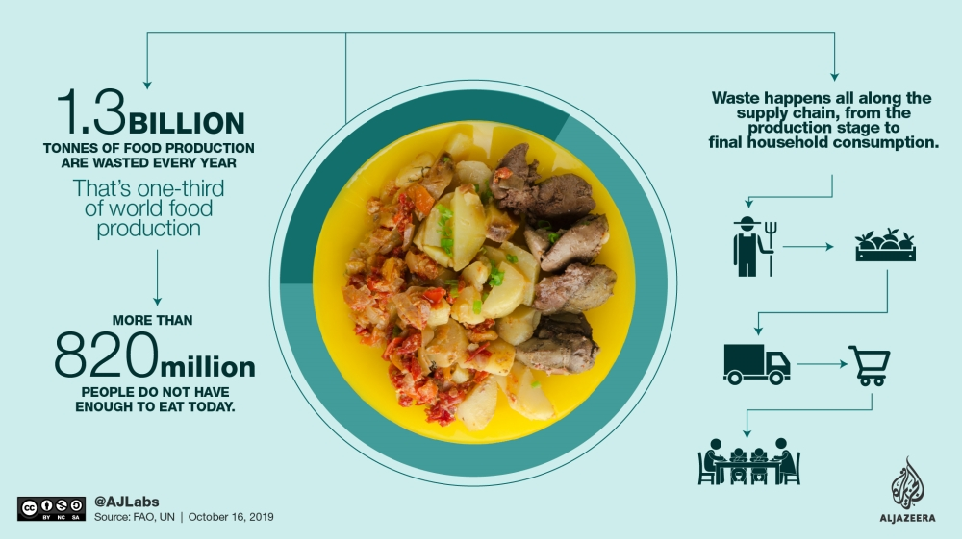
Dietary Behavior and Food Waste
Disposal of FOGs (Fats, oils, and Grease) can lead to sewer blockage.
Canned and frozen produce leads to lower food waste
Planning your trip to store can decrease household food waste.
Food waste can be created indirectly and without knowledge

Slide 4
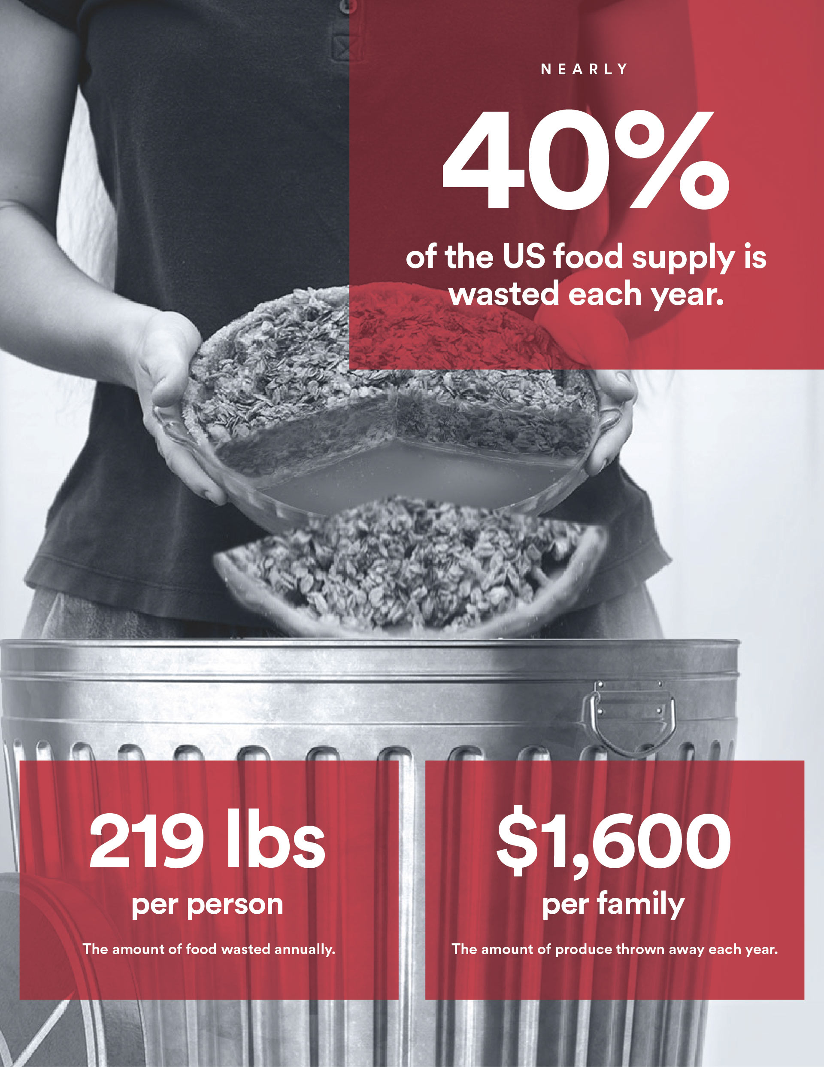
Nutrition and Food education
Not just at a academic level, but community and individual level
Having a holistic and sustainable framework key to being successful
Self-reflection and even journaling raises personal awareness on issue.
Education of one can lead to education of those around them

Slide 5
Conclusion
Education on proper storage and preparation of food leads to lower food waste.
Bringing awareness to FOGs and food waste disposal
Including sustainable factors in local communities
Being conscious of what you are purchasing

