Slide 1

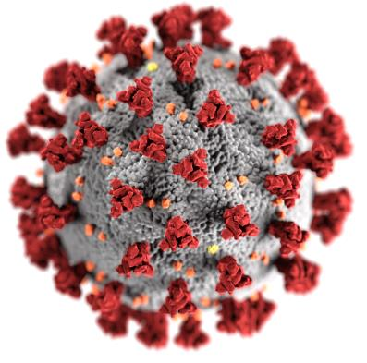
The Ever-changing Work Environment During COVID-19: Nurses’ Experiences During The Early Phase
Julie McCulloh Nair PhD, RN, APHN-BC, CCRE
Amanda Thomas BSN, RN

Slide 2

Introduction
At the beginning of COVID-19:
Crisis standards of care were implemented that led to constant change within the workplace. (HHS, 2020)
Nurses had limited resources
Clinical guidelines changed weekly
Insufficient population health education left Nurses unprepared for the pandemic. (Veenema et al, 2020)
This resulted in high anxiety, confusion and mistrust of respected organizations. (ANA, 2020)
Nurses have an equal obligation to care for self and others. (ANA, n.d.)

Slide 3
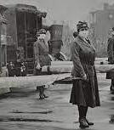
Background
Over the past century, nurses have served on the frontlines of several deadly pandemics, caring for the infected and dying patients. (Brand, 2016)
During COVID-19 nurses continued to work despite the fears of infection and moral distress due to crises standards of care.
Literature exists that reflect RNs willingness to serve, but very little exists that speaks to their experiences, perceptions and reaction to change rooted in crisis. (Stearns, 1998)

Slide 4
Purpose and Significance
The purpose of this study is to explore nurses’ experiences during the early phase of the COVID-19 pandemic.
Knowledge gained from nurses’ first-hand accounts and stories utilizing crisis standards of care during a pandemic is vital and may lead to new policies, preparedness education for future pandemics, and prevent repeating past mistakes.

Slide 5
Methods
A phenomenological approach was employed in this qualitative study.
This method allowed study investigators to explore nurses’ lived experiences using their own written descriptions and digital images. (Creswell & Poth, 2018; De Chesnay, 2015; Finlay, 2009)
Participants were asked to provide their stories using both methods along with demographic information to assist with characterization of participants.

Slide 6
Methods
Sample and Setting:
A purposive sampling strategy was used to recruit approximately 25 participants nationwide.
Study investigators used their personal networks (nursing colleagues, friends, and family) to recruit nurses to participate in this study via personal email, text messaging, social media accounts and the Sigma website.
Using a snowball technique, study investigators asked participants to share the recruitment letter that contained a link to the COVID-19 Nursing Experience survey with their personal nursing network via email, text messaging and social media accounts.
These strategies allowed for a deliberate selection of participants from all specialty areas within the nursing profession as this research focused exclusively on the nursing experience.
To meet inclusion criteria, participants had to be registered nurses, retired nurses, or new graduate nurses, with all others were excluded from this study.

Slide 7
Methods
Data Collection occurred in the U.S. between late April to early June 2020, which was during the early phase of COVID-19.
The COVID-19 RN experience survey was delivered via Qualtrics and consisted of 3 sections: demographics, written narratives, digital images and/or video of story. All submissions were anonymous with the survey taking approximately 30 mins – 1 hour to complete.
All study investigators used the 6-step process (Braun & Clark, 2008) for thematic analysis to generate themes from the collected lived experience data.
Study investigators met regularly for analysis sessions; trustworthiness of findings was assured due to similarities found among interpretations and bracketing was used to remove biases.
Quantitative data analysis was completed in Qualtrics and SPSS statistical software independently of the qualitative data analysis which was completed in MAXQDA2020™ software and Excel spreadsheets.
By combining these methods, study investigators were able to identify the essence of the nursing experience during the early phases of the COVID-19 pandemic. (Creswell & Poth, 2018; Marshal & Rossman, 2016)

Slide 8
Results
161 nurses enrolled in this study
40% of the participants worked in critical care, medical/surgical or the emergency department
Novice nurses (<5 years of experience) accounted for 42% of the participants
58 participants submitted narratives of their first-hand experiences during the early phase of this pandemic

Slide 9
Qualitative Results
Everchanging Environment was the overarching theme that emerged from this study
Six subthemes under this umbrella
Adapting to a new role
Innovation to practice
Nurses’ fears and anxiety
Job loss
Lack of supplies
Emotional distress

Slide 10
Qualitative Excerpts
“With every day came a new update. What we were being told to do just the day before wasn’t evidence-based practice any longer.”
“Within weeks, my floor was completely transitioned from a cardiac step-down to a COVID-19 unit. I had to forget everything I spent the last 6 months learning.”
“All PPE supplies were removed from our supply rooms and are now stored in a central location under lock and key … We are given one surgical and 1 n95 mask per week and have to make them last.”
“We have lived in a constant state of panic that we’ll bring this home to our families and loved ones. We were basically told to throw out all we have learned about infection control and proper PPE and wing it.”
“I feel trapped, and I feel like I’m suffocating with no way out or no end on sight.”

Slide 11
Discussion
Adoption of crisis care standards resulted in rapidly changing environment with little infrastructure support
Nurses were affected by the ever-changing environment irrespective of age, experience, institution type or practice settings
Constant changes to practice and work environment led to emotional distress
Fear & anxiety related to redeployment, lack of supplies, training, and overall unpreparedness to provide safe and effective care

Slide 12
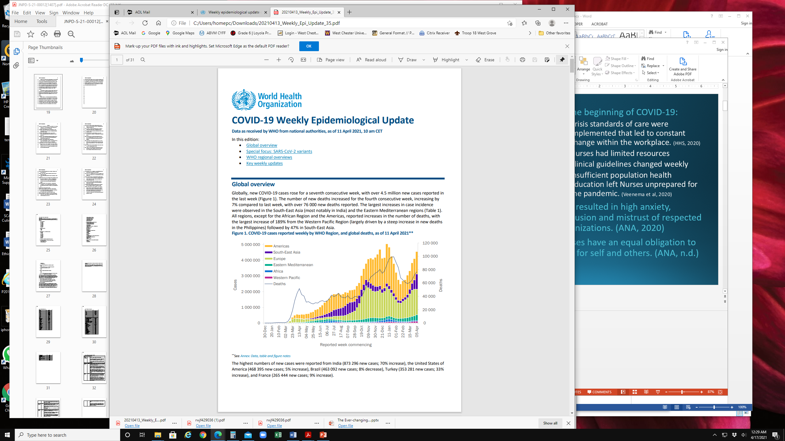
Conclusion
COVID-19 was unprecedented in its global reach and spread, and impacted nurses in all settings and specialty areas
Adoption of crisis care standards caused significant and frequent changes to the work environment
First-hand accounts illuminated the many gaps in public health emergency preparedness and response that require additional education, training and policy development.

Slide 13
Conclusion
Cross-training nurses for redeployment to other settings should be considered to ensure patient safety and clinical competencies
Access to mental health serves now and post-pandemic is highly recommended due to the high emotional distress experienced by nurses during this pandemic
Acknowledgements - Special thanks to our study team members, Drs. Susan Birkhoff and Deborah Mandel.
Final edits to the manuscript have been submitted in the Journal for Nurses in Professional Development.

Slide 14
Future Research
Focus is needed on nursing workforce development and preparedness to respond to public health emergencies, in addition to nurses’ mental health outcomes
Future studies should capture the nursing experience during different phases of the pandemic, to enable comparative analyses

Slide 15
References
American Nurses Association (ANA) (n.d.). Provision 5: Self-care & COVID-19. https://www.nursingworld.org/~4a1fea/globalassets/covid19/provision-5_-self-care--covid19-final.pdf
American Nurses Association (ANA) (2020, September). COVID-19: Evidence as the basis of decisions. https://www.nursingworld.org/~4a5b08/globalassets/covid19/covid-19_-evidence-as-the-basis-of-decisions-final_sm.pdf
Brand, R. (2016, May, 1) 408 . Charting nursing’s future: Reports that can inform policy and practice. Robert Wood Johnson Foundation. https://www.rwjf.org/content/dam/farm/reports/issue_briefs/2016/rwjf429036
Creswell, J. & Poth, C. (201 431 8). Qualitative inquiry & research design: Choosing among five approaches (4th ed.). Sage.
De Chesnay, M. (2015). Nursing research using phenomenology: Qualitative designs and methods in nursing. Springer.
Finlay, L. (2009). Debating phenomenological research methods. Phenomenology and Practice, 3(1), 6-25.
Stearns, P. (1998). Why study history? American Historical Association. https://www.historians.org/about-aha-and-membership/aha-history-and-archives/historical-archives/why-study-history-(1998)
U.S. Department of Health & Human Services (HHS) (2020). COVID-19 patient surge and scarce resource allocation. https://asprtracie.hhs.gov/covid-19-patient-surge
Veenema, T. G., Meyer, D., Bell, S. A., Couig, M. P., Friese, C. R., Lavin, R., Stanley, J., Martin, E., Montague, M., Toner, E., Schoch-Spana, M., Cicero, A., & Inglesby, T., (2020, June). Recommendations for improving national nurse preparedness for pandemic response: Early lesson from COVID-19. Johns Hopkins Center for Health Security. https://www.centerforhealthsecurity.org/our-work/publications/recommendations-for-improving-national-nurse-preparedness-for-pandemic-response--early-lessons-from-covid-19

