Slide 1
The Evaluation of a Soft Skills Curriculum in Athletic Training Education: A Mixed Methods Study
Emily A. Duckett, EdD, LAT, ATC
West Chester University of Pennsylvania
Research Day
April 29th, 2021

Slide 2
Objectives
Introduction
Purpose
Research Questions
Methodology
Participants
Description of Setting
Procedures
Instruments
Results
Discussion
Quantitative Results
Qualitative Results
Discussion of Results
Implications

Slide 3


Introduction
In healthcare, soft skills include: ethics, attitudes, interpersonal abilities, communication, and lifelong learning (Joubert et al., 2006).
Pre-professional healthcare students should have the opportunity to learn and practice soft skills to build foundational behaviors of professional practice prior to clinical experience.
A top priority of healthcare is quality patient-centered care
Foundational behaviors of professional practice (National Athletic Trainers’ Association, 2011)
Notes:
Point 3: compassionate care, and emphasizing the patient as their top priority of care

Slide 4


Empathy & Compassion
EMPATHY
COMPASSION
(Patel et al., 2019; Trzeciak & Mazzarelli, 2019)
Notes:
Analogy: Empathy is like a one-way street running toward the health care provider: detecting, processing, understanding and even feeling the incoming emotional cues from the patient. Compassion, on the other hand, is a street that runs in the other direction, a responsive action toward the one who is suffering. Empathy can be a one way street compassion cannot.
Empathy is defined as, the ability to sense, feel, and understand another’s emotions
Compassion is defined as an emotional response to another’s pain or suffering involving an authentic desire to help (Patel, 2019).

Slide 5
Benefits of Empathy & Compassion in Healthcare
↑ patient compliance (DiMatteo et al., 1993)
More accurate prognosis (Dubnicki, 1977)
↑ patient satisfaction (Zachariae, 2003)
↓ anxiety, depression and hostility in cancer patients (LaMonica, 1987)
Optimal physiological outcomes in diabetic patients (Hojat, 2011)
Improved patient adherence, satisfaction and treatment outcomes (Rattka, 2018)
Activation of the parasympathic nervous system (Trzeciak & Mazzarelli, 2019)
Psychological health benefits: trust building and cultivating hope (Trzeciak & Mazzarelli, 2019)
Scientific evidence to support the effects of compassion on provider well-being, employee engagement, and organizational performance
Notes:
1- Research by DiMattteo et al., (1993) revealed that empathetic patient communication and interaction resulted in increased patient compliance. Patient compliance is an essential aspect of athletic training services.
3- Additionally Zachariae et al., (2003) discovered that empathetic patient communication increased patient satisfaction. Which as a result could influence patient reported outcomes.
4- In a clinical outcome study, it was found that nurses’ empathetic engagement in patient care was predictive of reduced anxiety, depression and hostility in cancer patients
7- lowers blood pressure too
8- Psychological Health Benefits
Compassion builds trust
Hope: How patients do may depend on how they believe they will do

Slide 6


Purpose of Study
The purpose of this study was to investigate the ways in which pre-professional athletic training students’ transfer knowledge from a soft skills curriculum during a didactic preprofessional course to clinical practice during their clinical experience.
?

Slide 7
Research Questions
quan
1. How does a pre-professional soft skills curriculum associate with students’ development of empathy?
QUAL
In what ways do athletic training students perceive they transferred soft skills into clinical practice?
[qual]
How do athletic training students describe their emotional response to utilizing soft skills during clinical practice?
2. How does a pre-professional soft skills curriculum associate with students’ development of compassion?
In what ways are the development of soft skills associated with athletic training students’ subjective well-being?
In what ways are the development of soft skills associated with athletic training students’ subjective well-being?
Notes:
An explanatory sequential mixed method deign with a preliminary quantitative input was utilized (quan →QUAL [qual]) (Morgan, 2014).
The primary research question for this study is: In what ways can knowledge from a soft skills curriculum during a didactic pre-professional course be transferred to clinical practice during an athletic training student’s clinical experience?
Mixed methods methodology adds insight of a practical nature to the study. Students learn a soft-skills curriculum and throughout the semester the students used validated quantitative surveys to self-report their levels of empathy and compassion. Once the students transition to their clinical experience the qualitative component of the study adds the students’ voices and experience helping the researcher understand what knowledge participants’ transfer from the classroom to clinical practice through a case study design. Therefore, the report of the quantitative results followed by the qualitative results will lead to insight about how the quantitative personal perceptions help explain the quantitative results (Creswell, 2018).

Slide 8
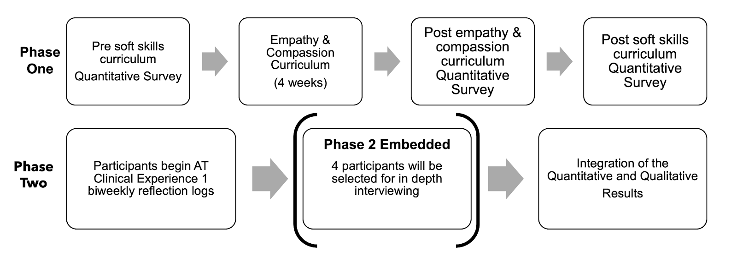
Study Timeline
Notes:
PARTICIPANTS:
Purposeful sample
Phase One: Upper level undergraduate students (n=19) enrolled in a preprofessional capstone in sports medicine course
Phase Two: Entry-level master students enrolled in a Commission on Accreditation of Athletic Training (CAATE) athletic training education program (ATEP) (n=19). The students are enrolled their first AT clinical experience
Phase Two Embedded: 4 semi-structured interviews selected by who reported using empathy and compassion most frequently during their clinical experiences

Slide 9
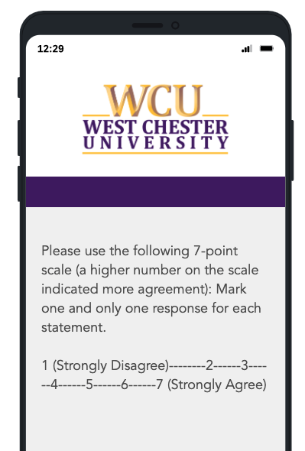
Surveys: Phase One
Jefferson Empathy Scale for Health Professions Students (JSE-HPS)
Compassion Scale (CS)

Slide 10
Reflection Logs: Phase Two
Empathy is defined by Patel (2019) as, the ability to sense, feel, and understand another’s emotions. Given that definition, describe one or more times when you demonstrated empathy during the past two weeks of your clinical experience.
Compassion is defined as an emotional response to another’s pain or suffering involving an authentic desire to help (Patel, 2019). Given that definition, describe one or more times when you demonstrated compassion during the past two weeks of your clinical experience.
Given the pandemic, in what ways has your ability to provide patient centered care been influenced in the last two weeks?
Please describe your own well-being in the past two weeks.
Describe the ways in which your own well-being has influenced your ability to exhibit soft skills and provide patient centered care in the last two weeks of your clinical experience.
How frequently did you utilize the soft skills of empathy and compassion in the last two weeks?
Notes:
6- 5 point Likertscale
1: Never: I do not use empathy and/or compassion during patient interactions
2: Rarely: I use empathy and/or compassion during patient interactions monthly
3: Sometimes: I use empathy and/or compassion during patient interactions weekly
4: Often: I use empathy and/or compassion during patient interactions daily
5: Always: I use empathy and/or compassion during every patient interaction

Slide 11
Semi-Structured Interview: Phase Two Embedded
Can you describe in your own words the definition of empathy?
Can you describe in your own words the definition of compassion?
Did [this class], specifically the lessons on compassion and empathy, influence you clinically?
If so, in what ways? If not, why do you think this was the case for you?
Talk to me about your clinical site. What does empathy and compassion look like at your clinical site?
Can you talk to me about a time when you demonstrated empathy/compassion at your clinical site?
Can you talk to be about a time when you observed your preceptor demonstrate empathy/compassion at your clinical site?
Do you think your own well-being is associated with the delivery of compassion and empathetic patient centered care? If so, how? If not, why not?
Given the pandemic can you talk to me about providing patient centered care during this time?

Slide 12


Data Analysis
Quantitative
Repeated measure ANOVA with composite scores
Qualitative
Constant comparative method of analysis
Thematic coding of reflection logs and semi-structured interviews
Notes:
I used the statistical analysis of a one-way repeated measures ANOVA to determine if the three groups' means were different over time with the same participants in each group. Girden (1992) suggests that a one-way repeated measures ANOVA should be used when participants have been measured over multiple time points to see if any changes have occurred usually during an intervention, in this case throughout a soft skills curriculum intervention.
I used a constant comparative analysis to discover themes and subthemes to best understand the phenomena of how students transfer knowledge from a soft skills curriculum during a didactic pre-professional course to clinical practice.
The coding process involved first and second cycle coding. First cycle coding is used to initially summarize segments of data (Miles et al., 2014). Specifically, I used in vivo coding as the first cycle coding technique. In vivo coding includes statements captured from the participants' words. Therefore, in vivo coding prioritizes and honors the participants' voices (Miles et al., 2014). Second cycle coding groups the first cycle codes into themes and sub themes. The categories and themes are used to answer the qualitative research questions: (1) In what ways do athletic training students perceive they transferred soft skills into clinical practice? (2) In what ways are the development of soft skills associated with athletic training students’ subjective well-being? (3) How do athletic training students describe their emotional response to utilizing soft skills during clinical practice? During second cycle coding, I evaluated the data for phrases or statements that answered the specific research questions and organized them into subcategories until I reached saturation. Charmaz (2001) described coding as “the critical link between data collection and their explanation of meaning. In qualitative data analysis, a code is a researcher-generated construct that symbolizes and thus attributes interpreted meaning to each individual datum for later purposes of pattern detection, categorization, theory building, and other analytic processes” (p. 3-4).

Slide 13
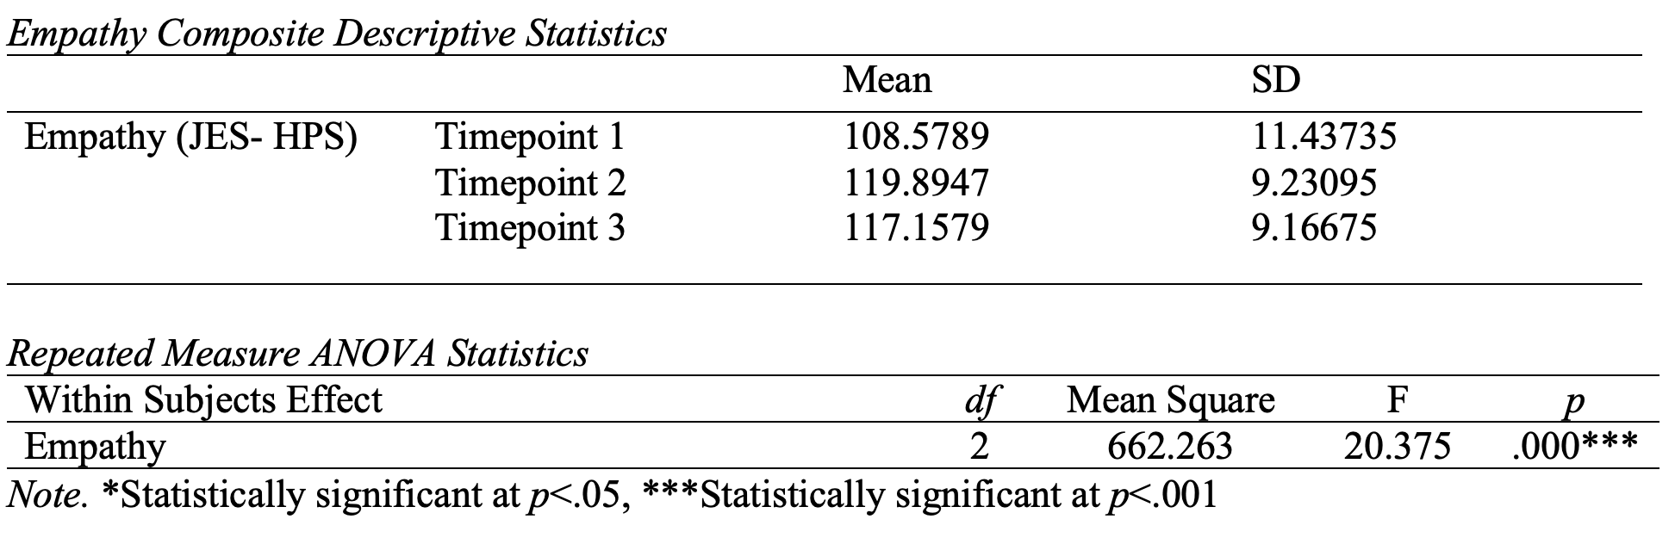
Quantitative Results: Student Empathy Development During an Academic Semester

Slide 14
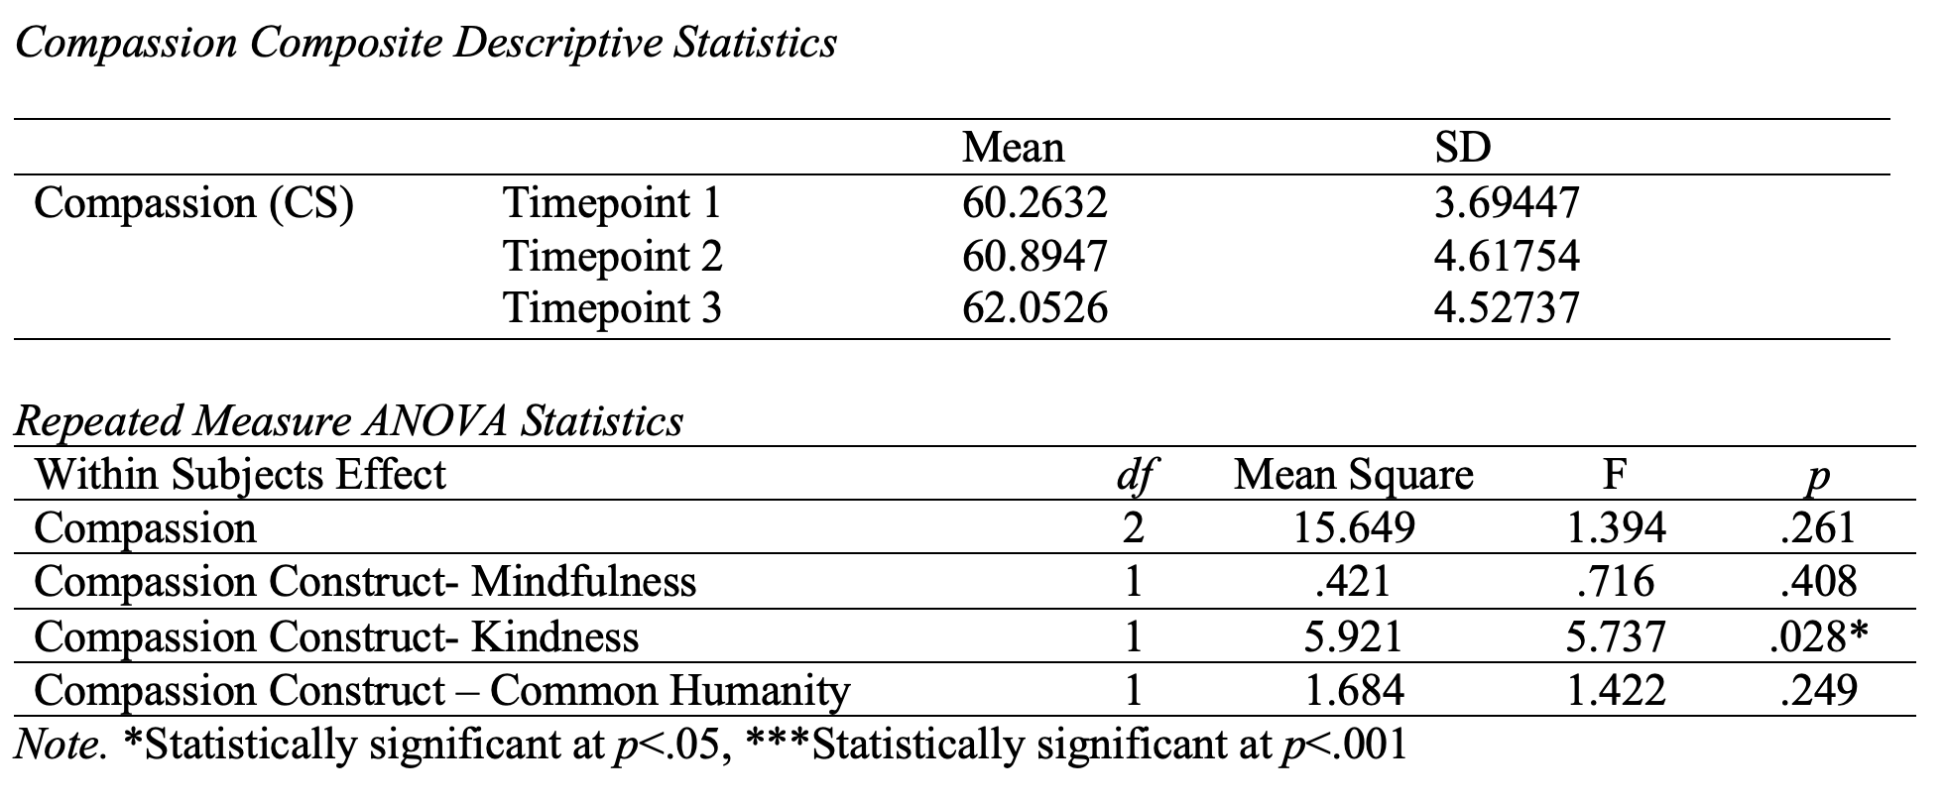
Quantitative Results: Student Compassion Development During an Academic Semester

Slide 15
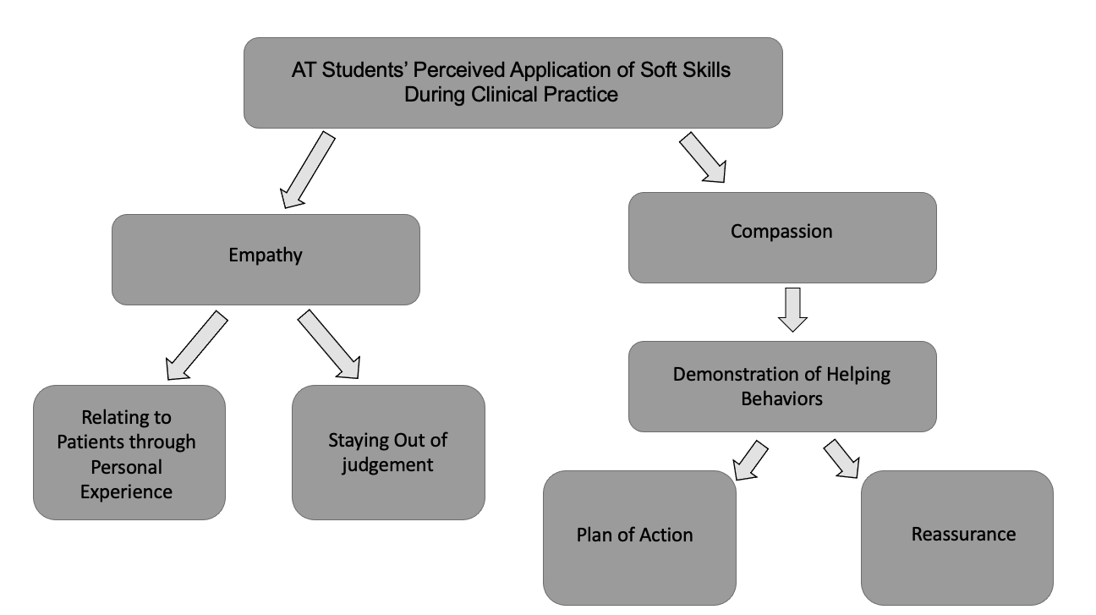
Qualitative Results: Perceived Application of Soft Skills
Notes:
Qualitative Results- Transferring Soft Skills into Clinical Practice

Slide 16
Qualitative Results: Curriculum to Clinical Practice
Class Activities:
Practice Discussing Emotions
Self-awareness
Patient- Centered Care
Clinical Experience:
Mentorship
Notes:
Qualitative Results- Transferring Soft Skills into Clinical Practice

Slide 17
Qualitative Results: Patient-Centered Care During a Pandemic
Challenges
Face masks made communication challenging
Policy Changes
Schedules Appointments
Altruism
more understanding when interacting with their patients in order to provide patient-centered care (Participant 1)
Needed to rely on body language and non-verbal communication
“Due to the pandemic, I feel as though we are able to give better patient-centered care than before (from what I can imagine). Many of these are one-on-one sessions and there is more time to get to know the athlete as an individual and how these injuries are affecting their lives” (Participant 5).
“We are all in this together and everyone’s situation is different, so it’s even more important to be considerate and kind in your care for others” (Participant 19).
Notes:
Given the pandemic, in what ways has your ability to provide patient-centered care been influenced in the last two weeks?
Altruism is, “motivation that is other-directed and aims to increase or benefit another individual's well-being” (Burks & Kobus, 2012, p. 318). The pandemic magnifies that each person faces challenges and struggles in their personal life and as healthcare providers it is critical to be respectful of those areas of their lives.

Slide 18
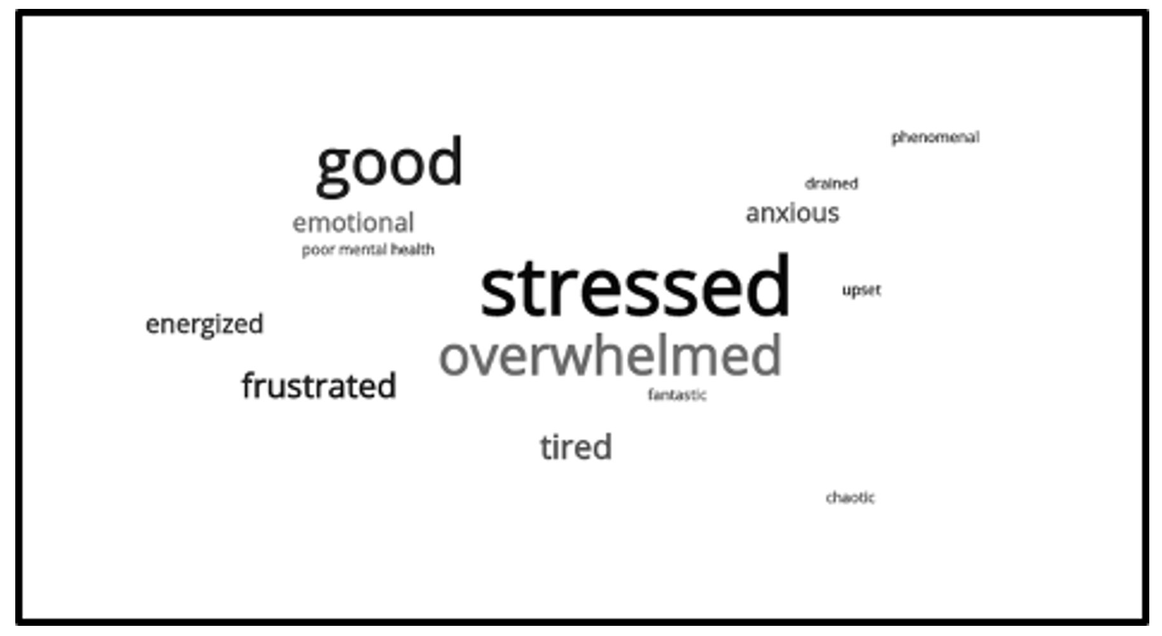
Qualitative Results: Students’ Subjective Well-Being
Notes:
Each research participant completed six reflection logs throughout the Fall 2020 semester. In this semester, the participants completed their first semester as Masters students and their first clinical experiences. Certainly, this semester is viewed as a transition period for the students as they step into the clinical responsibilities and core curriculum of an entry level Masters in Athletic Training program. With this in mind, the students were asked to describe their own well-being every two weeks during the semester. The students’ perception of their own well-being is displayed in this text cloud. In totality, the students completed 114 reflection logs and their answers fell along a large spectrum from negative to positive responses throughout the semester.

Slide 19
Qualitative Results: Emotional Response During Patient Care
Subjective Well-Being | Emotional Response During Patient Care | Example
Negative Emotions | Personal barriers that negatively impacted students’ ability to build therapeutic relationships | “My own well-being has been absolutely taken away from my ability to care for others. I am riding the [struggle] bus this week and it is very hard for me to be my best, kindest, and most compassionate self when it feels like every aspect of my life is a stressor” (Participant 16).
Neutral Emotions | “Flip the Switch” – a phenomenon where despite mood a sense of purpose to be fully present to help support a patient is practiced | “I am very aware that I’m in a dumpy mood… if I’m at my clinical site and I am evaluating someone you kind of flip that switch so you take on a different role… as soon as the patient is gone or I’m done providing care in that instance I can very easily go back to my mood. I know how I would want to be treated and how I would want to be as a clinician, so I think having that goal of who I want to be as an athletic trainer… that is what reminds me to flip the switch” (Participant 19).
Positive Emotions | Positive emotions that influence partnership and reciprocity therapeutic relationships | “I have been making sure to take breaks and focus on me, my mental health, and well-being because I am of no use to my athletes if I am overwhelmed” (Participant 13).
Notes:
Negative Emotions = “stressed 42/114, overwhelmed, frustrated, anxious, upset, poor mental health” The reasons for the student’s elevated stress levels were multifaceted and included poor time management skills, quarantine and COVID-19 exposures, academic classes, and aspects of the students’ personal lives.
Neutral Emotions = “tired, emotional, drained, chaotic” Again, the circumstance of the global pandemic created an unpredictable semester. Students learned how to adjust to changes which they viewed as a positive, however the whirlwind of not knowing what the next day would bring created a stressful environment for them. The academic workload, virtual clinical experience, and COVID-19 procedures seemed to produce the most stress for the students. Although, the students described their in person clinical as their “happy place” (Participant 13 and 17).
Positive Emotions = “good, energized, fantastic, and phenomenal” “Good” was the most frequently reported positive emotion, totaling 16 times. Thematically, the students seemed to report their well-being as “good” when they gave themselves permission to take a break. When the students described a positive state of well-being their underlying cause was being focused, fully rested, calm, and less stressed. Some students noticed how their own well-being created a difference in their patient care that they then began to make their own well-being a priority,

Slide 20
Discussion of Results
Curriculum Activities and Clinical Experiences
AT Students’ Perceived Application of Soft Skills
Students’ Subjective Well-Being and Emotional Response to Utilizing Soft Skills
How the Global Pandemic Influenced Patient-Centered Care
Notes:
Curriculum Activities and Clinical Experiences: Emotional Intelligence Theoretical Underpinnings: Freshwater and Stickley (2004) suggested that an EI healthcare curriculum should include the following components: reflective learning experiences, supportive supervision and mentorship, modeling, opportunities for working creatively with the areas and humanities, focus on developing self and dialogic relationships, developing empathy, and a commitment to emotional competency. Based upon both the findings of this research study and the nursing literature, I recommend that healthcare educators wanting to promote soft skill development within their curriculum implement foundational elements of emotional intelligence into their lessons in addition to activities such as discussing emotions and building self-awareness through the Clifton Strength Finder assessment (Freshwater & Stickley, 2004).
AT Students’ Perceived Application of Soft Skills: Empathy = relating to their patients through lived experiences. I propose that students in this research study easily connect to their patients through lived experiences because of their close proximity in age and their specific clinical assignment. The average age of students in this research study was 20.4 (0.5) years old, which is close in proximity to the majority of their high school patients' ages. Additionally, this study took place during a global pandemic which resulted in challenges and hardships for clinical coordinators to place students at clinical assignments. Therefore, athletic training students most commonly completed their Fall 2020 clinical rotation at high school locations, with 14 out of the 19 of research participants placed at high schools for their clinical rotation. Given that the majority of the participants experienced high school in a traditional setting, many of which also participated in high school sports, the participants easily connected with their high school patients through their personal lived experiences.
AT students interpreted compassion as plans of actions. For example, ensuring that the patient was comfortable with their therapeutic treatment plan, explaining the purpose behind their rehabilitation exercises, providing additional mental health resources and referrals, helping the patient schedule an appointment with a physician, and creating short-term and long-term goals with their patient.
Students’ subjective well-being mirrored their emotional response to utilizing soft skills during clinical practice: Singh and colleagues (2018) reported self-care, contemplative practices, and personal connection as facilitators of healthcare providers abilities to provide compassionate care
How the Global Pandemic Influenced Patient-Centered Care: In David and Larson’s (2018) research on athletic trainer empathy, patients reported communication as an essential part of patient-centered care. Specifically, nonverbal communication related to body language, presence, and attentiveness were important clinician actions from the patient’s perspective (David & Larson, 2018). Given our current global environment, soft skill curriculums now need to place an emphasis on navigating communication through nonverbal communication cues when both the practitioner and patient are wearing face masks for their safety.

Slide 21
Research Take Home Points
How is a pre-professional soft skills curriculum associated with students’ development of empathy?
Statistically significant findings support students’ development of empathy F(2)= 20.38, p=.000
How is a pre-professional soft skills curriculum associated with students’ development of compassion?
Data analysis did not reveal statistical significance for students’ development of compassion F(2)= 1.39, p=.261
In what ways do athletic training students perceive they transferred soft skills into clinical practice?
Empathy: Relating to patients through lived experiences and staying out of judgement
Compassion: Demonstrating helping behaviors of creating a plan of action or providing reassurance
In what ways are the development of soft skills associated with athletic training students’ subjective well-being?
Students reported subjective well-being mirrored their emotional response to utilizing soft skills during clinical practice
How do athletic training students describe their emotional response to utilizing soft skills during clinical practice?
Negative emotions- personal barriers, stress, being overwhelmed
Neutral emotions- “flip the switch”, helping others, kindness
Positive emotions- reciprocity, partnership

Slide 22
References
Creswell, J.W., & Plano Clark, V.L. (2018). Designing and conducting mixed methods research. Sage Publications.
Hojat, M. (2016). Empathy in health professions education and patient care. Springer.
Joubert, P.M., Kruger, C., Bergh, A,M., Pickworth, G.E., Van Staden C.W., Roos, J.L., Schurink, W.J., Du Preez, R.R., Grey, S.V., & Lindeque, B.G. (2006). Medical students on the value of role models for developing ‘soft skills’- “that’s the way you do it.” South African Psychiatry Review, 9, 28-32.
Lamm, C., Decety, J., & Stinger T. (2011). Meta-analytic evidence for common and distinct neural networks associated with directly experienced pain and empathy for pain. Neuroimage, 54(3), 2492-502.
Lown, B.A. (2016). A social neuroscience-informed model for teaching and practicing compassion in health care. Medical Education, 50, 332-342.
Morgan, D. L. (2014). Integrating qualitative and quantitative methods: A pragmatic approach. Sage Publications.
National Athletic Trainers’ Association. (2011). Athletic Training Education Competencies (5th ed). https://www.nata.org/sites/default/files/competencies_5th_edition.pdf
Patel, S., Pelletier-Bui, A., Smith, S., Roberts, M.B., Kilgannon, H., Trzeciak, S., & Roberts, B.W. (2019). Curricula for empathy and compassion training in medical education: A systematic review. PLOS ONE, 14(8), 1-25. https://doi.org/10.1371/journal.pone.0221412
Raab, S., Wolfe, B.D., Gould, T.E., Piland, S.G. (2011). Characterizations of a quality certified athletic trainer. Journal of Athletic Training, 46(6), 672-679.
Trzeciak, S., & Mazzarelli, A. (2019). Compassionomics: The revolutionary scientific evidence that caring makes a difference. Studer Group.

