Slide 1
STUDYING BREAK-IN ATTEMPTS ACROSS MULTIPLE SERVERS USING APACHE SPARK AND SECURITY LOGS
Tyler Clark & Kevin Codd

Slide 2
Introduction
We sought to better understand cyber attacks on West Chester University’s servers
Understand types, frequency patterns, and sources of attacks
Most information related to cyber-attacks is recorded in Linux system logs
Analyzed the system logs of WCU CSC Department’s five online servers
Utilized Spark, a large-scale data analytical engine to conduct our analysis

Slide 3

Apache Spark
Unified analytics engine for large-scale data
Can conduct unified compute jobs on distributed data sets
Functions using MapReduce Programming Framework
Allows for future scaling of our security log data

Slide 4
Servers
Bones | Roadrunner | Submitty | Coyote | Taz
The web server for faculty and other department-related web pages. | The web server for non-CS students to host pages for web development and design courses in the Information Technology program. | Hosts the Submitty autograding server for several CSC courses. | Available to CSC students for courses requiring a Linux environment. Has become obsolete and unused over the past few years but remains online as a potential backup solution for Taz. | Available to CSC students for courses requiring a Linux environment.

Slide 5
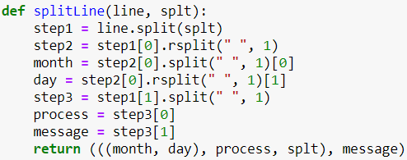
Structure of a Log
Date
Time
Server
Process
Message
(((‘Jan’, ‘24’), ‘sshd[18558]:’, ‘ submitty ‘), ‘Failed password for invalid user basesystem from 206.189.173.15 port 44942 ssh2’)

Slide 6
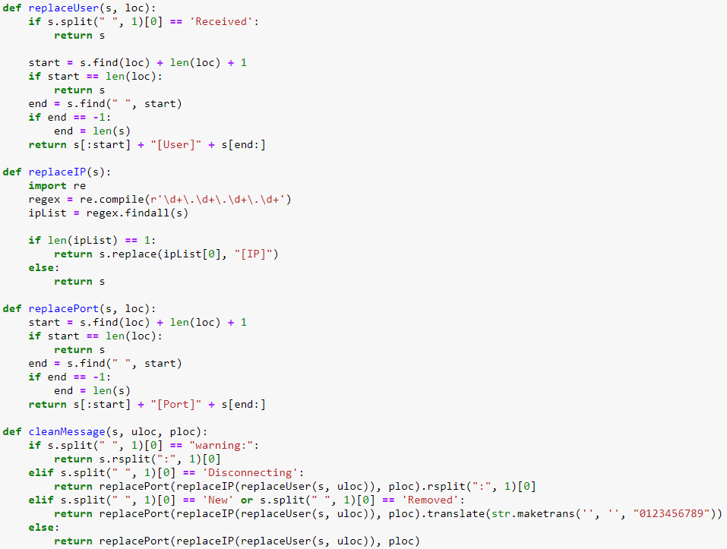
Cleaning Logs
User
IP
Port
‘Failed password for invalid user [User] from [IP] port [Port] ssh2’

Slide 7
The Result
5 million to 474
More observable
Room for improvement

Slide 8
Attempted Means of Access
SSH (Secure Shell Server) - Cryptographic protocol for remote login to a server
Primary means of access for legitimate users
Linux SSH process - handles incoming connections and user authentication via SSH protocol
4.9 million messages (97%) - vast majority of break-in attempts
Pure-FTP and vsftp - File Transfer Protocols
Means of transferring files to/from server
4372 messages(<0.1%)
Included messages indicative of attacks attempting to identify whether servers have FTP up and unprotected

Slide 9
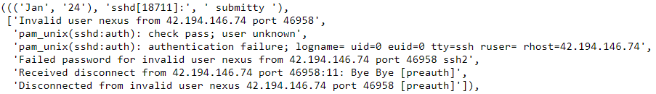
Type of Attacks
Standard Authentication Errors:
Servers are setup for authentication via password - most authentication errors stem from a failed password, also invalid username
Injection Attack:
An attempt to run malicious code through user-submitted strings.
String of hexadecimal values, possibly representing malicious code that could be run if executed from memory - difficult to determine exact intent

Slide 10
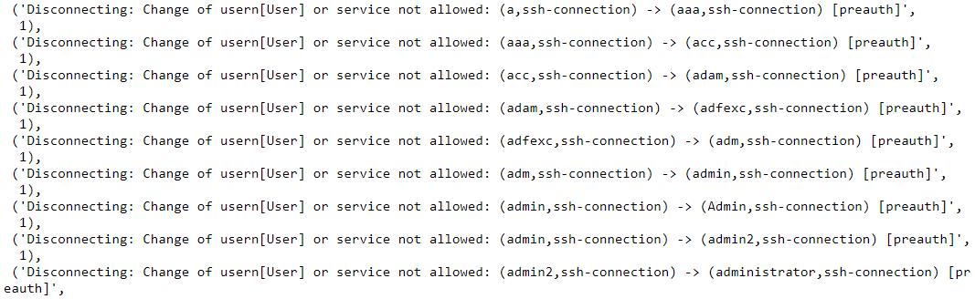
Types of Attacks
Evidence of Use of Username Dictionary:
Users (most likely bots) were attempting to change their usernames during authentication:

Slide 11
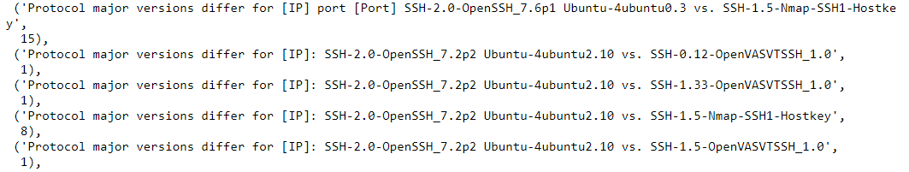
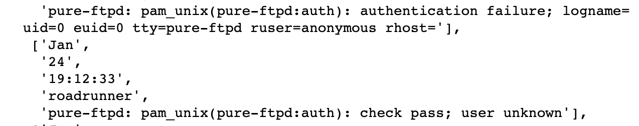
Types of Attacks
Attempts to Use Older SSH Versions:
Attackers were searching for whether the server was using an older version of SSH, most likely to use some exploit that was patched out in later versions.
File Transfer Protocol Attacks:
Attempts to access server via FTP as anonymous user

Slide 12
What We Considered an Attack
Our Definition:
When an SSH connection fails
Failed password
Invalid username

Slide 13
Grouping Messages
Key
Date
Process
Server
Value
Message

Slide 14
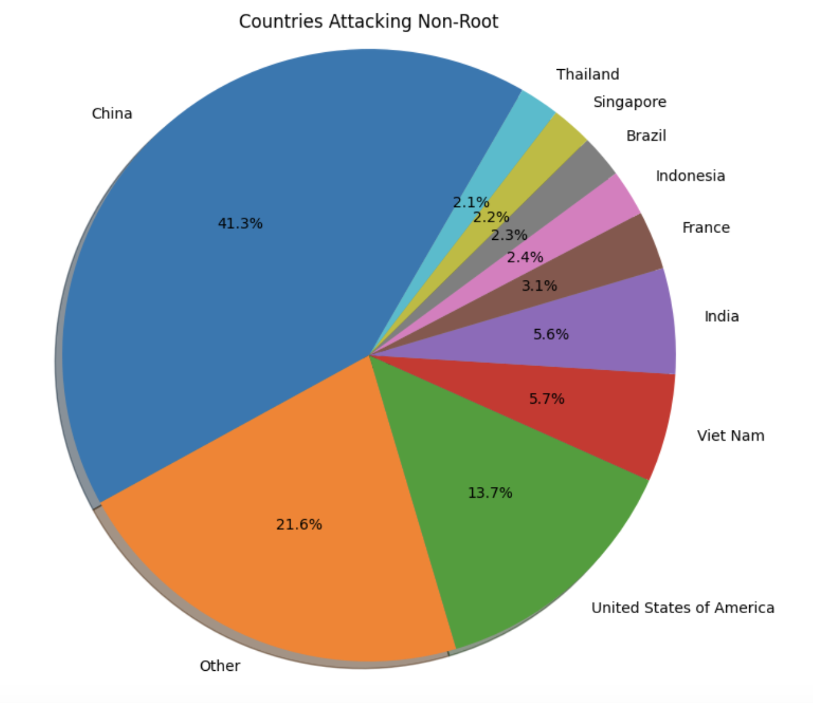
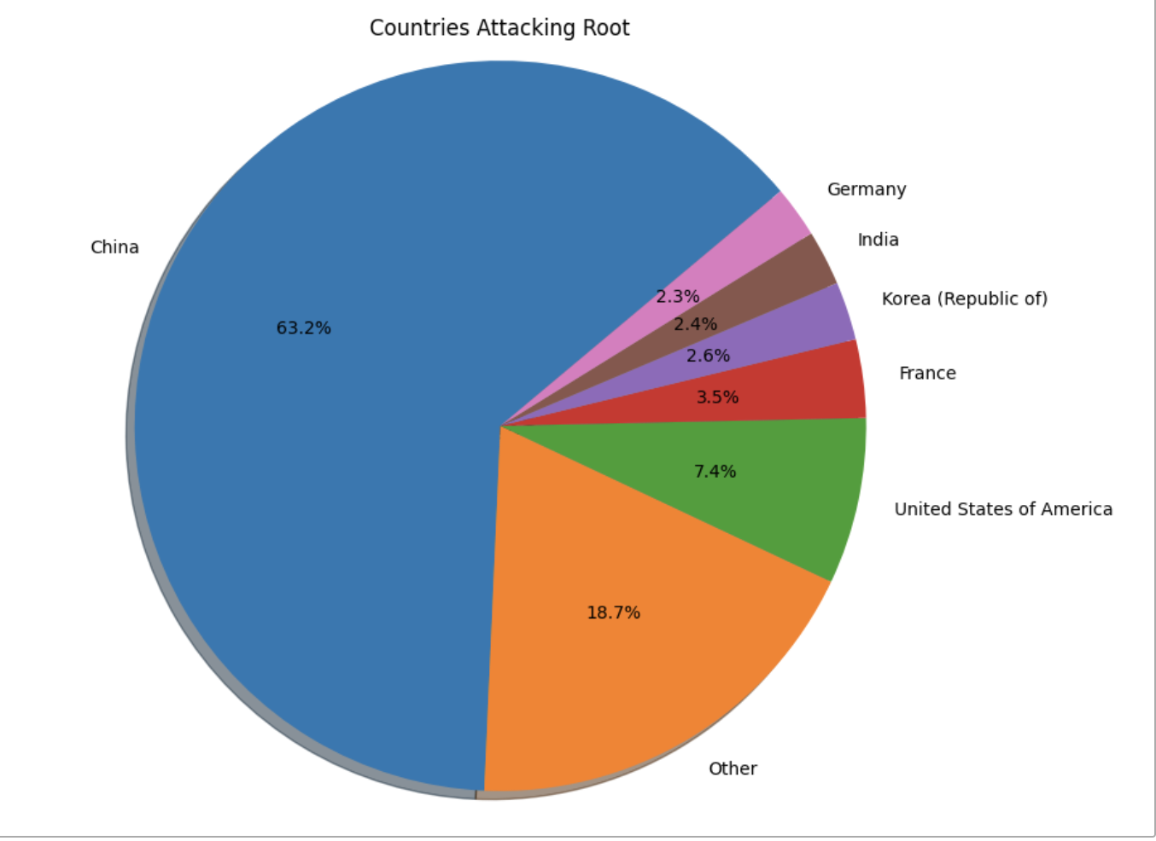
Countries of Origin

Slide 15
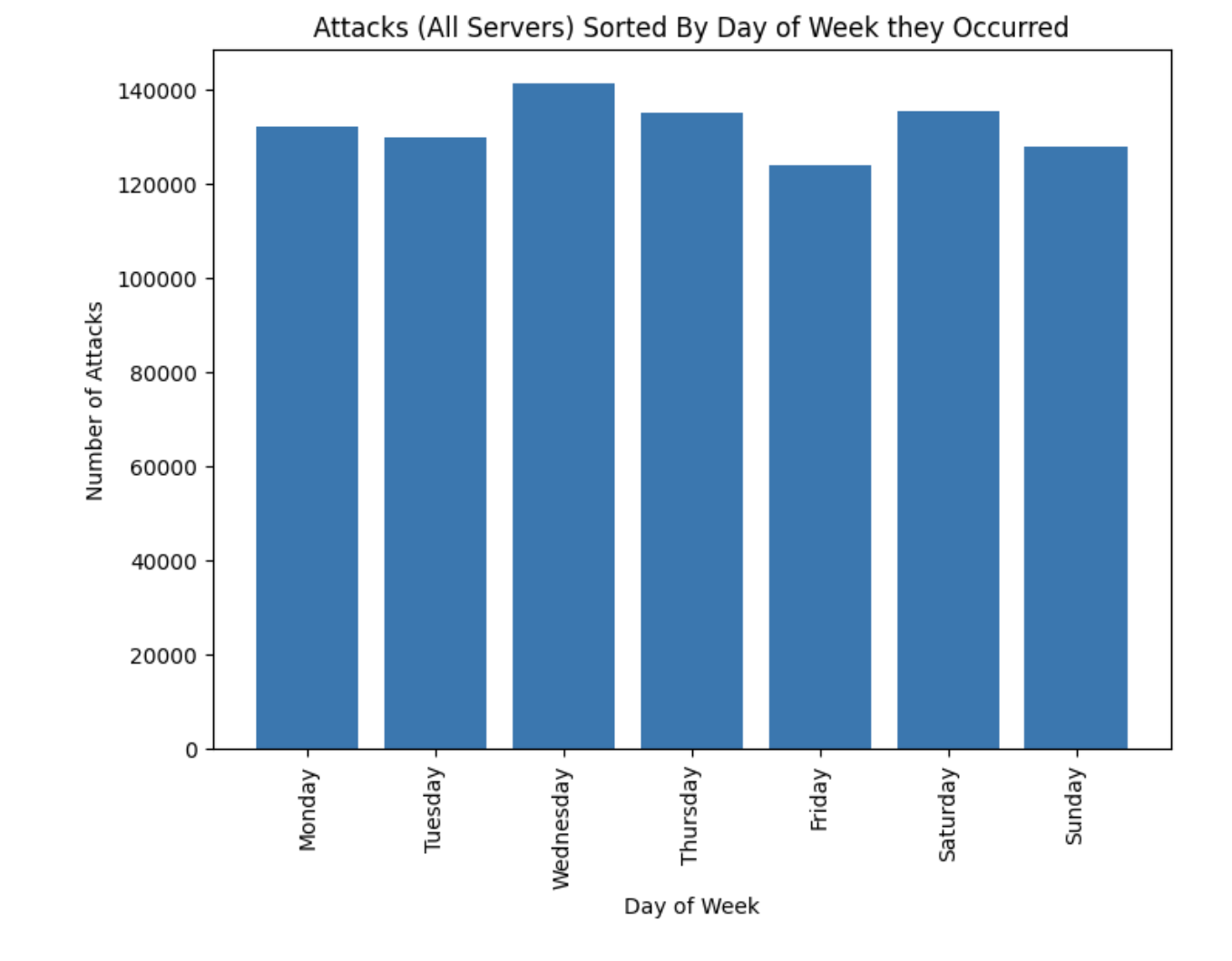

Slide 16
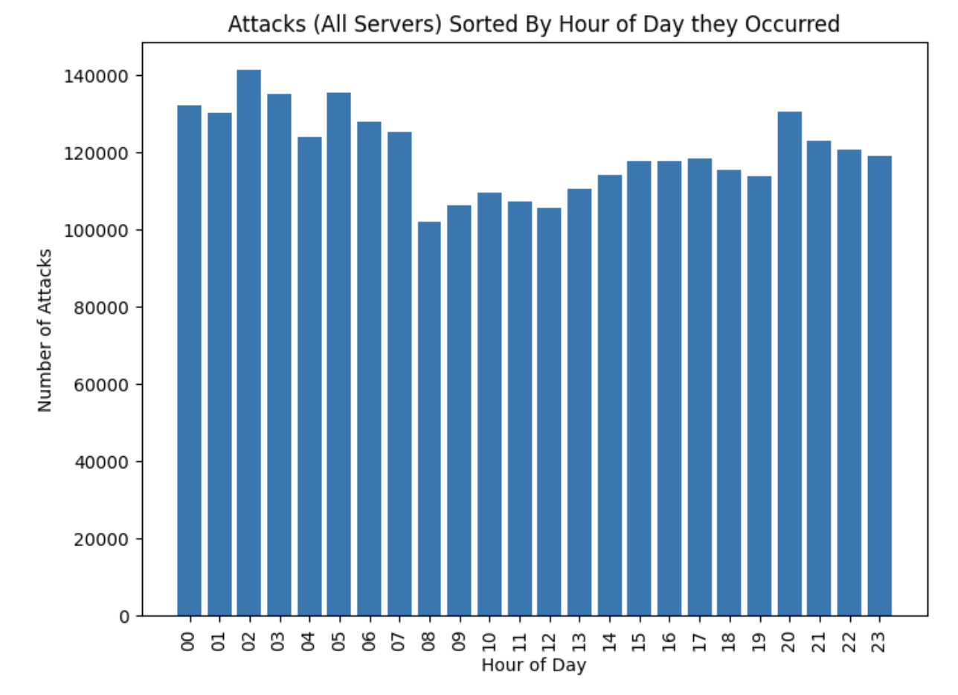

Slide 17
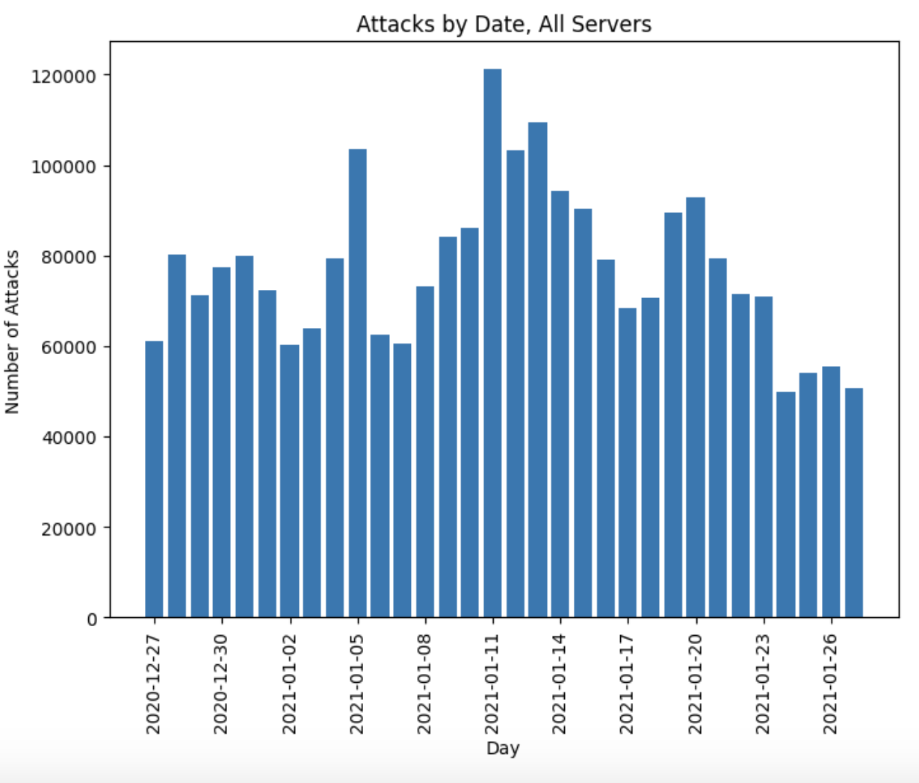

Slide 18
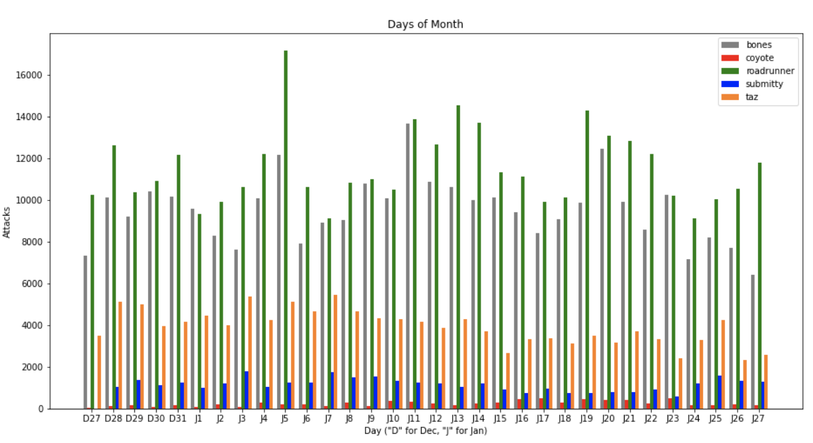

Slide 19
Conclusions
We gained a novel awareness of the types, frequency, and origins of attacks on our department’s servers
We established a scalable framework for future analysis

