Slide 1
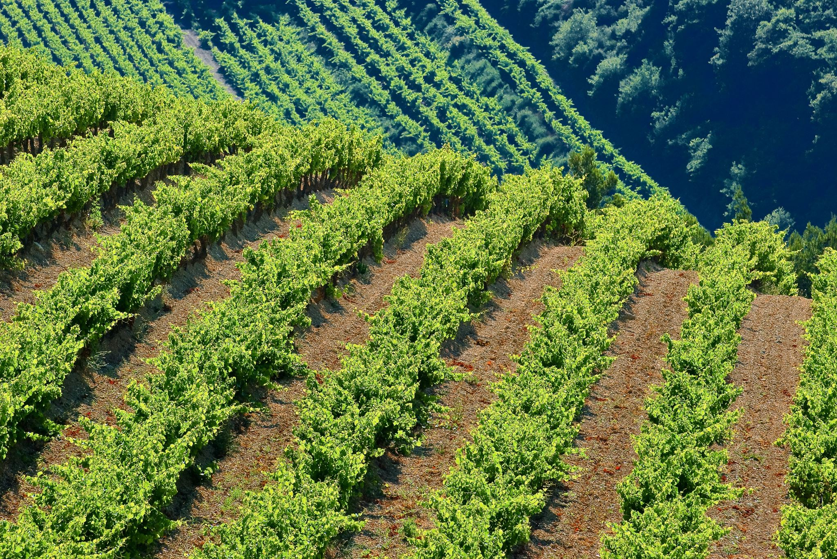
Return to a More Basic and Traditional Approach to Foodways
TOMMY BENEDETTI

Slide 2
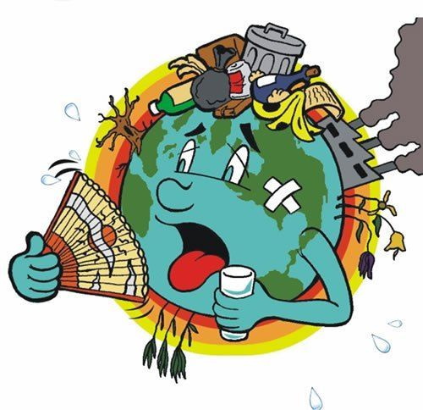
Background/Problem
The health of the planet and its inhabitants is declining
Current food practices are not sustainable (industrialized food system)
Return to more traditional, localized food practices can help to benefit these issues and to promote all 3 pillars of sustainability

Slide 3
Industrialized Food System & Environmental Health
Ease of current foodways leads to little-to no thought of how food is acquired, cultivated or reaches store shelves
Pesticides, fertilizers, agrochemicals, and factory farming are detrimental to environmental and human health
Industrial food system is responsible for the clearing of 70% of the worlds grasslands, 50% of savannas, 20% of tropical forests as well as 30% of greenhouse gasses, and 70% of annual water usage (Foley, 2011)

Slide 4
Local, Culture, and Sustainability
Placing emphasis on locally cultivated and obtained foods has a multitude of benefits for all three pillars of sustainability
Socially
Economically
Environmentally
Remembering cultural origins of food can improve these issues in an abundance of ways

Slide 5
Human Health
Today, the obesity rate in America is a shocking 33.9 percent — almost twice that of the French. And Italians, who also celebrate a love of cuisine, boast an obesity rate as low as 9.8 percent (Tarr, 2016).
Studies have shown that people who take the time to sit down and slowly enjoy a meal have more nutritious diets rich in fruits and vegetables (Tarr, 2016).
Growing evidence has illustrated that the presence of community supported agriculture or community gardens has a positive correlation with both physiological and mental well-being (Gregis et. al, 2021).

Slide 6
Local Economies and Connectivity
Locally sourced food leads to more revenue, job opportunities, food security and community prosperity
A healthy, biodiverse landscape will not only benefit the ecosystem, but will also benefit the health of those living in it (Cote, 2016)

Slide 7
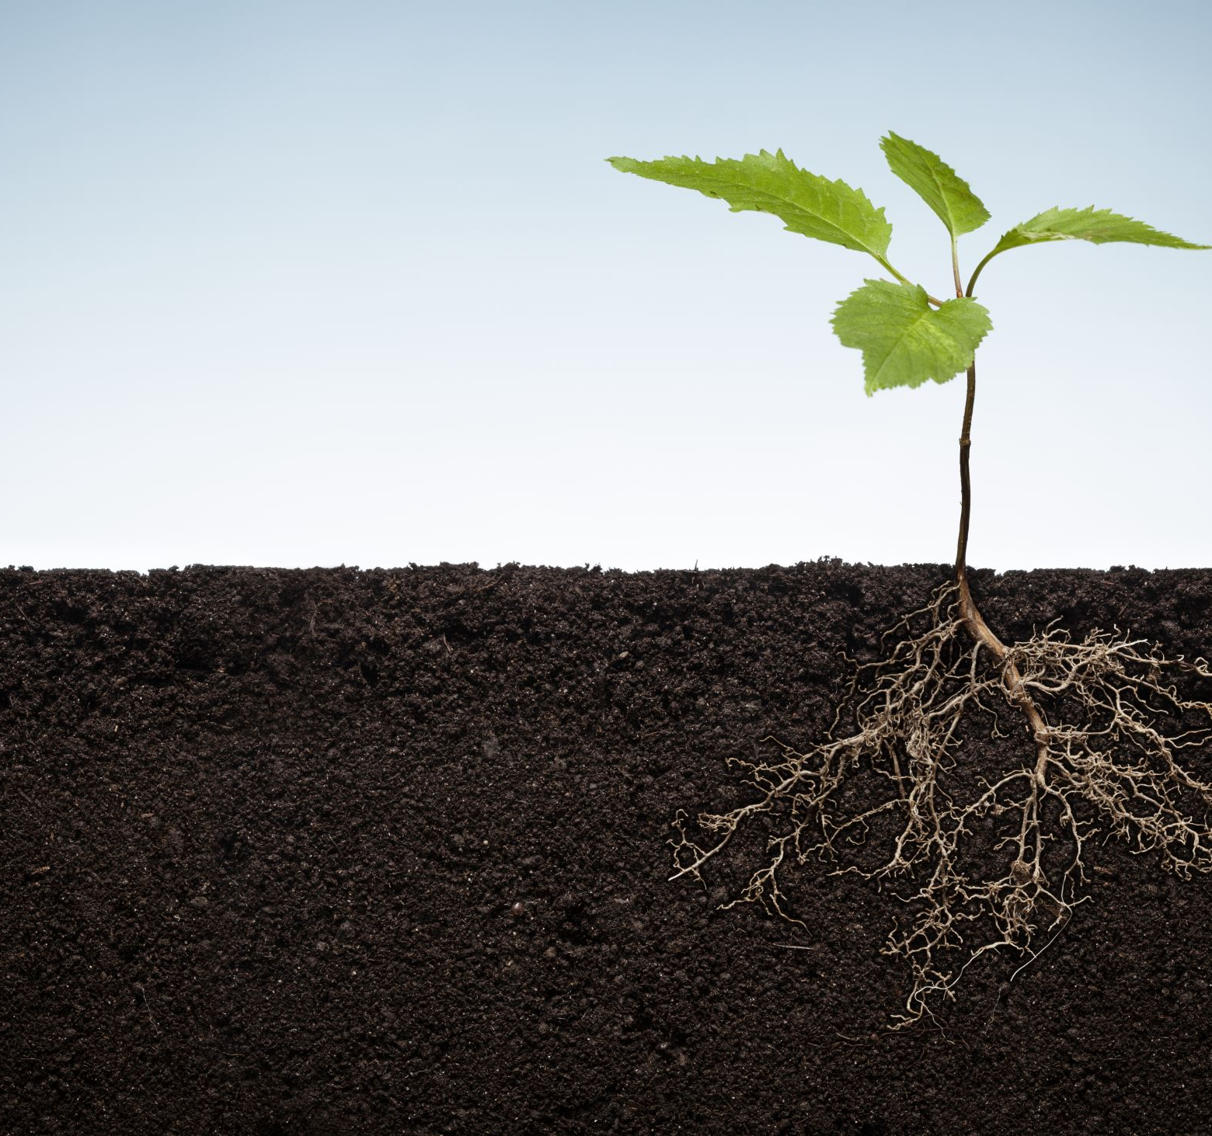
Conclusion
To protect the biodiversity of the landscape, economies of local communities, and health of human beings, it is vital for local policy makers and the earth’s inhabitants to grasp the importance of food’s geographical and cultural origins as well as the potential benefits of more traditional, localized food practices.

Slide 8
References
Tremblay, R., Landry-Cuerrier, M., & Humphries, M. M. (2020). Culture and the social-ecology of local food use by Indigenous communities in northern North America. Ecology & Society, 25(2), 293–318. https://doi.org/10.5751/ES-11542-250208
Willink, K. (2019). Food culture, relationality and the Slow Food Movement. Journal of European Popular Culture, 10(1), 61–73. https://doi.org/10.1386/jepc.10.1.61_1
Foley, Johnathan A. (2011). Can We Feed the World & Sustain the Planet? https://d2l.wcupa.edu/d2l/le/content/2911330/viewContent/23408684/View
Lang, Tim. (2004). Food Industrialization and Food Power: Implications for Food Governance. https://d2l.wcupa.edu/content/enforced1/2911330-2205-ANT277-01/Week%205/Lang_Food%20Industrialization%20and%20Food%20Power.pdf?_&d2lSessionVal=kcwu3Ixnp5pgNKtoC71RBIWWO&ou=2911330
DiGiovine, Michael A., Brulotte, Ronda L. (2014) Food and Foodways as Cultural Heritage. https://d2l.wcupa.edu/content/enforced1/2911330-2205-ANT277-01/Week%2013/DiGiovineBrulotte2014_Introduction_Food%20and%20Foodways%20as%20Cultural%20Heritage.pdf?_&d2lSessionVal=wClQEeT53O8bV97nlP3k2LGml&ou=2911330
Coté, C. (2016). “Indigenizing” Food Sovereignty. Revitalizing Indigenous Food Practices and Ecological Knowledges in Canada and the United States. Humanities (2076-0787), 5(3), 57. https://doi.org/10.3390/h5030057
Lowitt, K., Levkoe, C. Z., Spring, A., Turlo, C., Williams, P. L., Bird, S., Sayers, C. D., & Simba, M. (2020). Empowering small-scale, community-based fisheries through a food systems framework. Marine Policy, 120. https://doi.org/10.1016/j.marpol.2020.104150
DiGiovine, Michael A. (2010) ‘La Vigilia Italo-Americana: Revitilizing the Italian-American Family Through the Christmas Eve “Feast of the Seven Fishes”’, Food and Foodways, 18: 4, 181-208. https://www.tandfonline.com/doi/abs/10.1080/07409710.2010.529012
Tarr, Alexandra. (2016) Food and Culture From Local Relationality to Global Responsibility. Claritas: Journal of Dialogue and Culture, Vol. 5, No. 1, 52–62 https://docs.lib.purdue.edu/cgi/viewcontent.cgi?article=1141&context=claritas
Gregis, A., Ghisalberti, C., Sciascia, S., Sottile, F., & Peano, C. (2021). Community Garden Initiatives Addressing Health and Well-Being Outcomes: A Systematic Review of Infodemiology Aspects, Outcomes, and Target Populations. International Journal of Environmental Research and Public Health, 18(4). https://doi.org/10.3390/ijerph18041943
Images
https://www.pinterest.com/pin/280700989263401706/

