Slide 1
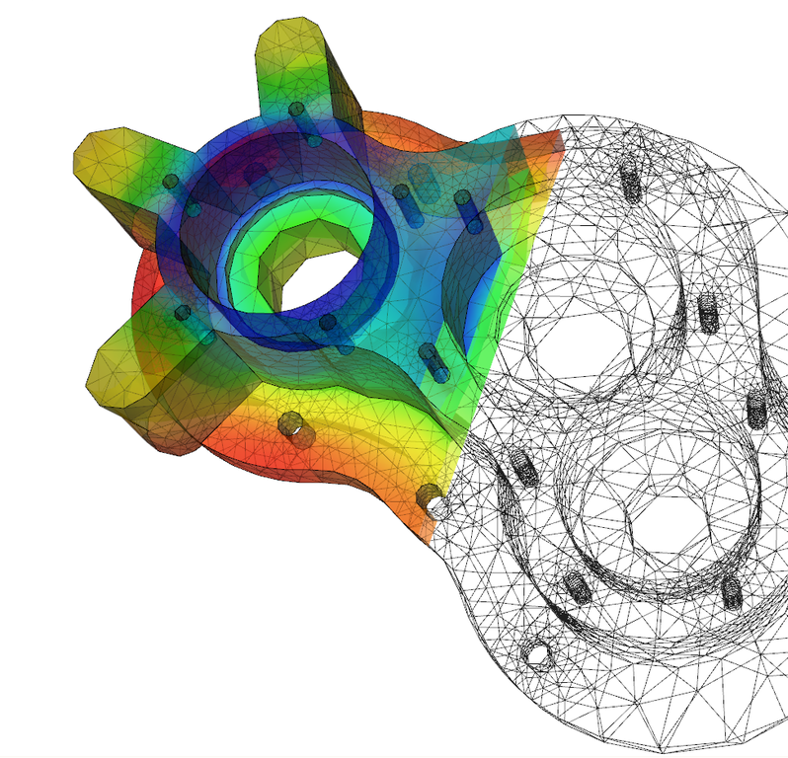



Solving the Heat Equation with Interfaces
WCUPA
Research and Creative Activity Day
April 29, 2021
Presenter: Michael Bauer
With: Rex Llewellyn, Shauna Frank
Mentored by: Dr. Chuan LI

Slide 2
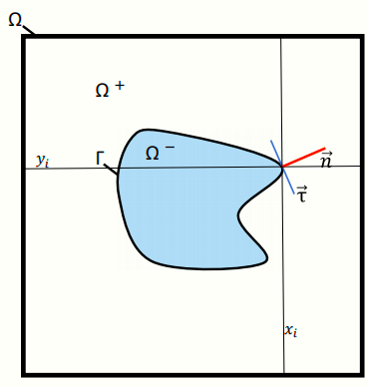
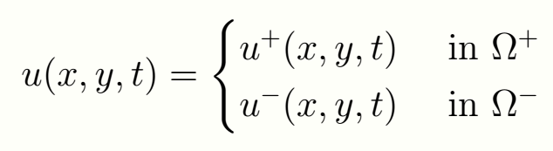
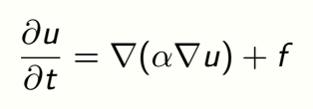

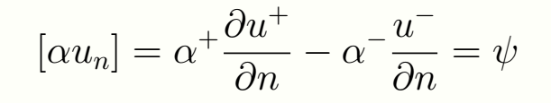

Solving the Heat Equation with Interfaces
$α− diffusion coefficient$
u – function of interest
$Ω$ – domain of interest
Г – interface
$Φ$ – zeroth jump condition
$ψ −first jump condition$

Slide 3
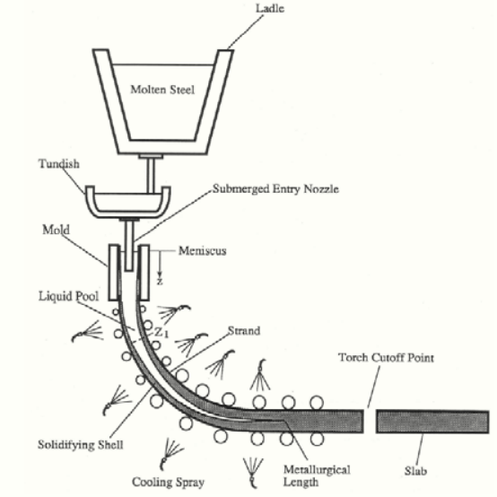
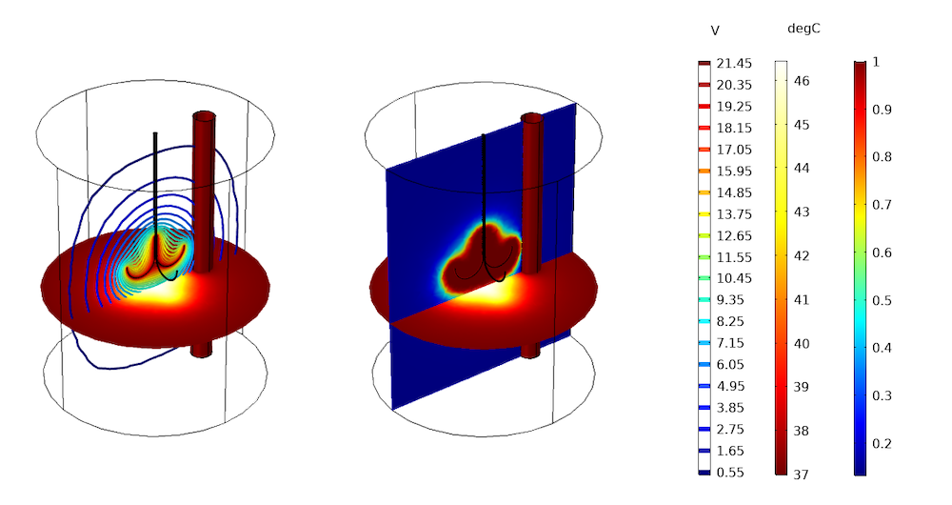
Applications
Metallurgy
  Steel Continuous Casting
Mathematical Biology
  Cancer Treatment
  Ecological Modeling

Slide 4
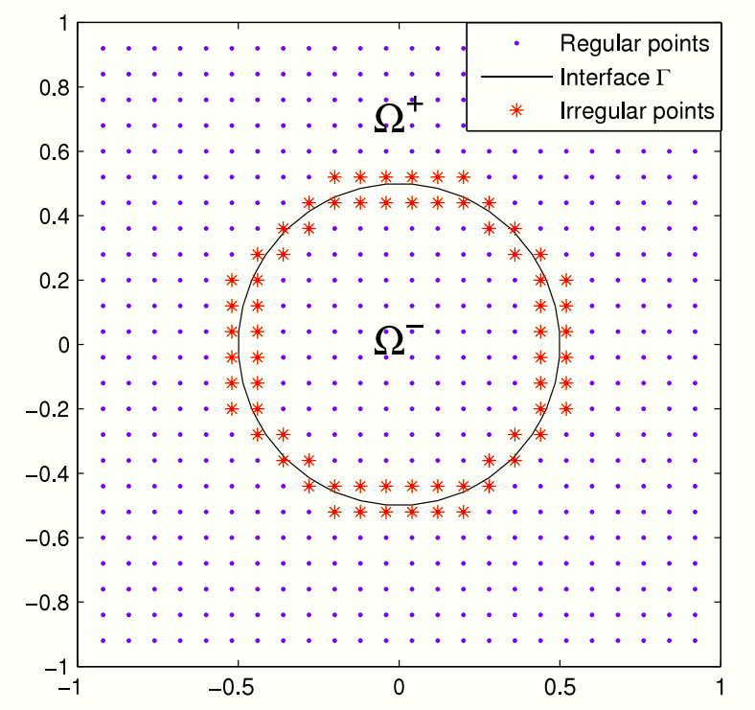

Numerical Treatment

Slide 5
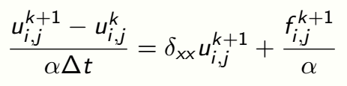
Temporal Discretization
Euler Method
  1st Order Accuracy

Slide 6
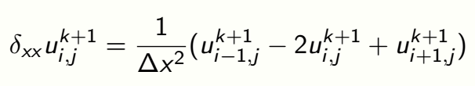
Spatial Discretization
At regular nodes
At nodes adjacent to interface
~
~

Slide 7




Spatial Discretization
Transformations
Jump Conditions
Notes:
See text below equation 17 to formulate explanation as well as slides notes from dr li’s suggestions

Slide 8
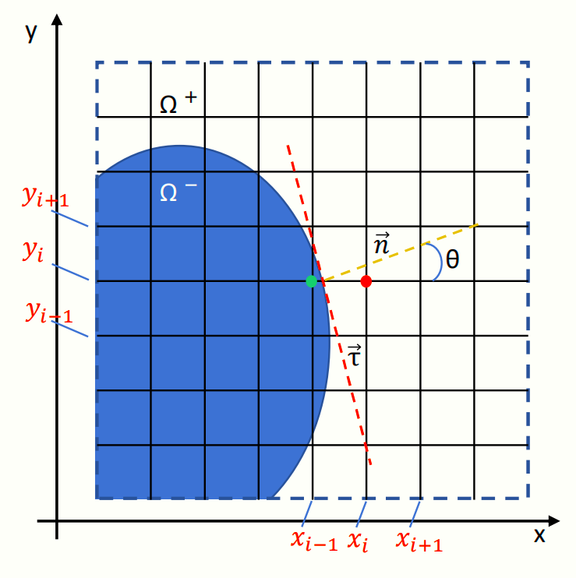

Slide 9
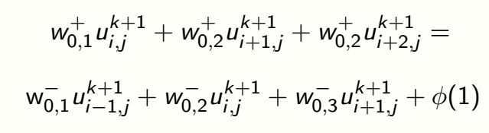
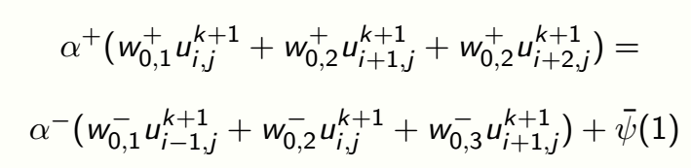
Spatial Discretization
From we have
~
~
From we have
~
~
Notes:
See text below equation 17 to formulate explanation as well as slides notes from dr li’s suggestions

Slide 10
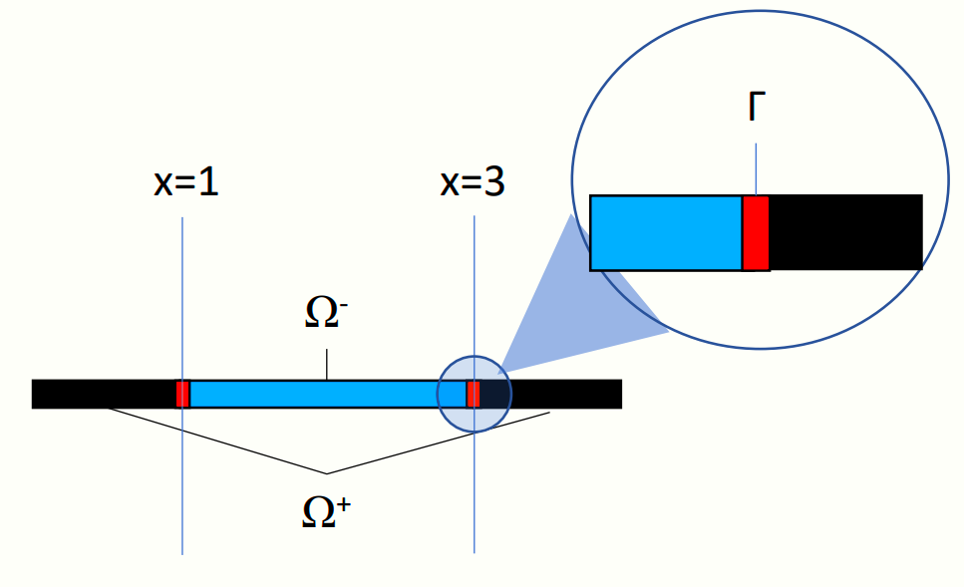
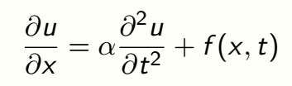

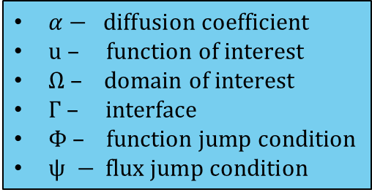
Numerical Experiments
$\frac{\text{∂}u}{\text{∂}x}=$ $▽•(α▽u)$
in $Ω=Ω^{+} \text{∪} Ω^{−}$
Jump Conditions
$$\left[u\right]=u^{+}−u^{−}= Φ$$
$$\left[αu_{x}\right]=α^{+}\frac{{\text{∂}u}^{+}}{\text{∂}x}−α^{−}\frac{{\text{∂}u}^{−}}{\text{∂}x}=ψ$$
-
+
-
+
$α− diffusion coefficient$
u – function of interest
$Ω$ – domain of interest
Г – interface
$Φ$ – function jump condition
$ψ − flux jump condition$

Slide 11




Numerical Experiments
We will look at the example where the analytical solution is given as
With the following source terms

Slide 12
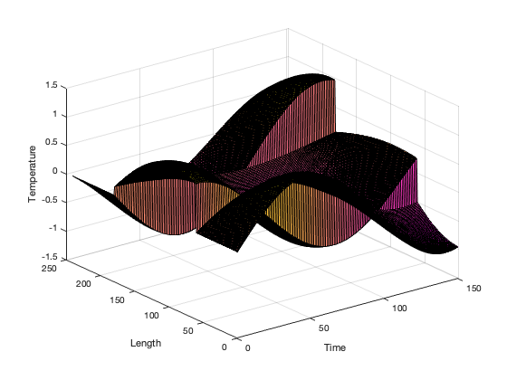
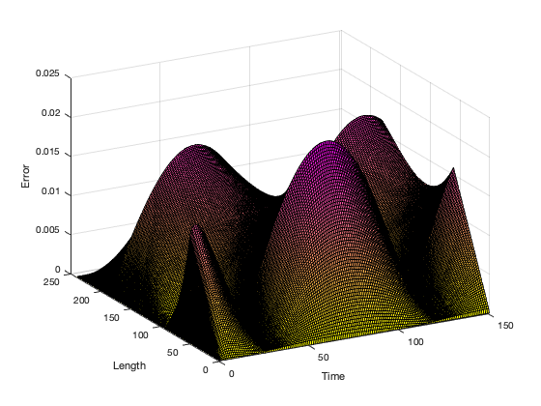
Numerical Experiment
Result
Error

Slide 13




Numerical Experiments
We will look at the example where the analytical solution is given as
With the following jump conditions

Slide 14
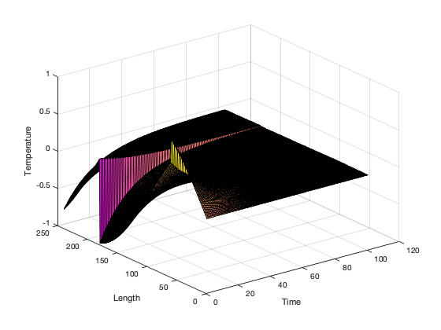
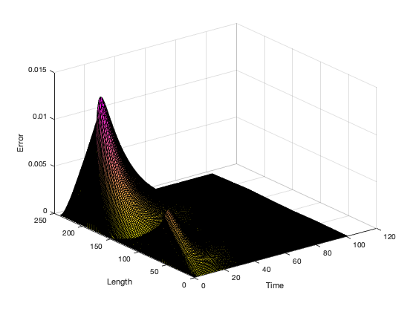
Numerical Experiment
Result
Error

Slide 15
Future Improvements
Increase to 2D
  This will introduce additional complications at nodes near interfaces
Increase complexity of Interfaces
Utilize Peaceman-Rachford method
  Higher accuracy in temporal discretization
Address corner cases with irregular interface geometries

Slide 16
Conclusion
This exercise demonstrates the effectiveness of MIB in solving the Heat Equation with Interfaces
Further improvements are required for applications to real-world tasks

