Slide 1
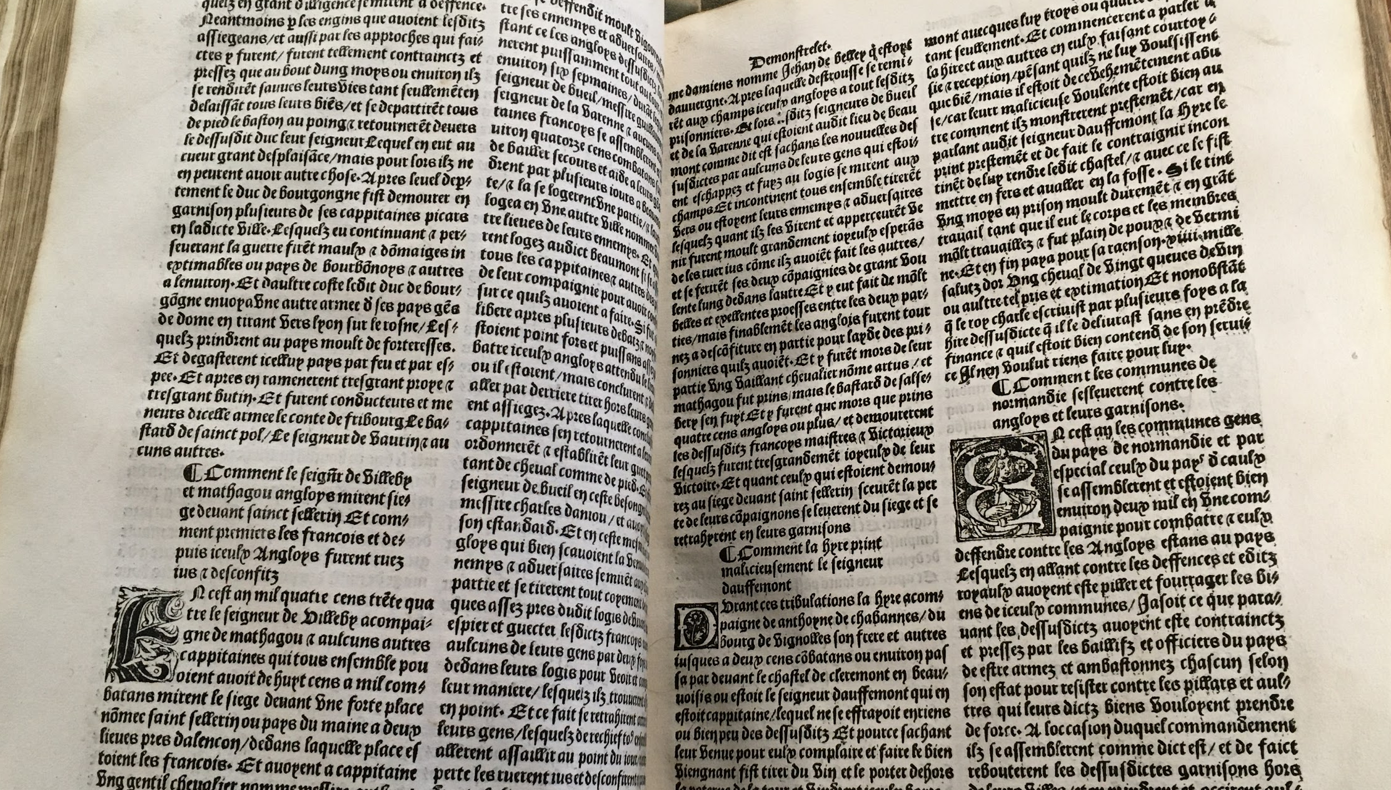
Marginalia and Mystery:
A Renaissance Treasure in the WCU Special Collections
By Kelli Billings

Slide 2
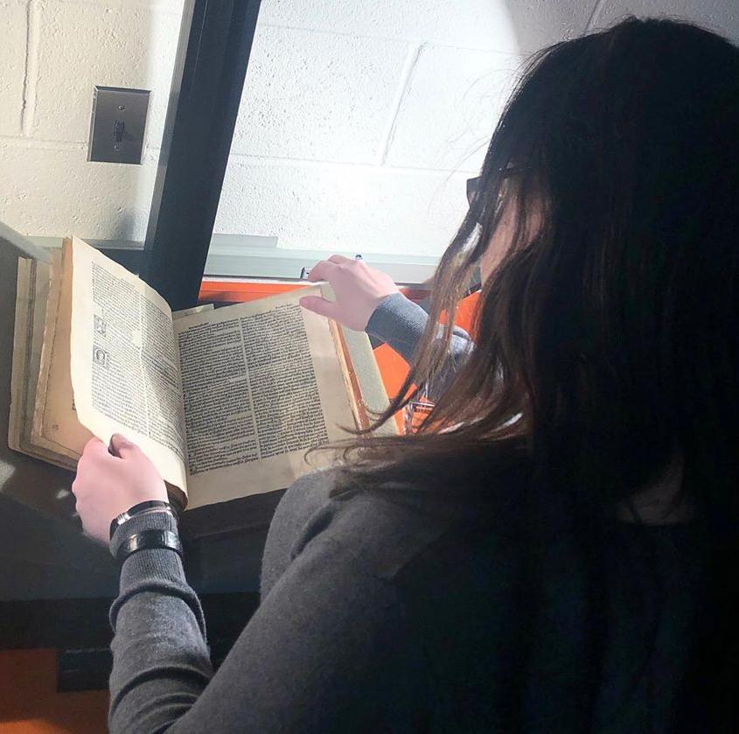
The Researcher
I began my career as a history student at
West Chester University in Spring 2019.
A decade earlier, I had earned a degree in French from WCU, the culmination of years of interest in the language.
My ongoing interest and research centers on England and France in the medieval (~600-1400) and Renaissance (~1400-1600) time periods.

Slide 3
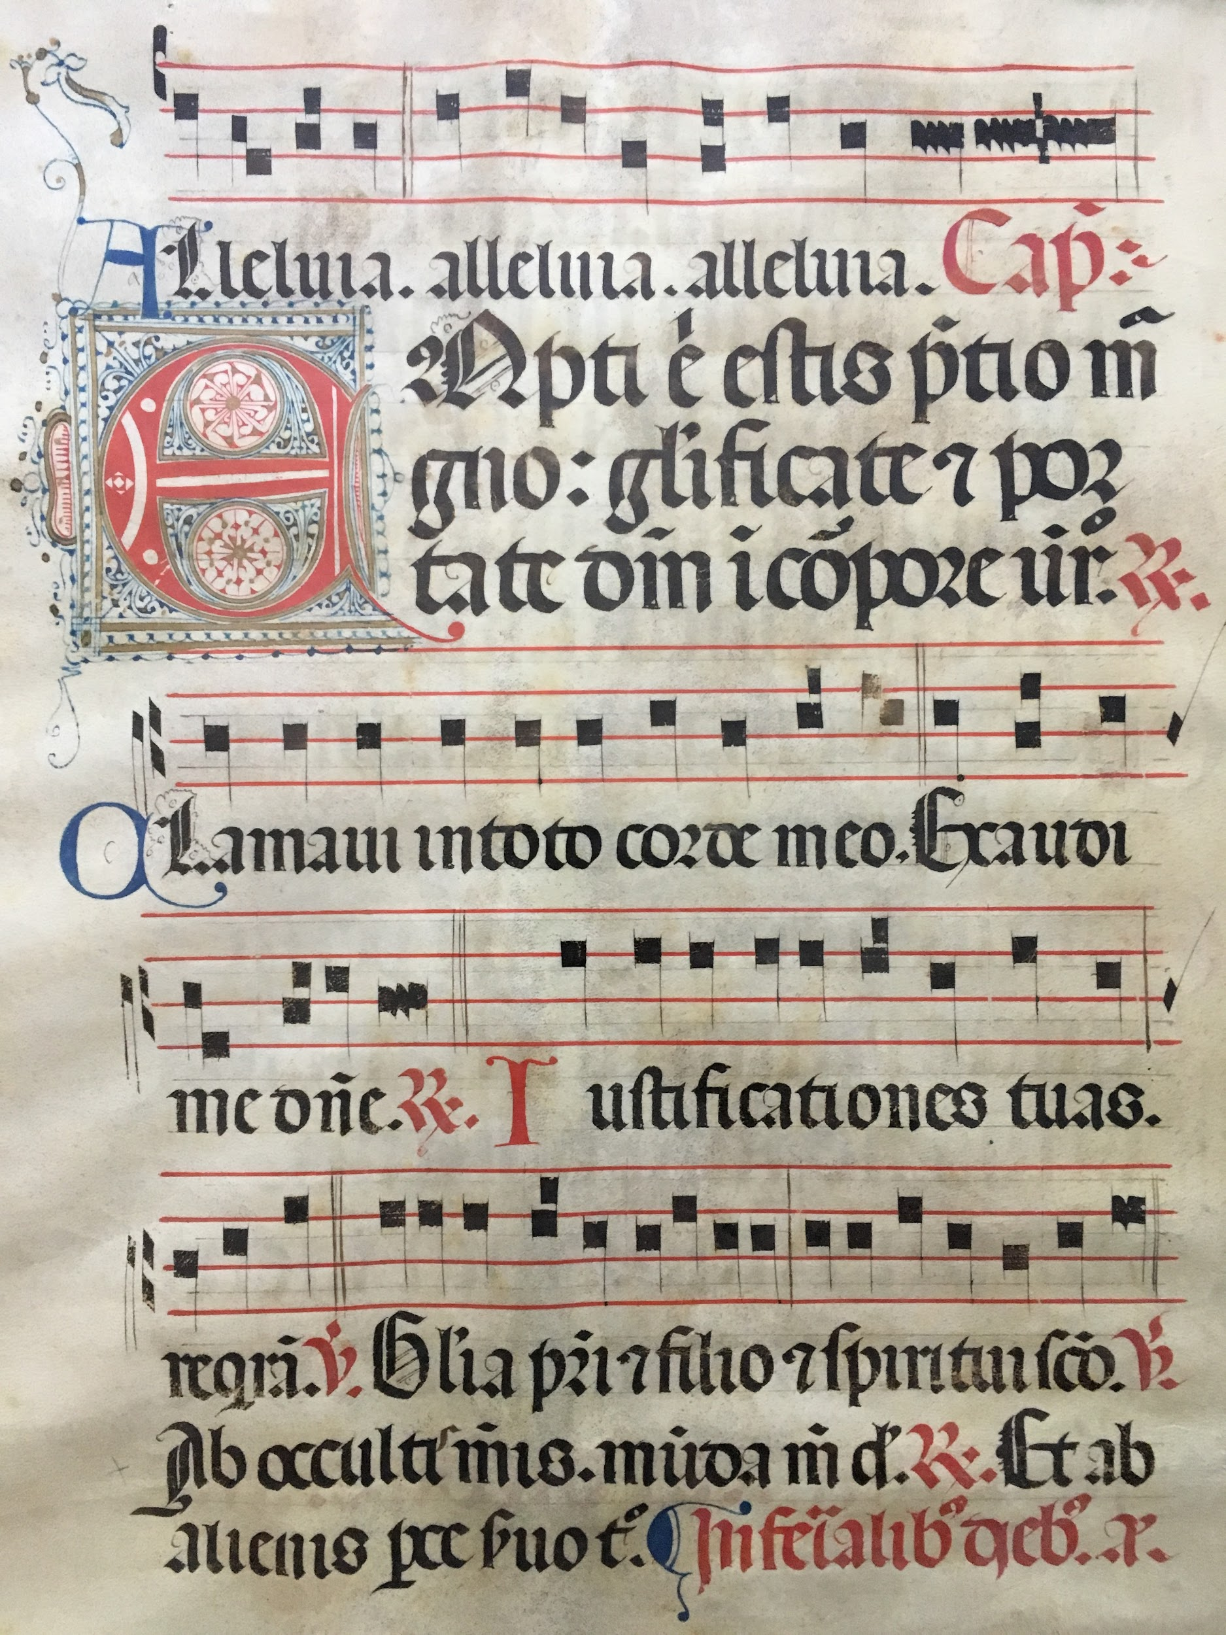
Special Collections
My study of medieval manuscripts proved useful during a visit to a nearby antique market in September 2019, where I discovered what appeared to be a leaf from an illuminated medieval manuscript. I had to buy it!
I turned to my professors for help in finding out more about it and was eventually referred to Ron McColl, the new Special Collections librarian, who invited me to bring it in.
We soon discovered a shared enthusiasm for history and old books, and Ron soon offered me an internship in Special Collections.

Slide 4
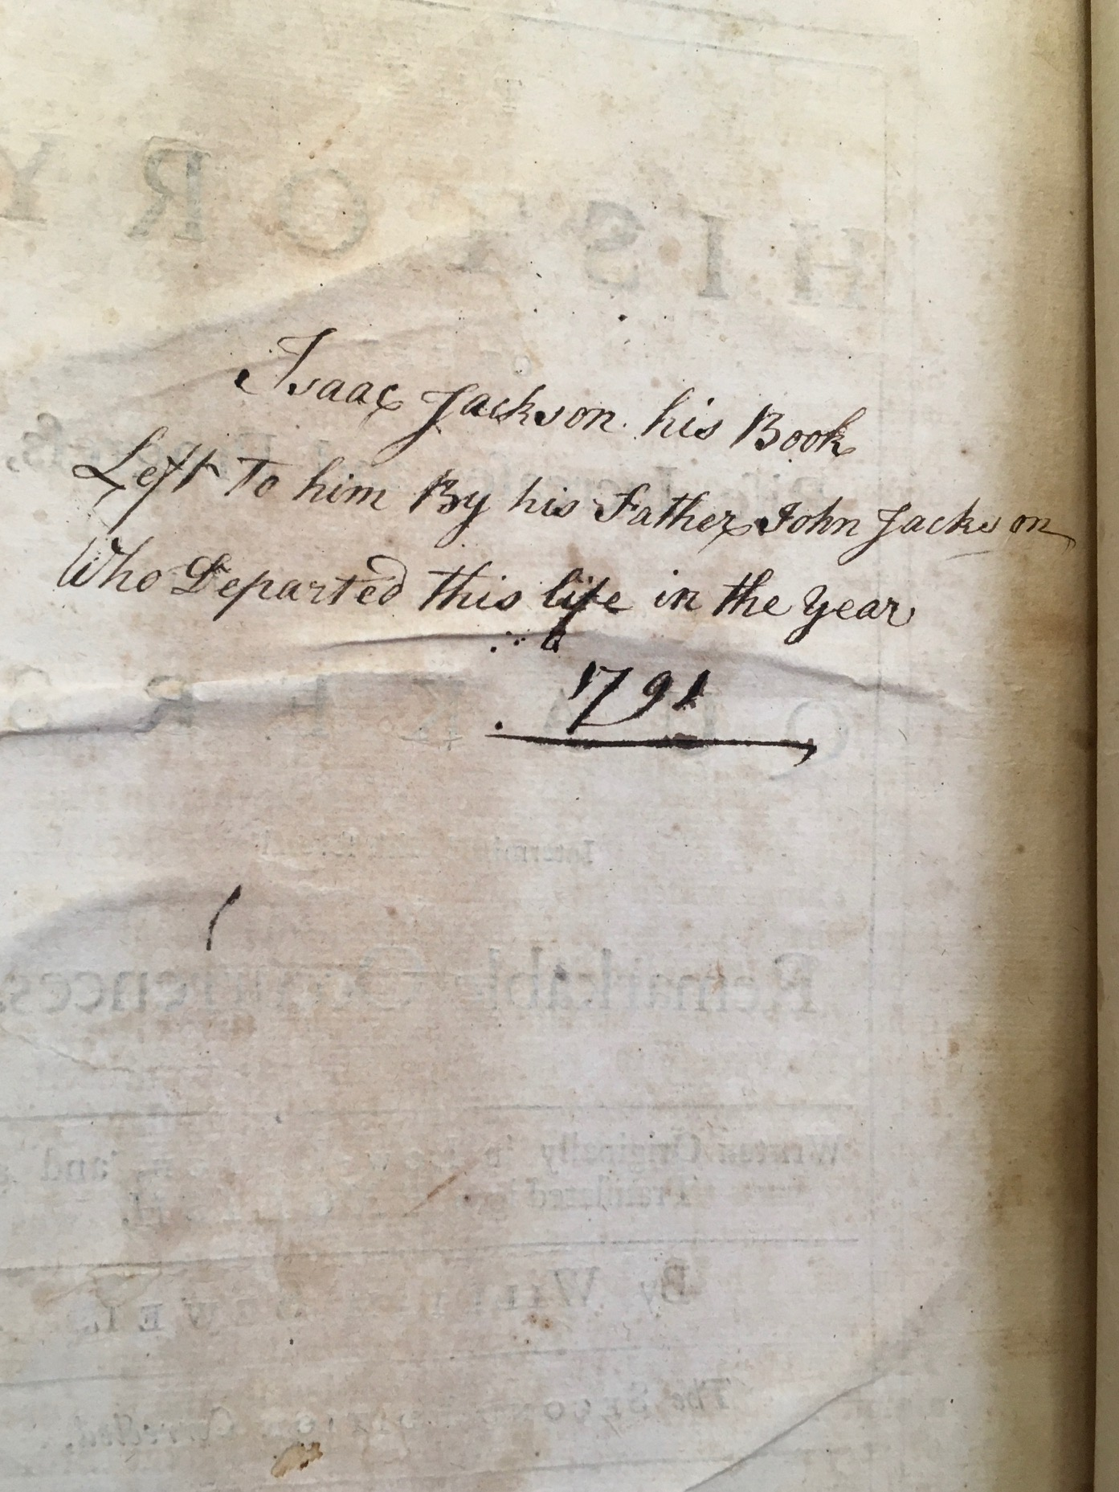
Early Printed Books Project
My first project was to catalog our books printed before 1800.
So far I have catalogued over 100 books, dating as far back as the sixteenth century.
These books often contain delightful surprises, like contemporary bookmarks, pressed flowers, and handwritten annotations.
I developed a familiarity with handwriting styles of the sixteenth, seventeenth, and eighteenth centuries that would soon prove invaluable.

Slide 5
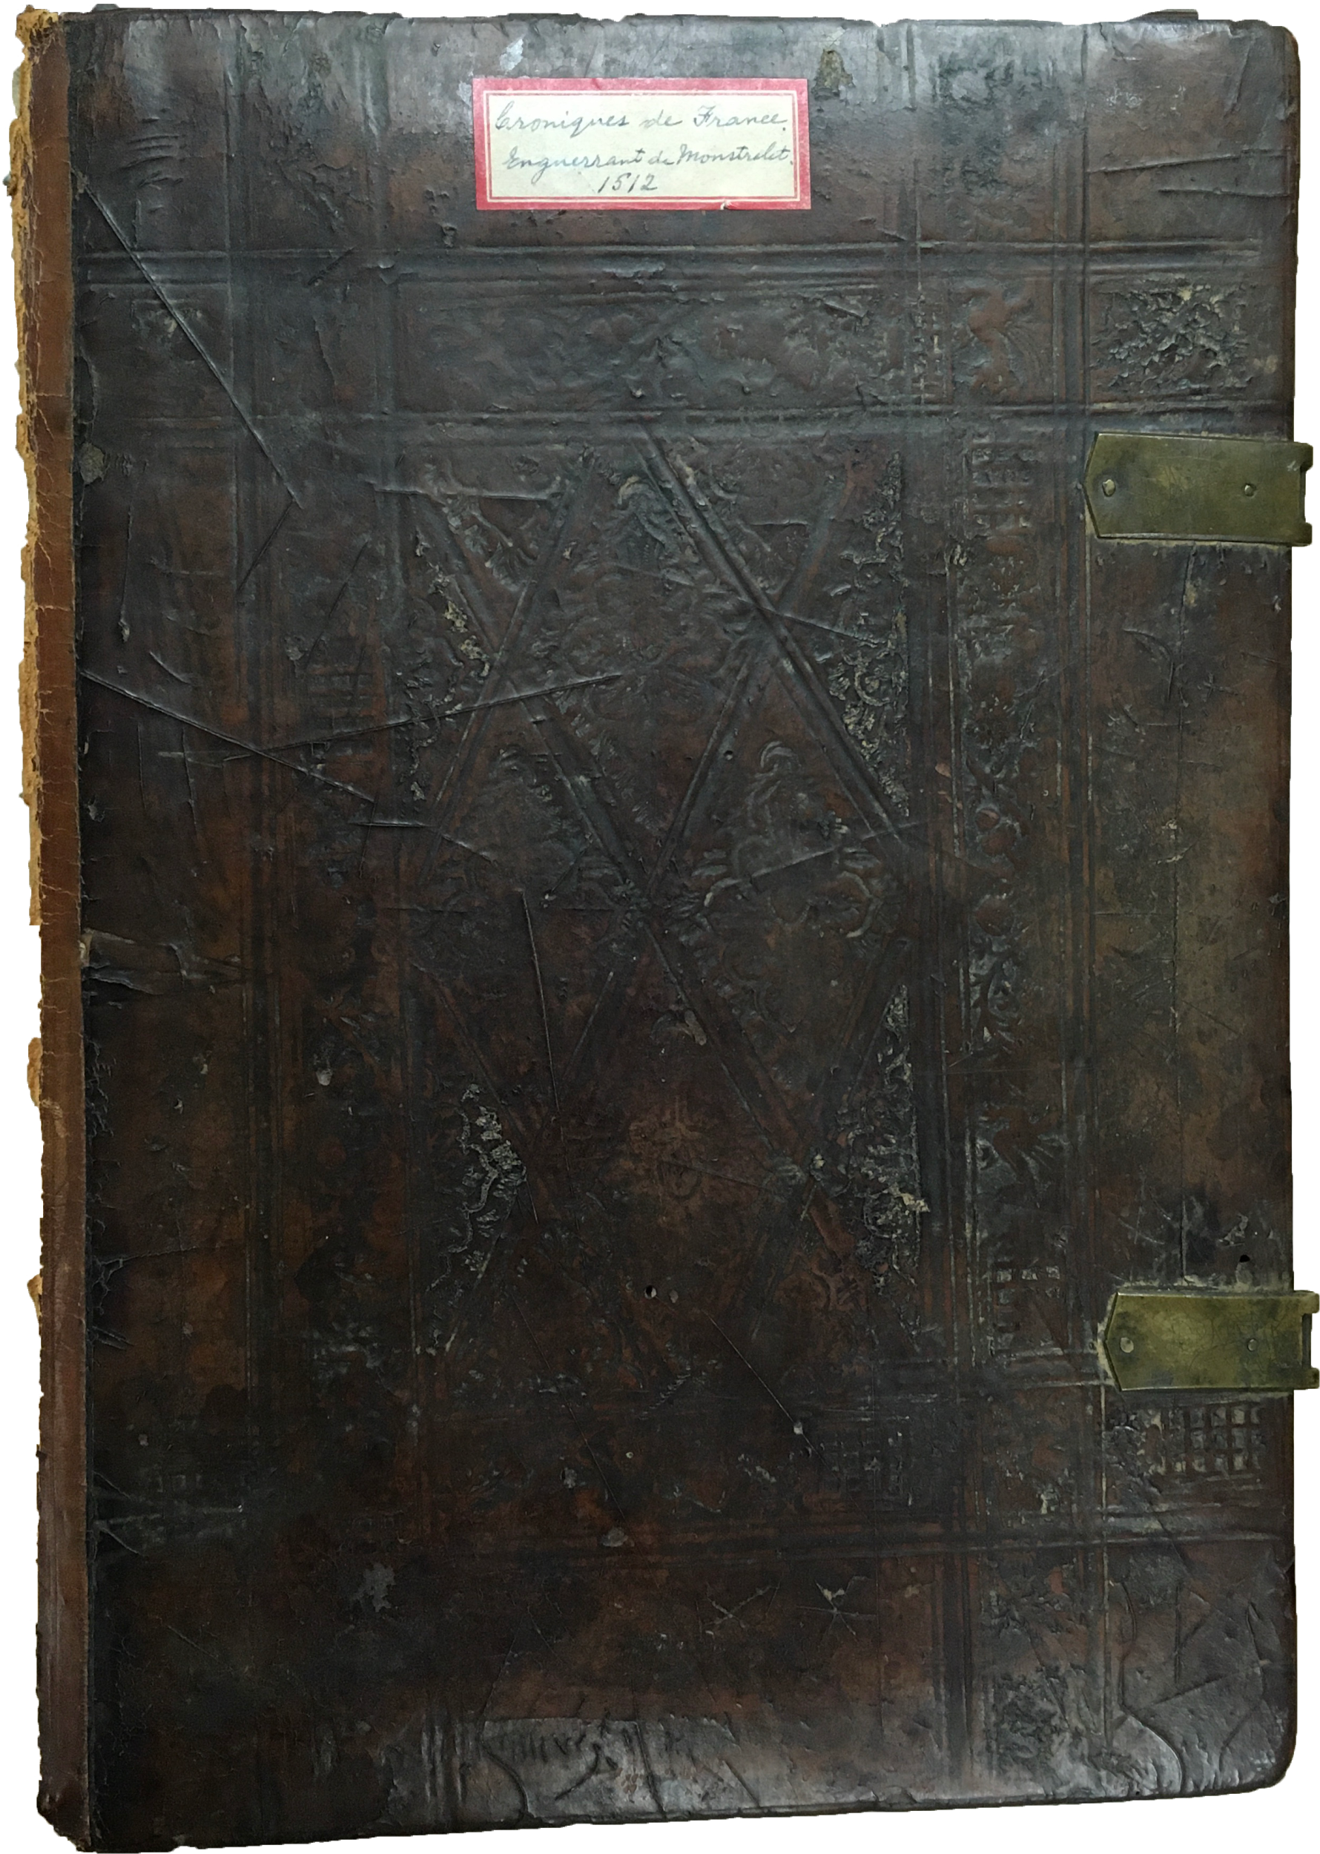
The Chronicles of Monstrelet, 1512
In December, Ron brought me the Chronicles of Monstrelet, published in 1512, which he had discovered in one of the library’s storage rooms. No one knew how it had arrived at WCU. I was immediately intrigued by this mystery book.
French clerk Enguerrand de Monstrelet composed the Chronicles to detail the political events in France from 1400-1444, during the Hundred Years’ War with England.¹
My knowledge of French allowed me to read some of the text, which was a thrilling connection with the past.
¹ Georges Le Brusque, “Chronicling the Hundred Years War in Burgundy and France in the Fifteenth Century,” in Writing War: Medieval Literary Responses to Warfare, ed. Corinne Saunders, Francoise Le Saux, and Neil Thomas (Boydell and Brewer, 2004).

Slide 6
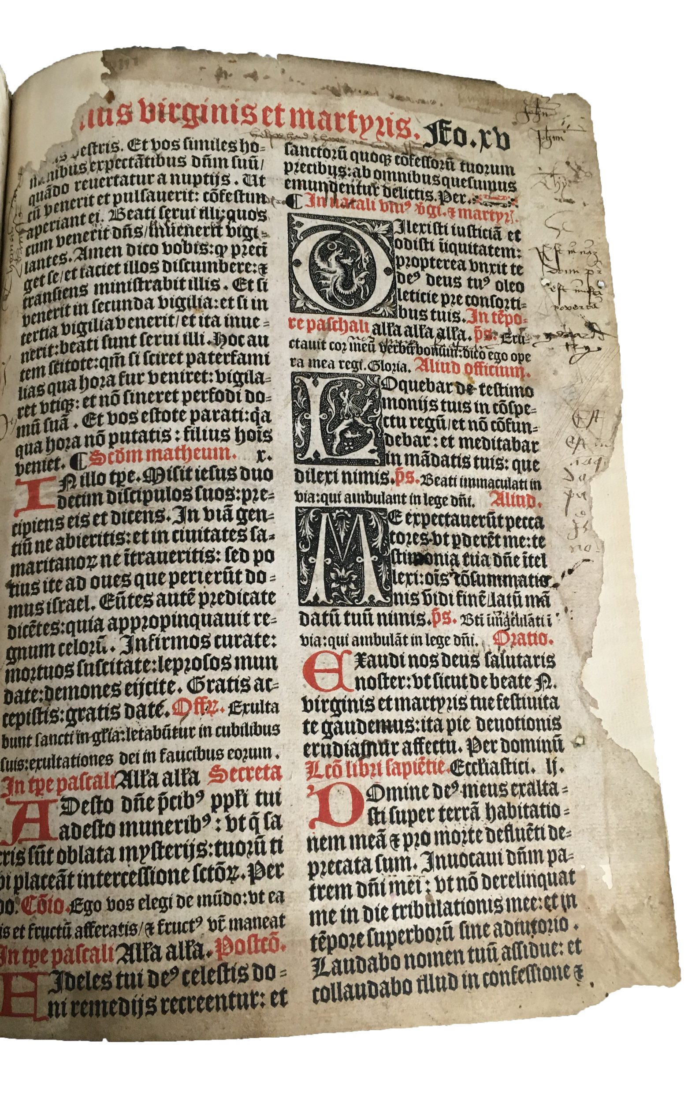
Diving In
The first examination revealed a wealth of surprises:
discoloration of the front cover had turned the stamped-leather binding from a warm brown to a bluish black
a bookplate showed that the book belonged at one time to an Arthur Hugh Smith Barry at Marbury Hall
handwritten inscriptions and other marginalia covered the title page and several others throughout
the book lacked the first of the three volumes
attached to one of the back endpapers was a page from another book, apparently a religious text

Slide 7
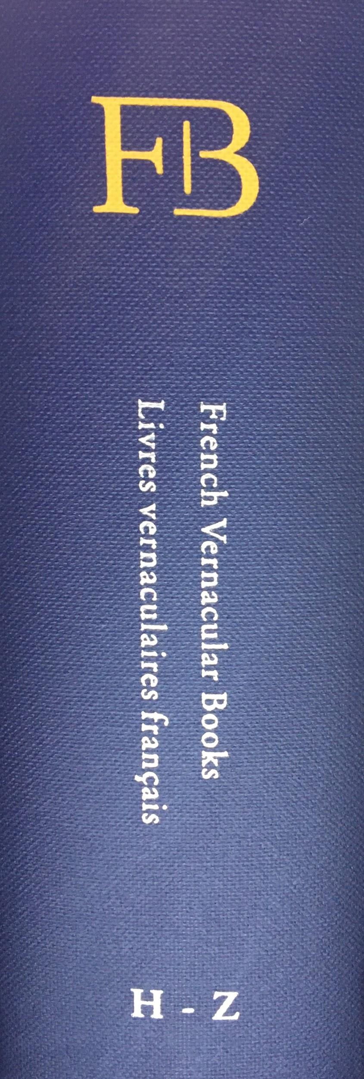
Initial Research
Several editions of this work were published in manuscript and print in the fifteenth and sixteenth centuries.²
Only 24 copies of the 1512 edition are known to survive.
According to French Vernacular Books, the seminal work on early printed French books, only two of these copies are in the U.S.³
The one at WCU is not among them...
Could we have stumbled upon an undocumented treasure?
² Hanno Wijsman, “History in Transition: Enguerrand de Monstrelet’s Chronique in Manuscript and Print (C. 1450-C. 1600),” in Book Triumphant: Print in Transition in the Sixteenth and Seventeenth Centuries, ed. Malcolm Walsby and Graeme Kemp, 1st ed., vol. 9, Library of the Written Word - the Handpress World Series (Leiden ; Boston: Brill, 2011).
³ Andrew Pettegree, Malcolm Walsby, and Alexander S. Wilkinson, eds., French Vernacular Books: Books Published in the French Language before 1601 = Livres Vernaculaires Français: Livres Imprimés En Français Avant 1601 (Leiden ; Boston: Brill, 2007).

Slide 8
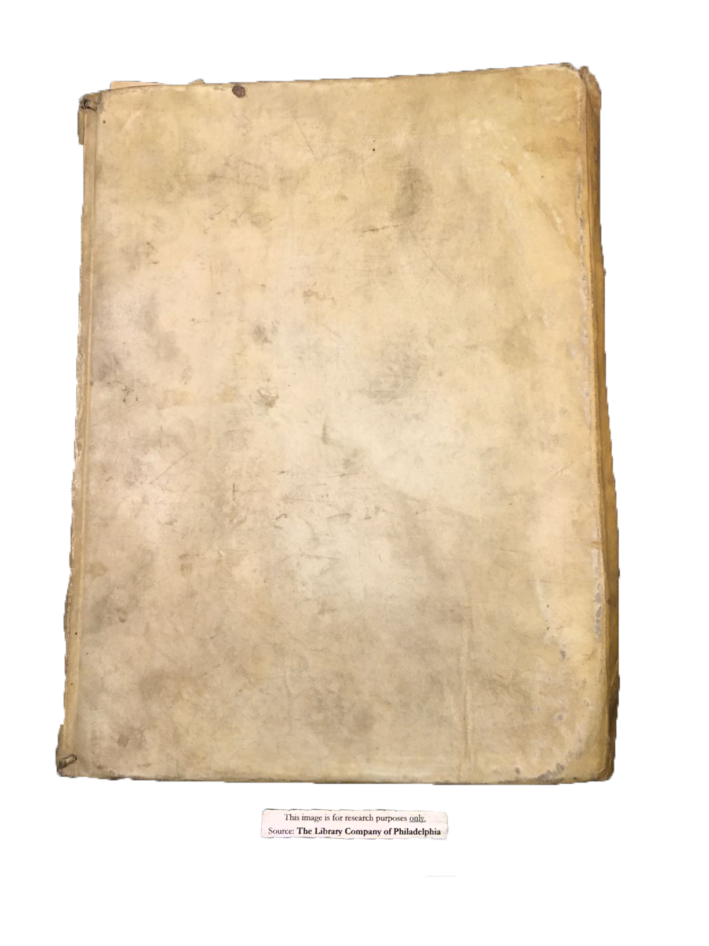
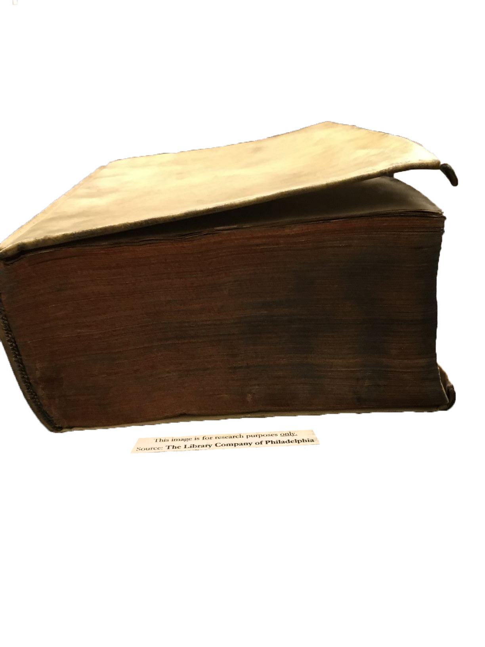
Library Company
View of Front
The Library Company of Philadelphia held one copy.
I paid a visit and was able to examine the book. My task was to compare its signs of use to ours.
It was very different:
all three volumes were bound together in light calf binding
no marginalia, but there was some underlining of names in the text
View of Bottom

Slide 9
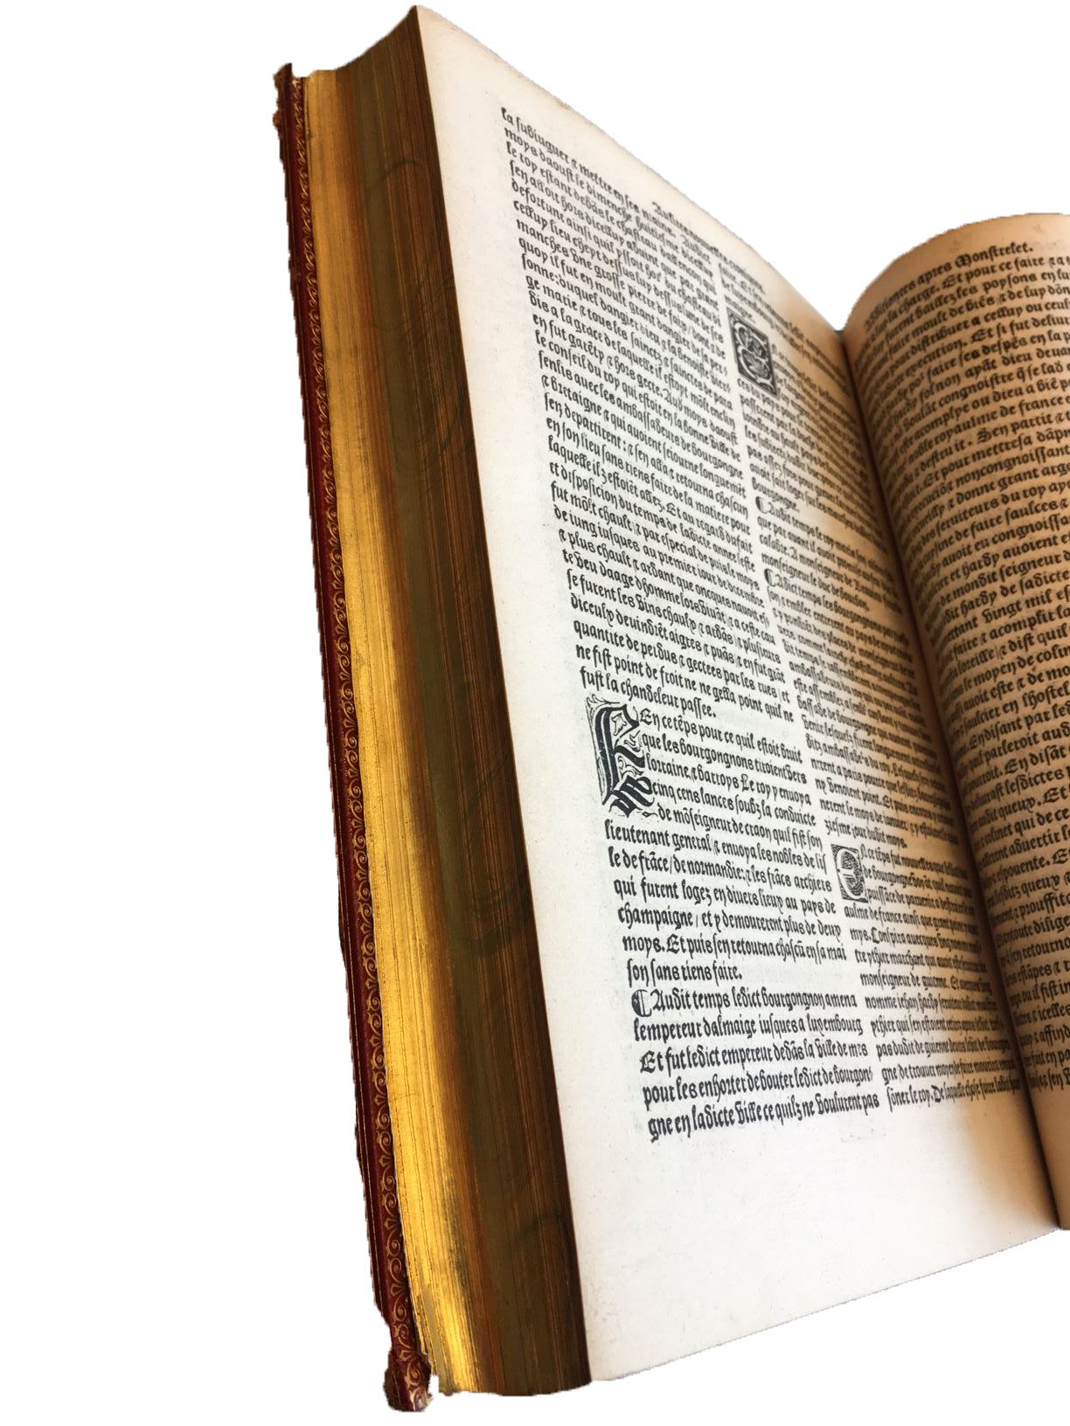
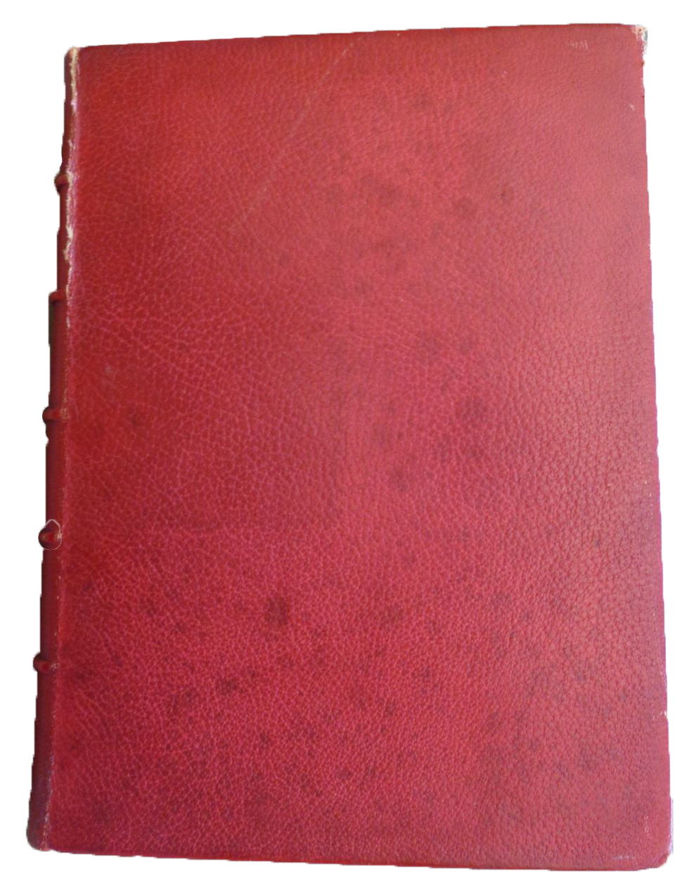
Beinecke Library
Interior
The other copy was in the care of the Beinecke Library at Yale University in Connecticut.
This book was also quite different from ours:
nineteenth-century red leather binding
gold-leafed pages
not a mark in the whole book
Exterior

Slide 10
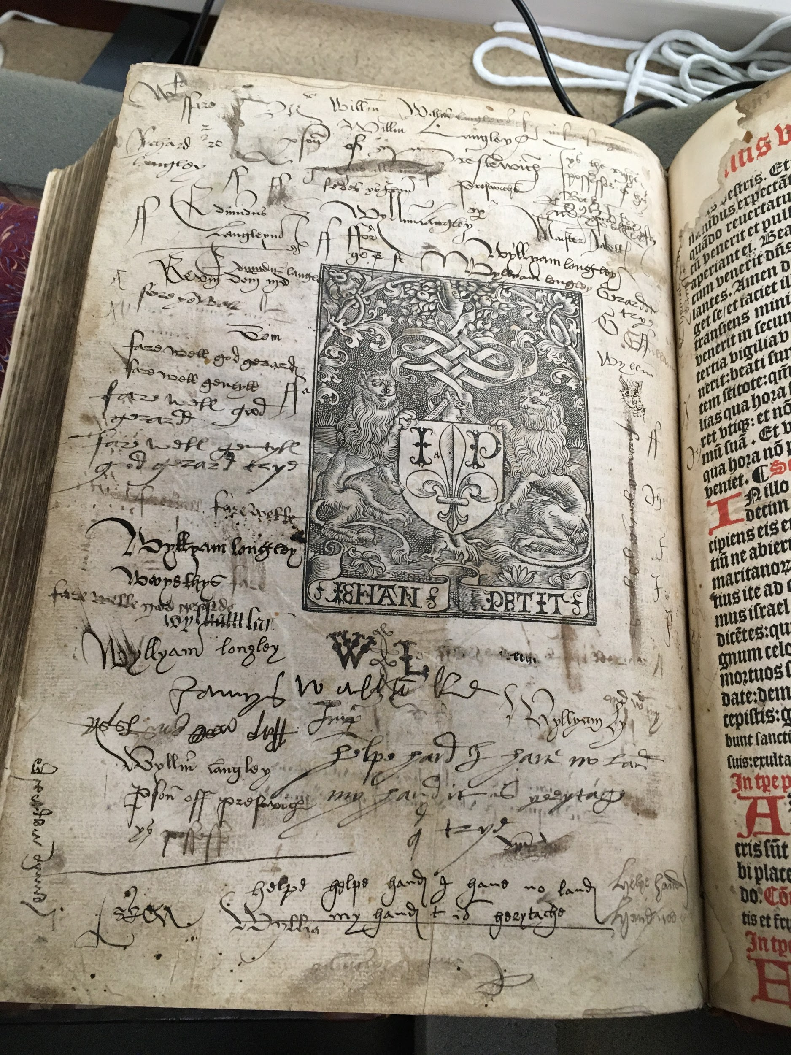
One of a Kind
Having seen the only other known copies in America, I had a clear idea about what made the WCU Monstrelet unique.
It had by far the most signs of use- a historian’s goldmine!
The next step was to assess these signs of use.

Slide 11
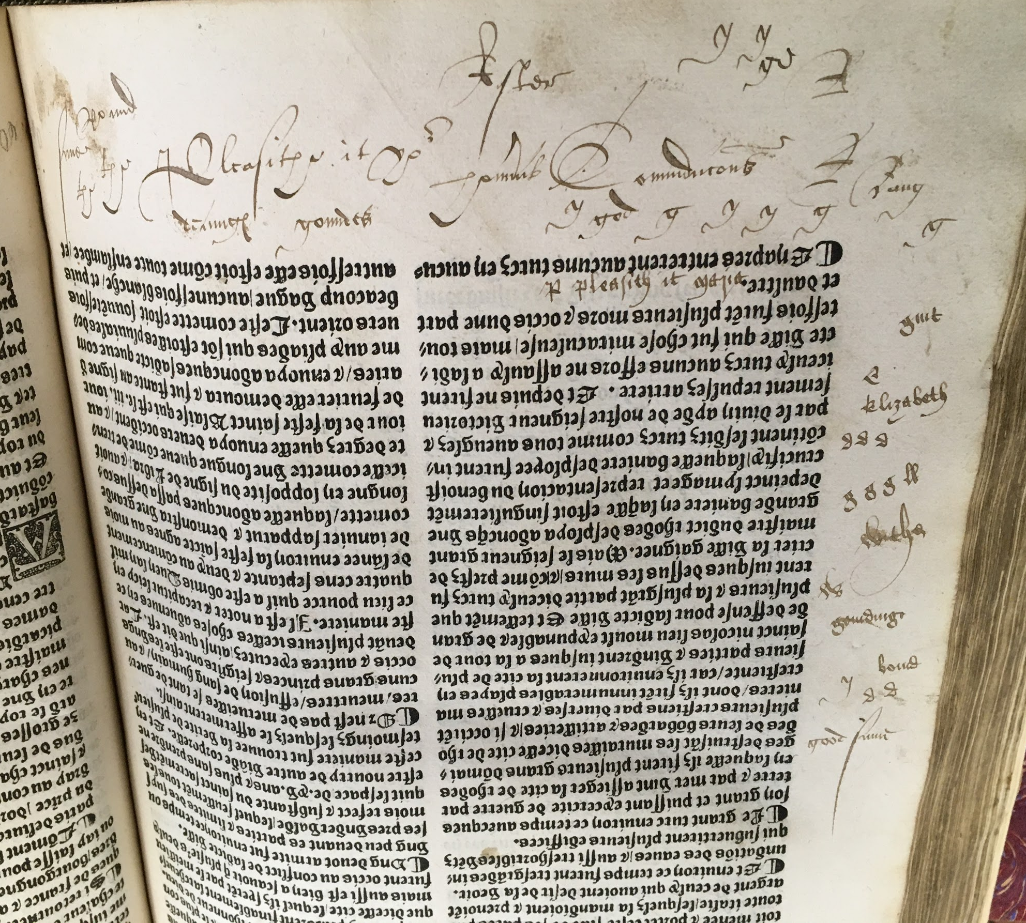
Marginalia or Graffiti?
Eight pages featured distinct annotations.
Previous users adorned these pages with names, handwriting exercises, and other inscriptions, most of which appear to be in English.
Some of these inscriptions are in a practiced hand, but many of them are essentially scribbles unrelated to the text.
I was able to determine that the majority of the script was written in secretary hand, commonly used in Britain in the sixteenth and seventeenth centuries.⁴
⁴ Carole Shammas, “Acquiring Written Communication Skills as the Vernacular Standardizes: A Case Study of an English Family’s Letters 1560–1700,” Huntington Library Quarterly 82, no. 3 (2019): 429–82.

Slide 12
Who was Wyllyam Langloy?
This name shows up over ten times in multiple spelling variations, many on a single page (shown in full on slide 10).
With nothing to go on but a name, he remains one of the biggest mysteries of the WCU Monstrelet.

Slide 13
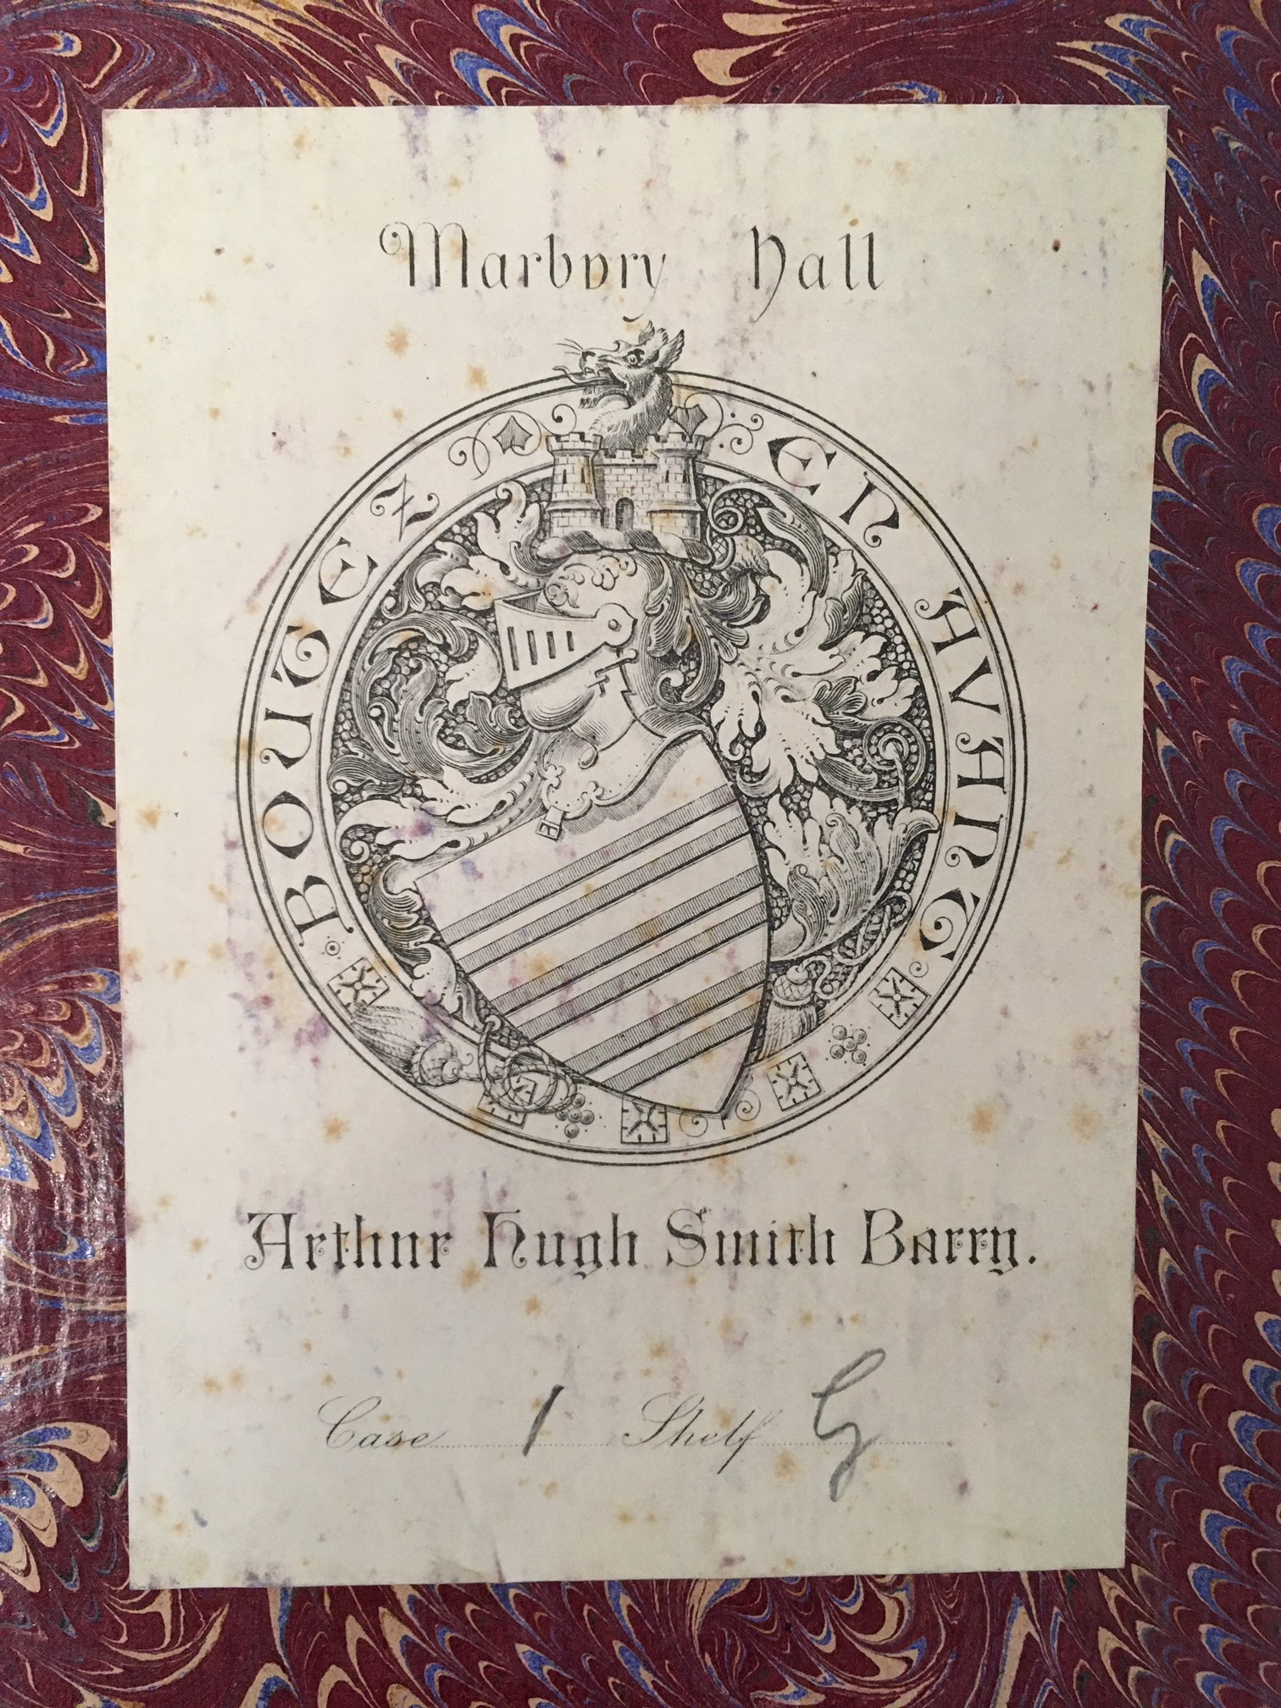
Special Connections
The bookplate was a more concrete clue to the book’s provenance. Arthur Hugh Smith Barry (1843-1925) was an Irish parliamentarian and the First Baron Barrymore.
His estate at Marbury Hall in Northwich, England was famous for the collection of art, sculpture, and rare books the family had accumulated over the centuries. A few years following Smith Barry’s death, this collection was sold in a series of auctions.⁴
⁴ Alan Redley and Frances Findlay, “History of Marbury Hall and Parkland,” The Friends of Anderton and Marbury (blog), October 29, 2012, https://foam.merseyforest.org.uk/wp-content/uploads/2012/10/Section-3-Collections-of-Books-Art-and-MarblesRev10.pdf.

Slide 14
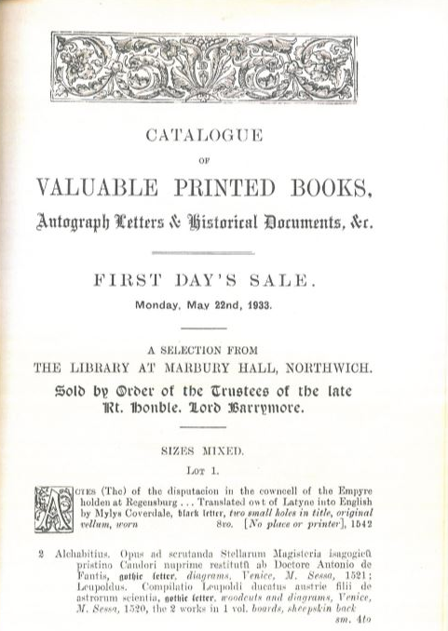
Special Connections
The Friends of Anderton and Marbury, a local history organization in Northwich, referenced a book auction in 1933. Could the Monstrelet have been up for bids?
An inquiry to the Friends in April 2020 yielded a response from Alan Redley, the organization’s chair, who kindly sent me a scan of the complete auction catalog.
The Monstrelet was listed as lot 128!

Slide 15
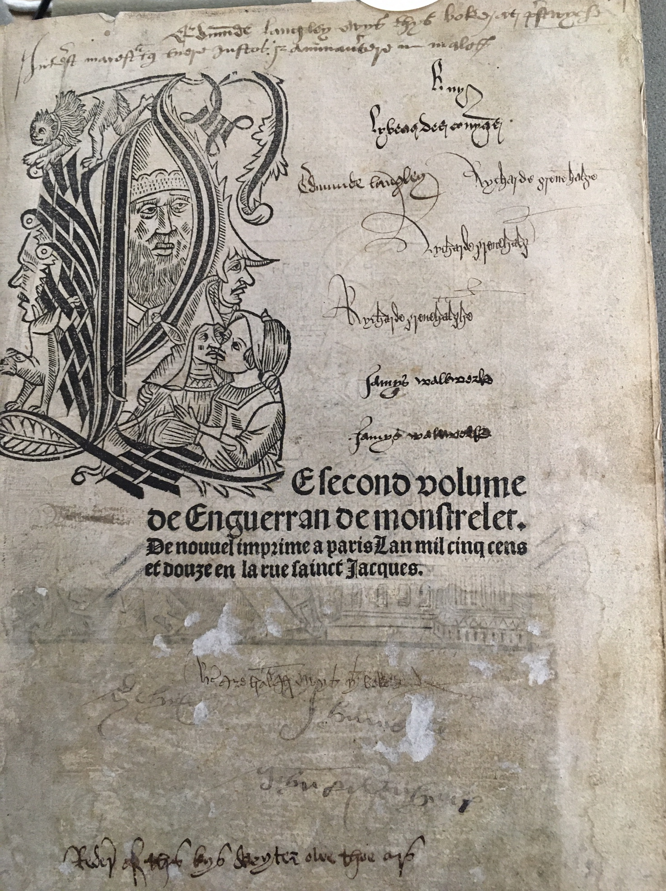
The Next Chapter
Where might the research go from here?
Consult a paleography expert to help decipher the remaining inscriptions
Create a formal descriptive bibliography of the book’s condition
Identify the buyer at the Marbury Hall auction
Investigate (however tentatively) the identity of Wyllyam Langloy
The West Chester University Monstrelet was overlooked in the official inventory of this Renaissance chronicle…could there be others?

